Slide 1
HDL-Component-Manager
Version management for HDL IP.

Slide 2
Why HCM?
Reduce merging between programs
Identify pedigree of code
Reduce work load of maintaining re-useable code
Communicate changes to code
Notes:
HCM came into being when I attempted to merge updates from one program to another. It did not go well. There were several cases where I had thought the merge went well, but it did not.
We also found a bug in a component that was shared between two programs. We would have had to merge the change back. It did not seem to be worth the effort. Although how do we share this update with future programs.
Our code base is starting to look like a product line. We are now running three programs at the same time that re-use a lot of the same code. Our current methods for sharing code, merging, was not going to work out.

Slide 3
Benefits
Control the distribution of HDL Code
Improve communication between users
Share code to/from a central location
Notes:
The purpose of this slide is to show what you will gain if you use HCM.

Slide 4
Features
Uses Major.Minor.Patch version control
Works with SVN repositories
  Supports multiple repositories
  Supports externals
Automates
  Sharing code between projects
  Installing and upgrading code
Supports multiple versions of components
Language independent
Notes:
The purpose of this slide is to show what HCM can do.

Slide 5
Subcommands
Subcommand | Description
create | Creates component directory in repository
install | Add or upgrade a component from a repository
uninstall | Removed installed component from working copy
list | Displays information on installed components
publish | Pushes changes to a component to a repository
show | Displays detailed information on a single installed component
validate | Verifies installed component matches repository version
Notes:
This slide just lists the subcommands and a brief description. I would just walk quickly through this slide as each is detailed later.

Slide 6
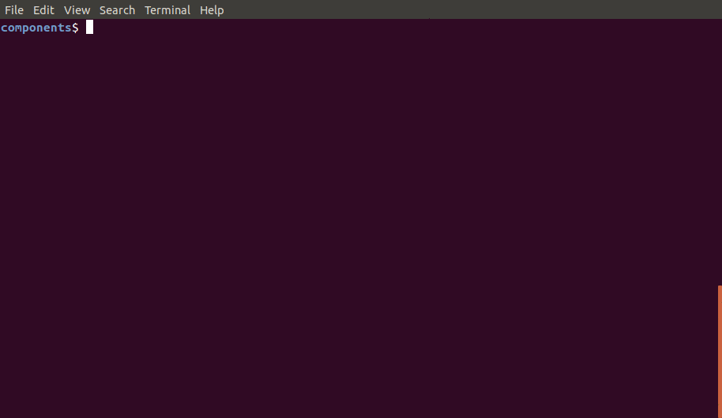
Installing
Notes:
Allow the GIF to run and point out these issues:

Slide 7
Install Options
Option | Description
version | Major.Minor.Patch version of component to install
url | Location of component directory in repository
force | Install component ignoring any local changes
external | Install component as an external
dependencies | Install dependencies
upgrade | Install dependencies to the latest version
url is optional if HCM_URL_PATHS environment variable is set.
Dependencies will not install a dependent if it is already installed. Use upgrade to force the latest version

Slide 8

List Command

Slide 9
List Columns
Column | Description
Component | Name of the component installed
Version | Currently installed version
Upgrade | Latest version available for the component
Status | Flags indicating status of the component E = Installed as external M = Committed modifications U = Uncommitted modifications
URL | Where the component was installed from

Slide 10
List Options
Option | Description
all | Include directories not under HCM control

Slide 11

Show Command

Slide 12
Show Rows
Column | Description
Component | Name of the component installed
Version | Currently installed version
URL | Where the component was installed from
Source | Where the component was published from
Dependencies | The components required

Slide 13
Show Options
Option | Description
manifest | Prints out the md5sum manifest of the component
upgrades | Prints out log information for each available upgrade
modifications | Prints out log information for each commit to the component after it was installed.

Slide 14

Uninstall Command

Slide 15
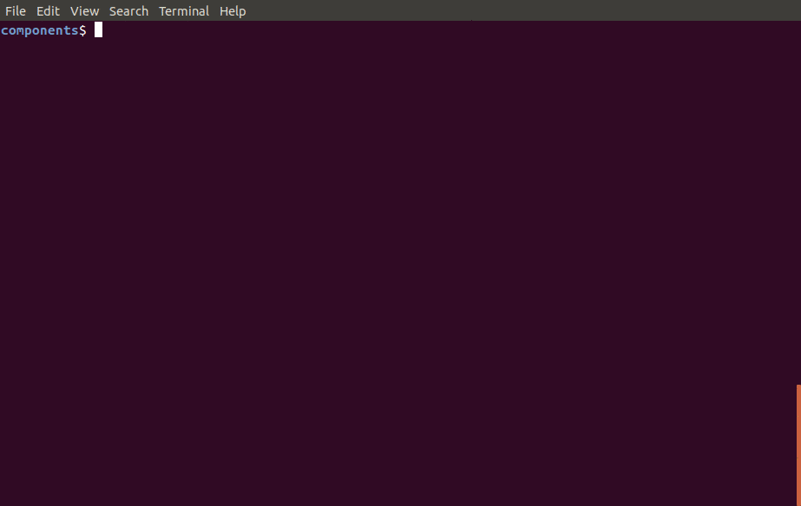
Publish Command

Slide 16
Publish Options
Option | Description
m | Commit message
f | File to use as commit message
url | Where to publish the component
M and f are mutually exclusive
Url is used when publishing for the first time or when publishing to a different location

Slide 17
Scenarios

Slide 18
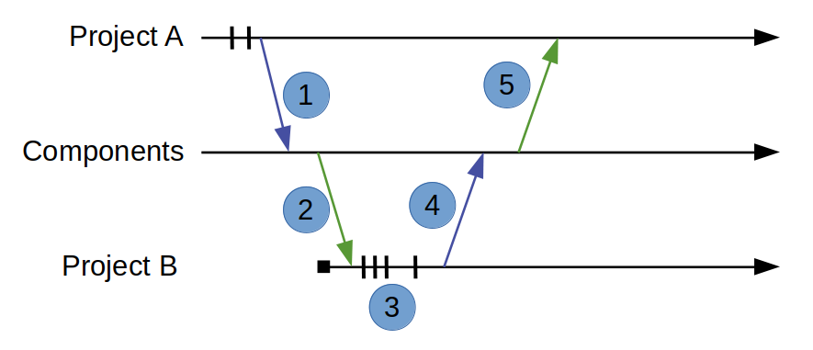
Sharing Update

Slide 19
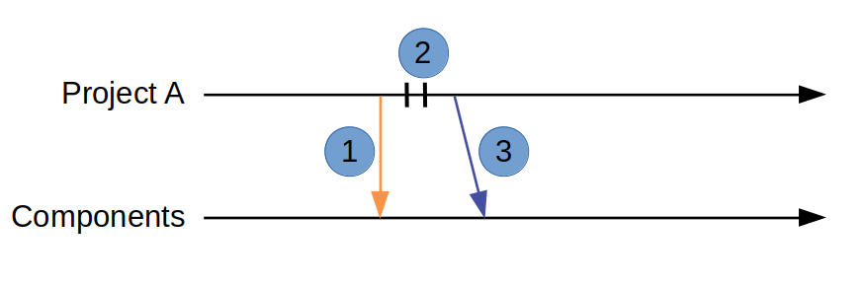
Change a previous version
Notes:
PA is at version 1.0.0
Components is at version 1.1.0
PA doesn’t want the changes at 1.1.0
PA commits changes and publishes 1.0.1

Slide 20
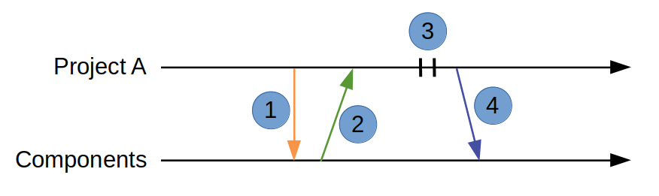
Update an upgraded version
Notes:
1. Check if there is an upgraded version
2. Install the ulipgraded version
3. Make and commit changes
4. Publish updated version

Slide 21
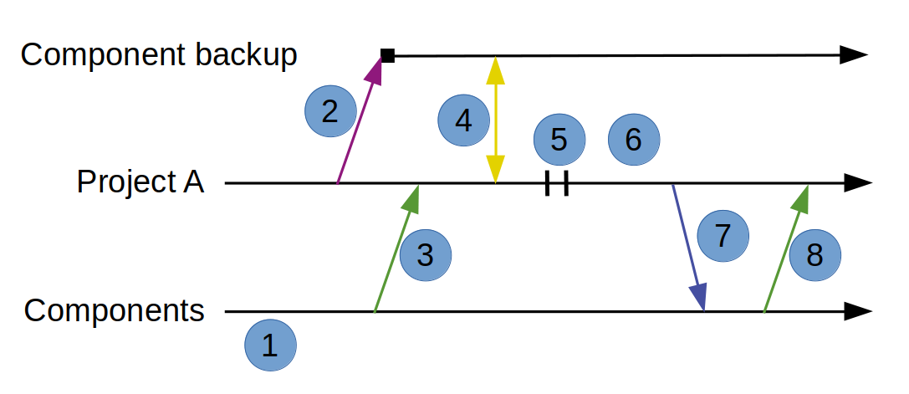
Publish an out of date componet
Notes:
1. check which version of component to update
2. make backup copy of component
3. Install desired version
4. Use file compare tool to check differences
5. Merge changes
6. Commit changes
7. Publish new version
8. Install new version

