Slide 1
Hybrid quantum + HPC with IQM
Hands-on workshop
[Presenter name]
[Venue] · [Date] · QDMI · Qrisp · Slurm · AMD GPUs
Notes:
Welcome. Audience: HPC practitioners new to quantum. In three hours you will run code on your own laptop and on an IQM quantum computer through the same standard interface HPC centres use in production, and see why CPUs, GPUs and QPUs need tighter coupling as algorithms mature. Check that everyone ran setup_local.sh.

Slide 2
Three hours, seven blocks, three labs
# | Block | Min | Format
1 | Who is IQM · the Resonance cloud | 15 | talk + live UI
2 | Structure of an HPC + QC supercomputer | 15 | talk
3 | QDMI and running it on your computer | 30 | Lab 1
4 | Hybrid algorithms on Resonance, then through QDMI | 30 | Lab 2 · Qrisp
5 | Optional: QSCI on an AMD GPU via Slurm | 30 | Lab 3
6 | Future of hybrid algorithms: why tight integration | 15 | talk
7 | Tight integration for quantum error correction | 15 | talk
Breaks after blocks 3 and 5 · labs default to free :mock devices
Notes:
Walk the agenda. Blocks 1–2 build vocabulary, 3–5 are hands-on, 6–7 look ahead. Block 5 is optional: if time is short, demo it. Breaks after block 3 (10 min) and block 5 (5 min).

Slide 3
What you will be able to do
01
02
03
Run QDMI locally and on Resonance
Run a hybrid algorithm
Ship a quantum + GPU pipeline
Open a simulator and an IQM QPU through one vendor-neutral interface, query calibration data, submit jobs, time the round trip.
Grover and QAOA in Qrisp on a simulator, an IQM mock and real hardware, then the same program through QDMI.
QSCI as two Slurm jobs: sampling on a quantum access node, linear algebra on an AMD GPU node.
Setup check: python qdmi_demo.py list · Resonance token · pip install qrisp[iqm] · Docker (optional)
Notes:
Three outcomes, one per lab. If anyone cannot run qdmi_demo.py list, pair them with a neighbour now; pairs can share a laptop and a token.

Slide 4
Who is IQM, and what is IQM Resonance
01
Block 1 · 15 min
Superconducting quantum computers from chip to cloud.
Notes:
Block 1, 15 minutes. Credibility and orientation; keep it short, the labs are where people learn.

Slide 5
IQM: chip to cloud
On-premises: IQM Radiance. Runs as a Slurm node via the HPC Integration Service (May 2026); in production at LRZ, which hosts four IQM systems
Cloud: IQM Resonance. IQM QPUs as a managed, EU-hosted service with a free Starter tier
Software. Qrisp as default SDK, plus Qiskit, Cirq, CUDA-Q, TKET; QDMI-on-IQM for HPC
Learning. IQM Academy: free curriculum and notebooks
Sources: IQM press release, 12 May 2026; IQM Resonance deck
Notes:
IQM is headquartered in Espoo, Finland, with a large Munich presence. Two delivery models: on-prem Radiance for HPC centres and cloud Resonance. The HPC Integration Service launched 12 May 2026 and is built on QDMI, the subject of block 3. LRZ is the production reference, with four IQM systems integrated into an existing HPC environment.

Slide 6
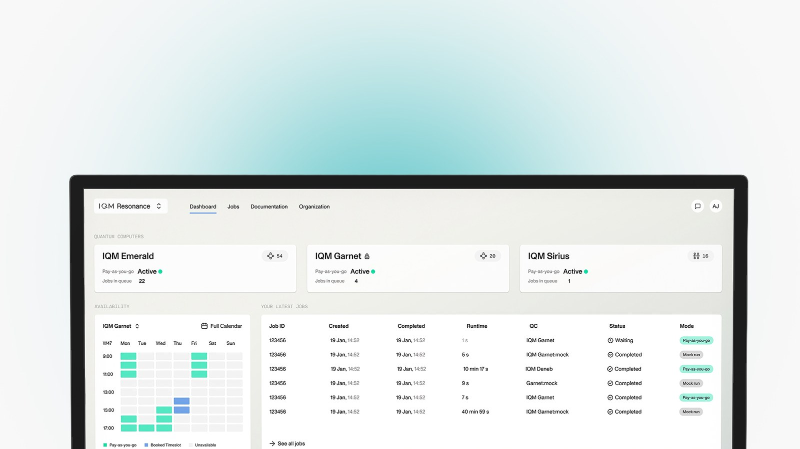
IQM Resonance: quantum in the cloud
Three ways in
Starter: free monthly credits, free mock devices, IQM Academy
Pay-as-you-go: credits that don't expire, billed in QPU seconds
Skip-the-queue: reserved timeslots, pulse-level access, group management
Notes:
Live demo, 3 minutes: open resonance.meetiqm.com, show QPU status, calibration data and job history, then Create Token, which everyone needs for Lab 1. Point out mock devices: same API and job flow, zero credits. Tier details are from the Resonance deck; check current pricing before quoting numbers.

Slide 7
QPUs by topology
IQM Garnet (Crystal 20): 20 qubits, square lattice
IQM Crystal 54: 54 qubits; median 2-qubit fidelity 99.5%, quantum volume 64
IQM Star 24: qubits around a central resonator, effective all-to-all
IQM Crystal 150: next on the roadmap
Square lattices map natively onto the surface code
Source: IQM Resonance deck; check the dashboard for live availability
Notes:
Different algorithms prefer different hardware. Crystal: nearest-neighbour square lattice, a native fit for surface-code error correction. Star: a central resonator gives effective all-to-all connectivity, useful for dense QAOA graphs and co-designed simulations. Crystal 54 figures from the Resonance deck (also CLOPS 2550). Crystal 150 was listed for H1 2026 on the roadmap slide; confirm status.

Slide 8
Your first job in five minutes
1
2
3
4
Sign up
Create a token
Install
Run
resonance.meetiqm.com/signup
Side panel → Create token; keep it out of git
pip install "qrisp[iqm]" or iqm-qdmi
garnet:mock first, free; then the real QPU
Always test on a :mock device first: same API, same job flow, zero credits
Notes:
The individual-user path, and the first cells of Lab 2. Older Qrisp versions use api_token= instead of token=; the notebook handles both. Emphasise the mock-first habit.

Slide 9
Structure of an HPC + QC supercomputer
02
Block 2 · 15 min
The QPU becomes one more scheduled accelerator next to CPUs and GPUs.
Notes:
Block 2, 15 minutes. Speak the audience's language: partitions, licences, prolog, shared filesystems.

Slide 10
A QPU is another accelerator
 | CPU | GPU (e.g. AMD MI300X) | QPU (IQM)
Good at | control flow, orchestration | dense linear algebra, ML | sampling hard quantum distributions
Programmed in | C, Fortran, Python | HIP / ROCm, JAX | circuits: Qrisp, Qiskit, QIR
Scheduled as | nodes, cores | GRES gpu:N | partition + licence per device
Returns | memory | device memory | bitstrings: counts, shots
Limited by | Amdahl | PCIe / HBM bandwidth | coherence, calibration drift, shots
The QPU never sees your data: it returns samples, and classical nodes turn samples into answers
Notes:
Map quantum onto concepts the room already has. The QPU is a sampler; every useful algorithm today is hybrid, and the classical side can be substantial, as Lab 3 shows. Licences are Slurm's mechanism for finite shared resources; the MQT playground and IQM's integration schedule QPUs that way.

Slide 11
Anatomy of an HPC + QC cluster
Users
ssh · Jupyter
Login node
Spack / modules · sbatch
Slurm controller
slurmctld + slurmdbd accounting
compute partition
classical nodes (slurmd)
gpu partition
AMD GPUs · ROCm · JAX
quantum partition
quantum access nodes: compiler + QDMI
IQM Radiance
on-prem
IQM Resonance
cloud, HTTPS
QDMI device libraries →
Shared filesystem across partitions · device licences limit concurrent quantum allocations
Notes:
The QDMI-on-IQM reference picture. Quantum access nodes are ordinary Linux nodes running the compiler and the QDMI device library; the QPU sits behind them, on-prem or in the cloud. Jobs request a QPU with --licenses=<device id>. Classical stages run in compute or gpu partitions and exchange data via the shared filesystem. You build exactly this, in Docker, in Lab 1.

Slide 12
Three ways to couple, one code path
Loose
Tight
Automated
Cloud QPU
On-prem QPU as a Slurm partition
SPANK plugin
Classical work at your site, quantum jobs forwarded to Resonance. Fastest start; the user supplies endpoint and token.
Quantum and classical jobs share scheduling and accounting; iterative hybrid jobs stay inside the centre.
A Slurm plugin injects endpoint and credentials in the prolog and enforces site policy. Users never handle tokens.
Deployment scenarios from Burgholzer et al., arXiv:2604.19869: application code is unchanged in all three
Notes:
The three deployment scenarios from the QDMI-on-IQM paper. Operators can start loose with cloud access and tighten without rewriting user code. The SPANK plugin ships in the QDMI-on-IQM repo under spank/ (GPLv3 because it links Slurm).

Slide 13
Latency decides what is practical
Loop | What must happen | Time budget
Cloud job round trip | WAN + queue + compile + run + results | seconds: you measure it in Lab 1
On-prem Slurm job | no WAN hop; co-scheduled with CPU/GPU jobs | set by scheduler and queue
Variational iteration | N circuits per update, hundreds of updates | iterations × round trip
Mid-circuit feedforward | measure → decide → act inside one circuit | within coherence: microseconds
QEC decode + feedback | stream syndromes to a GPU, decode, correct | < 4 µs end-to-end demonstrated (NVQLink)
4 µs: IQM, Zurich Instruments and NVIDIA NVQLink real-time QEC demonstrator, March 2026
Notes:
Keep this table in mind all day. The first rows are software and scheduling problems; the last two are hardware integration problems. Lab 1's latency loop prints your own number for the first row.

Slide 14
QDMI: one device interface for every QPU
03
Block 3 · 30 min
10 minutes of concepts, then Lab 1: your laptop as the classical node, IQM Resonance as the quantum node.
Notes:
Block 3. The heart of the workshop for an HPC audience: standard interfaces are what make accelerators operable.

Slide 15
Why a standard interface
Tools, frameworks, schedulers: evolve independently
Qiskit
Qrisp
PennyLane
MQT compilers
Slurm + SPANK
Monitoring
QDMI · session · query · job
IQM Resonance
IQM Radiance
MQT DDSIM
Amazon Braket
other vendors
Device implementations: vendor-specific, hidden behind the interface
QDMI: Munich Quantum Software Stack · github.com/Munich-Quantum-Software-Stack/QDMI
Notes:
QDMI comes from the Munich Quantum Software Stack (TUM, LRZ, Munich Quantum Valley). It is a C API so every language can bind to it. Above the waist: anything that compiles, schedules or monitors. Below: one device library per backend. Without it, N SDKs times M vendors integrations; with it, N plus M.

Slide 16
QDMI in three function groups
Session
Authenticated context for one device: base URL, token or tokens file, device selector.
IQM_QDMI_device_initialize();
IQM_QDMI_device_session_alloc(&s);
/* set BASEURL, TOKEN ... */
IQM_QDMI_device_session_init(s);
IQM_QDMI_device_session_create_device_job(s, &j);
/* set PROGRAMFORMAT, PROGRAM, SHOTSNUM */
IQM_QDMI_device_job_submit(j);
IQM_QDMI_device_job_wait(j, 0);
IQM_QDMI_device_job_get_results(j, ...);
IQM_QDMI_device_job_free(j);
IQM_QDMI_device_session_free(s);
IQM_QDMI_device_finalize();
Query
Device, site (qubit) and operation properties: topology, T1/T2, fidelities, durations.
Job
Submit a program (IQM JSON, QIR, QASM), check or wait, cancel, fetch counts or shots.
Lifecycle from Burgholzer et al., arXiv:2604.19869, Fig. 1
Notes:
The minimal lifecycle from the QDMI-on-IQM paper. Apart from the IQM_ prefix, the same calls work against any QDMI device. Explicit ownership and error codes make it easy to wrap from C++, Fortran, Rust or Python. In the lab we use MQT Core's Python bindings, which map one-to-one onto these calls.

Slide 17
QDMI-on-IQM in practice
QDMI call → IQM Server API
Session and job parameters
session_init: discover backends, resolve the target, cache calibration
query_*_property: served from the cache, no network round trip
job_submit: build the IQM payload (circuit or calibration job)
job_check / wait: poll and map IQM states to QDMI states
get_results: counts or shots, fetched once and cached
BASEURL: IQM Server endpoint
TOKEN / AUTHFILE: API token or tokens file
CUSTOM1 / CUSTOM2: quantum computer ID / alias
PROGRAMFORMAT: IQMJSON · QIR · CALIBRATION
job CUSTOM1 / CUSTOM5: heralding · qubit mapping
pip install iqm-qdmi · C++20 · Spack for clusters · Apache-2.0 with LLVM exception (SPANK plugin GPLv3) · arXiv:2604.19869
Notes:
Condensed from the QDMI-on-IQM paper. Two operational points: queries come from cache, so compilers can call them freely; credentials can come from parameters or environment variables, which is why the same script runs interactively and under sbatch. Prebuilt wheels exist for Linux, macOS and Windows; the C++ library integrates via CMake FetchContent or Spack.

Slide 18
The software path in the lab
Your code
Qiskit · Qrisp
QDMIBackend
Target from queries
QDMI driver
manifests by ID
IQM device lib
QDMI-on-IQM
IQM Server API
Resonance / Radiance
from mqt.core.qdmi import builtin_driver, ProgramFormat
print(builtin_driver.registered_device_ids())
# ['mqt.ddsim.default', 'iqm.<qpu>', 'iqm.<qpu>.mock']
dev = builtin_driver.open_device("mqt.ddsim.default")
job = dev.submit_job(BELL, ProgramFormat.QASM2, 1000)
job.wait(60); print(job.get_counts())
from mqt.core.plugins.qiskit \
import QDMIBackend
be = QDMIBackend.from_device_id(
IQM_ID, token=TOKEN)
tqc = transpile(qc, backend=be)
be.run(tqc, shots=500)
Notes:
Left: raw QDMI from Python, opening a device by stable ID. Right: the Qiskit BackendV2 adapter, whose Target (native prx and cz gates, coupling map, fidelities) is built purely from QDMI queries. Switching from local DDSIM to IQM is a change of device ID. IDs depend on the installed iqm-qdmi version, so list them first.

Slide 19
Lab 1 setup: your laptop
$ cd 01_qdmi_local_to_resonance
$ ./setup_local.sh # uv venv + mqt-core + iqm-qdmi
$ source .venv/bin/activate
$ python qdmi_demo.py list
mqt.ddsim.default local
iqm.<qpu>.mock IQM (remote)
$ cp env.example .env # paste your token
$ set -a; source .env; set +a
$ python qdmi_demo.py info --device auto-iqm
$ python qdmi_demo.py bell --device auto-iqm --via qiskit
$ python qdmi_demo.py loop --device auto-iqm
Or the notebook
QDMI_Tutorial_Local_to_Resonance.ipynb walks the same steps with plots.
Credentials
RESONANCE_API_KEY or IQM_TOKENS_FILE, optional IQM_QC_ALIAS. Never commit .env.
Notes:
Lab starts here, 20 minutes. Everyone should reach qdmi_demo.py list within five minutes; those ahead can start the Slurm playground. Common failures: iqm-qdmi missing from the venv (no iqm IDs), token not exported, or an alias the account cannot see.

Slide 20
Lab 1 in five steps
1
2
3
4
5
Discover
Classical node
Quantum node
Native job
Latency loop
List device IDs without loading any library
Bell state on local DDSIM through QDMI
Open IQM; query T1/T2, fidelities, coupling map
IQM JSON: prx + cz on a coupled qubit pair
Time the classical ↔ quantum round trip
Write down your round-trip time: we come back to it in block 6
Notes:
Walk the steps quickly, then let people work. Step 4 is the teaching moment: native gates are prx(theta, phi) with angles in turns plus cz, and the qubit pair comes from the coupling map QDMI returned. Step 5 prints the mean round trip and extrapolates to a 500-job VQE.

Slide 21
Lab 1, step 6: under Slurm
start_playground.sh builds a mini HPC centre in Docker from the MQT Core Slurm playground:
login · controller · 2 compute nodes · 2 quantum access nodes · slurmdbd + MariaDB
QDMI devices are Slurm licences named after the device ID; a monitor holds jobs while a device is down.
Only the launch method changes: qdmi_demo.py is the file you ran on your laptop.
$ sinfo; scontrol show licenses
$ export RESONANCE_API_KEY=...
$ cd /jobs
# quantum stage on a QAN
$ QID=$(sbatch --parsable \
--licenses=iqm.<qpu>.mock bell.sbatch)
# classical stage, no licence
$ sbatch --dependency=afterok:$QID \
--export=ALL,BELL_JOB=$QID analyze.sbatch
$ sacct -X --format=JobID,Partition,State
Playground: mqt.readthedocs.io/projects/core · needs Docker with 4 CPUs, 12 GiB RAM
Notes:
Optional during the lab. The playground is maintained by the Munich Quantum Toolkit team; our script adds the IQM device package and licences and copies workshop scripts to /jobs. Slurm exports the submission environment by default, so the token reaches the job. sacct shows the licence as a tracked resource: quantum usage lands in the same accounting as CPU hours.

Slide 22
Hybrid algorithms: Resonance, then QDMI
04
Block 4 · 30 min
8 minutes on the variational loop and Qrisp, then Lab 2: simulator → mock → real QPU → QDMI.
Notes:
Block 4. From infrastructure to algorithms, keeping the systems view.

Slide 23
Every variational algorithm is one loop
Classical node
optimiser proposes θ, combines measurements into E(θ)
circuits(θ)
Quantum node
prepares the state, measures each Pauli group
counts
Cost of one run
iterations × measurement groups × shots
Examples
VQE for chemistry, QAOA for optimisation, the VQE inside QSCI
Systems view
wall time ≈ iterations × (round trip + classical step)
Notes:
One picture for VQE, QAOA and friends. The quantum node prepares a parameterised state and measures it; the classical node estimates energy or cost and updates parameters. Tie back to Lab 1's latency. Gradient-free optimisers (COBYLA, SPSA) suit noisy hardware; finite-difference gradients waste shots.

Slide 24
Qrisp: variables, not qubits
Typed quantum data
QuantumVariable, QuantumFloat, QuantumBool, QuantumArray with infix arithmetic
from qrisp import *
from qrisp.grover import diffuser
@auto_uncompute
def oracle(qf):
z(qf * qf == 0.25)
qf = QuantumFloat(3, -1, signed=True)
h(qf)
for _ in range(2):
oracle(qf); diffuser(qf)
print(qf) # {0.5: 0.47, -0.5: 0.47, ...}
Automatic uncomputation
@auto_uncompute frees temporaries; the compiler recycles ancillae
Compile anywhere
Simulator, IQM backends, Qiskit export, and in Lab 2 any QDMI device
Qrisp: qrisp.eu · Eclipse Foundation, open source
Notes:
Qrisp is IQM's default SDK on Resonance. This is the Grover example from the Qrisp tutorial: solve x² = 0.25. Multiplication, comparison and uncomputation are synthesised for you. The IQM sales deck claims Shor in about 11 lines of Qrisp versus about 500 in Qiskit; present it as IQM's claim and let the lab speak.

Slide 25
Lab 2: Qrisp on IQM
1
2
3
4
Simulator → mock
Real QPU
Grover + QAOA
Through QDMI
QuantumFloat arithmetic and GHZ, then the same calls on garnet:mock
Flip RUN_ON_HARDWARE and compare with the mock
x² = 0.25, then a MaxCut loop on simulator and mock
VirtualBackend wraps QDMIBackend: any QDMI device
Intro_to_Qrisp_on_IQM.ipynb · based on IQM Academy, Get started with Qrisp on IQM
Notes:
22 minutes. The first half mirrors the IQM Academy notebook. The QAOA cell is the hybrid loop: QAOAProblem drives a classical optimiser that submits circuits each step. The last section closes the loop with Lab 1: wrap the QDMI backend as a Qrisp VirtualBackend and the same algorithm runs on DDSIM or IQM through the standard interface.

Slide 26
IQM tools for hybrid algorithms
IQM QAOA library
Error reduction
Open source; from problem definition to hardware, with transpilation tuned for IQM topologies.
Noise reduction at pulse and measurement level; most runs automatically on IQM hardware.
Pulse-level access
IQM Academy
Tune gates and pulse shapes, suppress noise, reproduce low-level experiments exactly.
Free curriculum: Qrisp modules, error reduction, a QEC memory experiment on IQM hardware.
docs.meetiqm.com/iqm-qaoa · iqmacademy.com
Notes:
Pointers rather than a tour; these are what participants reach for after the workshop. Links are on the closing slide.

Slide 27
QSCI: IQM QPU + AMD GPU via Slurm
05
Block 5 · 30 min
Optional block: the quantum computer shrinks the matrix, the GPU does the linear algebra.
Notes:
Block 5, optional. If time is short, run the notebook in inline mode as a 5-minute demo.

Slide 28
QSCI: shrink the matrix, then solve it
Input
Quantum
GPU
Output
A very large matrix
Shrink it
Do the linear algebra
Ground-state energy
The molecule's Hamiltonian: energy as a function of the electrons' state. Too large to handle classically.
Sample the electron configurations that matter and keep only those, without changing the answer we want.
Build the Hamiltonian on the kept configurations and find its lowest eigenvalue.
The approximate lowest energy of the molecule's electrons.
The lab runs H₂; the same code runs on larger molecules
Notes:
The plain-language version. We want linear algebra on a matrix that is, in principle, too large to work with classically. The quantum part shrinks the matrix in a way that should not change the output we are looking for; the classical GPU part does the linear algebra on the smaller matrix. In chemistry terms, the input is the molecule's Hamiltonian, which gives the energy as a function of the electrons' state, and the output is the approximate ground-state energy. The demo uses H₂, which is small enough to check against an exact answer, but nothing in the code is specific to H₂.

Slide 29
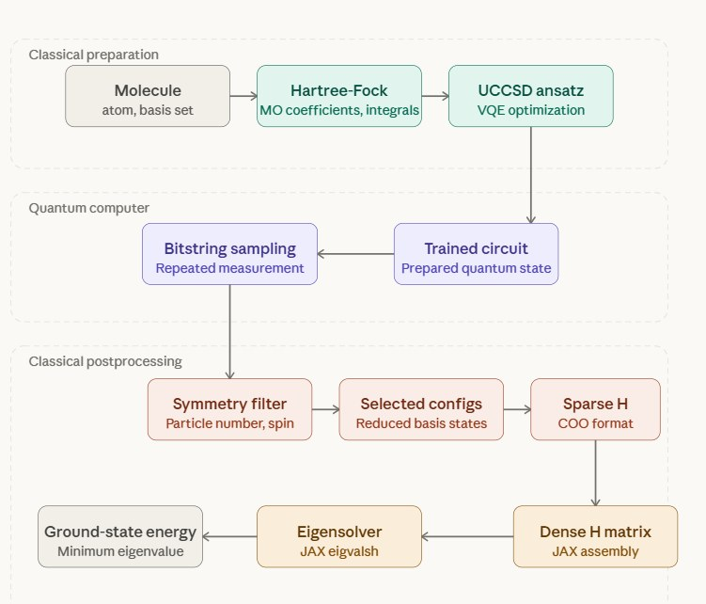
The QSCI workflow
Where each step runs
Login node: molecule, Hartree-Fock, UCCSD ansatz
QPU via QDMI: train the circuit, sample bitstrings
AMD GPU: symmetry filter, subspace Hamiltonian, JAX eigvalsh
Cost: O(|S|²) matrix elements, O(|S|³) eigensolve
Figure: IQM, QSCI on AMD tutorial (Steinmann, Bulmash)
Notes:
The original notebook's figure. The selected subspace S is the shrunken matrix. Noise robustness: bitstrings with the wrong electron number or spin are filtered out. Scaling: the classical side grows with the size of S, so it belongs on GPU nodes; the energy is a variational upper bound on the true ground-state energy.

Slide 30
The same code as two Slurm jobs
config.json
molecule, backends
Quantum stage
quantum partition · licence · QDMI
quantum.json
counts, θ, timings
Classical stage
gpu partition · afterok · JAX/ROCm
result.json
E_QSCI vs E_FCI
cfg = QSCIConfig(atom="H 0 0 0; H 0 0 1", basis="sto-3g",
vqe_backend="statevector", # optimise classically
sample_backend="qdmi:mqt.ddsim.default") # then "qdmi:<iqm id>"
qid, cid = submit_pipeline(run_dir, "slurm/quantum_stage.sbatch", "slurm/classical_stage.sbatch",
device_license="mqt.ddsim.default", classical_partition="gpu", gpus=1)
wait_for([qid, cid]); print(json.loads((run_dir / "result.json").read_text()))
Notes:
The pattern from the QDMI-on-IQM paper's QSCI demonstration: the application code stays fixed; only backend strings and the launch method change. The classical stage holds no quantum licence, so the QPU is free while the GPU works. For iterative variants, a heterogeneous Slurm allocation keeps both resources without re-queuing.

Slide 31
Lab 3: four places to run QSCI
Where | Classical stage | Quantum stage | Setup
Inline (this kernel) | NumPy or JAX | statevector or any QDMI device | pip install -r requirements.txt
Laptop + Docker | playground compute nodes | QAN → DDSIM or Resonance | start_playground.sh
AMD GPU droplet | MI300X, ROCm JAX | same node, quantum partition | single_node_slurm_droplet.sh
Your cluster, e.g. LUMI-G | AMD GPU partition | QAN with HTTPS, or Radiance | partitions + account
Cheap first: optimise on statevector, sample on an IQM :mock, then the real QPU · VQE on hardware ≈ iterations × groups × shots (≈45 credits on Garnet in the original notebook)
Notes:
22 minutes or a demo. Most participants run inline mode with DDSIM, then flip sample_backend to an IQM mock. Those with a GPU droplet run the single-node Slurm script once. The notebook benchmarks dense eigvalsh versus subspace size on whatever JAX sees, which is where the AMD GPU becomes visible; H₂ itself is far too small to need it.

Slide 32
Hybrid algorithms need tight integration
06
Block 6 · 15 min
IQM's simulation team: what runs on hardware today, and why each step pulls CPUs, GPUs and QPUs closer.
Notes:
Block 6, 15 minutes. Use IQM's own research portfolio as the evidence.

Slide 33
IQM's hybrid algorithm portfolio
Method | Quantum part | Classical part | Status · arXiv
QSCI in ghost-Gutzwiller embedding | sample impurity ground states | embedding loop, diagonalisation | on IQM Garnet · 2506.21431
QC-AFQMC | matchgate shadows of a trial state | walker propagation, overlaps (JAX) | H₈ on IQM Emerald · 2606.19239
OVQITE | operator-projected measurements | linear solve per time step | ~100× fewer shots · 2409.12018
Augmented imaginary-time evolution | shallow state preparation | augmented ITE update | H chains · 2606.23934
Randomized block encoding | functions f(H) of a Hamiltonian | sampling, estimation | CERN, Google, IQM · 2604.07448
Variational real-time dynamics | reduced operator manifold | equations of motion | 2609.15272
Source: IQM Simulation team publications
Notes:
Common thread: a quantum kernel inside a classical outer loop, and the classical part is far from trivial. QC-AFQMC runs hundreds of imaginary-time steps, each needing quantum-derived overlaps. The team also co-designs hardware: nanoscale NMR simulation on a star chip, and fermion-to-qubit encodings with arbitrary code distance for the error-corrected era.

Slide 34
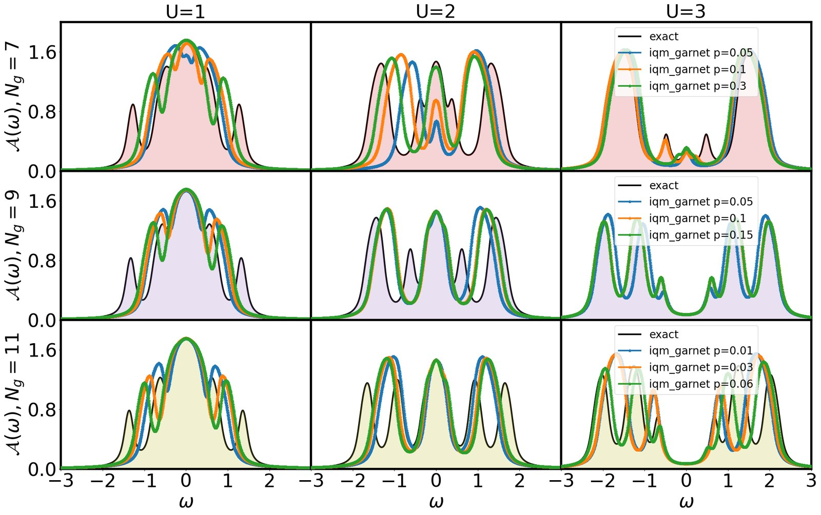
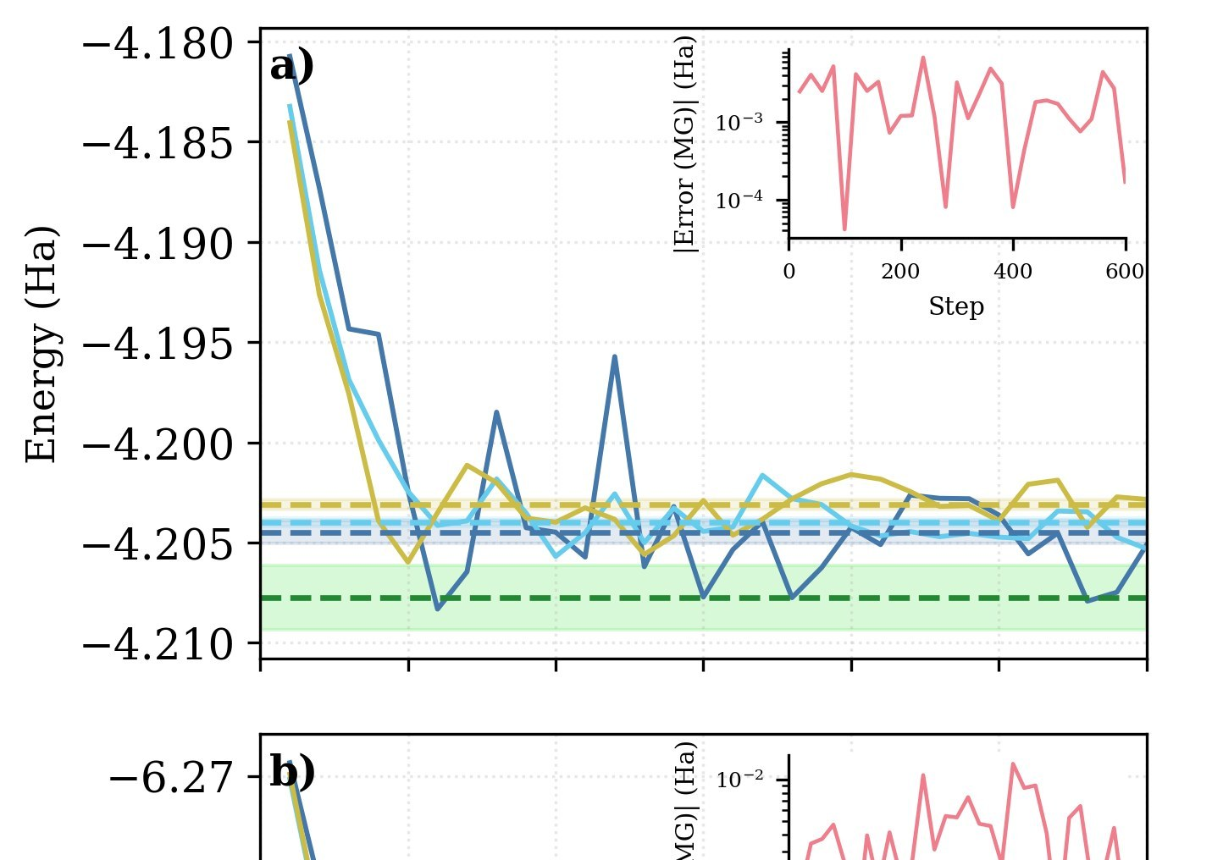
Hybrid loops on IQM hardware
Ghost-Gutzwiller + QSCI on IQM Garnet
QC-AFQMC, H₈ on IQM Emerald
The full embedding loop converged on hardware (Sriluckshmy, Jamet, Šimkovic, arXiv:2506.21431)
16 qubits, stable over 600 imaginary-time steps (Nappi, Kiser, Šimkovic, arXiv:2606.19239)
Notes:
Left: ghost-Gutzwiller embedding with QSCI as impurity solver; the team's deck notes it as the only converged solution of its kind on hardware. Right: QC-AFQMC for H₈ with error-mitigated data from IQM Emerald, within chemical precision of exact results. The same paper cut the dominant post-processing scaling from about N^5.5 to N^4.5 (an estimated 248× speed-up at 100 orbitals) using JAX. Classical HPC is half the result.

Slide 35
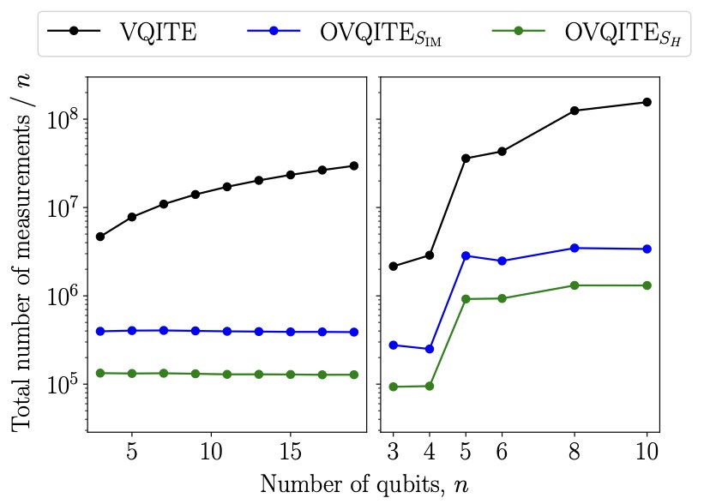
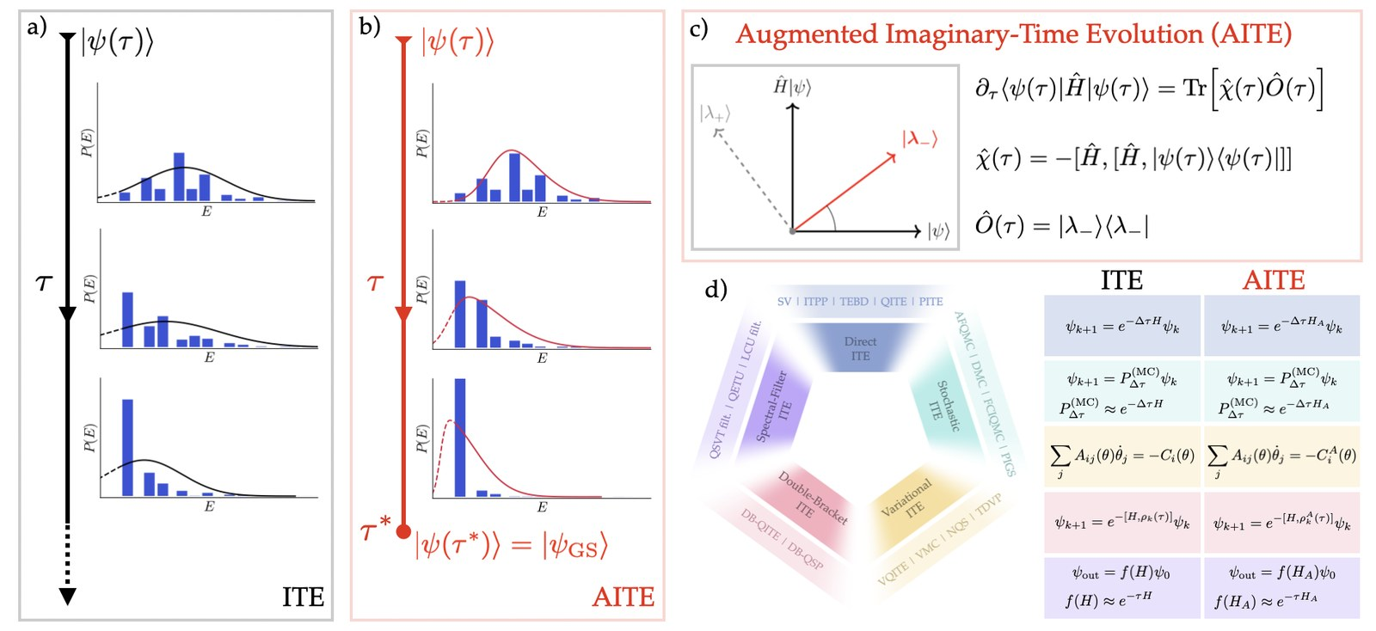
Fewer shots, fewer round trips
OVQITE
Augmented imaginary-time evolution
About two orders of magnitude fewer measurements than VQITE at the same accuracy (arXiv:2409.12018)
Converges at finite imaginary time instead of only asymptotically (arXiv:2606.23934)
Notes:
Fewer shots and iterations mean fewer round trips. But even optimal algorithms iterate, and the classical update grows with system size, so the communication pattern between QPU and HPC decides time to solution.

Slide 36
Time to solution ≈ iterations × round trip
Each step removes waiting
Today, cloud: seconds per hop; fine for exploration
Next, QPU as a Slurm node: no WAN, co-scheduled with GPUs
Then, real-time coupling: microseconds, as QEC requires
Notes:
The bridge to block 7. Ask what each participant's Lab 1 round trip implies for a 500-circuit VQE. That motivates on-prem integration. Standard interfaces like QDMI make the first two steps a configuration change; the third is hardware co-design, a different class of problem.

Slide 37
Tight integration for QEC
07
Block 7 · 15 min
Logical qubits need a decoder that keeps up with every round: an HPC problem with a microsecond deadline.
Notes:
Block 7, 15 minutes.

Slide 38
Error correction is a real-time HPC loop
1
2
3
4
Measure
Stream
Decode
Correct
Syndrome bits from ancilla qubits, every round
Control electronics → GPU over a low-latency link (RDMA)
Matching or ML decoder on GPUs infers the errors
Update the Pauli frame or feed back before the next round
If the decoder falls behind the round rate, a backlog builds and logical operations stall
Notes:
QEC in one breath: many physical qubits encode one logical qubit; ancilla measurements give syndromes every round; a classical decoder infers errors and the system tracks or corrects them. The decoder is the HPC part, and unlike everything earlier today it has a hard deadline set by physics. Throughput grows with code distance and logical-qubit count.

Slide 39
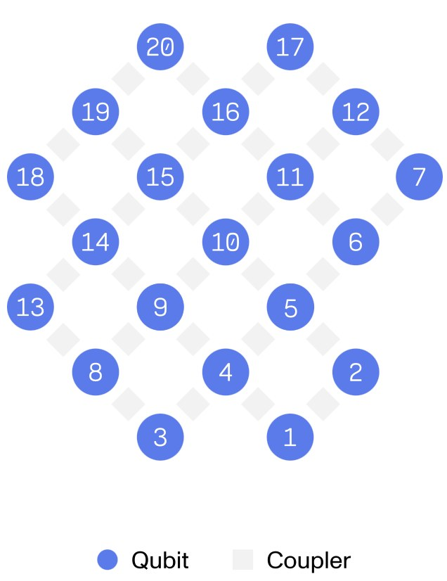
QEC building blocks
Real-time QEC demonstrator, March 2026
IQM · Zurich Instruments · NVIDIA
Hardware
Crystal square lattices with tunable couplers map natively onto the surface code
Real time
20-qubit IQM QPU + Zurich Instruments ZQCS + NVIDIA NVQLink GPU decoding: under 4 µs end to end
Try it
IQM Academy QEC memory experiment with Qrisp on IQM Emerald; fermion-to-qubit codes with growing distance from IQM's simulation team
IQM press release, 16 Mar 2026
Notes:
Announced 16 March 2026: IQM and Zurich Instruments are building a real-time QEC demonstrator with NVIDIA NVQLink, combining IQM's 20-qubit system, the ZQCS control system and GPU decoding; reported end-to-end latency under 4 microseconds via RDMA over Ethernet. The IQM Academy memory experiment lets participants run a small error-correction experiment themselves. Figure: IQM Garnet square-lattice topology.

Slide 40
What HPC centres can prepare now
Layer | Today (hybrid, NISQ) | Error-corrected era
Interface | QDMI: session, query, job | plus streaming and real-time extensions
Scheduler | partitions, device licences, afterok chains | heterogeneous co-allocation of QPU + GPU
Interconnect | HTTPS to cloud, LAN on-prem | µs-latency fabric (RDMA) to control electronics
Accelerators | GPUs for post-processing (QSCI, AFQMC) | GPUs/FPGAs as always-on decoders
Operations | calibration as scheduled jobs | calibration and decoding as services
Start loose (Lab 1), then integrate on-prem: every step reuses the same user code
Notes:
Practical takeaway for operators. Everything in the middle column you saw working today; the right column is the roadmap. QDMI-on-IQM already supports calibration jobs through the job interface, a first step towards calibration as a scheduled operation.

Slide 41
Three things to take home
1
2
3
A QPU is an accelerator
QDMI keeps code stable
Coupling must tighten
Partitions, licences and accounting: the HPC playbook applies.
Laptop, Resonance, on-prem Radiance, Slurm: the same application.
Seconds today, co-scheduling next, microseconds for error correction.
Notes:
Summarise in under two minutes, then open the floor.

Slide 42
Thank you
Questions, and where to go next
resonance.meetiqm.com · qrisp.eu
iqmacademy.com · arXiv:2604.19869
github.com/iqm-finland/QDMI-on-IQM
Workshop repo: [repo URL]
Notes:
Leave this up during Q&A. Replace [repo URL] with where you publish the workshop folder. Encourage people to keep their Resonance accounts and try the IQM Academy QEC memory experiment.

