Slide 1

Discrete Wavelet Transform Using Chapel

Slide 2
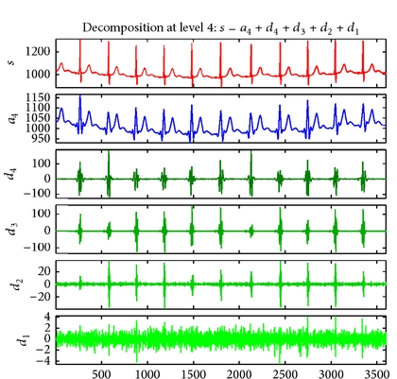
Wavelet Transform
Background
A wavelet transform is a common signal processing technique used to decompose a signal into a set of sub-signals — each reflecting various degrees of detail from the original. This is useful in a variety of domains such as image compression (JPEG uses a discrete wavelet transform) or signal de-noising:
ECG Signal
Average Component of DWT
Detail Components of DWT
The highest detail-level is essentially all noise. By discarding this signal, and computing an inverse DWT, one can obtain a denoised version of the original signal.
https://www.researchgate.net/figure/Wavelet-denoising-for-ECG-record-no-103m-using-Biorthogonal-1D-wavelet_fig1_262698301

Slide 3
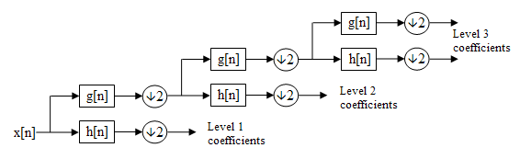
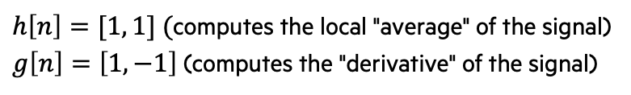
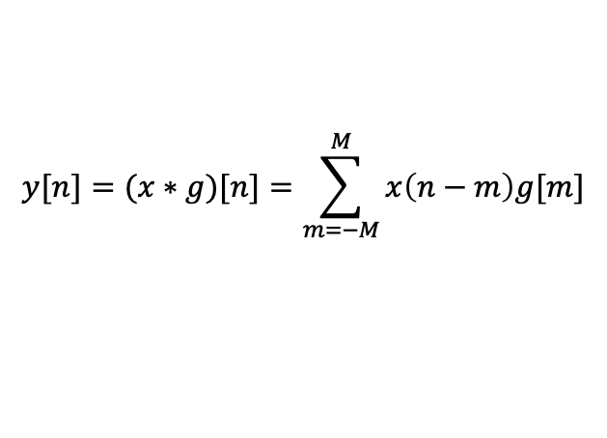
Wavelet Transform
Background
A DWT of a signal x is typically computed using a cascaded bank of filters and down-samplers:
A variety of filter types can be used for g[n] and h[n]. In this example, we'll use the two-element HARR wavelet, which is one of the simplest wavelet functions. These are their impulse responses:
A filter g is applied to a signal x using a discrete convolution:
Note that each layer of filtering can be computed concurrently
https://en.wikipedia.org/wiki/Discrete_wavelet_transformhttps://en.wikipedia.org/wiki/Discrete_wavelet_transform
$h\left[n\right]=[1, 1] ($computes the local "average" of the signal)
$g\left[n\right]=\left[1, −1\right]$(computes the "derivative" of the signal)
$$y[n]=(x∗g)[n]=\sum_{m=−M}^{M}{x\left(n−m\right)g[m]}$$
where g is defined over {-M, …, M}

Slide 4
Chapel Implementation of 1d dwt
These are the signatures of each functions used in the 1D DWT
Their implementations will be discussed on the following slides
// compute an n-level DWT of x
proc haarWavelet1D(x, n){ … }
// compute one step of the wavelet computation on the input signal (stores results in the 'output' array)
// this procedure relies on the following three procedures to complete each step
proc hwRec(signal, output, fmax, fstop){ … }
// convolution with the HAAR wavelet high-pass filter
proc haarHP(x) { … }
// convolution with the HAAR wavelet low-pass filter
proc haarLP(x) { … }
// down-sample by a factor of 2
proc downSample2(x) { … }
https://en.wikipedia.org/wiki/Discrete_wavelet_transformhttps://en.wikipedia.org/wiki/Discrete_wavelet_transform

Slide 5
Wavelet Transform
Implementation – Filter Convolution and Down-sampling
// convolution with the HAAR wavelet high-pass filter
proc haarHP(x) {
var y : [x.domain] int = x;
forall i in x.domain#(x.domain.size-1) do y[i] -= x[i+1];
return y;
}
// convolution with the HAAR wavelet low-pass filter
proc haarLP(x) {
var y : [d] int = x;
forall i in x.domain#(x.domain.size-1) do y[i] += x[i+1];
return y;
}
// down-sample by a factor of 2
proc downSample2(x) {
var y : [{x.domain.first..(x.domain.last/2)}] int;
y = x[x.domain by 2];
return y;
}

Slide 6
Wavelet Transform
Implementation – Progressive Filtering using a Recursive Procedure
// recursive helper for wavelet computation
proc hwRec(signal, output, fmax, fstop) {
// check termination condition
if fmax == fstop {
// store the final layer of high-pass coefficients
output[{0..<fmax}] = signal;
} else {
cobegin {
// compute and store the low-pass coefficients
output[{fmax/2..<fmax}] = downSample2(haarLP(signal));
// compute the high-pass coefficients and start the next layer of filtering
hwRec(downSample2(haarHP(signal)), output, fmax/2, fstop);
}
}
}

Slide 7
Wavelet Transform
Implementation – Calling Recursive Procedure
// compute an n-level DWT of x
proc haarWavelet1D(x, n) {
assert(2**log2(d.size) == d.size, "array size must be a power of 2");
var output : [x.domain] int;
hwRec(x, output, x.size, x.size / 2**n);
return output;
}
// apply a 3-level DWT to a simple signal
var signal = [i in {0..<32}] (i-16)**2;
var wt = haarWavelet1D(signal, 3);
writeln(signal);
writeln(wt);

Slide 8
Chapel Implementation of 1d dwt With Type annotations
// compute an n-level DWT of x
proc haarWavelet1D(x: [?d] ?t, n): [d] t
// compute one step of the wavelet computation on the input signal (stores results in the 'output' array)
// this procedure relies on the following three procedures to complete each step
proc hwRec(const signal,ref output, fmax: int, fstop: int){ … }
// convolution with the HAAR wavelet high-pass filter
proc haarHP(x: [?d] ?t): [d] t { … }
// convolution with the HAAR wavelet low-pass filter
proc haarLP(x: [?d] ?t): [d] t { … }
// down-sample by a factor of 2
proc downSample2(x: [?d] ?t): [d] t { … }
Updated signatures for each of the same procedures using type annotations, type queries and formal intents.
The following slides will discuss these in more detail; however, it is important to note that a program written this way will behave the same as the previously defined program without type annotations

Slide 9
Wavelet Transform
Implementation – Filter Convolution and Down-sampling
// convolution with the HAAR wavelet high-pass filter
proc haarHP(x: [?d] ?t): [d] t {
var y : [d] t = x;
forall i in d#d.size-1 do y[i] -= x[i+1];
return y;
}
// convolution with the HAAR wavelet low-pass filter
proc haarLP(x: [?d] ?t): [d] t {
var y : [d] t = x;
forall i in d#d.size-1 do y[i] += x[i+1];
return y;
}
// down-sample by a factor of 2
proc downSample2(x: [?d] ?t) {
var y : [{d.first..(d.last/2)}] t;
y = x[d by 2];
return y;
}

Slide 10
Wavelet Transform
Implementation – Progressive Filtering using a Recursive Procedure
// recursive helper for wavelet computation
proc hwRec(const signal, ref output, fmax: int, fstop: int) {
// check termination condition
if fmax == fstop {
// store the final layer of high-pass coefficients
output[{0..<fmax}] = signal;
} else {
cobegin {
// compute and store the low-pass coefficients
output[{fmax/2..<fmax}] = downSample2(haarLP(signal));
// compute the high-pass coefficients and start the next layer of filtering
hwRec(downSample2(haarHP(signal)), output, fmax/2, fstop);
}
}
}

Slide 11
Wavelet Transform
Implementation – Calling Recursive Procedure
// compute an n-level DWT of x
proc haarWavelet1D(x: [?d] ?t, n): [d] t {
assert(2**log2(d.size) == d.size, "array size must be a power of 2");
var output : [d] t;
hwRec(x, output, d.size, d.size / 2**n);
return output;
}
// apply a 3-level DWT to a simple signal
var signal = [i in {0..<32}] (i-16)**2;
var wt = haarWavelet1D(signal, 3);
writeln(signal);
writeln(wt);

Slide 12
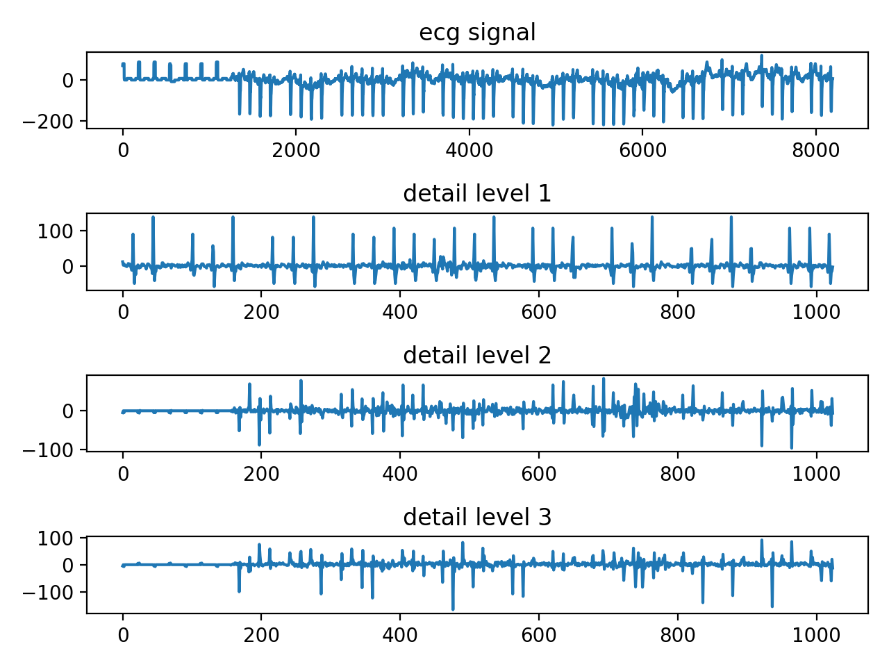
ECG Example
Using code from previous slides on some real data
Looking at this example: https://github.com/jeremiah-corrado/chpl_dwt_example
Compile with: 'chpl wavelet.chpl --fast'
Run with: './wavelet'
You should see an output like this in the results folder:
Run again with: './wavelet -–nLevels=5' to see different results

