Slide 1
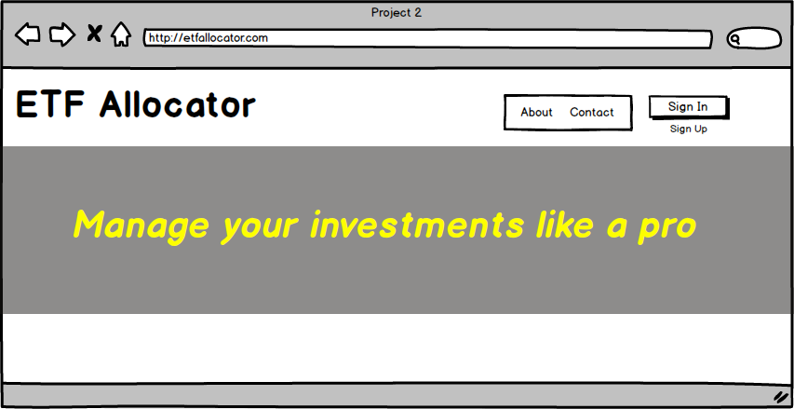
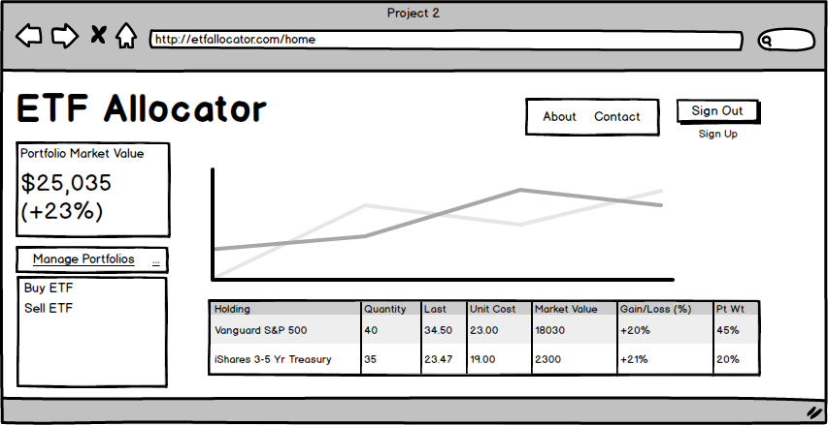
Project 2 – ETFAllocator Beta
UI Wireframe version 0.10 (23 July 2017)

