Slide 1
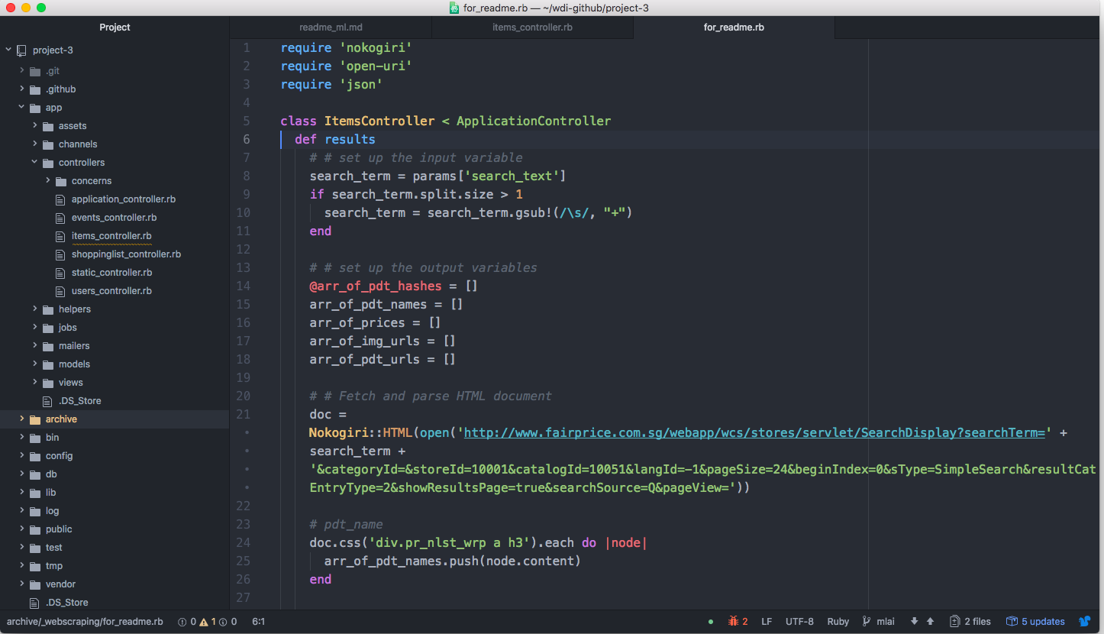
Require the gems
Fetch the HTML doc
Parse the doc using CSS selectors

Slide 2
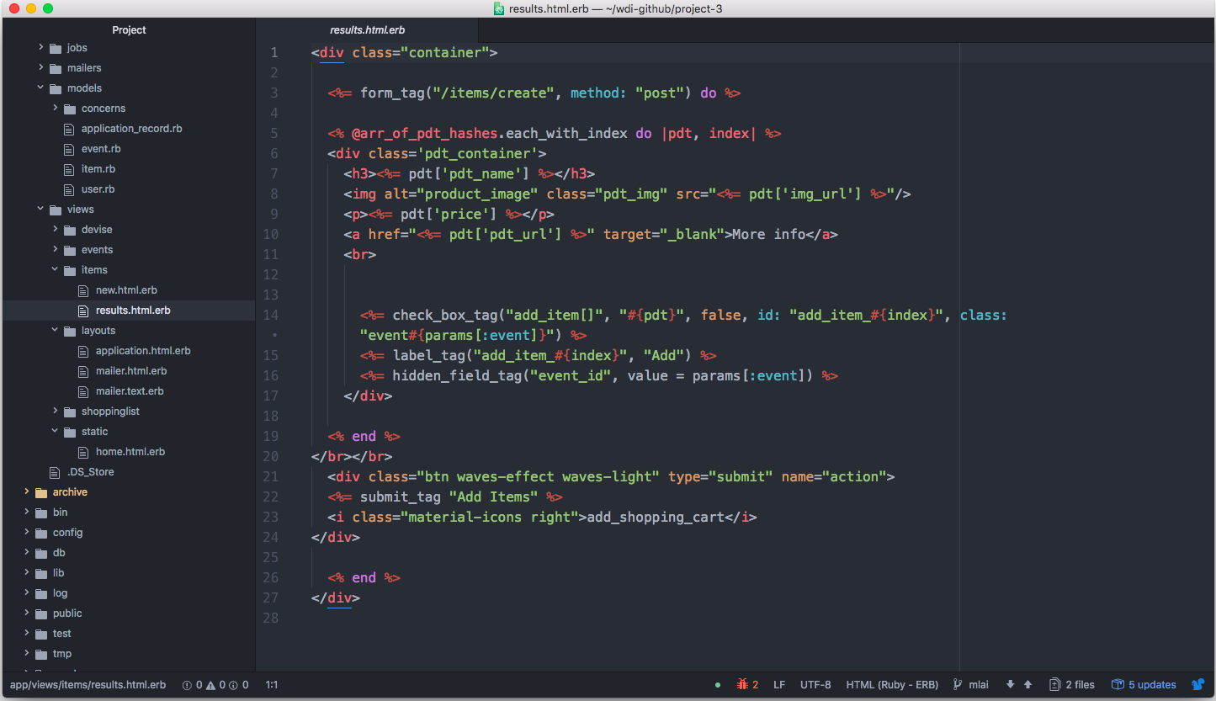
Iterate through the array of hashes >> i.e. Display each item

Slide 3
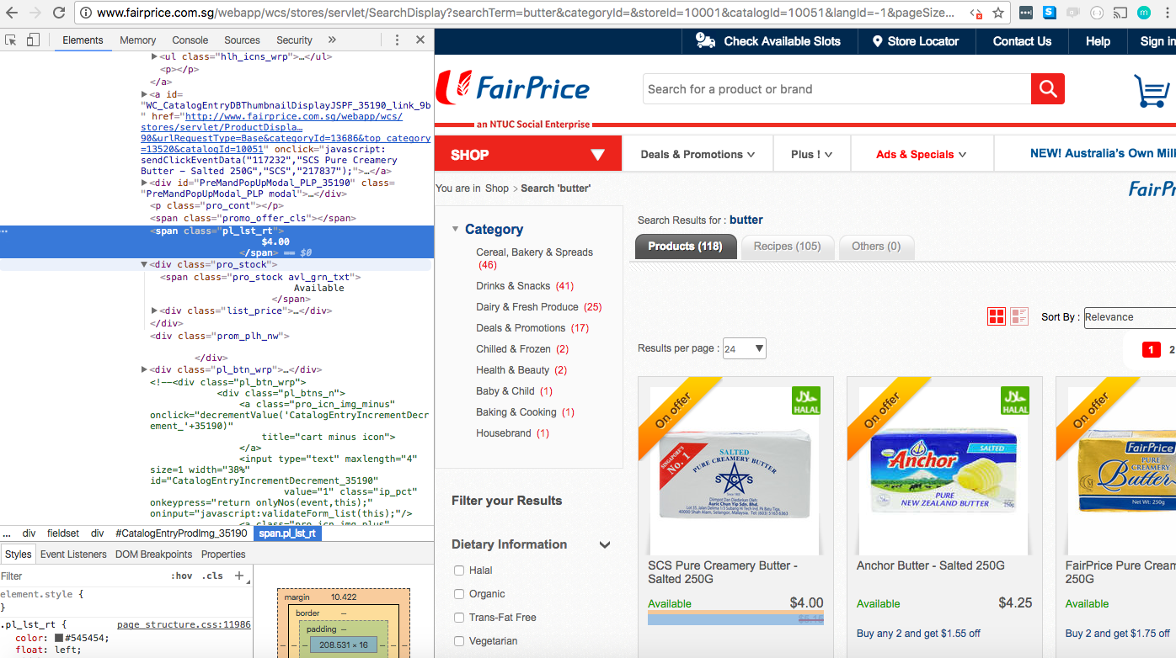
We want to grab the data in each product container
e.g. price

