Slide 1

Leafleting Effectiveness: Pilot Studies
Jack Norris, RD, Executive Director, Vegan Outreach
Notes:
initiated projects to test various aspects of our advocacy
PPR to test differences in diet change between booklets
Paid people small fee on Amazon turk to read a PDF and take a survey
No SS between booklets, but
1+ week (or more) vegan for every 75 booklets
pp gave up mammals didn't increase chicken consumption (in fact, it slightly decreased)
Can read about it on our website Outreach -> Effectiveness
PPR only for booklets read online
Now have ongoing study measure leafleting effectiveness

Slide 2

Potential Benefits of Leafleting
Direct diet change
Word of mouth
Touchpoint
Community building

Slide 3
Leafleting Effectiveness Study
Assesses only direct diet change
Pilot Phase
Testing incentives

Slide 4
Pilot One: Fall 2015
5,000 booklets, 1,000 controls
Stickers offering $5 gift certificate total for taking pre- and post-tests
Treatment response: 88 (1.8%)
Control response: 16 (1.6%)
No bias in favor of animals?

Slide 5
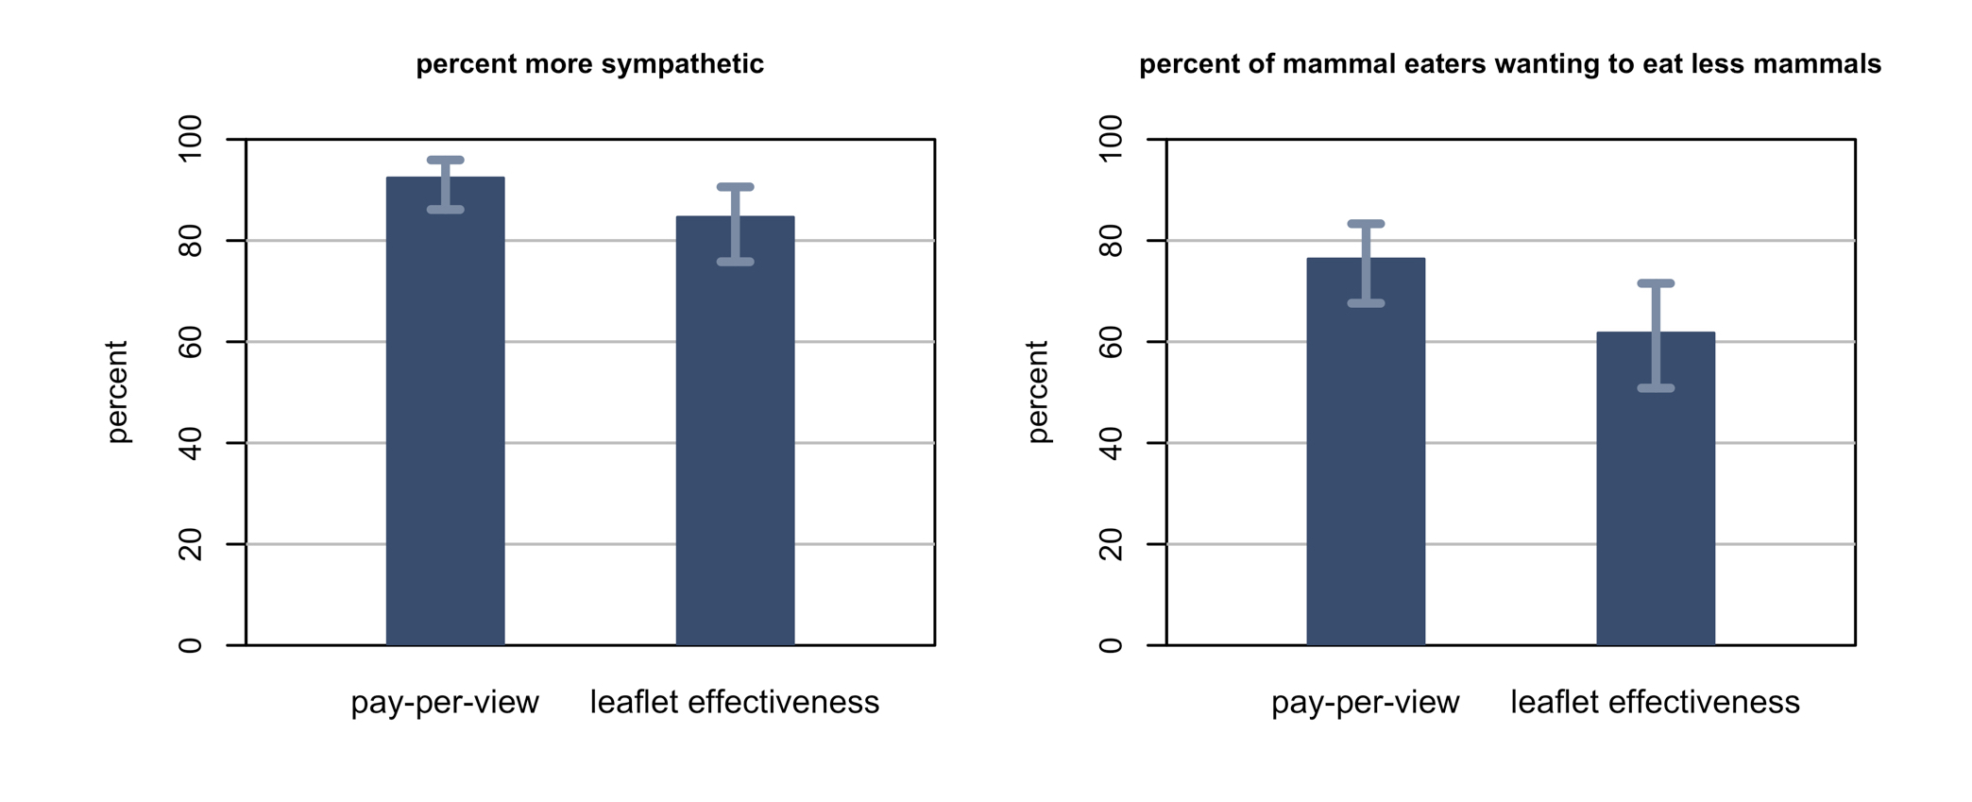
Pre-Test Response Compared to Videos

Slide 6
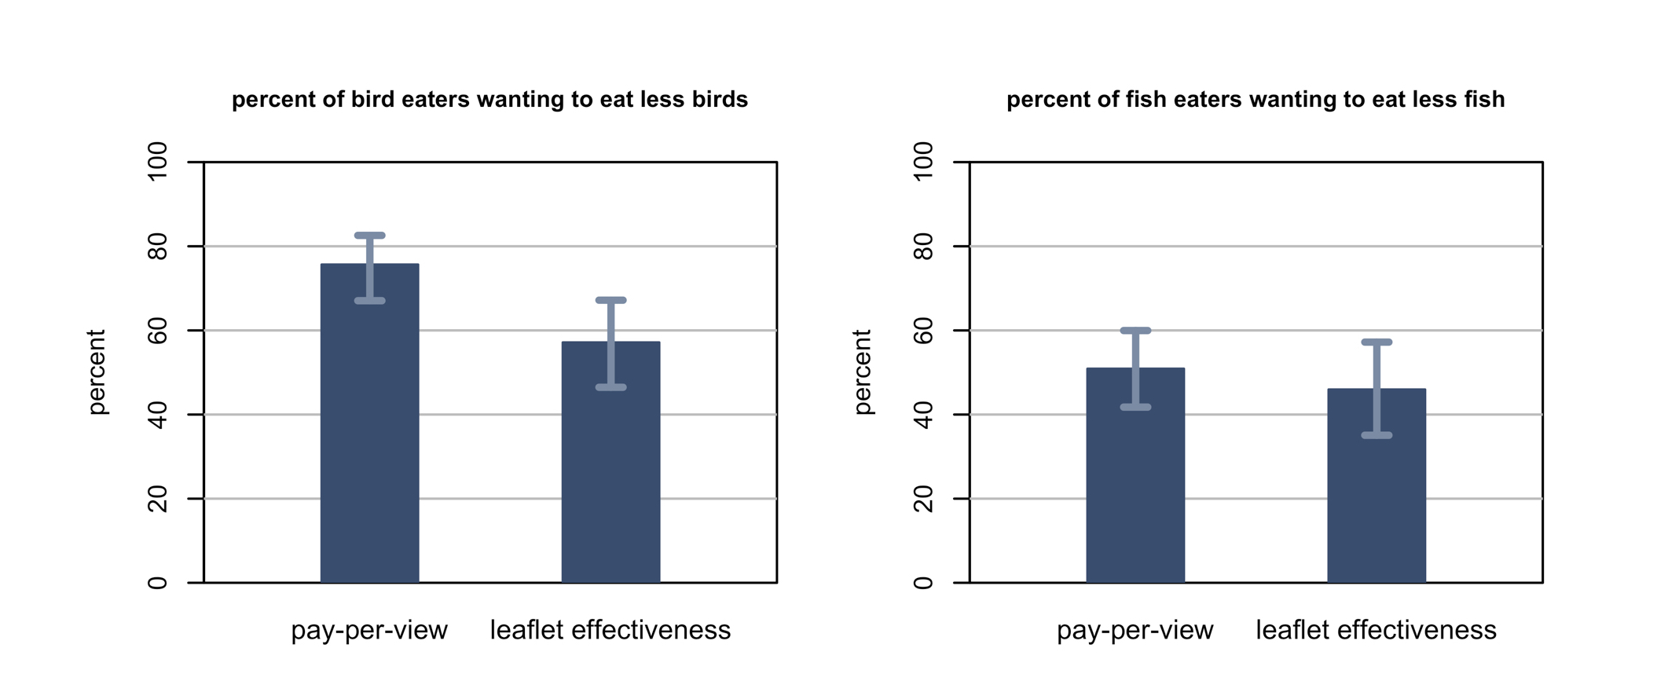
Pre-Test Response Compared to Videos

Slide 7
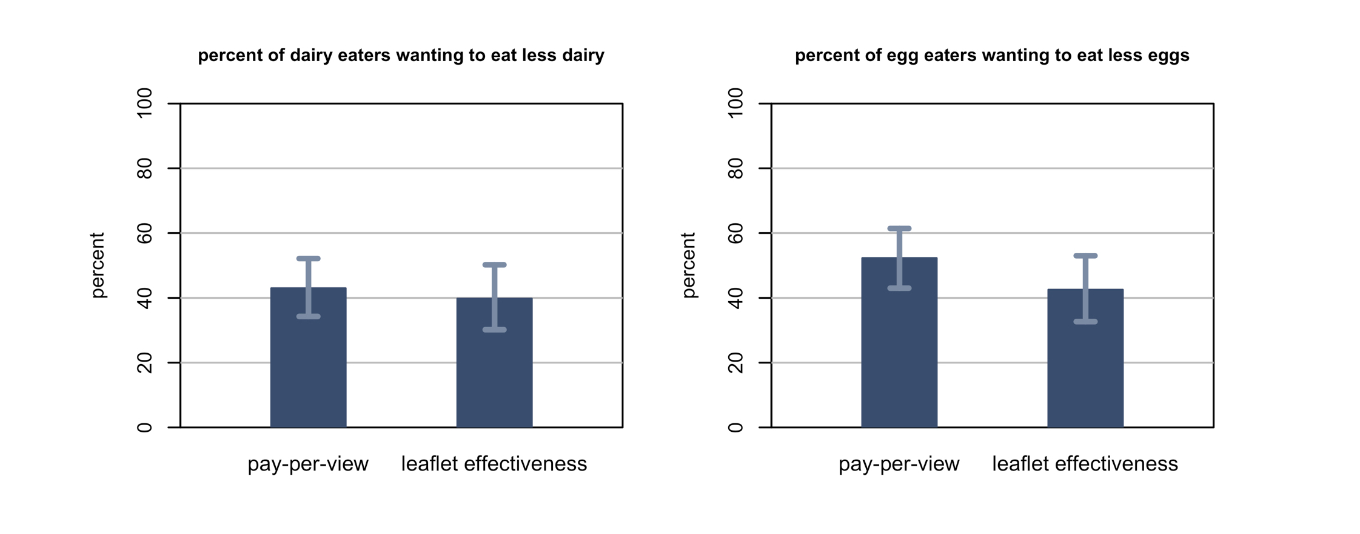
Pre-Test Response Compared to Videos

Slide 8
Pilot Two: Spring 2016
200 booklets
Stickers offering $10 or $20 gift certificate for taking pre- and post-tests
Response: 3 and 2 respectively

Slide 9
Pilot Three: Fall 2016
600 booklets
Stickers offering $5 gift certificate for pre-test; survey offering $10 for post-test
Pre-test response: 38 (6.3%)
Post-test in late November
Hoping for 5%
Notes:
Hey, as Getty Lee of the band Rush once said about being paid to sing on a radio show, "10 bucks is 10 bucks."

Slide 10
Power Calculations
80% power calculations
Assume 5% response rate
Based on previous Pay Per Read study

Slide 11
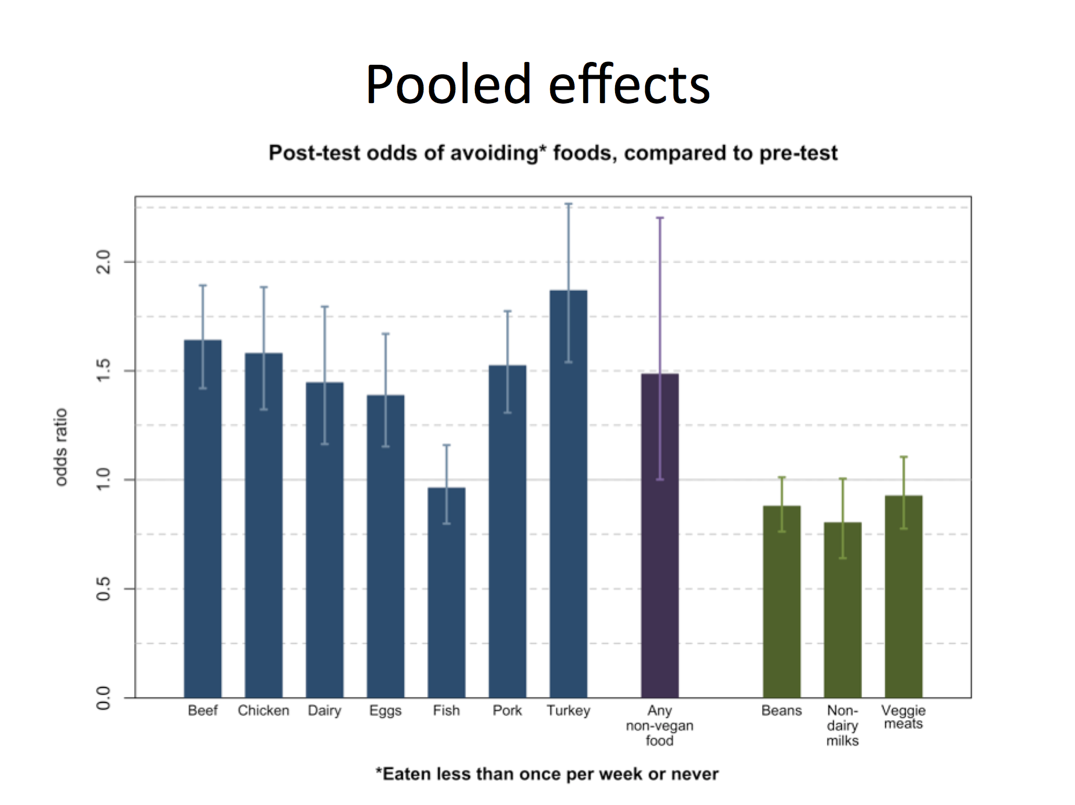
Pay Per Read Results

Slide 12
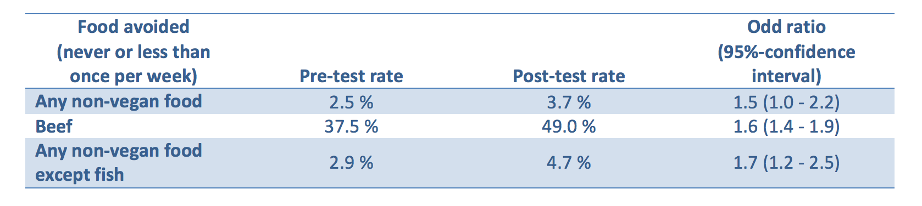
Pay Per Read Results

Slide 13
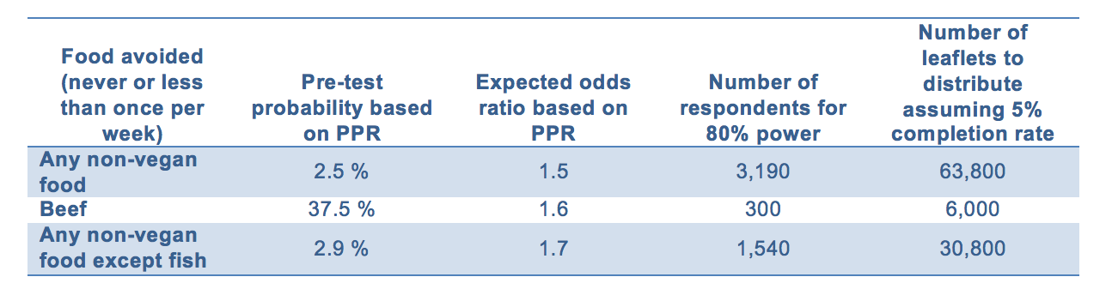
Booklets Required for LES Cases

Slide 14
Booklets Required for LES Controls
Assuming a 1.0 odds ratio for controls
Desire relatively small confidence intervals
500 – 1,000 participants should be enough
At 5%, 500 responses = 10,000 booklets

Slide 15
Costs
2,040 incentives = $33,600
40,800 stickers = $6,528
40,800 booklets = $2,856
Total = $42,984
245 hours for stickering
Notes:
Physically, this is doable.
Monetarily, we might want to do this in stages.

Slide 16
Jack@VeganOutreach.org VeganOutreach.org

Slide 17
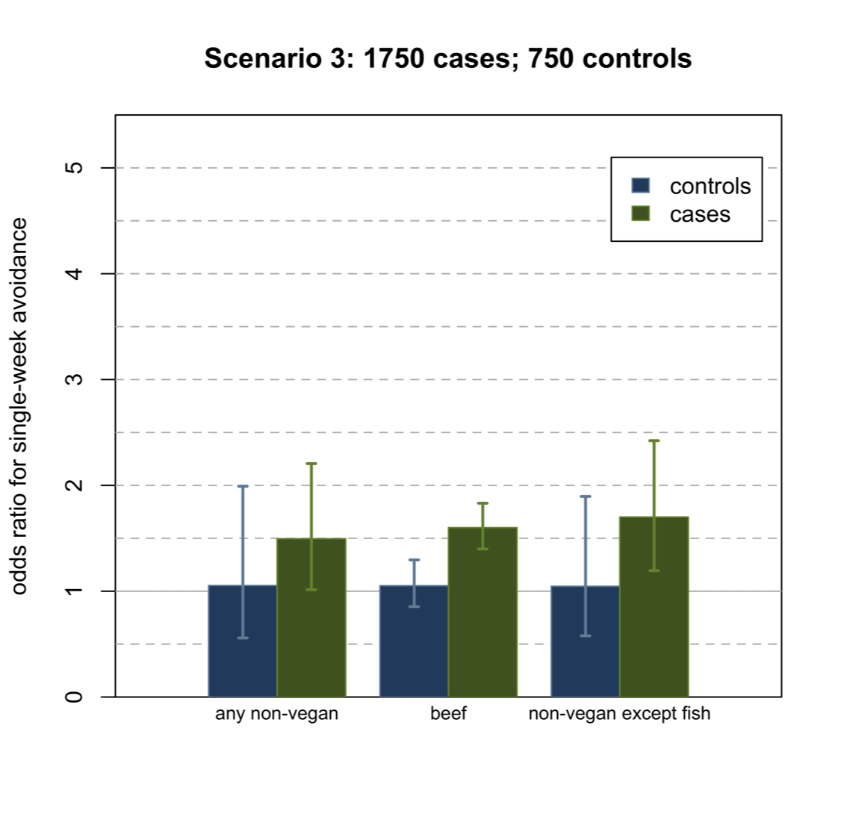
Confidence Intervals for 750 Controls
Notes:
In case people want to see an example of the CIs for controls.

