Slide 1
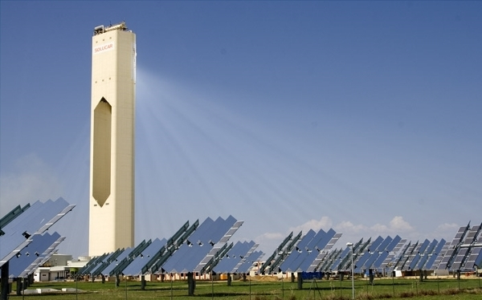
Solar Power
http://io9.com/379226/a-solar+powered-death-ray
Kim Grant
Solar Tower PS10, near Seville, Spain

Slide 2
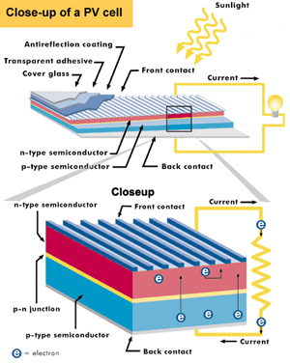
How Solar Power Works
Photovoltaic Cells
Energy in the light is absorbed by the material and electrons bounce off.
This gives them a higher state of energy, producing an electric current.
Currently PV cells include:
  Monocrystalline silicon
  Polycrystalline silicon
  Microcrystalline silicon
  Cadmium telluride
  Copper indium selenide
  or sulfide

Slide 3
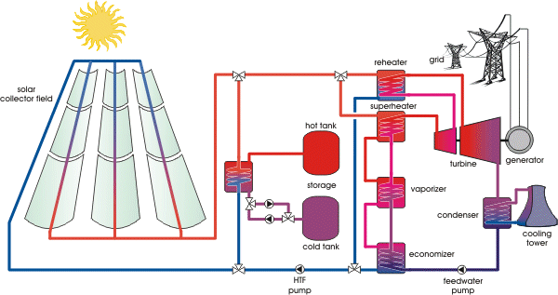
How Solar Power Works
Concentrated Solar Power
A Heliostat system directs sunlight to a central tube which contains a medium, such as molten salt
This circulates and heats water into steam

Slide 4
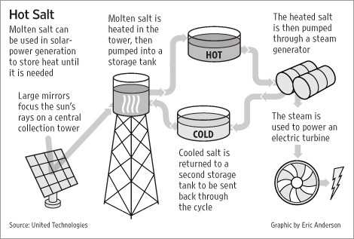
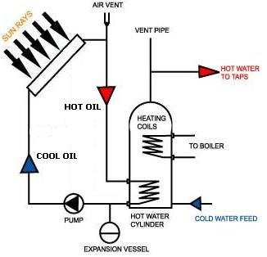
Still, how it works
More Concentrated Solar Power
  Large scale conductor
  Small scale conductor

Slide 5
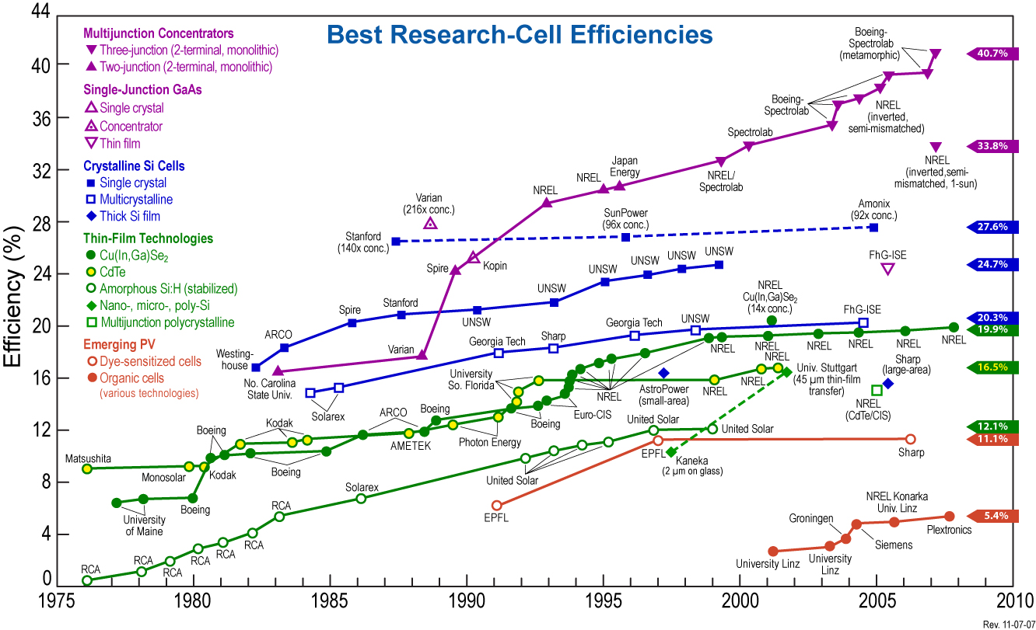
Research
http://en.wikipedia.org/wiki/Solar_cell

Slide 6

Benefits
Powered by the Sun
Zero emissions
Little maintenance once installed
Can last a lifetime
For every $mill. Invested, 5-15 jobs are created
http://www.psy.ritsumei.ac.jp/~akitaoka/sun.jpg

Slide 7
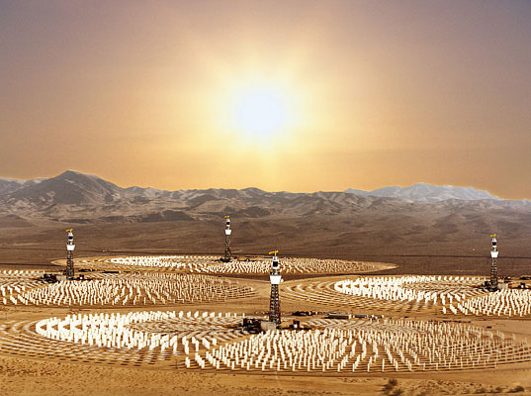
Downsides
Expensive to install initially
Doesn’t work at night
Hard to store the energy (can use batteries)
Large scale production takes space
Isn't completely efficient, doesn't utilize all of the sun's energy... yet

Slide 8
So, why solar power?
With the amount of solar energy the planet receives we have the potential to provide at least 1,000 times the energy consumed globally. (in 2008)
On a sunny day the sun gives off 1,000 watts of energy to the earths surface per square meter
Sunlight is infinite, unlike many of our other energy sources

Slide 9
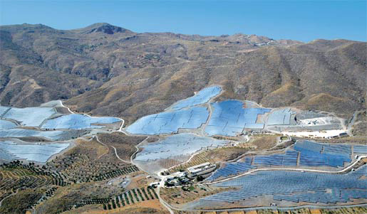
Current Usage
PV Power Plants
  Spain has the top two plants (both built in 2008)
  Portugal is next, followed by Germany
  Spain has four more plants
  US is next on the list, the plant was finished Oct, 2009
Concentrated Solar Power Stations
  Top three stations are in the US (all parabolic troughs)
  Next three are in Spain
PV plant in Andalusia, Spain
http://www.solarserver.de/solarmagazin/solar-report_0509_e_3.html

Slide 10
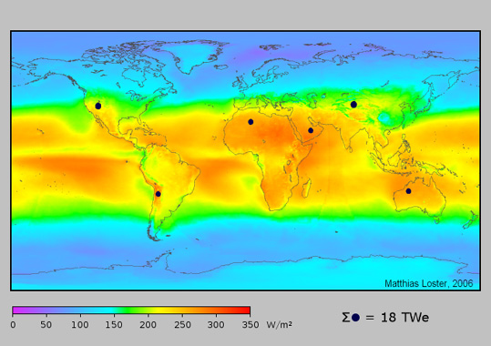
Germany and Solar Power
Accounted for half of the global solar power usage in 2007
  Waldpolenz Solar Park 40,000 MW-h /year
  In 2006 passed a feed-in tariff. Utilities paid customers for the power they would feed into the grid if they installed solar panels
    Achieved 8.3 GW by 2009
  Germany is reducing the subsidy amount though

Slide 11
Works Cited
http://io9.com/379226/a-solar+powered-death-ray
http://www.petervaldivia.com/technology/energy/solar-power.php
http://www.solarhome.org/infoadvantagesofsolarpower.html
http://en.wikipedia.org/wiki/Solar_panel
http://en.wikipedia.org/wiki/Solar_power
http://en.wikipedia.org/wiki/Polycrystalline_silicon
http://www.statesadvancingsolar.org/solar-101/benefits-of-solar

