Slide 1

Predicting Motorcycle Accident Risk in Southern California
Ed Baek
Amber Garcia
Ryan Neighbor
Jeremia Snipes
National University
ANA699
January 08, 2026
Dr. Mario Missakian

Slide 2
Overview of the Presentation
Public safety impact of motorcycle crashes
Research questions on injury severity
Related crash severity research
Southern California crash data
Proposed analytical approach
Notes:
Edit as needed: Here we map out the structure we’ll be going through for this presentation. We’ll start by explaining why motorcycle safety is an important topic to study, then move into our research questions. From there, we’ll review relevant prior research, describe our data sources, and finally outline the analytical methods we plan to use to answer our questions.

Slide 3
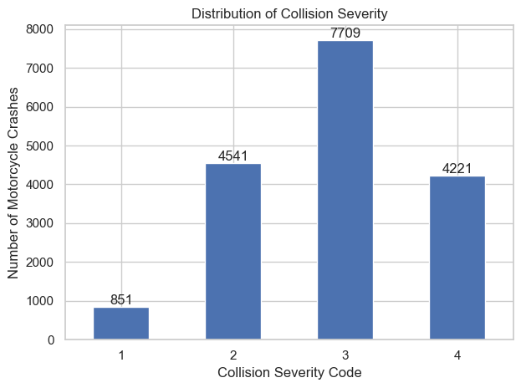
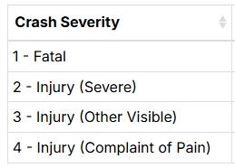
Motorcycle crashes in California frequently result in serious injury or fatal outcomes.
Notes:
Edit as needed: Motorcyclists are considered vulnerable road users because they lack the physical protection available to vehicle occupants. National transportation data consistently show that motorcyclists experience much higher rates of severe injury and fatality per crash compared to passenger vehicles. In California specifically, motorcycles account for a relatively small share of registered vehicles, but a much higher share of serious traffic injuries and deaths. In 2023, there were 583 motorcyclist fatalities, nearly a 19% increase from 2019’s 491 motorcyclist fatalities. Understanding what factors increase the likelihood of severe outcomes can help inform safety interventions, roadway design decisions, and policy efforts aimed at reducing preventable injuries

Slide 4
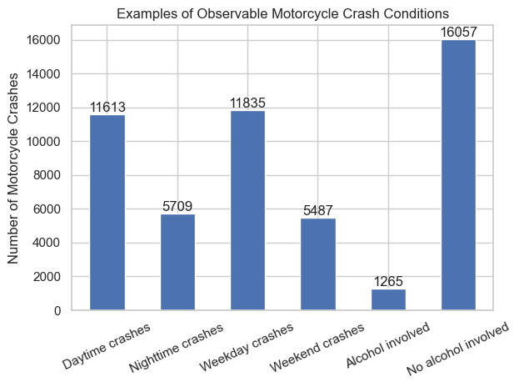
1) Which observable crash conditions are associated with severe or fatal motorcycle injuries in California?
2) How does motorcycle injury severity vary across time, location, and roadway context?
Notes:
Edit as needed: Our primary research question is; Which factors are most strongly associated with severe or fatal motorcycle crash outcomes in California? Building on that we’ll also be asking; How does alcohol involvement relate to crash outcomes? Are there spatial patterns or locations with consistently higher motorcycle crash risk? These questions are designed to be answered by California crash data and predictive modeling techniques.
01/11/2026 Edit:
Which observable crash conditions are associated with severe or fatal motorcycle injuries in California?
How does injury severity vary across time, location, and roadway context?
Can historical Southern California crash data distinguish severe injury outcomes from less severe outcomes?
The dataset records several layman-observable crash conditions, including time, location, roadway context, and alcohol involvement, which motivate analysis of injury severity differences.

Slide 5
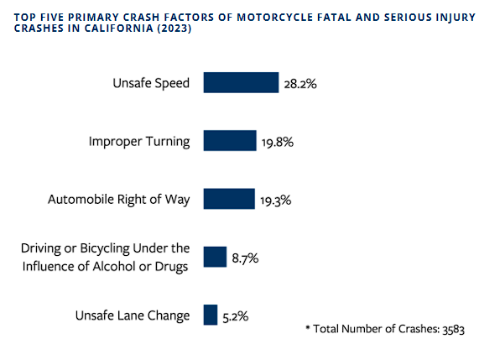
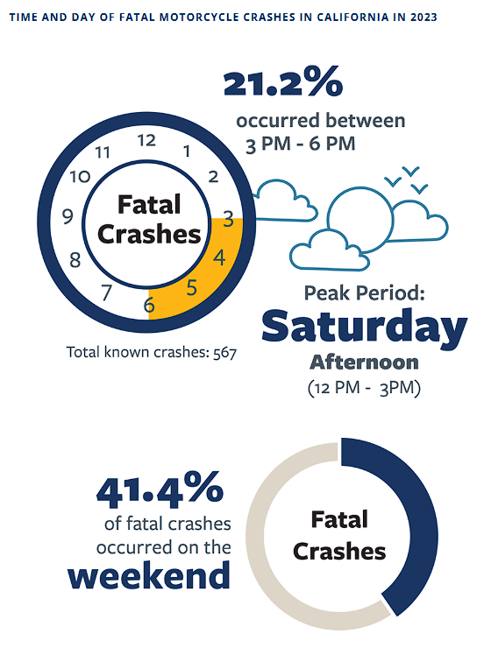
Prior research demonstrates that crash severity is influenced by multiple interacting factors and can be effectively studied using statistical and machine learning models.
(2025 SafeTREC Traffic Safety Facts: Motorcycle Safety | Safe Transportation Research and Education Center, 2025)
Notes:
Edit as needed: Existing research has consistently shown that injury severity in motorcycle crashes is influenced by a combination of human, vehicle, and roadway factors. Early epidemiologic and statistical studies established motorcycle crash severity as a persistent public safety concern and examined relationships between factors such as speed, roadway design, and injury outcomes. More recent research has shifted toward machine learning approaches, which allow for higher predictive accuracy and the ability to capture complex, nonlinear relationships. For example, recent studies using models such as gradient boosting have achieved high accuracy in predicting injury severity and have identified factors like speed limits, roadway type, and crash dynamics as key contributors.

Slide 6
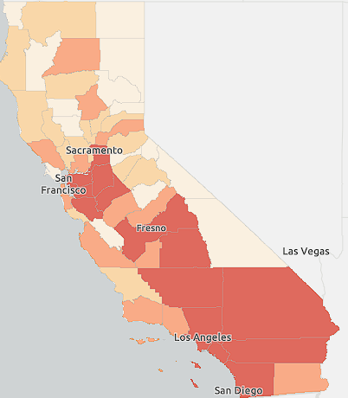
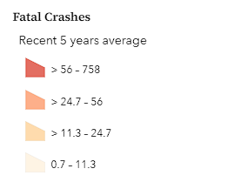
Publicly available California crash data provide sufficient detail to support prediction of motorcycle crash severity.
Notes:
Edit as needed(taken from repo): Our primary data source will be motorcycle involved crash records from the Transportation Injury Mapping System (TIMS), a public crash data platform developed by UC Berkeley Safe Transportation Research and Education Center. TIMS provides access to motorcycle crash records derived from California’s Statewide Integrated Traffic Records System (SWITRS), the official statewide database of police-reported traffic collisions. SWITRS data originate from California Highway Patrol and local law enforcement collision reports and are updated on a regular basis.
Motorcycle crash records were accessed using the TIMS Motorcycle Crash Map Viewer and filtered by county, crash severity, alcohol involvement, and year. The resulting dataset contains event-level crash records for multiple Southern California counties, including injury severity outcomes, alcohol involvement indicators, roadway and environmental conditions, temporal variables, and geocoded latitude and longitude.

Slide 7





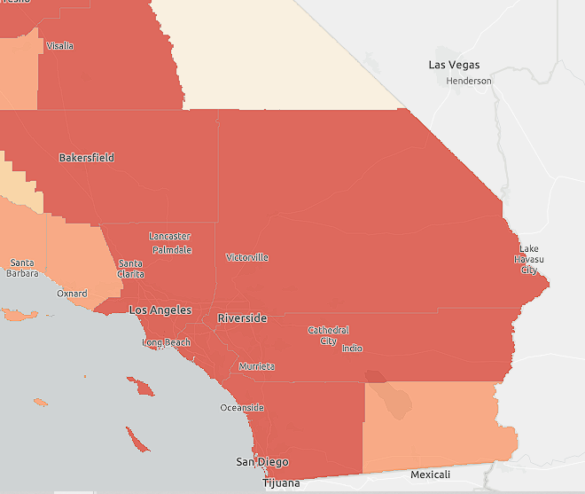
The dataset enables a structured analytical pipeline integrating exploratory analysis, predictive modeling, and spatial risk assessment to predict motorcycle crash injury severity.
Data cleaning
EDA
Injury Severity Defined
Predictive modeling
Model Evaluation
Spatial Hotspot Analysis
.
Notes:
EAN: This dataset will support our structured analytical pipeline designed to move from raw collision records to prediction of motorcycle crash injury severity. We’ll begin with data cleaning and preprocessing to ensure consistency and completeness across variables. EDA will be utilized to understand distributions, identify patterns, and inform modeling decisions. Injury severity is defined as the primary outcome, allowing this to be framed as a classification task. Predictive modeling will be conducted using logistic regression, and tree based methods to balance interpretability with predictive performance. Model performance will be evaluated using ROC-AUC to assess each models ability to distinguish between severe/non-severe crashes. Finally spatial analysis using geographic metrics will be applied to identify high-risk locations and injury severity hotspots. Together this analytical pipeline ensures that predictions are data-driven, interpretable, and grounded in both statistical and spatial context.

Slide 8

Motorcycle crash injury severity remains a serious and ongoing public safety concern across Southern California communities.
Notes:
EAN: To summarize, this project demonstrates that motorcycle crash injury severity in Southern California can be systematically studied and predicted using publicly available crash data and established analytical methods. Prior research shows that crash severity is influenced by multiple interacting factors, including roadway characteristics, environmental conditions, and crash dynamics, which informed both our variable selection and modeling approach. Using California crash data, we proposed a structured analytical pipeline that moves from data cleaning and EDA to injury severity classifications, predictive modeling, and spatial hotspot identification. Logistic regression and tree-based models allows us to balance interpretability with predictive performance, while ROC-AUC provides consistent framework for model evaluation. Incorporating spatial analysis further extends this work by identifying geographic concentrations of severe crashes, supporting the potential for targeted, location-specific safety interventions. Overall, this approach establishes a strong foundation for predictive motorcycle crash severity analysis and future work on improving roadway safety outcomes.

Slide 9
References
Hsu, T.-P., & Wen, K.-L. (2022). Using multinomial regression to explore the spatial factors affecting left-turn oncoming accidents involving motorcycles. Traffic Injury Prevention, 23(1), 46–50. https://doi.org/10.1080/15389588.2021.2009115
Kraus, J. F., Franti, C. E., Johnson, S. L., & Riggins, R. S. (1976). Trends in deaths due to motorcycle crashes and risk factors in injury collisions. Accident Analysis & Prevention, 8(4), 247–255. https://doi.org/10.1016/0001-4575(76)90010-5
Motorcycle safety. (2023). California Office of Traffic Safety. https://www.ots.ca.gov/grants/motorcycle-safety/
Safe Transportation Research and Education Center. (2025). 2025 SafeTREC traffic safety facts: Motorcycle safety. University of California, Berkeley. https://safetrec.berkeley.edu/2025-safetrec-traffic-safety-facts-motorcycle-safety
Wei, T., Zhu, T., Lin, M., & Liu, H. (2024). Predicting and factor analysis of rider injury severity in two-wheeled motorcycle and vehicle crash accidents based on an interpretable machine learning framework. Traffic Injury Prevention, 25(2), 194–201. https://doi.org/10.1080/15389588.2023.2284111
‌

