Slide 1
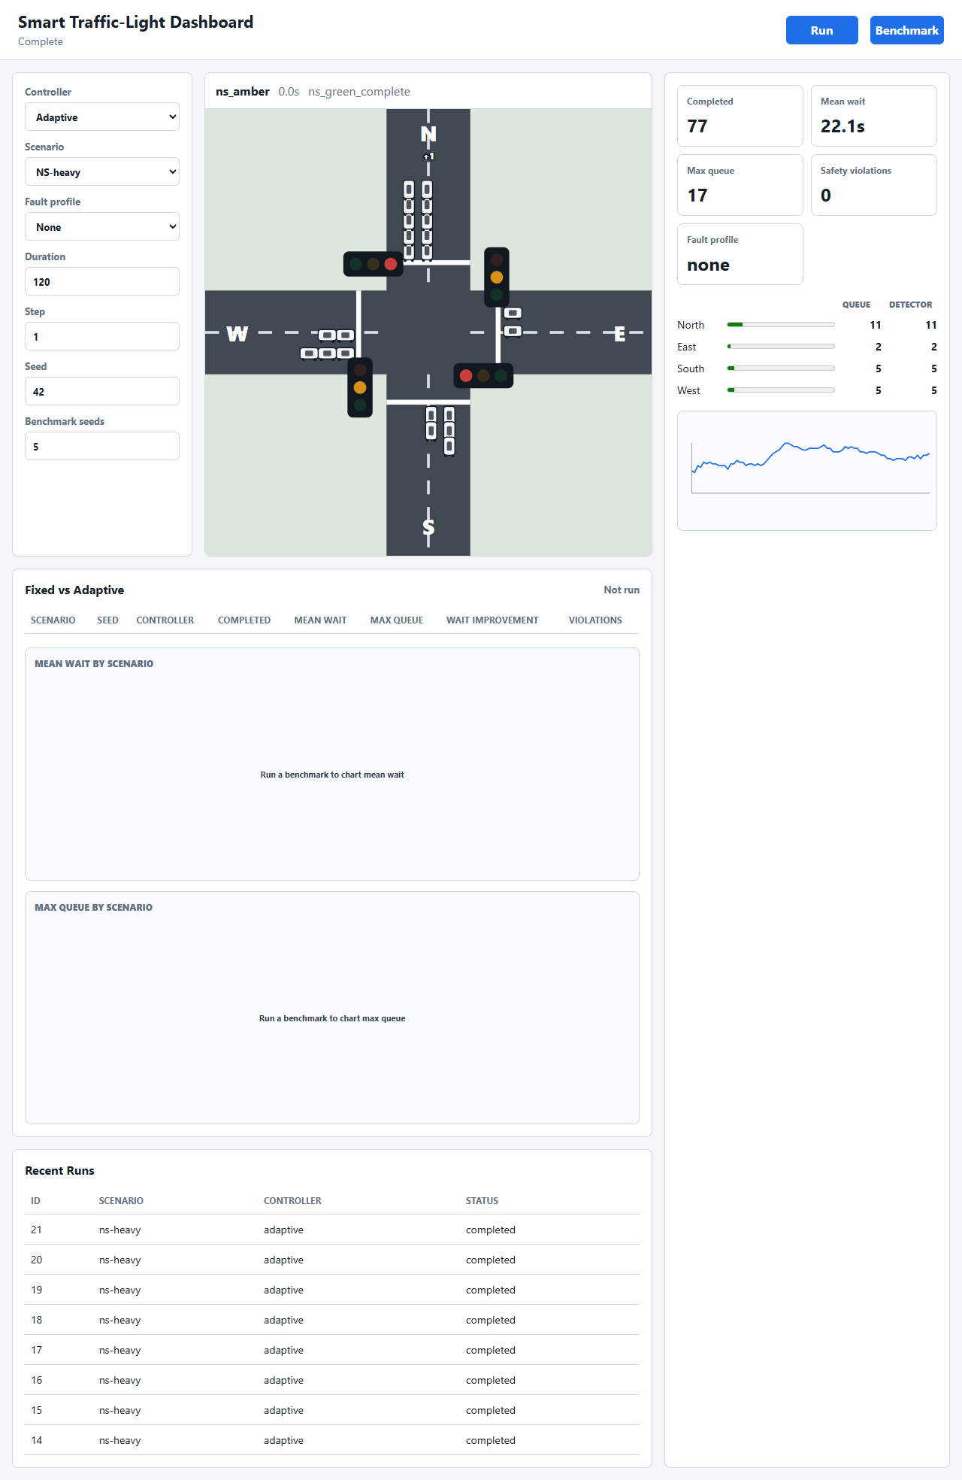
GHANA COMMUNICATION TECHNOLOGY UNIVERSITY (GCTU)
FACULTY OF ENGINEERING | DEPARTMENT OF COMPUTER ENGINEERING
Design and Evaluation of a Simulation-Based Adaptive Smart Traffic-Light Controller
Final-year project demonstration
Software simulation | dashboard | repeatable benchmarks
BY:
HENYO THEOPHILUS - ID 4121230031
DJAGNI JERRY KODJO - ID 4121230036
SUPERVISOR: DR. PHILLIP KISEMBE
Smart Traffic-Light Simulation | 1
Notes:
Open by saying the project now focuses on full software simulation rather than physical Raspberry Pi hardware. State the core claim: adaptive timing reduces waiting time or queue length while maintaining zero conflicting-green violations.

Slide 2
Project problem
Fixed-time traffic lights cannot react to changing demand
A fixed cycle may serve an empty approach while vehicles wait elsewhere.
Adaptive timing can allocate longer green time to the busier movement.
Any timing improvement must preserve amber and all-red clearance.
The project evaluates the algorithm with repeatable simulation data.
5
benchmark scenarios
10
random seeds
0
hardware required
Smart Traffic-Light Simulation | 2
Notes:
Explain the decision to move away from hardware: simulation gives repeatable evidence and keeps the project focused on controller logic and safety testing.

Slide 3
Engineering contribution
The value is the implemented and tested control system
This project does not claim adaptive traffic lights are new.
It implements both fixed-time and adaptive controllers for fair comparison.
It uses repeatable scenarios and seeds instead of one-off demonstration runs.
It separates true queue values from detector values seen by the controller.
It produces tests, CSV results, charts, screenshots, and a presentation deck.
24
pytest checks
10
benchmark seeds
0
conflict target
Smart Traffic-Light Simulation | 3
Notes:
Use this slide to answer the examiner's likely concern: similar systems exist, but this submission is an engineering implementation with requirements, architecture, tests, evaluation, and evidence.

Slide 4
Simulation boundary
Virtual detectors replace physical sensing in the approved scope
Included or abstracted | Outside current physical scope
Virtual detector demand from simulated queues | Camera, ultrasonic, loop, or GPIO hardware
Stuck-high and stuck-low detector faults | Real sensor calibration and electronics
Rain, darkness, glare, and dirt as detector-error causes | Image quality or night-vision modelling
Unequal, burst, and changing traffic demand | Turning lanes, lane changes, and blocked roads
Safe phase machine and all-red clearance | Certified public-road operation
Dashboard, logs, CSVs, charts, and tests | Physical roadside deployment
Smart Traffic-Light Simulation | 4
Notes:
Explain that vehicles are detected by a virtual detector in the simulation. Rain, darkness, glare, and dirt are discussed as causes of bad readings, represented by detector-fault profiles rather than physical perception.

Slide 5
Implementation architecture
The controller stays separate from simulation, storage, and UI
Layer | Purpose | Main files
Domain | Signal phases, timing, safety checks | src/trafficlight/domain/
Simulation | Queues, scenarios, faults, benchmarks | src/trafficlight/simulation/
Storage | SQLite run, event, detector, metric logging | src/trafficlight/storage/
Interface | CLI, FastAPI, WebSocket dashboard | src/trafficlight/main.py, api/, dashboard/
Same controller code is used by the CLI, API, dashboard stream, and benchmark scripts.
Smart Traffic-Light Simulation | 5
Notes:
Point out that the architecture gives a clean explanation for the simulation-only pivot. The algorithm does not depend on GPIO or a physical sensor.

Slide 6
Controller safety
Adaptive timing changes green duration only
Safe phase sequence
all-red, NS green, NS amber, all-red, EW green, EW amber
0
Fixed and adaptive controllers share the same phase machine.
Every signal state passes through the conflicting-green safety check.
Minimum green protects active traffic from instant switching.
Maximum green prevents one movement from holding green indefinitely.
conflicting-green target
Smart Traffic-Light Simulation | 6
Notes:
Stress that the adaptive algorithm never directly commands arbitrary lamp colours. It only influences the green phase duration.

Slide 7
Simulation workflow
Each run advances the intersection in fixed time steps
Sample arrivals from the selected traffic scenario demand rates.
Create true queue demand for North, East, South, and West.
Apply detector faults when a fault profile is selected.
Advance the controller and check for unsafe signal states.
Discharge vehicles on green approaches and record metrics.
Experiment settings
Setting | Value
Duration | 300 s
Step | 0.5 s
Seeds | 1 to 10
Scenarios | 5
Smart Traffic-Light Simulation | 7
Notes:
Explain that fixed and adaptive benchmark pairs use the same seed, so the arrival trace is identical for the comparison. The corrected simulator samples arrivals from configured demand rates and measures mean wait from completed vehicles.

Slide 8
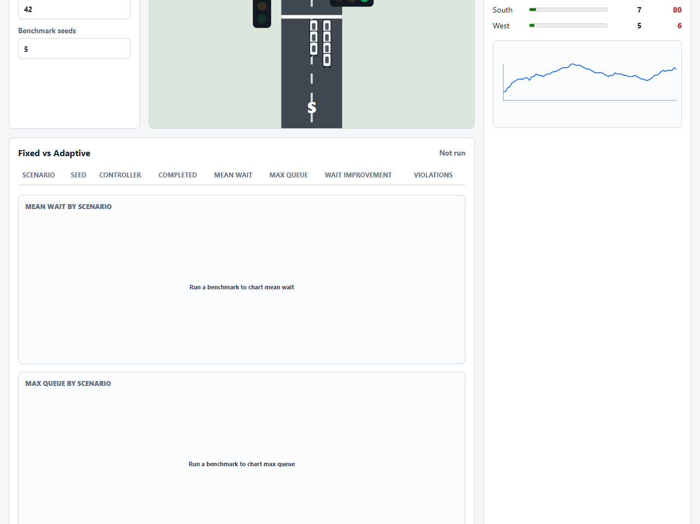
Dashboard evidence
Live simulation and detector faults are visible in the browser
Live queues and moving vehicles
Detector stuck high while real queue is lower
Smart Traffic-Light Simulation | 8
Notes:
Use this slide if the live dashboard is slow during the demo. The images are saved Playwright screenshots from the implemented dashboard.

Slide 9
Benchmark results
Adaptive control reduced mean wait in all scenarios
8.33%-43.11%
mean-wait improvement
range
0
safety violations
Smart Traffic-Light Simulation | 9
Notes:
Source: results/dissertation/benchmark_summary.csv and results/dissertation/results_summary.md. The benchmark used 300-second runs, 0.5-second steps, and seeds 1 to 10. Results use the corrected completed-vehicle wait metric.

Slide 10
Fault testing
Bad detector input affects performance, not phase safety
Fault profile | Runs | Completed | Mean wait | Max queue | Safety violations
none | 10 | 196.50 | 29.51 s | 22.90 | 0
ns-stuck-high | 10 | 198.40 | 26.52 s | 17.40 | 0
ew-stuck-low | 10 | 197.50 | 24.29 s | 17.30 | 0
all-stuck-low-midrun | 10 | 160.60 | 34.18 s | 41.00 | 0
The worst fault profile reduced completed vehicles and increased maximum queue, but no test produced conflicting green signals.
Smart Traffic-Light Simulation | 10
Notes:
Source: results/dissertation/failure_modes.csv and results/dissertation/results_summary.md. Explain that faults alter demand readings only; they do not set signal colours.

Slide 11
Conclusion
The simulation supports the adaptive-control claim
The project runs fully in software with no physical hardware dependency.
Adaptive timing reduced mean wait in all five benchmark scenarios.
The adaptive controller completed more vehicles than the fixed-time baseline.
Benchmark and detector-fault experiments recorded zero conflicting-green violations.
The main limitation is the simplified traffic model.
24
tests passing
0
final safety violations
Smart Traffic-Light Simulation | 11
Notes:
Close with the limitation clearly: this is a controlled simulation, not a public-road controller. Point to future work such as pedestrian phases, richer detector noise, SUMO validation, and optional hardware adapters.

