Slide 1
statistics and bacterial GWAS
Jeremiah Yarmie
Biostats Final Presentation

Slide 2

GWAS
Genome-Wide Association Studies
attempts to identify genotype/phenotype associations
statistical in nature: optimization through maximizing precision and power
Notes:
-attempts to identify causative relationships between genetic variants and phenotypic outcomes within a population
-inherently statistical approach, concerned with maximizing precision and power in its analysis.
-top-down approach to conducting genetic research, compared to bottom-up approaches rooted in molecular biology like creating knock outs, mutant strains, etc.

Slide 3
bacterial approaches
GTCATAACTTACCTGAGACTACTTGGAAATGTGGCTAGATC
GTCATAACTTACCTGAGACTACTTGGAAATGTGGCTAGATC
GTCATAACTTACCTGAGACTACTTGGAAATGTGGCTAGATC
allele counting -is an allele more present in cases vs controls?
homoplasy -is there an appearance of genotype/phenotype on multiple branches of a phylogenetic tree?
GTCATAACTTACCTGAGACTACGTGGAAATGTGGCTAGATC
GTCATATCTTACCTGAGACTACTTGGAAATGTGGCTAGATC
GTCATATCTTACCTGAGACTACTTGGAAATGTGGCTAGATC
Notes:
allele-counting
-looks for an increased presence of a certain allele at a locus in cases relative to controls.
homoplasy
-presence of similar genetic loci on different branches of a phylogenetic tree
-accounts for the effects of population structure and linkage disequilibrium inherently
-requires a much smaller sample size to reach statistical significance

Slide 4
issues
GWAS results
real world
association
unrelated
two problems arise due to bacterial clonal reproduction:
1) linkage disequilibrium 2) population stratification
can result in spurious associations (false positives)
truly related
false negative (type II error)
true positive
no causation
false positive (type I error)
true negative
Notes:
confounding effect of genetic relatedness between different bacterial isolates and strains

Slide 5
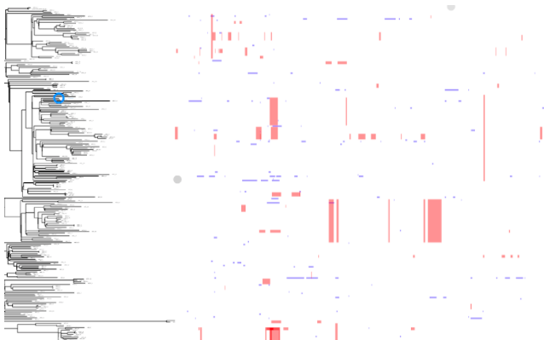
clonal frame
unlike in humans, almost the entire bacterial chromosome is under linkage disequilibrium -a clonal frame interrupted by areas of recombination
Notes:
almost the entire bacterial chromosome is under linkage disequilibrium.
-a patchwork of recombined regions on a tract of linked regions called a clonal frame
-all regions of the clonal frame are in linkage disequilibrium.

Slide 6
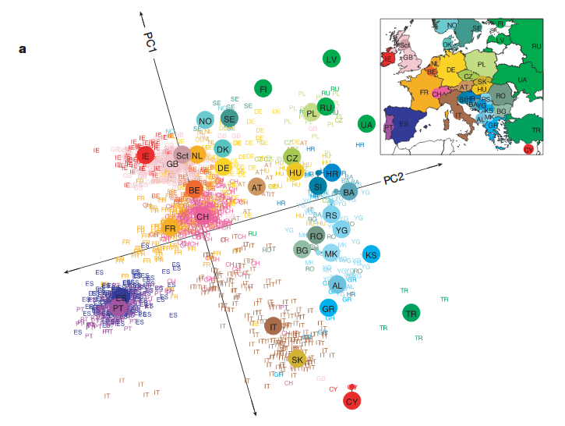
populations
like in humans, population stratification can result in spurious associations
-if a specific population is enriched with an allele it may be deemed associated
Notes:
population stratification
-certain subgroups of closely-related individuals can give rise to spurious associations with phenotypes of interest.
-members of a population and subpopulation structure contain a non-random distribution of alleles.
-problem in highly clonal and rarely recombining bacteria

Slide 7
solutions?
principal component analysis can correct for population stratification and clonal frames
the largest principal components tend to correspond to these sources of error
but PCA trades statistical power for reduced type I error
reduced false positives
ability to determine associations
Notes:
PCA
-correct for population structure and stratification when conducing GWAS analysis.
-largest principal components tend to correspond to major population structures and strain lineages or clonal frames.

Slide 8
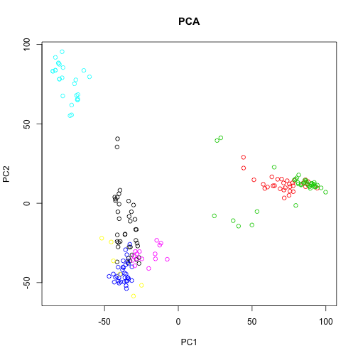
typically
standard GWAS approaches pair PCA with downstream linear mixed modelling
PCs are used as fixed effect factors in downstream linear regression analysis
Notes:
Principal components identified that consider population structure are then chosen as fixed effect factors in downstream linear regression

Slide 9
treeWAS
homoplasy-based tool for bacterial GWAS
phylogenetic approach to correcting for stratification
appropriate for both clonal and recombining bacterial species
Notes:
-balances a low false positive rate, high sensitivity, and high positive predictive value
-appropriate to use both with highly clonal bacteria and extremely recombinant ones (through the implementation of ClonalFrameML)

Slide 10
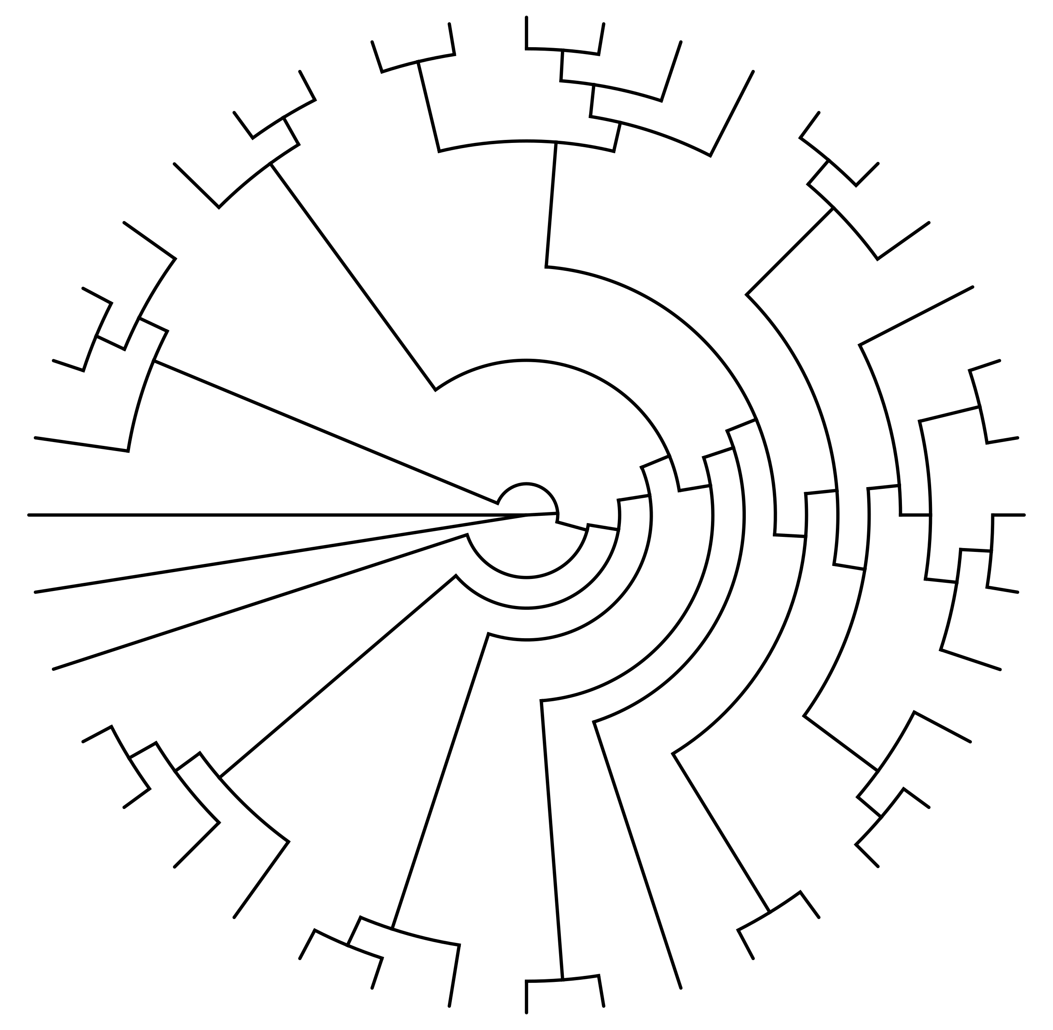
workflow
creates null dataset representing confounding factors
conducts hypothesis tests between null and test scores to determine significance
Notes:
-uses a null genetic dataset to conduct hypothesis tests on the validity of associations seen in the test data
-null dataset represents test dataset except for associations (unless they arise due to the confounding factors)
-maintains: clonal genealogy, terminal phenotype, genetic composition and homoplasy

Slide 11
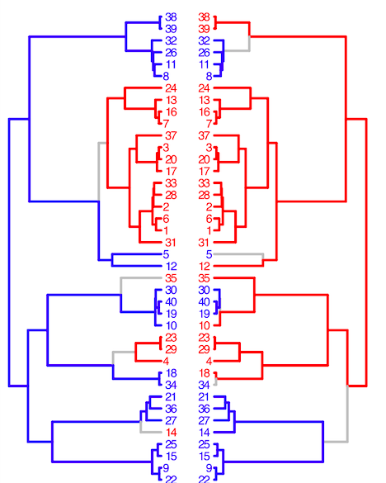
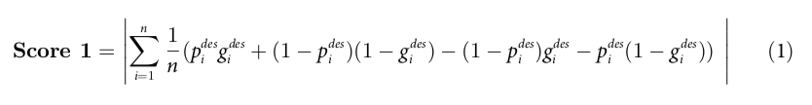
terminal score
phenotype
genotype
considers tree tips only
agnostic to ancestral states (internal nodes)
Notes:
- Measures sample-wide association across the tree leaves.
- Counts all 4 terminal states p+g+, p+g-, p-g+, and p-g-
- Then determines if an allele is over-represented among a particular phenotypic state
- Only determines association at the tree termini, agnostic to ancestral states

Slide 12
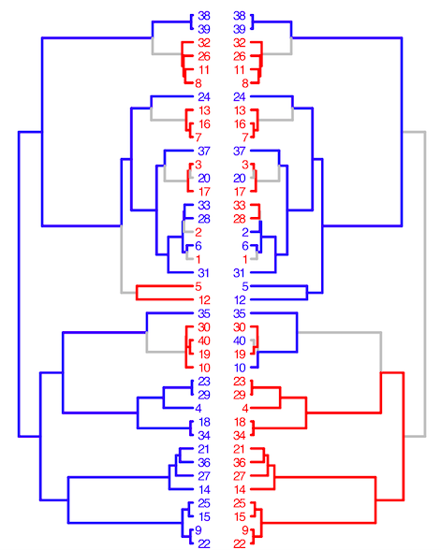
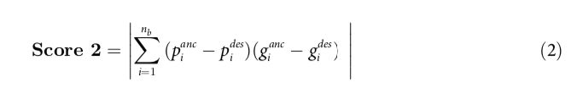
simultaneous score
phenotype
genotype
considers ancestral states (internal nodes)
measures parallel change in genotype and phenotype occurring along a tree branch
Notes:
-Measures the degree of parallel change in genotype and phenotype across tree branches.
-Counts the number of branches containing a simultaneous substitution in both genotype and phenotype. -Simultaneous substitutions indicate a strong relationship between genotype and phenotype.
-Able to detect associations arising through similar or complementary pathways.

Slide 13
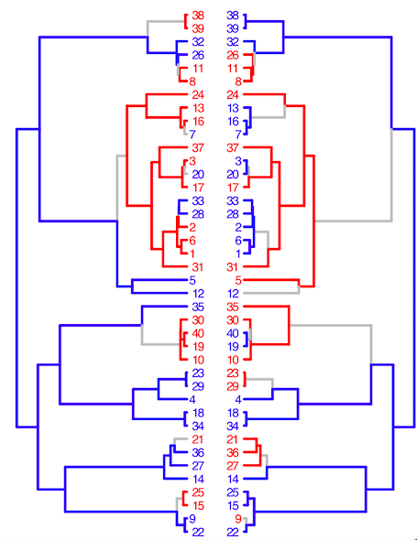

subsequent score
phenotype
genotype
measures proportion of entire tree where genotype and phenotype coincide

Slide 14

workflow
three scores are compared to null distribution determined from null loci and true phenotypes
Notes:
-null distribution of the three association score statistics is calculated by measuring associations between the null loci and the true phenotypes. -these will represent the null hypothesis of our tests.

Slide 15
multiple testing
correcting for multiple loci and three tests
then a significance threshold is drawn
Notes:
Bonferroni correction and p = 0.01 threshold

Slide 16
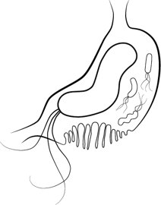

my datasets?
Helicobacter pylori extremely recombinant
Mycobacterium tuberculosis extremely clonal
genomic datasets were taken from previous GWAS studies

Slide 17
my datasets?
Helicobacter pylori extremely recombinant
Mycobacterium tuberculosis extremely clonal
genomic datasets were taken from previous GWAS studies
Notes:
had issues accessing the data (said it was uploading on NCBI’s SRA, but it was actually deposited in contig draft genome form)
could not run the same pipeline that you can with SRA data (fastq illumina reads)
tried multiple alignments but it was too computationally intensive and didn’t end up working

Slide 18
dataset size
entire H. pylori dataset from Berthenet et al. (2018) used -170 genomes
subset M. tuberculosis dataset from Farhat et al. (2019) used -183 genomes
Notes:
Reduction in the Mtb dataset was done predominantly due to time and computation power, as well as being similar in size to the Hp dataset.

Slide 19
phenotypic data
metadata for M. tuberculosis is antimicrobial resistance or susceptibility (binary) for various drugs:
-isoniazid, rifampin, pyrazinamide, ethambutol, streptomycin, kanamycin, etc.

Slide 20
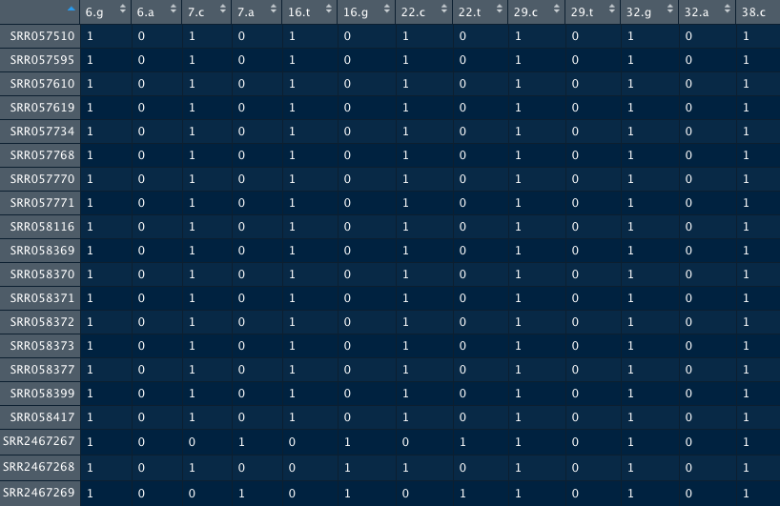
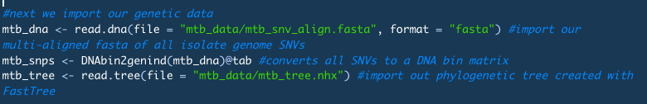
data input
multi-aligned SNV fasta
newick tree

Slide 21


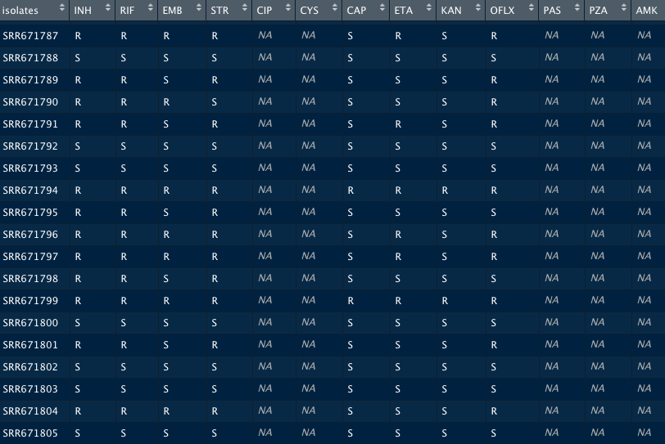
data input
vector of phenotypic data

Slide 22

calling treeWAS
just one line of code

Slide 23
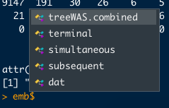
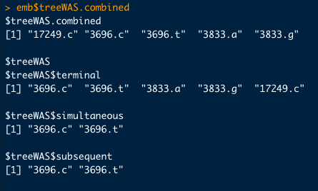
data output

Slide 24
M. tuberculosis results
gene | name | function | in LMM GWAS?
rpoB | RNA polymerase B | transcription | Yes
rpsL | small ribosomal protein | translation | No
fabG1 | 3-oxoacyl-ACP reductase | mycolic acid production | Yes
lldD2 | L-lactate dehydrogrenase | pyruvate biosynthesis | No
embA | arabinosyl transferase | mycolic acid production | Yes

Slide 25
ease of use
i used a very small subset of the total genomes analyzed using PCA-LMM GWAS
this is not a true validation study
think of it as a “pilot” or proof of concept

Slide 26

discussion
each analysis only took about 4 minutes to run, so scaling up should be easy
data pre-processing will increase in time and computational demand with more genomes, however

Slide 27
input
no support for non-binary categorical phenotypic data
only binary categorical and continuous phenotypes supported

Slide 28
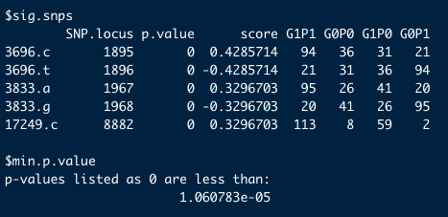
output
Bonferroni corrected p-value <10⁻⁵
it would be nice for the p-values to be printed with precision, especially since it may come up in journal guidelines or with reviewers

Slide 29
references
Berthenet, E., Yahara, K., Thorell, K., Pascoe, B., Meric, G., Mikhail, J. M., … Sheppard, S. K. (2018). A GWAS on Helicobacter pylori strains points to genetic variants associated with gastric cancer risk. BMC biology 16(1), 84. doi:10.1186/s12915-018-0550-3
Chen, P. E., and Shapiro, B. J. (2015) The advent of genome-wide association studies for bacteria. Curr Opin Microbiol. 25:17-24. doi: 10.1016/j.mib.2015.03.002.
Collins, C., and Didelot, X. (2018) A phylogenetic method to perform genome-wide association studies in microbes that accounts for population structure and recombination. PLOS Computational Biology 14(2): e1005958. https://doi.org/10.1371/journal.pcbi.1005958
Earle, S., Wu, C., Charlesworth, J. et al. Identifying lineage effects when controlling for population structure improves power in bacterial association studies. Nat Microbiol 1, 16041 (2016) doi:10.1038/nmicrobiol.2016.41
Falush, D. Bacterial genomics: Microbial GWAS coming of age. Nat Microbiol 1, 16059 (2016) doi:10.1038/nmicrobiol.2016.59
Farhat, M.R., Freschi, L., Calderon, R. et al. GWAS for quantitative resistance phenotypes in Mycobacterium tuberculosis reveals resistance genes and regulatory regions. Nat Commun 10, 2128 (2019) doi:10.1038/s41467-019-10110-6
Lees, J., Bentley, S. Bacterial GWAS: not just gilding the lily. Nat Rev Microbiol 14, 406 (2016) doi:10.1038/nrmicro.2016.82
Price, A., Patterson, N., Plenge, R. et al. Principal components analysis corrects for stratification in genome-wide association studies. Nat Genet 38, 904–909 (2006) doi:10.1038/ng1847
Saber, M. M. and Shapiro, J. (2019) Benchmarking bacterial genome-wide association study (GWAS) methods using simulated genomes and phenotypes. bioRxiv 795492; doi: https://doi.org/10.1101/795492 (pre-print)

Slide 30
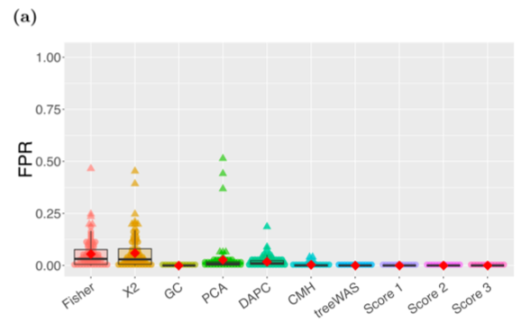
false positives
type I error
detected when it doesn’t exist
fpr = _________false positives________ (false positives + true negatives)

Slide 31
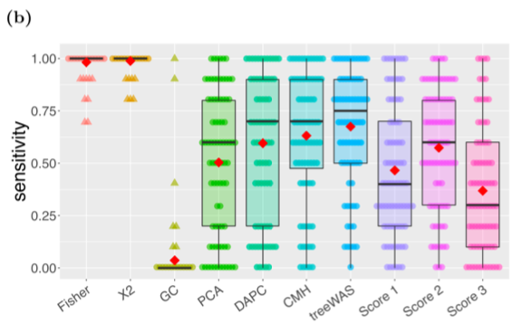
sensitivity
true positive rate
proportion of hits that are real
tpr = _________true positives________ (true positives + false negatives)

Slide 32
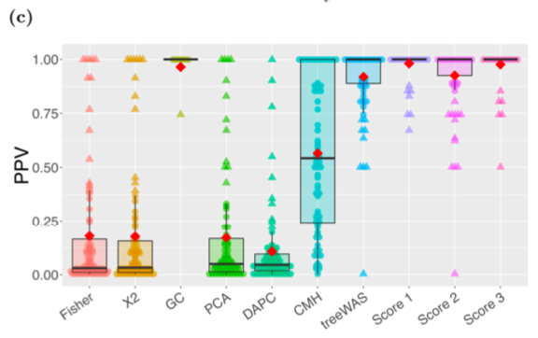
positive predictive value
proportion of results that are true positives and negatives
ppv = _________true positives________ (false positives + true positives)

Slide 33
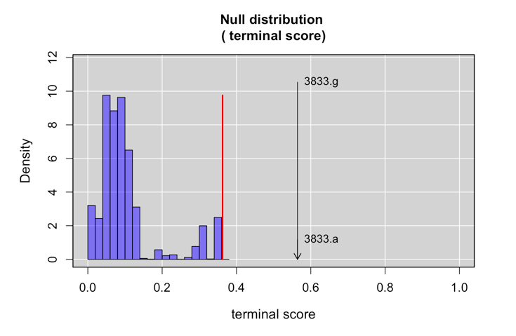
output
null distribution

Slide 34
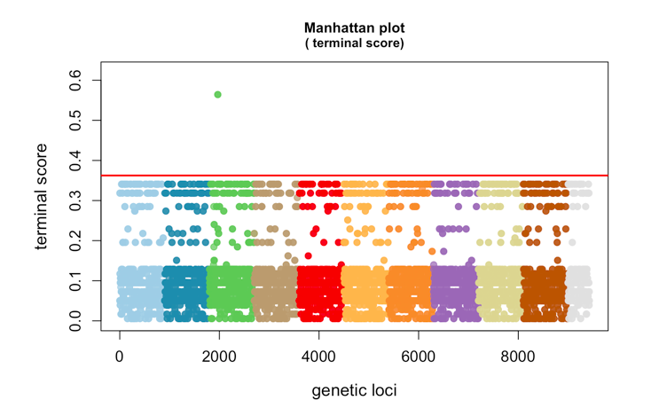
output
manhattan plot

Slide 35
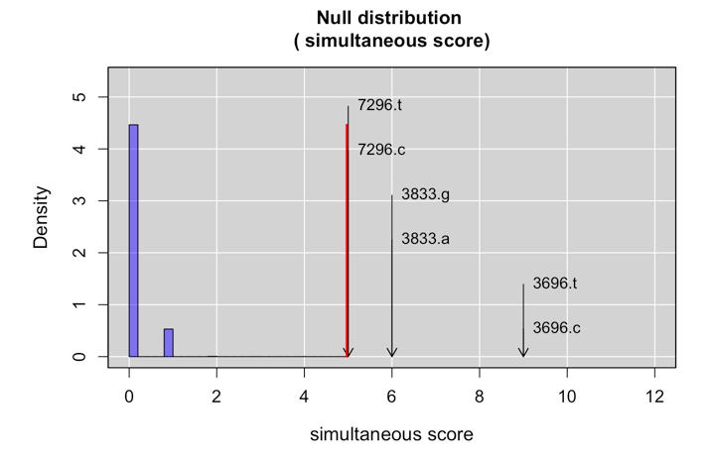
output
null distribution

Slide 36
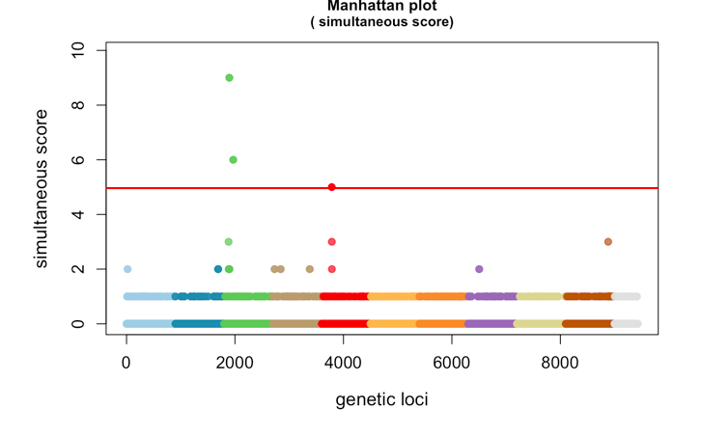
output
manhattan plot

