Slide 1
Hopper Hack
Dream Team Hotel Lovers

Slide 2
Context

Slide 3
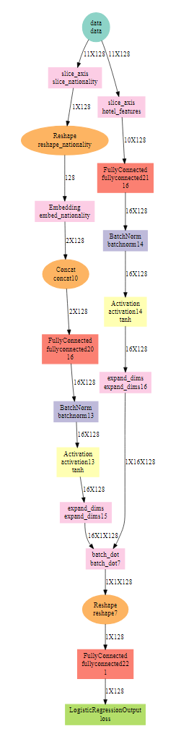
Recommender Architecture

Slide 4
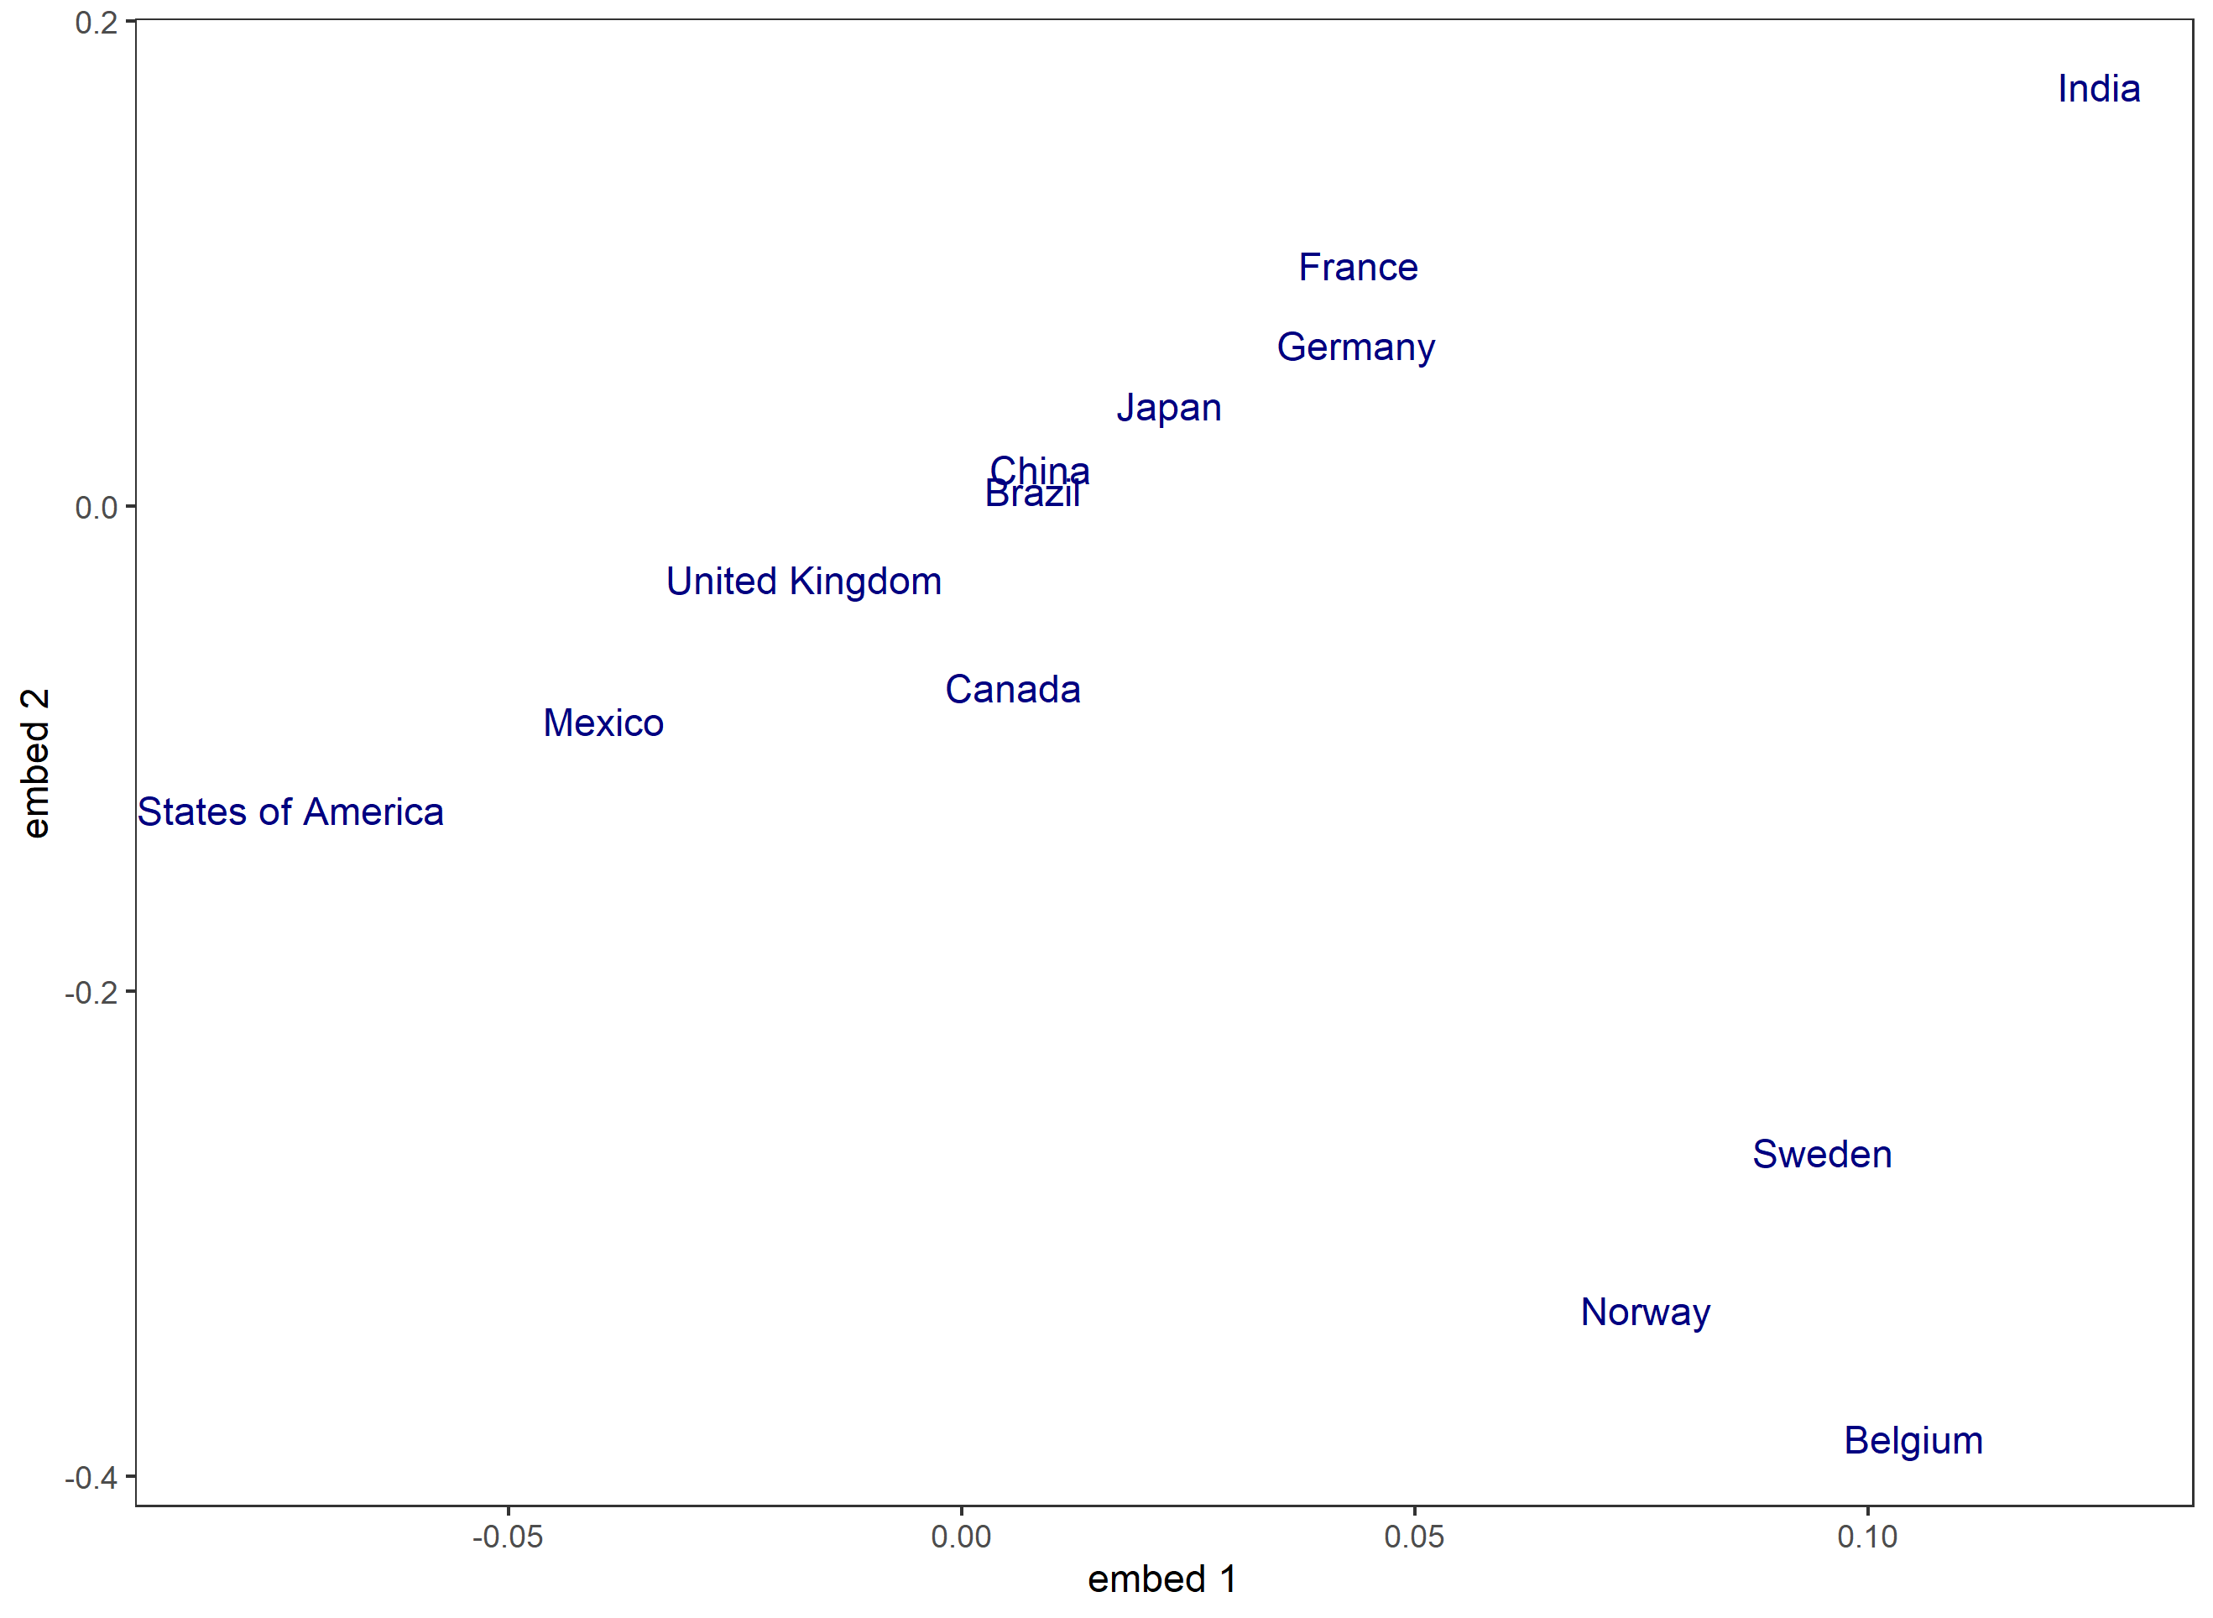
Country Embeddings

