Slide 1
Hopper Hack
Dream Team Hotel Lovers

Slide 2
Context

Slide 3
Context

Slide 4
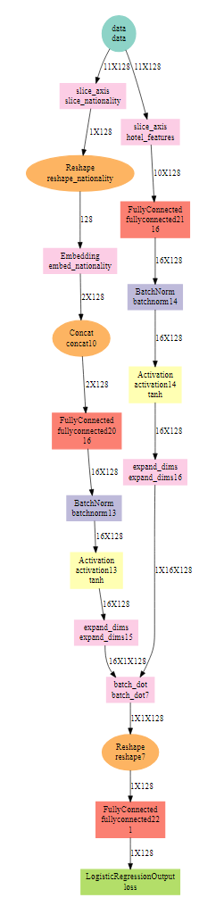
Recommender Architecture

Slide 5
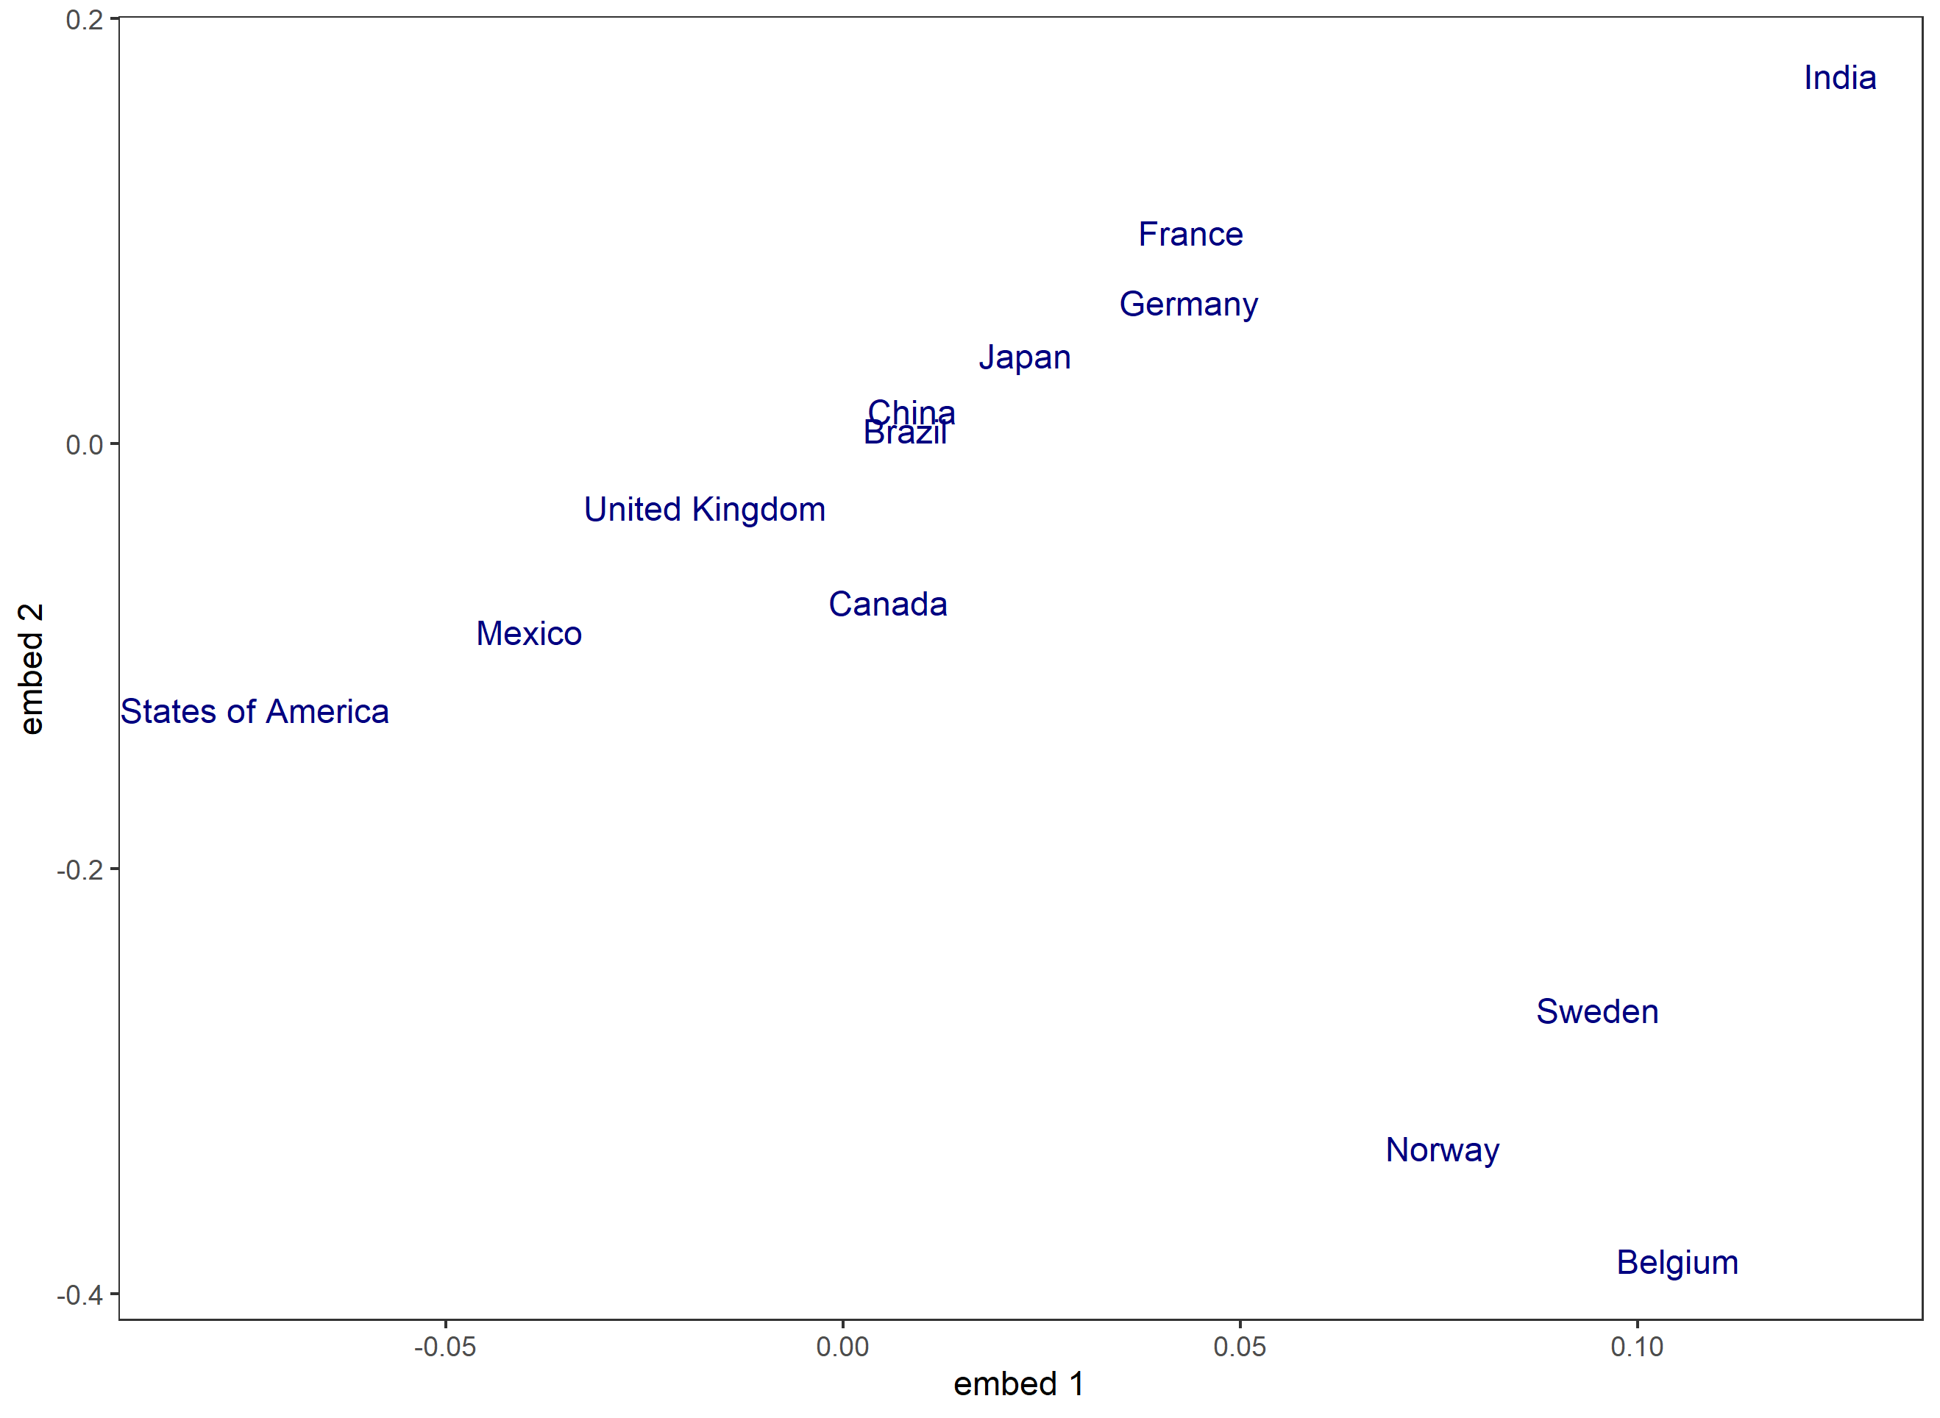
Country Embeddings

