Slide 1

System
:
Act as …, your task is to …,
User
:
Summarize Segment 1
Assistant
:
Summary 1 (by ChatGPT)
$$⋯$$
User
:
Summarize Segment 10
Assistant
:
Summary 10 (by ChatGPT)
User
:
Provide an overall summary

Slide 2
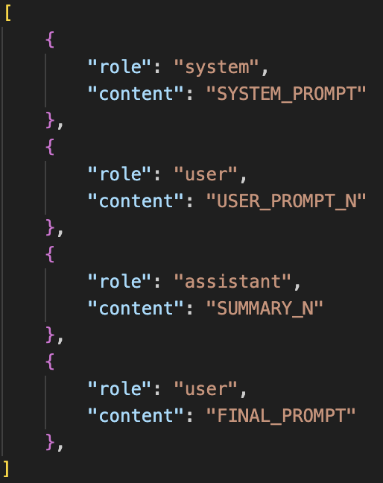
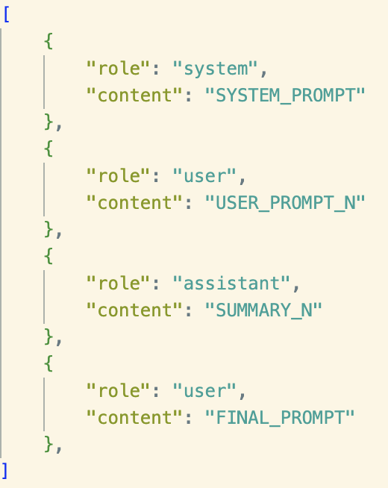
System
:
Act as …, your task is to …,
User
:
Summarize Segment N
:
Repeat N = 10 times
Assistant
Summary N (from ChatGPT)
User
:
Provide an overall summary

Slide 3


System: Act as …, your task is to …,
User: Summarize Segment N
Repeat N = 10 times
Assistant: Summary N (from ChatGPT)
1.
2. Get res, append to msgs, go back to 1
User : Provide an overall summary
System: Prompt
System: Prompt
System: Prompt
System: Prompt
User: Segment 1
User: Segment 1
User: Segment 1
User: Segment 1
Assistant: Summary 1
Assistant: Summary 1
Assistant: Summary 1
User: Segment 2
User: Segment 2
Assistant: Summary 10
User: Overall summary

Slide 4

Repeat N = 10 times
System: Prompt
System: Prompt
System: Prompt
System: Prompt
User: Seg 1
User: Seg 1
User: Seg 1
User: Seg 1
Assistant: Sum 1
Assistant: Sum 1
Assistant: Sum 1
User: Seg 2
User: Seg 2
Assistant: Sum 2
$$⋯$$
Assistant: Sum 10
User: Final Prompt

Slide 5

Repeat N = 10 times
System: Prompt
System: Prompt
User: Seg 1
System: Prompt
User: Seg 1
Assistant: Sum 1
System: Prompt
Assistant: Sum 1
User: Seg 2
User: Seg 1
User: Seg 1
Assistant: Sum 1
User: Seg 2
$$⋯$$
Assistant: Sum 2
Assistant: Sum 10
User: Final Prompt

Slide 6
System: Prompt
System: Prompt
User: Seg 1
System: Prompt
User: Seg 1
Assistant: Sum 1
System: Prompt
Assistant: Sum 1
User: Seg 2
User: Seg 1
User: Seg 1
Assistant: Sum 1
User: Seg 2
$$⋯$$
Assistant: Sum 2
Assistant: Sum 10
User: Final Prompt

Slide 7

System: Prompt
System: Prompt
System: Prompt
System: Prompt
User: Seg 1
User: Seg 1
User: Seg 1
User: Seg 1
Assistant: Sum 1
Assistant: Sum 1
Assistant: Sum 1
User: Seg 2
User: Seg 2
Assistant: Sum 2
$$⋯$$
Assistant: Sum N
User: Final Prompt

Slide 8

Repeat N = 10 times
System: Prompt
System: Prompt
System: Prompt
System: Prompt
User: Seg 1
User: Seg 1
User: Seg 1
User: Seg 1
Assistant: Sum 1
Assistant: Sum 1
Assistant: Sum 1
User: Seg 2
User: Seg 2
Assistant: Sum 2
$$⋯$$
Assistant: Sum 10
User: Final Prompt

Slide 9

Repeat N = 10 times
System: Prompt
System: Prompt
System: Prompt
System: Prompt
User: Seg 1
User: Seg 1
User: Seg 1
User: Seg 1
Assistant: Sum 1
Assistant: Sum 1
Assistant: Sum 1
User: Seg 2
User: Seg 2
Assistant: Sum 2
$$⋯$$
Assistant: Sum 10
User: Final Prompt

Slide 10
Repeat N = 10 times
System: Prompt
System: Prompt
System: Prompt
System: Prompt
User: Seg 1
User: Seg 1
User: Seg 1
User: Seg 1
Assistant: Sum 1
Assistant: Sum 1
Assistant: Sum 1
User: Seg 2
User: Seg 2
Assistant: Sum 2
$$⋯$$
Assistant: Sum 10
User: Final Prompt

