Slide 1


Slide 2
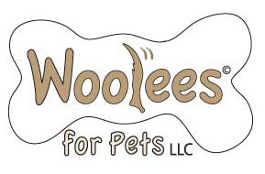
Woolees encompasses a tradition of hard work and “all things animal”. Woolees are created from 100% wool fabric woven in the US and Canada and gently stuffed with natural wool fleece from sheep and alpacas raised here in Maine. We are proud to offer this USA made product to animals and their people.

