Slide 1
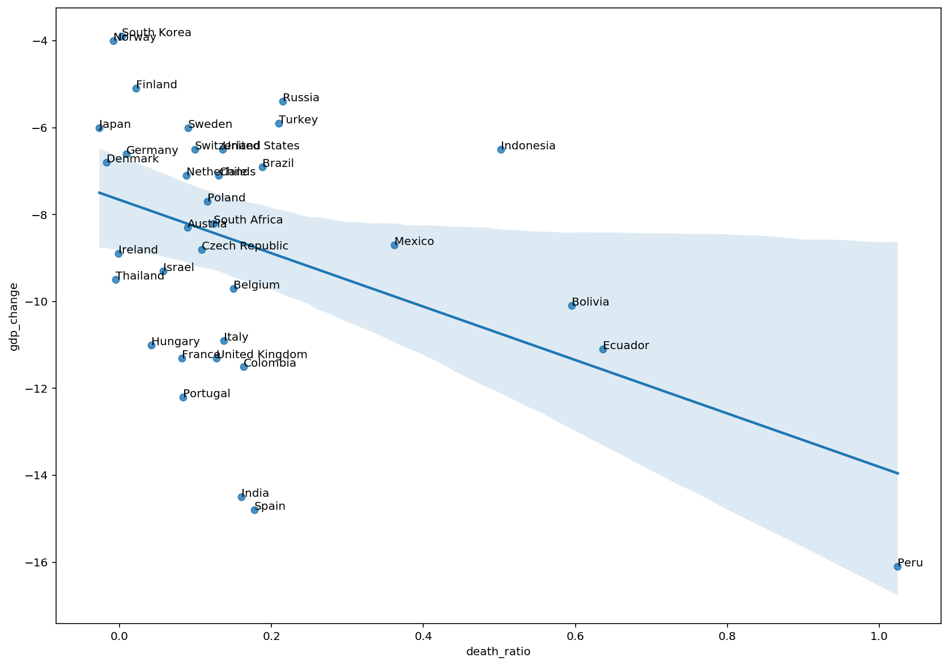
GDP growth rate difference
(Year 2020 - Year 2019)
Excess/Expected Death (Year 2020)

