Slide 1
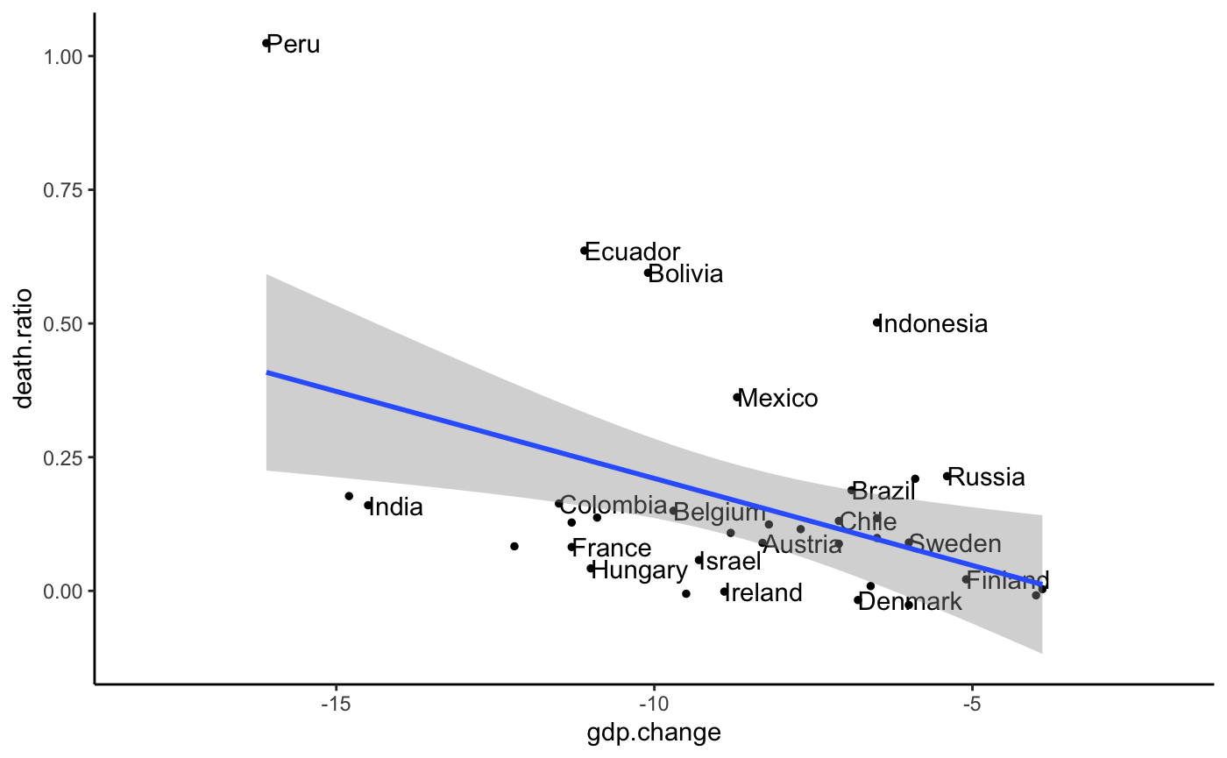
Excess/Expected Death (Year 2020)
-15% -10% -5%
GDP growth rate difference
(Year 2020 - Year 2019)

