Slide 1
C0 – Introduction
my humble ML course
C0 – Introduction
Notes:
Introduction:
What is a ML model?
Supervised learning
Unsupervised learning

Slide 2


my humble ML course
Applications
Data analysis
Statistics
Pros
High level
Cons
Bad for software products
Hard to see source code
Applications
ML, DL
Software
Pros
Easy to see source code
Good for deploying products
Cons
More lines of code than R

Slide 3



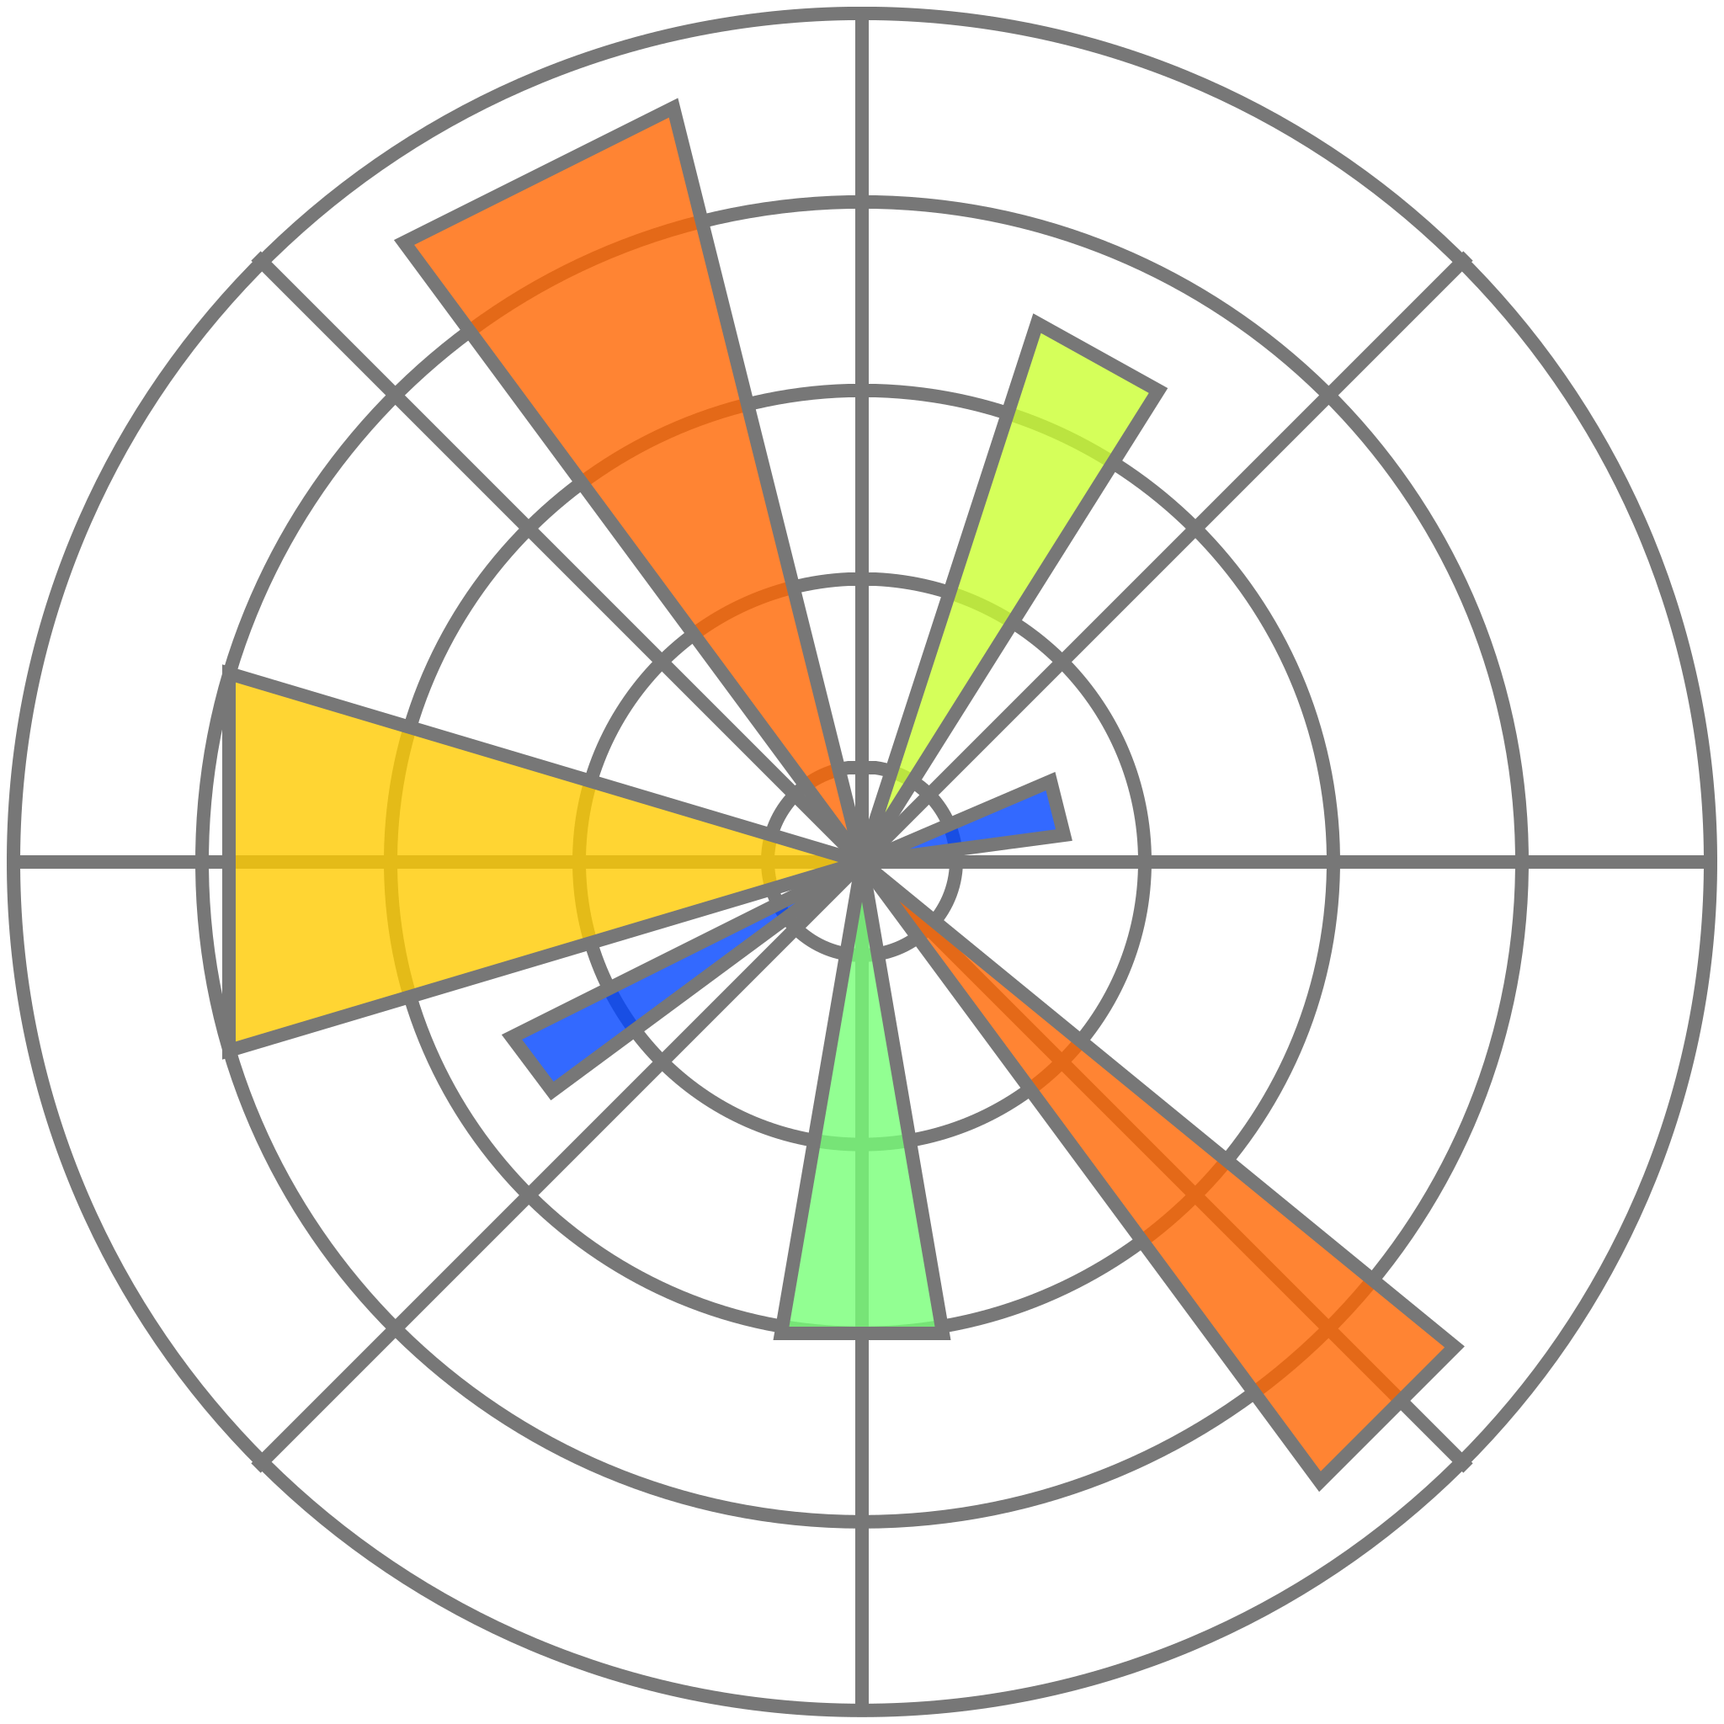


my humble ML course
Python libraries
Datasets (dataframes)
Beautiful plots
Scientific computing
Linear algebra (vectors, matrices)
ML algorithms ready-to-use
Basic plots

Slide 4



my humble ML course
Python Online IDEs
Integration with Google Drive
Good to learn
No installations required
Alternative to Colab

Slide 5
my humble ML course
Additional resources
https://github.com/SuvroBaner/Python-for-Data-Science-and-Machine-Learning-Bootcamp/blob/master/1.%20Python%20Crash%20Course/Python%20Crash%20Course.ipynb
https://colab.research.google.com/github/kamperh/data414/blob/main/practicals/python_numpy/python_numpy.ipynb
https://github.com/donnemartin/data-science-ipython-notebooks/blob/master/pandas/pandas.ipynb
https://github.com/neurodatascience/course-materials-2020/blob/master/lectures/12-may/01-python-for-data-analysis/python-for-data-analysis.ipynb
https://github.com/donnemartin/data-science-ipython-notebooks/tree/master/pandas
https://github.com/iutzeler/Introduction-to-Python-for-Data-Sciences/tree/master
Notes:
https://github.com/kamperh/data414

Slide 6
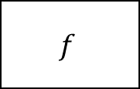


my humble ML course
What is Machine Learning?
Training data
The field of machine learning is concerned with the question of how to construct computer programs that automatically improve with experience. ~ Tom Mitchell
Field of study that gives computers the ability to learn without being explicitly programmed ~ Arthur Samuel
The goal of machine learning is to develop methods that can automatically detect patterns in data, and then to use the uncovered patterns to predict future data or other outcomes of interes. ~ Kevin P. Murphy
Learning algorithm
Input
Output
$$f$$
$$x$$
$$y$$
Model /
Hypothesis
Notes:
https://github.com/kamperh/data414

Slide 7

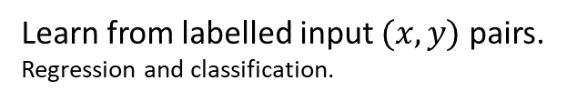



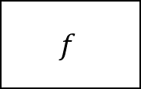

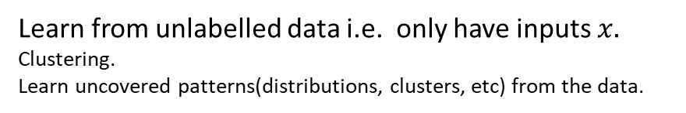

my humble ML course
Types of learning
Supervised Learning
Unsupervised Learning
Learn from labelled input $(x,y)$ pairs.
Regression and classification.
Learn from unlabelled data i.e. only have inputs $x.$
Clustering.
Learn uncovered patterns(distributions, clusters, etc) from the data.
Input
Real value
Input
$$f$$
$$f$$
$$x$$
$$\hat{y}$$
$$y$$
$$x$$
$$\hat{y}$$
Model /
Hypothesis
Model output /
Prediction
Model /
Hypothesis
Model output /
Prediction
Notes:
https://github.com/kamperh/data414

Slide 8
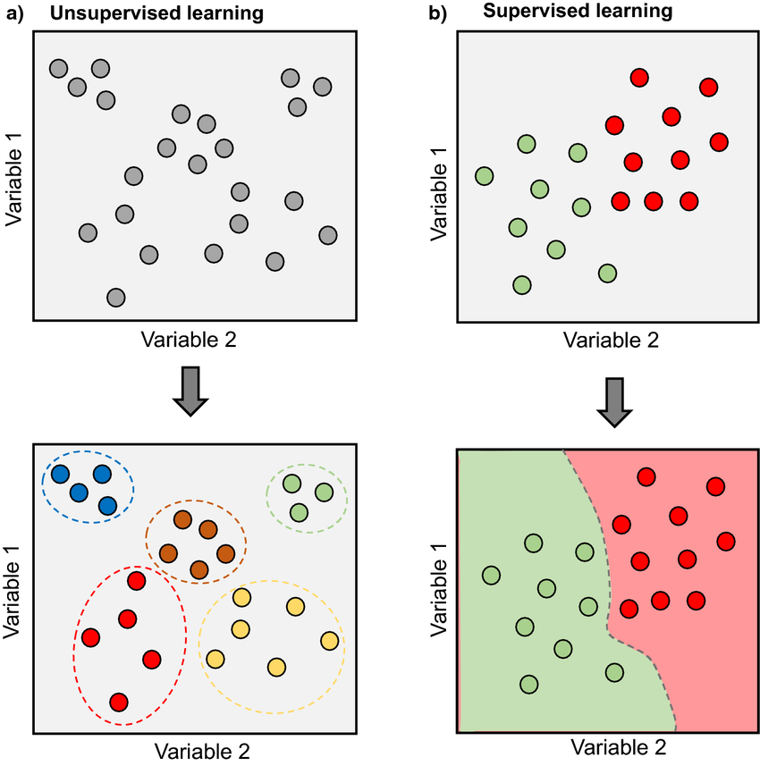
my humble ML course
Supervised vs. Unsupervised
Notes:
https://github.com/kamperh/data414

Slide 9
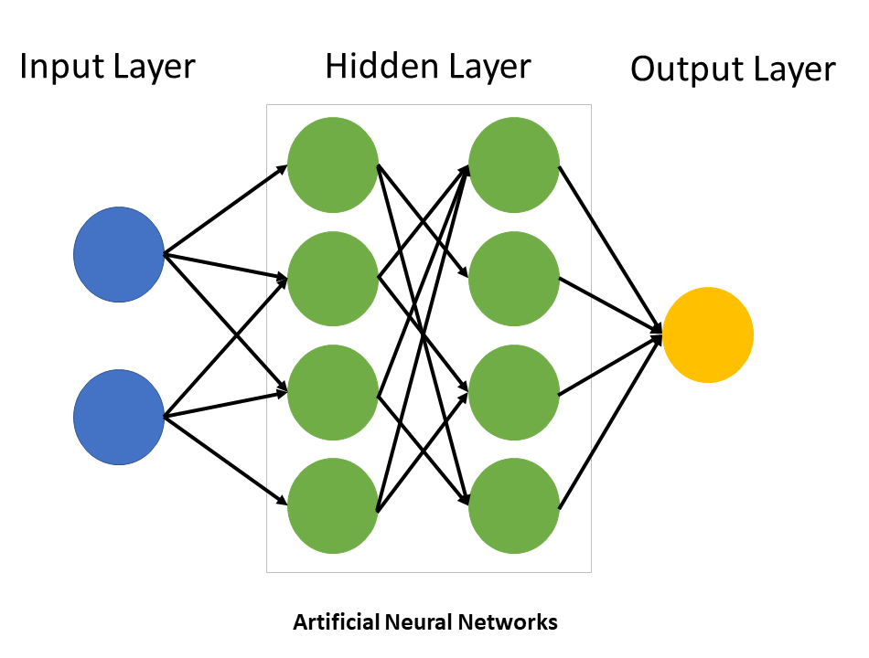
my humble ML course
What is Deep Learning?
Deep Learning is a subfield of machine learning concerned with algorithms inspired by the structure and function of the brain called artificial neural networks.
Notes:
https://github.com/kamperh/data414

Slide 10
my humble ML course
Deep Learning
AI
NLP
Computer Vision
ML
Generative Models
DL
…
Notes:
https://github.com/kamperh/data414

Slide 11
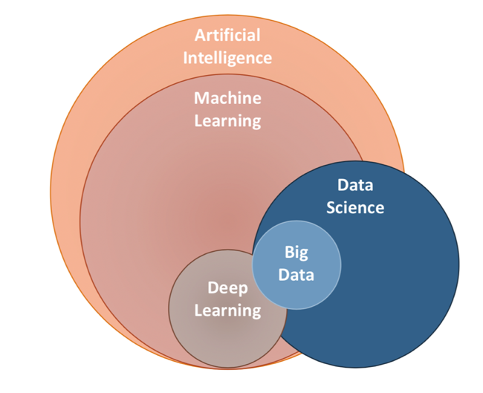
my humble ML course
What is Data Science?
Notes:
https://github.com/kamperh/data414

