Slide 1
Machine Learning
Gradient Descent Algorithm
Linear Regression
Non-Linear Regression
Logistic Regression
Decision Trees
Regression Trees
Classification Trees
Clustering Algorithms
K-Means
Hierarchical clustering
DB-Scan
Mean Shift
GMM
Support Vector Machine
Deep Learning
MLP
CNN
Datasets
Breast Cancer Wisconsin
MIMIC-III
Framingham Heart Study
Alzheimer’s Disease Neuroimaging Initiative
Drug discovery
Microbiome

Slide 2
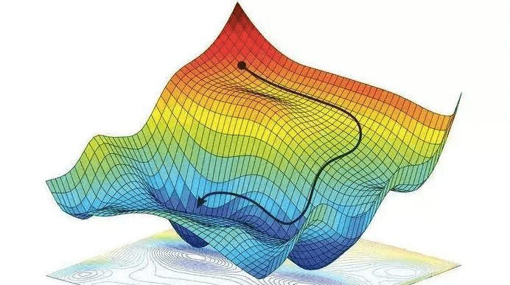
C1 – Gradient Descent Algorithm
my humble ML course
Notes:
https://towardsdatascience.com/gradient-descent-algorithm-a-deep-dive-cf04e8115f21
https://towardsdatascience.com/all-machine-learning-models-explained-in-6-minutes-9fe30ff6776a
https://medium.com/grabngoinfo/gradient-descent-vs-616ba269de8d

Slide 3
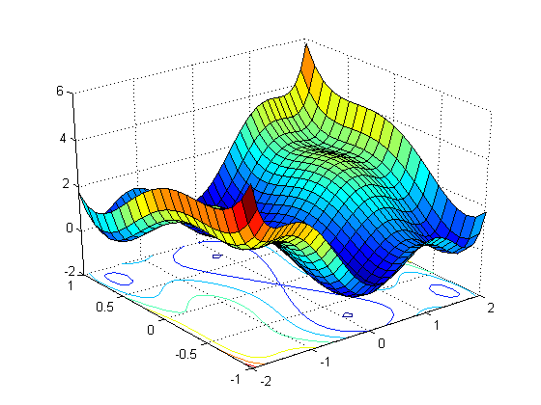
my humble ML course
Vanilla Gradient Descent
First-order optimization algorithm to find a local minimum/maximum of a given function.
Gradient descent algorithm does not work for all functions.
There are two specific requirements. A functions must be:
differentiable
convex

Slide 4
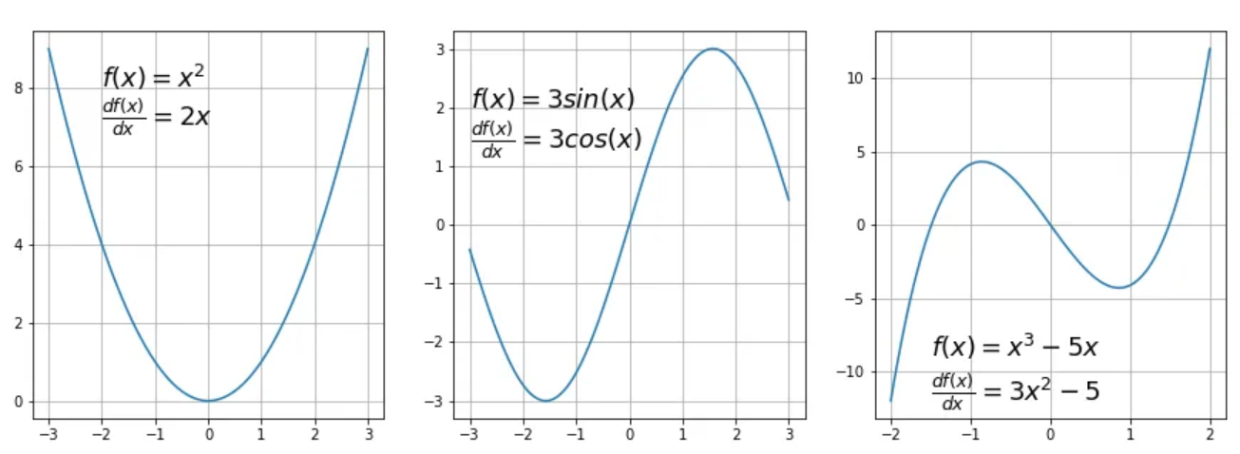
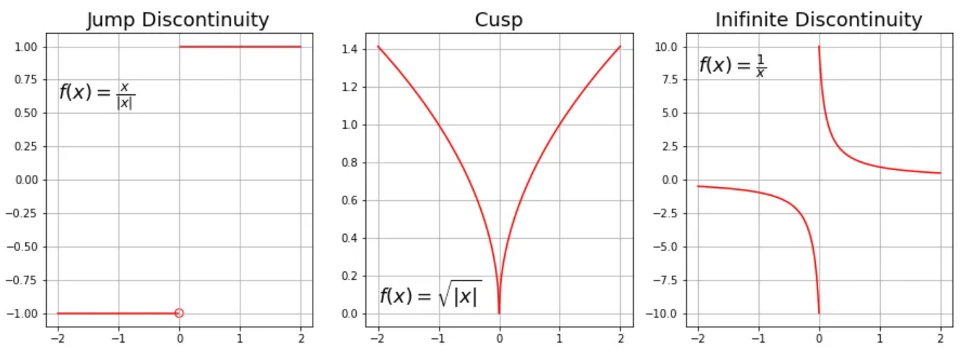
my humble ML course
Vanilla Gradient Descent
Differentiable:
A function is differentiable it has a derivative for each point in its domain

Slide 5
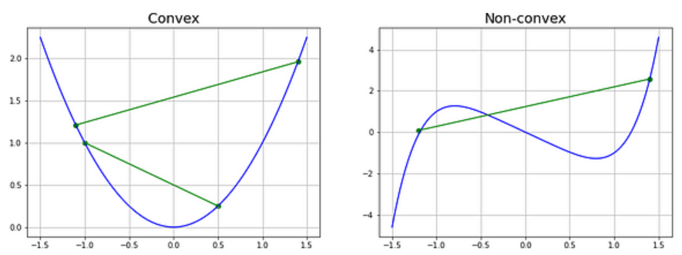
my humble ML course
Vanilla Gradient Descent
Convex:
A real function is convex on an interval (a,b), if the chord joining any two points in the function lies above the function.

Slide 6
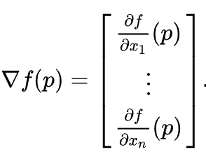
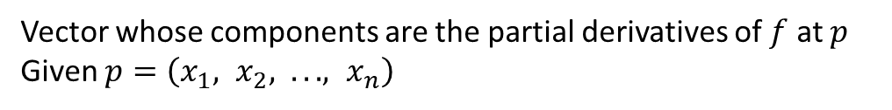
my humble ML course
Gradient
Vector whose components are the partial derivatives of $f$ at $p$
Given $p=\left(x_{1}, x_{2}, .. . , x_{n}\right)$
The gradient vector is used to determine the direction in which a function grows fastest at a given point, and it is also used in function optimization to find minimums and maximums.
If the gradient of a function at a point is zero, then that point may be a local minimum or maximum of the function, or an inflection point.

Slide 7
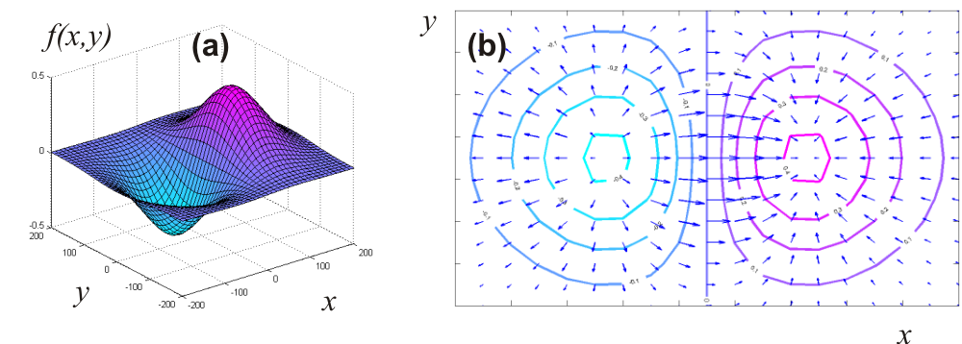
my humble ML course
Gradient
Notes:
https://www.geogebra.org/m/QhfcuhqA
https://www.geogebra.org/m/VKU7BrFK

Slide 8
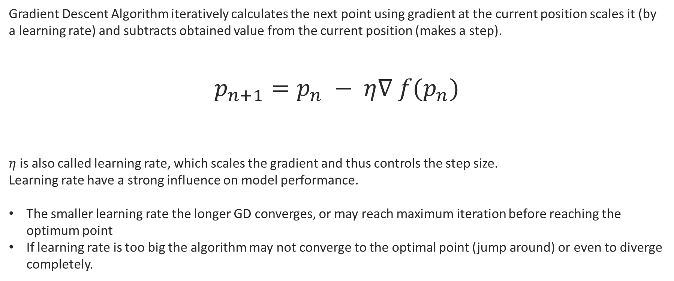
my humble ML course
Gradient descent algorithm
Gradient Descent Algorithm iteratively calculates the next point using gradient at the current position scales it (by a learning rate) and subtracts obtained value from the current position (makes a step).
$$p_{n+1}=p_{n} − η∇ f(p_{n})$$
$η$is also called learning rate, which scales the gradient and thus controls the step size.
Learning rate have a strong influence on model performance.
The smaller learning rate the longer GD converges, or may reach maximum iteration before reaching the optimum point
If learning rate is too big the algorithm may not converge to the optimal point (jump around) or even to diverge completely.

Slide 9
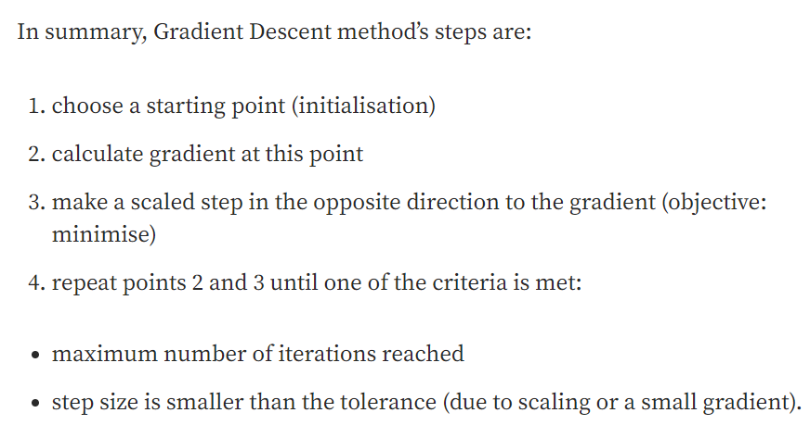
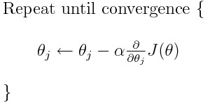
my humble ML course
Gradient descent algorithm

Slide 10
my humble ML course
def gradient_descent(start, gradient, learn_rate, max_iter, tol=0.01):
"""Gradient descent algorithm.
args:
start: starting point (maybe random initialisation)
gradient: function to calculate gradient
learn_rate: learning rate | scaling factor for step sizes
max_iter: maximum number of iterations
tol: tolerance for stopping criterion
returns:
steps: list of all steps
x: final value
"""
steps = [start]
x = start
for _ in range(max_iter):
diff = learn_rate * gradient(x)
if np.abs(diff) < tol:
break
x = x - diff
steps.append(x)
return steps, x

Slide 11
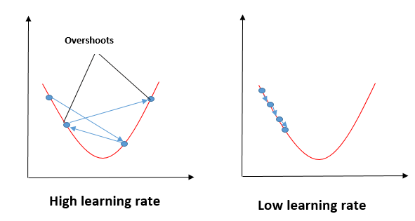
my humble ML course

Slide 12
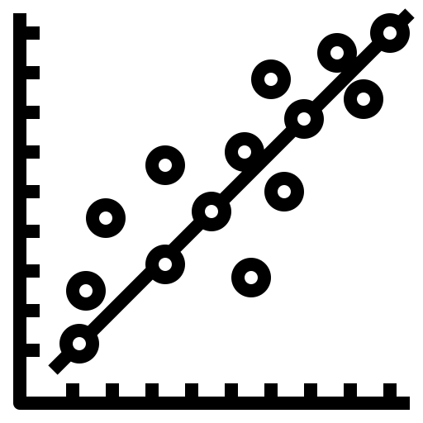
C1 – Linear Regression
my humble ML course
Notes:
https://www.analyticsvidhya.com/blog/2021/06/linear-regression-in-machine-learning/

Slide 13
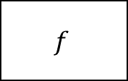
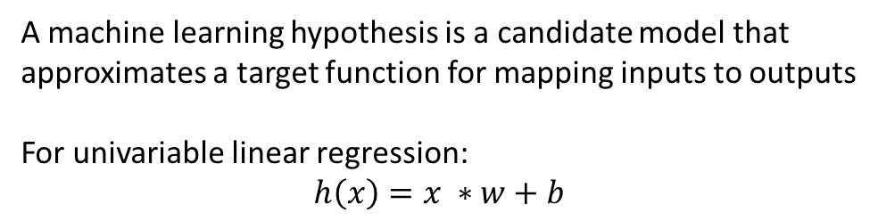


my humble ML course
Model/Hypothesis
Training data
A machine learning hypothesis is a candidate model that approximates a target function for mapping inputs to outputs
For univariable linear regression:
$$h\left(x\right)=x ∗w+b$$
Learning algorithm
Input
Output
$$f$$
$$x$$
$$y$$
Model /
Hypothesis

Slide 14
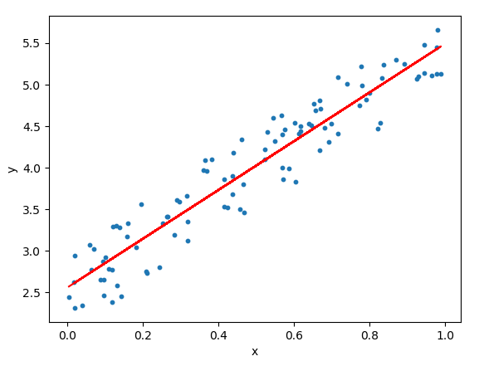
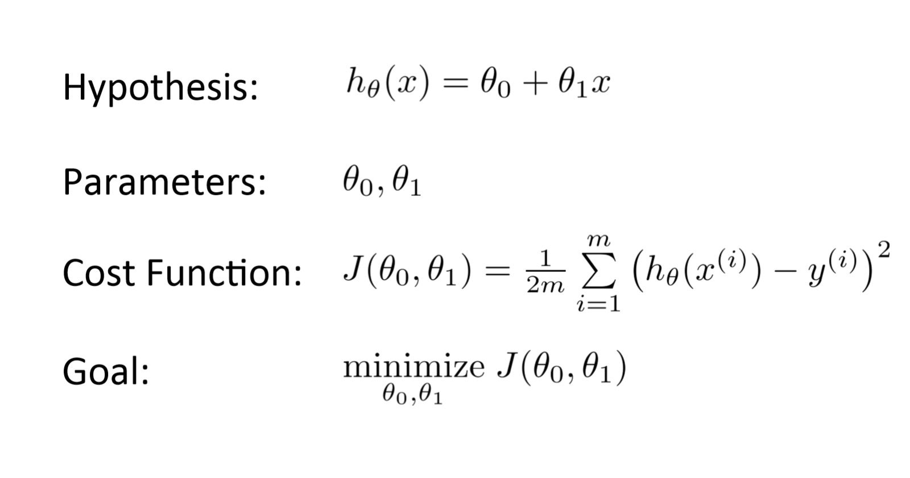
my humble ML course
Univariable Linear Regression
is an attempt to model the relationship between variables by fitting a linear equation to observed data.
GOAL: Find the best line that fits the data.

Slide 15
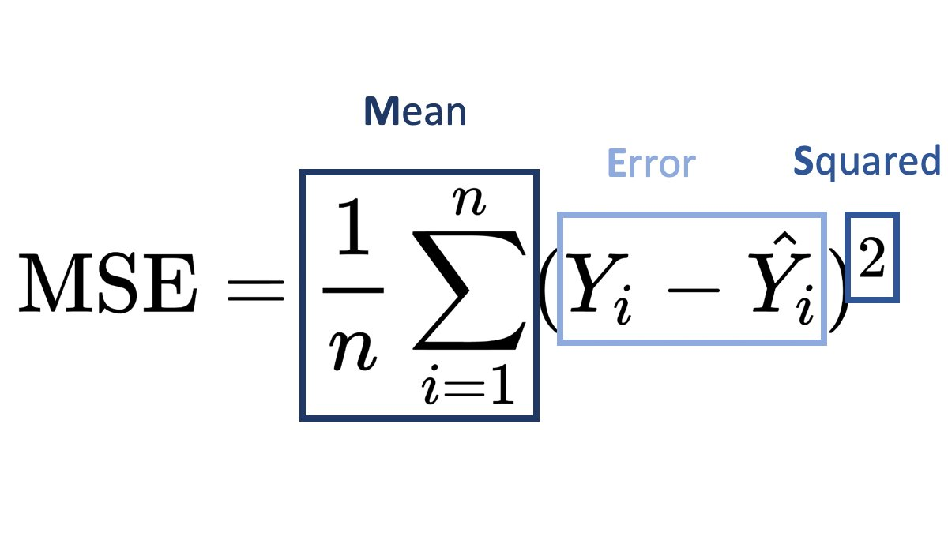
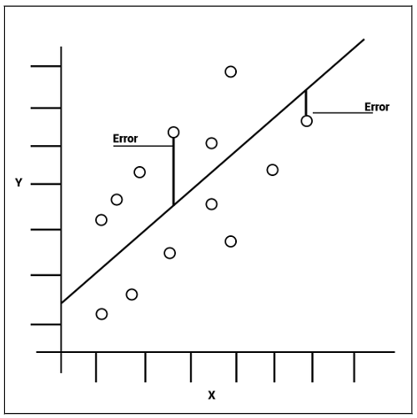
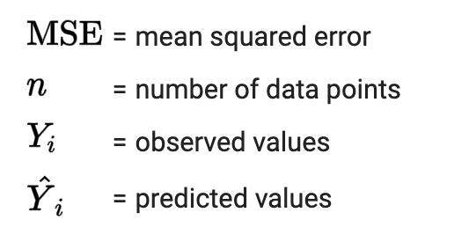
my humble ML course
Loss function (MSE)

Slide 16
my humble ML course
Univariable Linear Regression

Slide 17
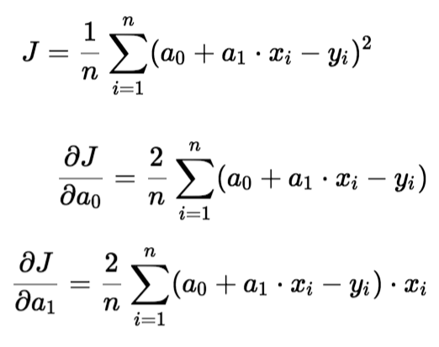
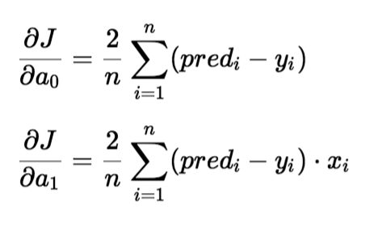
my humble ML course
Partial derivatives / Gradient Vector

Slide 18
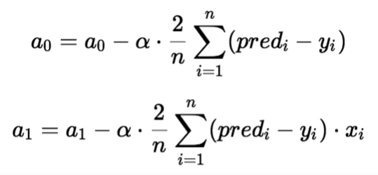
my humble ML course
Update parameters with GD algorithm
Notes:
https://math.stackexchange.com/questions/3152235/partial-derivative-of-mse-cost-function-in-linear-regression
https://www.analyticsvidhya.com/blog/2021/06/linear-regression-in-machine-learning/
https://sebastianraschka.com/faq/docs/mse-derivative.html

Slide 19
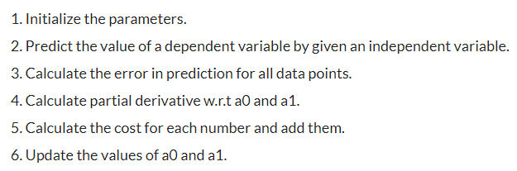
my humble ML course
Pseudocode
Notes:
https://github.com/kamperh/data414

Slide 20

my humble ML course
Code
Notes:
https://github.com/kamperh/data414

Slide 21
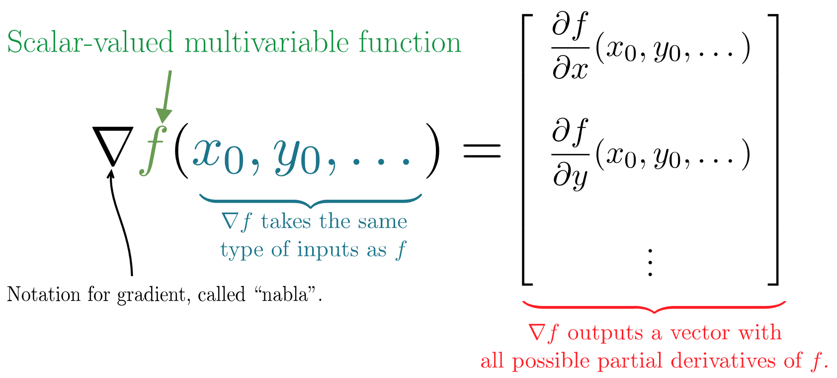
my humble ML course
Notes:
https://github.com/kamperh/data414

