Slide 1
Uploading Arduino Code in the Marlin Environment to Lulzbot Taz Pro
Vinh Nguyen

Slide 2
Basic information
The Lulzbot Taz Pro uses an Archim2 motherboard that can be programmed with custom code.
The Arduino environment is used in these instructions.
A PC with a USB port must be used.

Slide 3
Preparing Arduino Environment
Download the latest Arduino software from https://www.arduino.cc/en/software
Install the Archim board for the Arduino software. Instructions (reproduced below) are on https://reprap.org/wiki/Archim2
Install Archim board support:
From the Arduino File menu select Preferences.
Add the following URL to "Additional Board Manager URLs" section.
https://raw.githubusercontent.com/ultimachine/ArduinoAddons/master/package_ultimachine_index.json
The Board Manager is found at the top of the Tools->Board selection menu.
Open the Board Manager and the list boards will automatically update.
Search for Archim and install.
Install TMCStepper library: Arduino IDE-> Sketch menu -> Include Library -> Manage Libraries -> install TMCStepper

Slide 4
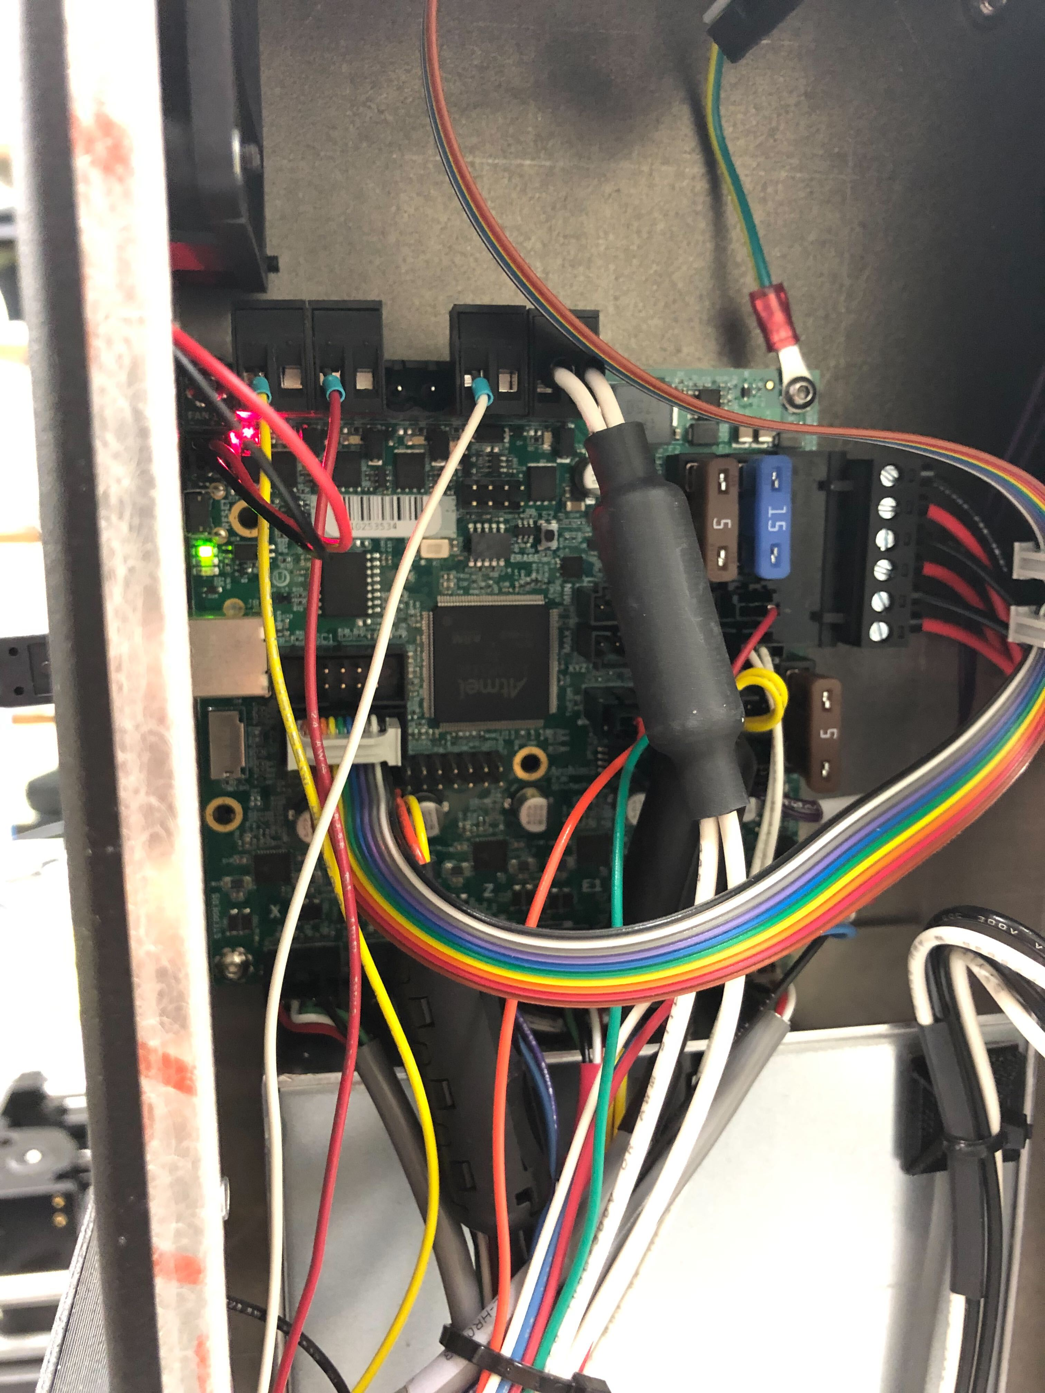
Preparing Taz Pro
ERASE Button
Remove the side panel (left of LCD when facing the front of the printer) by unscrewing the bolts.
Turn on the power to the Taz Pro (red switch in front)
Hold the ERASE button for 1 second to clear the EEPROM memory (this switches the board from “Operating Mode” to “Uploading Mode”)
The LCD should be blank about 10 seconds after pressing the ERASE button

Slide 5
Uploading Code from Arduino
Connect the PC to the Taz Pro using the USB port in the back of the printer
Open the “Marlin.ino” file in the Arduino IDE
Go to the upper tab and select Tools->Board->ultimachine-sam->Archim
While also in Tools, select Tools->Port->”The Serial Port that represents your board”
Upload the code. You should see the following message if done correctly
Write 316452 bytes to flash (1237 pages)
[==============================] 100% (1237/1237 pages)
done in 14.833 seconds
Verify 316452 bytes of flash
[==============================] 100% (1237/1237 pages)
Verify successful

