Slide 1
Uploading Code in the Marlin Environment to Lulzbot Taz Pro
Vinh Nguyen

Slide 2
Basic information
The Lulzbot Taz Pro uses an Archim2 motherboard that can be programmed with custom code.
Visual Studio Code (NOT Visual Studio) is used as the Integrated Development Environment (IDE) to modify the code.
The Arduino environment is used to upload the code (NOT TO MODIFY THE CODE). The Arduino IDE is terrible to modify the code, and the code is fairly complex.
A PC with a USB port must be used.

Slide 3
Preparing Visual Studio Code Environment
Download the latest Visual Studio Code software from https://code.visualstudio.com/Download
You can add any C++ extensions you’d like; this software doesn’t depend on anything specific.
PlatformIO, which is a way to directly upload code (other than using the Arduino) does not seem to work well with Lulzbot firmware.

Slide 4
Preparing Arduino Environment
Download the latest Arduino software from https://www.arduino.cc/en/software
Install the Archim board for the Arduino software. Instructions (reproduced below) are on https://reprap.org/wiki/Archim2
Install Archim board support:
From the Arduino File menu select Preferences.
Add the following URL to "Additional Board Manager URLs" section.
https://raw.githubusercontent.com/ultimachine/ArduinoAddons/master/package_ultimachine_index.json
The Board Manager is found at the top of the Tools->Board selection menu.
Open the Board Manager and the list boards will automatically update.
Search for Archim and install.
Install TMCStepper library: Arduino IDE-> Sketch menu -> Include Library -> Manage Libraries -> install TMCStepper

Slide 5
Modifying the code Open Arduino IDE
To prepare the code for modification, Open the “Marlin.ino” file in the Arduino IDE
Then select File->Preferences
In the options, select “Use External Editor”, and then confirm by selecting “OK”
Preparing the environment this way allows us to use the Arduino environment as an uploading environment while also allowing us to modify the same code that’s opened in Visual Studio Code

Slide 6
Modifying the code Open Visual Studio Code IDE
Open Visual Studio Code IDE
Select “File” -> “Open Folder”
Select the folder that has the code. If downloading the code from Github, this would be “exploratory-soft-printer”. Alternatively, you can open the “Marlin” subfolder underneath the “exploratory-soft-printer” folder.
You can now edit the code.

Slide 7
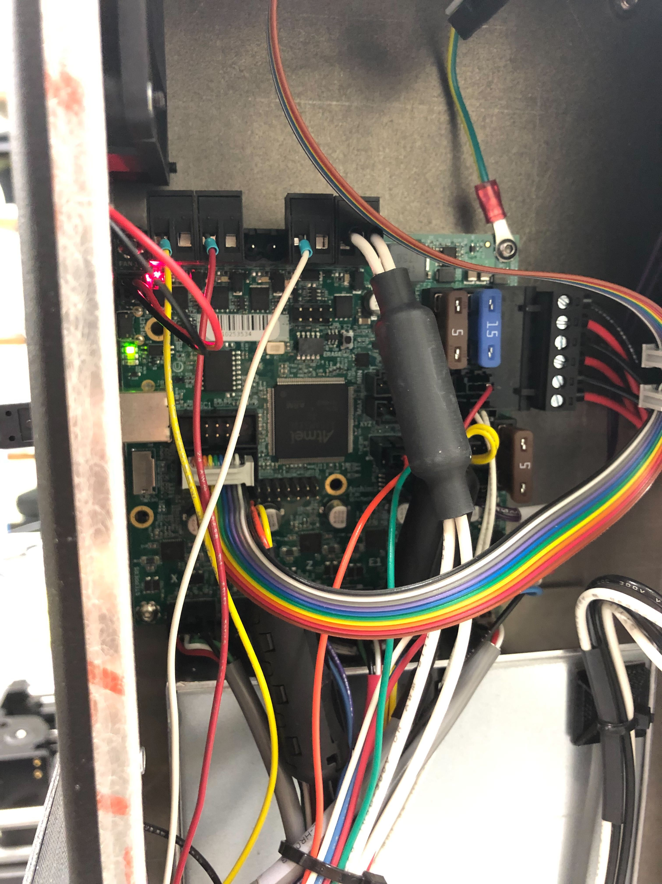
Uploading Code Preparing Taz Pro
ERASE Button
Remove the side panel (left of LCD when facing the front of the printer) by unscrewing the bolts.
Turn on the power to the Taz Pro (red switch in front)
Hold the ERASE button for 1 second to clear the EEPROM memory (this switches the board from “Operating Mode” to “Uploading Mode”)
The LCD should be blank about 10 seconds after pressing the ERASE button

Slide 8
Uploading Code Arduino IDE
Connect the PC to the Taz Pro using the USB port in the back of the printer
Go to the Arduino IDE
Go to the upper tab and select Tools->Board->ultimachine-sam->Archim
While also in Tools, select Tools->Port->”The Serial Port that represents your board”
Upload the code. You should see the following message if done correctly
Write 316452 bytes to flash (1237 pages)
[==============================] 100% (1237/1237 pages)
done in 14.833 seconds
Verify 316452 bytes of flash
[==============================] 100% (1237/1237 pages)
Verify successful

