Slide 1
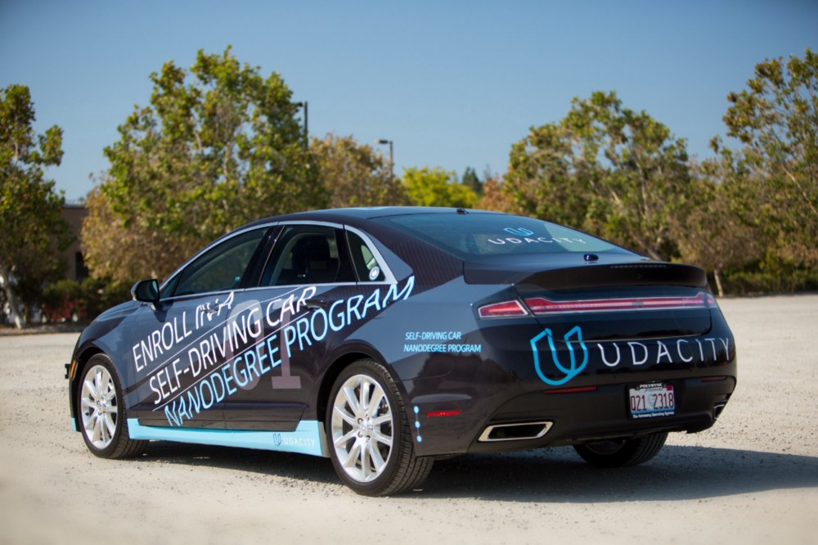
SDCND
FINAL
PROJECT
PART 1

