Slide 1
Video Presentation – Data Governance Big Data
http://go.makebigdatawork.org/mc20171011tyb2-0?utm_campaign=Webinars&utm_source=hs_email&utm_medium=email&utm_content=57260581&_hsenc=p2ANqtz-8hmYAo_a-gYkREvi-piZ7sJR7A62whKJnYd_nFcJD0BR24Ro0VTbY3Ii2PAK4NoY8tqZDDRrqtr3Xl1aot5ksCjPa1zg&_hsmi=57260581

Slide 2
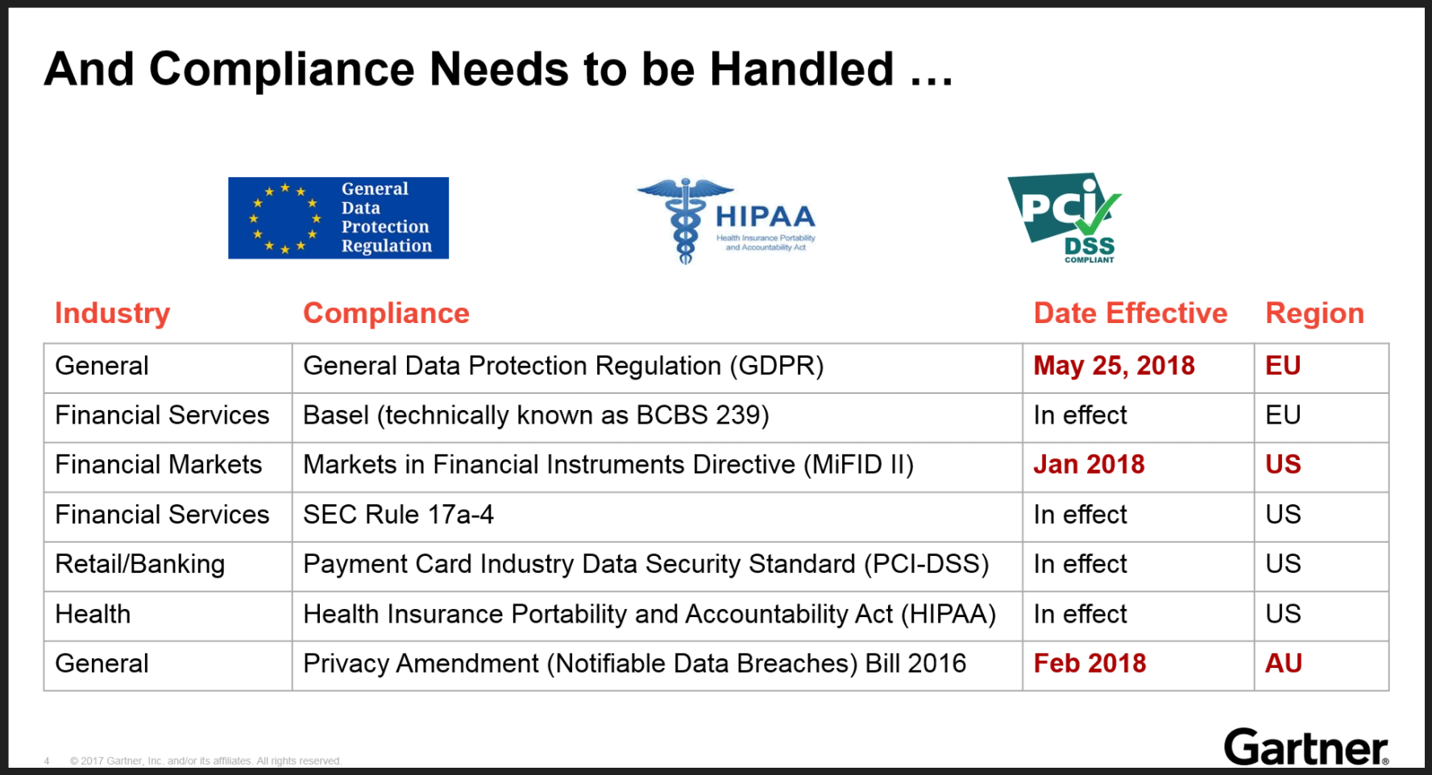
Presentation of Data Governance on 10/10/2017 by Sanjeev Mohan, Gartner

Slide 3
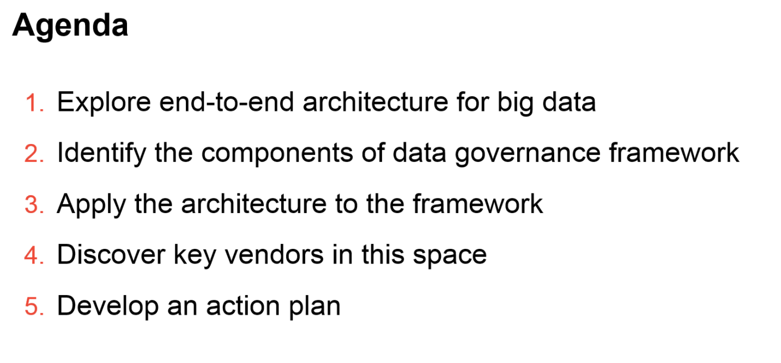

Slide 4
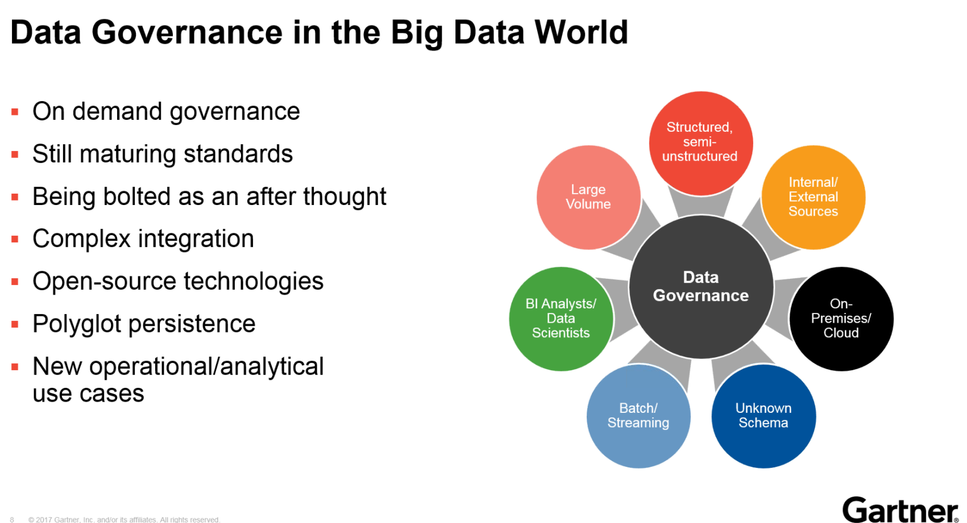

Slide 5
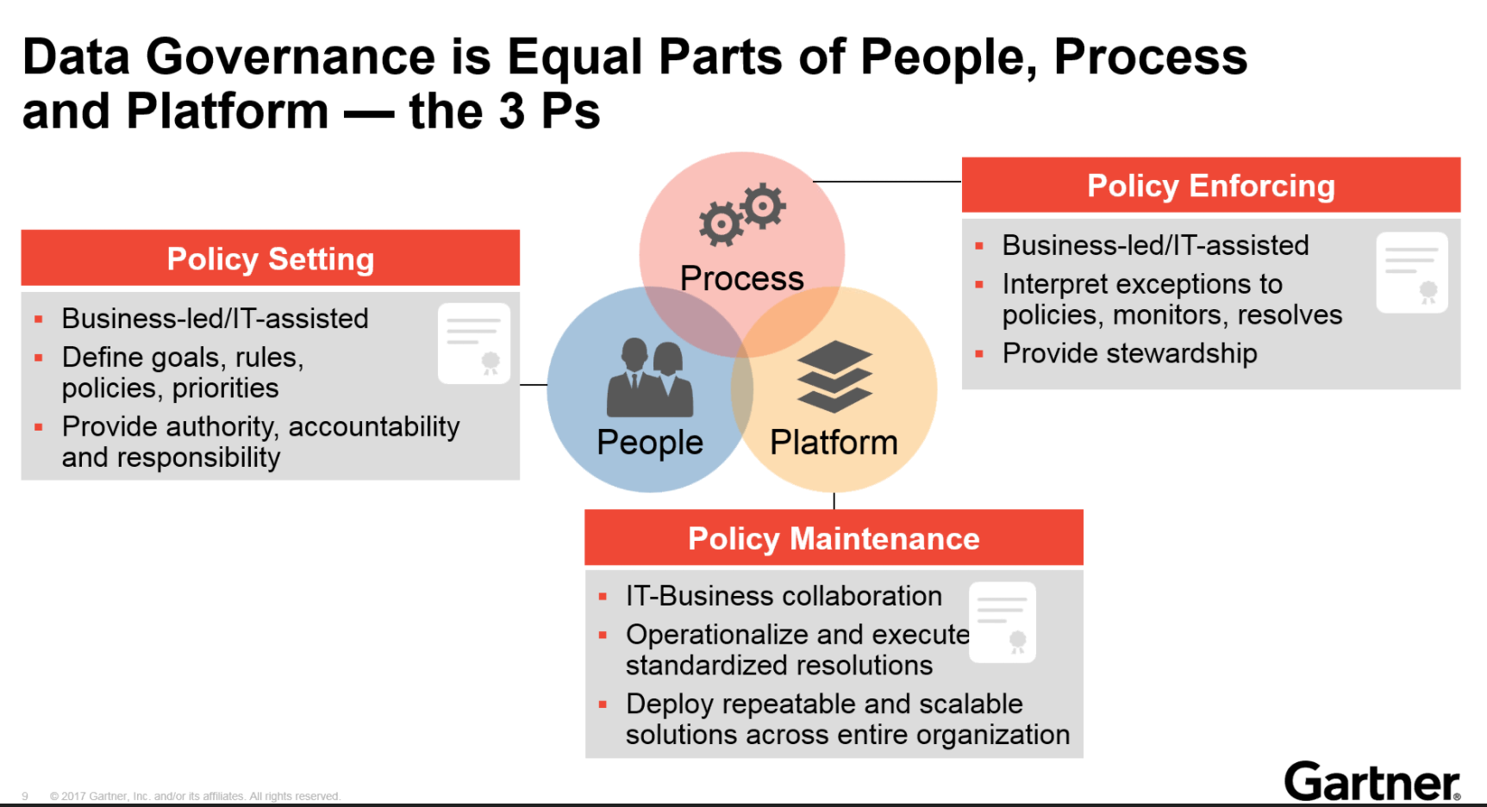

Slide 6
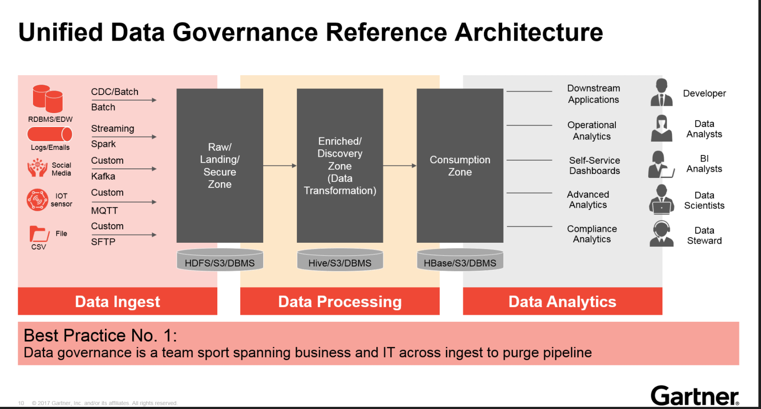

Slide 7
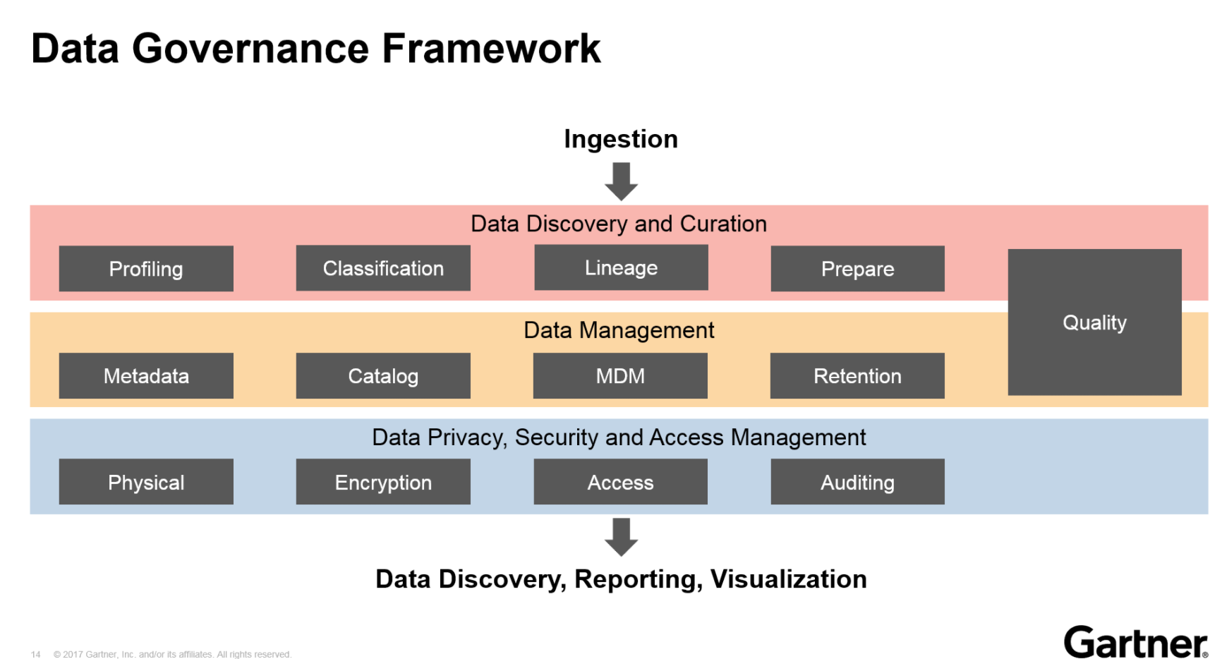

Slide 8
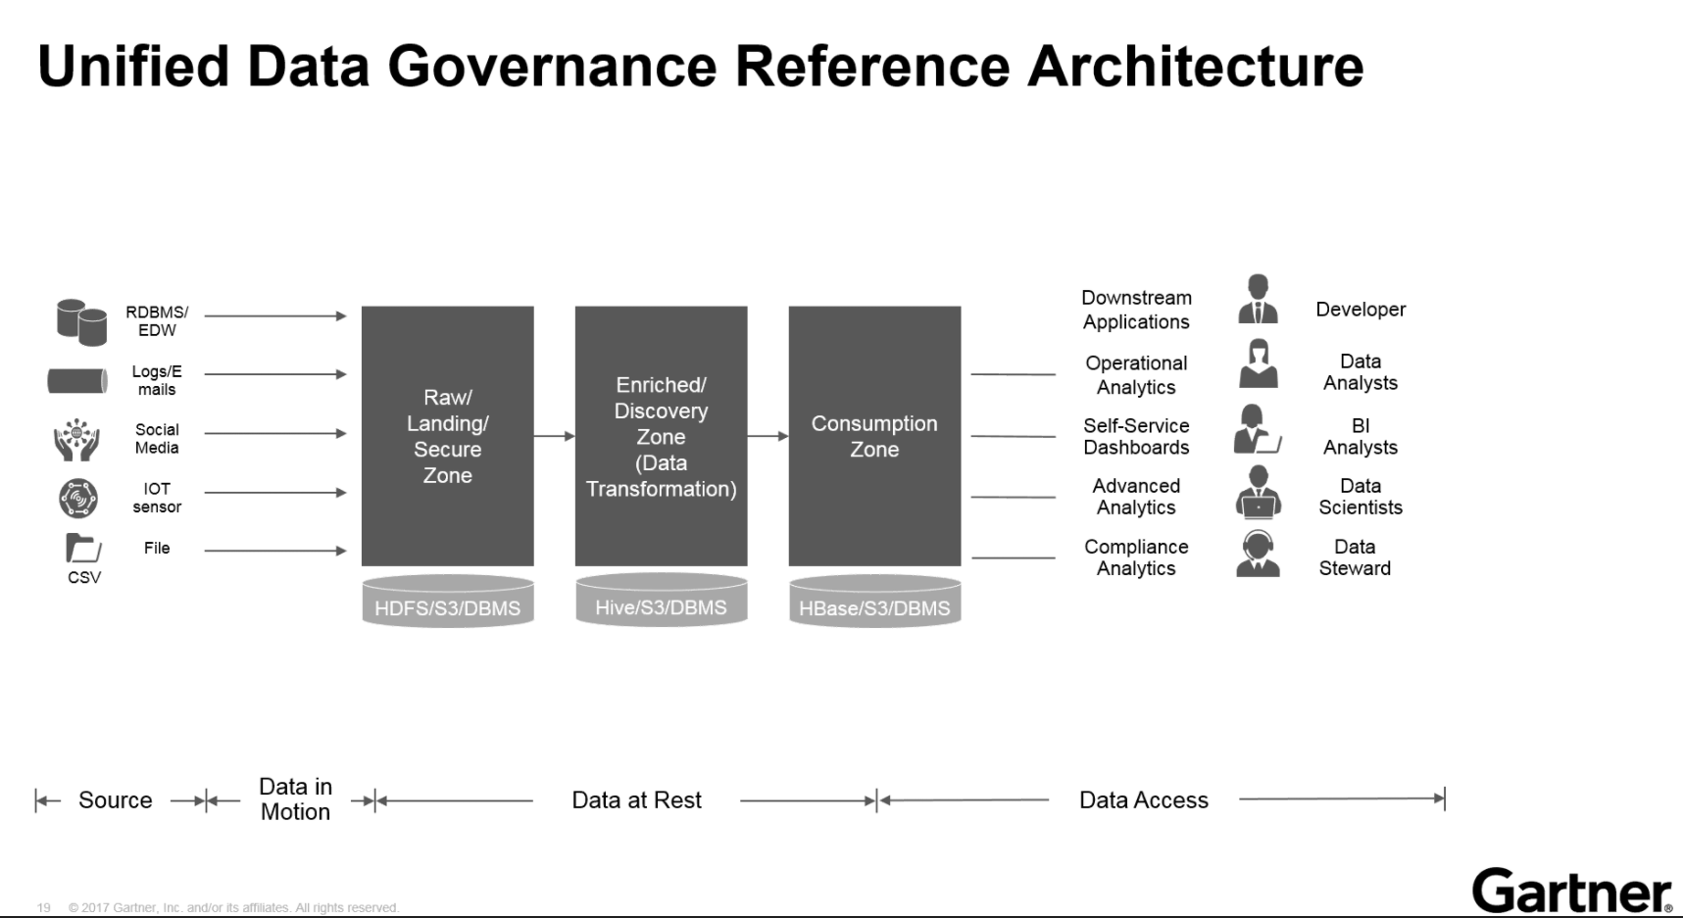

Slide 9
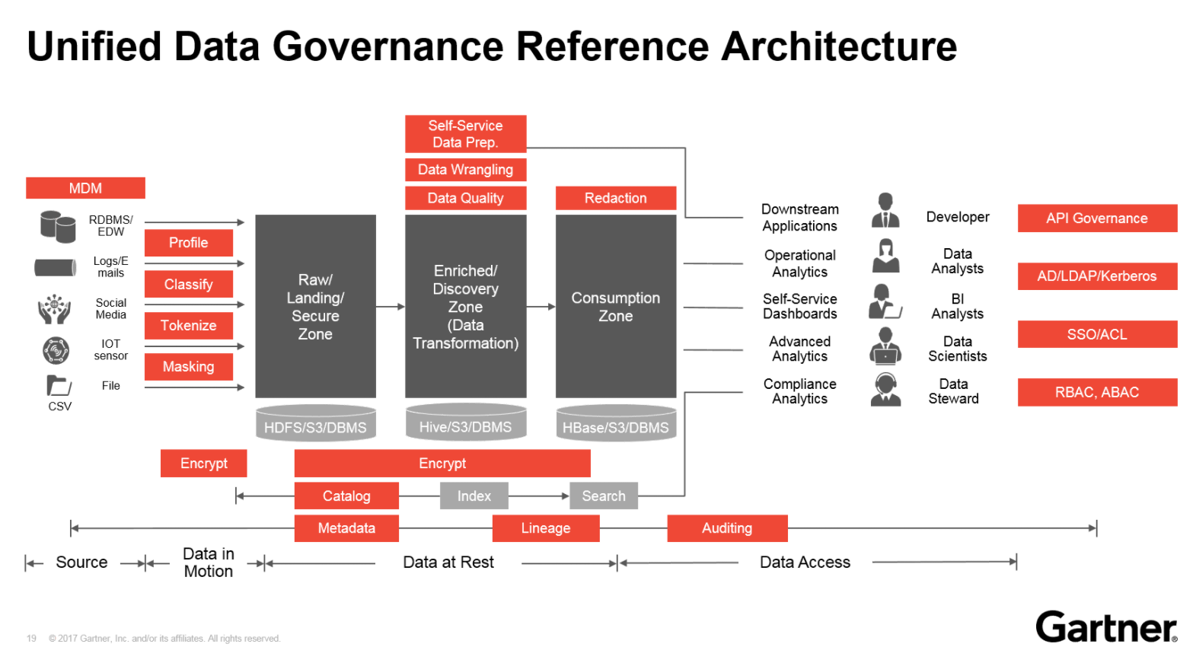

Slide 10
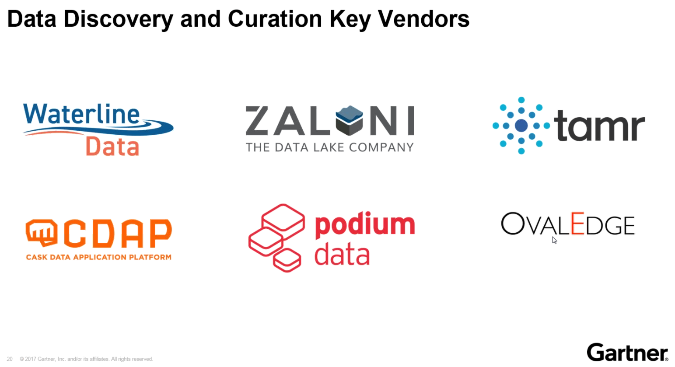

Slide 11
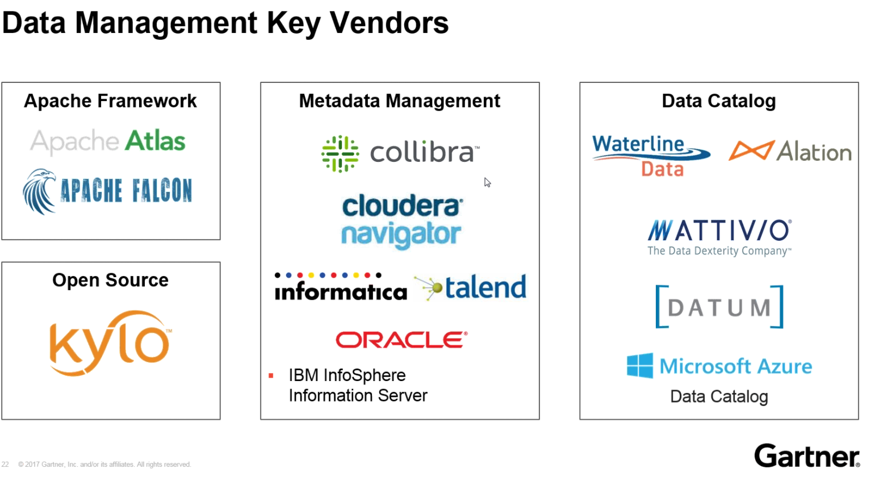

Slide 12
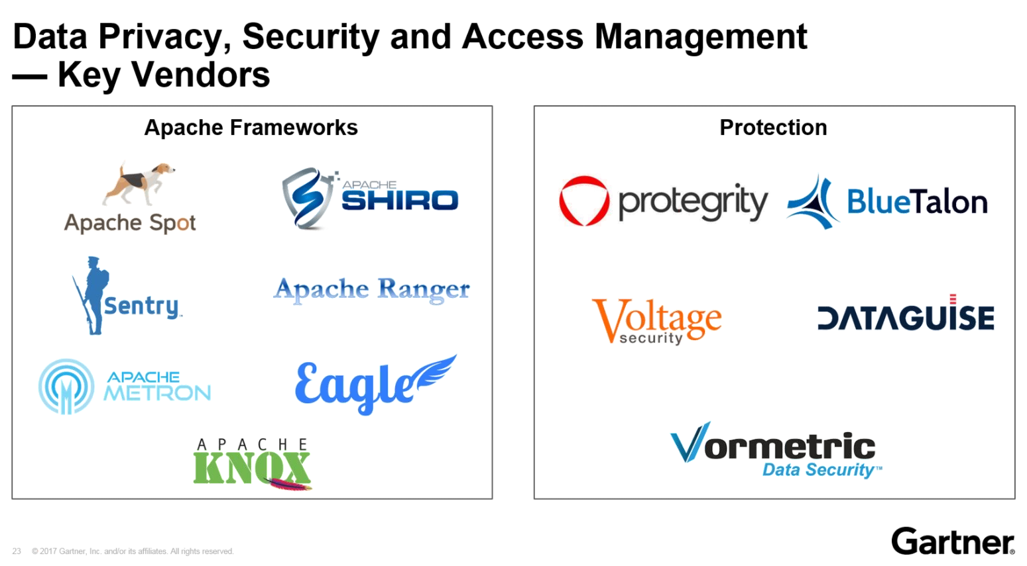

Slide 13
