Slide 1
Chapter 7
Introduction to Structured Query Language (SQL)

Slide 2
Learning Objectives
In this chapter, you will learn:
The basic commands and functions of SQL
How to use SQL for data administration (to create tables and indexes)
How to use SQL for data manipulation (to add, modify, delete, and retrieve data)
How to use SQL to query a database for useful information

Slide 3
Introduction to SQL
Categories of SQL functions:
Data definition language (DDL)
Data manipulation language (DML)
Nonprocedural language with basic command vocabulary set of less than 100 words
Differences in SQL dialects are minor

Slide 4
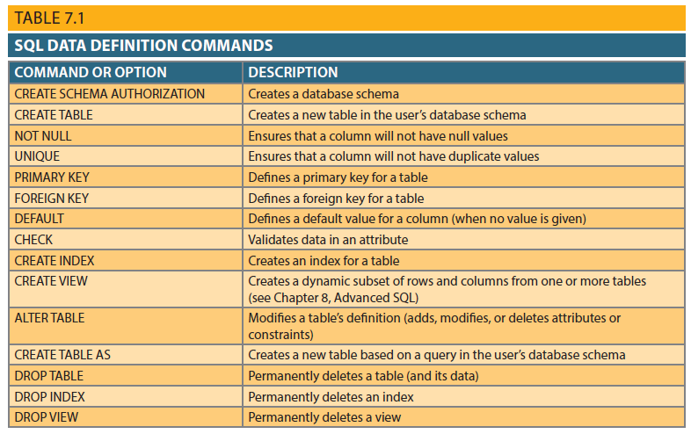
Table 7.1 - SQL Data Definition Command

Slide 5
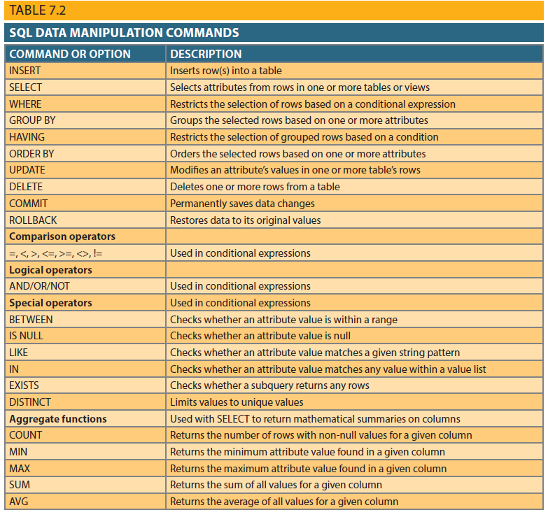
Table 7.2 - SQL Data Manipulation Commands

Slide 6
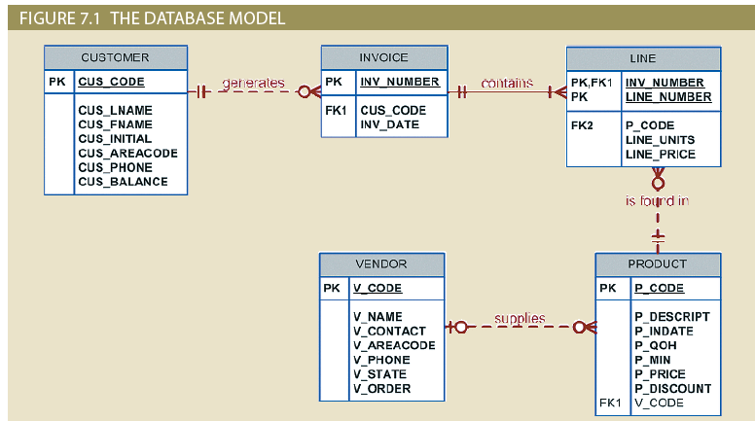
Figure 7.1 - The Database Model

Slide 7
Creating the Database
Create database structure
RDBMS creates physical files that will hold database
Differs from one RDBMS to another
Authentication is the process DBMS uses to verify that only registered users access the database
Required for the creation tables
User should log on to RDBMS using user ID and password created by database administrator

Slide 8
The Database Schema
Logical group of database objects – such as tables and indexes - related to each other
Command:
CREATE SCHEMA AUTHORIZATION {creator};
Seldom used directly as command is usually optional

Slide 9
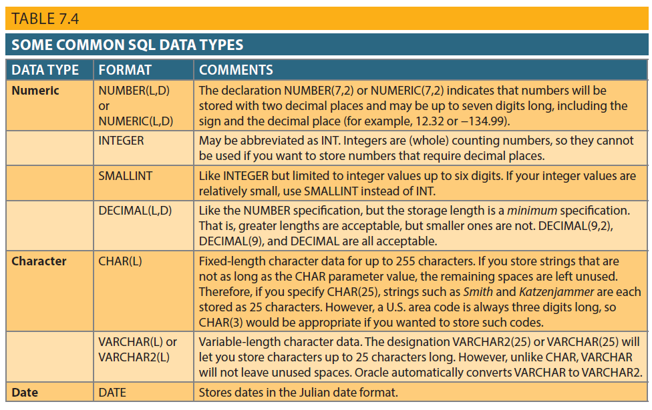
Table 7.4 - Common SQL Data Types

Slide 10
Creating Table Structures
Use one line per column (attribute) definition
Use spaces to line up attribute characteristics and constraints
Table and attribute names are fully capitalized
Features of table creating command sequence:
NOT NULL specification ensures data entry
UNIQUE specification avoids duplicated values
Table definition enclosed in parentheses
RDBMS automatically enforces referential integrity for foreign keys.

Slide 11
SQL Constraints
NOT NULL
UNIQUE
DEFAULT
Ensures that column does not accept nulls
Ensures that all values in column are unique
Assigns value to attribute when a new row is added to table
CHECK
Validates data when attribute value is entered

Slide 12
SQL Indexes
When primary key is declared, DBMS automatically creates unique index
The CREATE INDEX command can be used to create indexes on the basis of any selected attribute
UNIQUE qualifier prevents a value that has been used before
Composite indexes prevent data duplication
To delete an index use the DROP INDEX command

Slide 13
Data Manipulation Commands
INSERT: Command to insert data into table
Syntax - INSERT INTO tablename VALUES();
Used to add table rows with NULL and NOT NULL attributes
COMMIT: Command to save changes
Syntax - COMMIT [WORK];
Ensures database update integrity

Slide 14
Data Manipulation Commands
SELECT: Command to list the contents
Syntax - SELECT columnlist FROM tablename;
Wildcard character(*): Substitute for other characters/command
UPDATE: Command to modify data
Syntax - UPDATE tablename SET columnname = expression [, columnname = expression] [WHERE conditionlist];

Slide 15
Data Manipulation Commands
WHERE condition
Specifies the rows to be selected
ROLLBACK: Command to restore the database
Syntax - ROLLBACK;
Undoes the changes since last COMMIT command
DELETE: Command to delete
Syntax - DELETE FROM tablename
[WHERE conditionlist];

Slide 16
Inserting Table Rows with a SELECT Subquery
Syntax
INSERT INTO tablename SELECT columnlist FROM tablename
Used to add multiple rows using another table as source
SELECT command - Acts as a subquery and is executed first
Subquery: Query embedded/nested inside another query

Slide 17
Selecting Rows Using Conditional Restrictions
Can select partial table contents by placing restrictions on rows to be included
Syntax enables to specify which rows to select:
SELECT columnlist
FROM tablelist
[WHERE conditionlist];
WHERE clause adds conditional restrictions to the SELECT statement

Slide 18
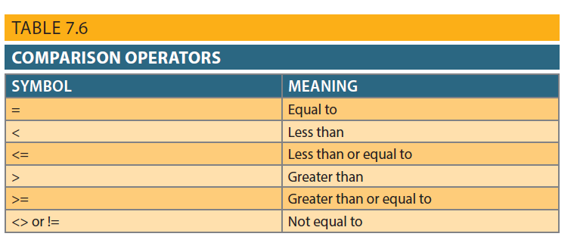
Table 7.6 - Comparison Operators
Adds conditional restrictions on selected character attributes and dates

Slide 19
Comparison Operators: Computed Columns and Column Aliases
SQL accepts any valid expressions/formulas in the computed columns
Alias: Alternate name given to a column or table in any SQL statement to improve the readability
Computed column, an alias, and date arithmetic can be used in a single query

Slide 20
Arithmetic Operators
The Rule of Precedence: Establish the order in which computations are completed
Performed in this order:
Operations within parentheses
Power operations
Multiplications and divisions
Additions and subtractions

Slide 21
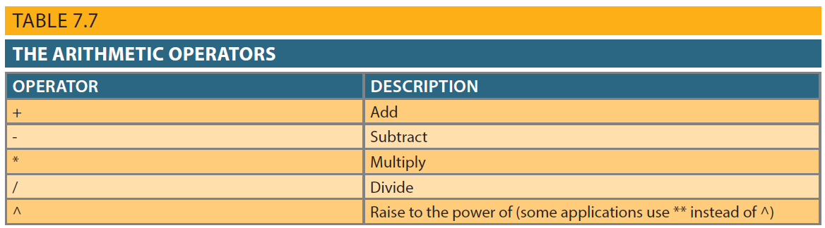
Table 7.7 - The Arithmetic Operators

Slide 22
Logical Operators: AND, OR and NOT
OR and AND: Used to link multiple conditional expressions in a WHERE or HAVING clause
OR requires only one of the conditional expressions to be true
AND requires all of the conditional expressions to be true
NOT is used to negate the result of a conditional expression
Boolean algebra is dedicated to the use to logical operations

Slide 23
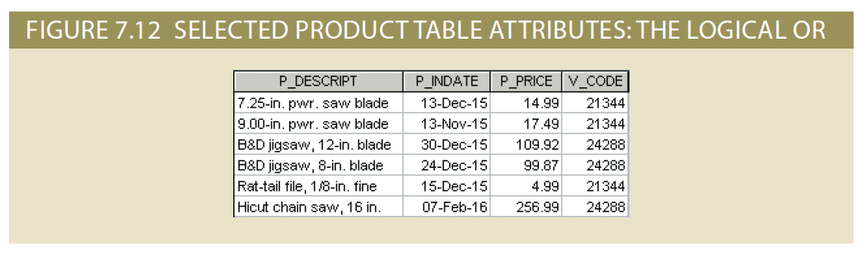
Figure 7.12 - Selected PRODUCT Table Attributes: The Logical OR

Slide 24
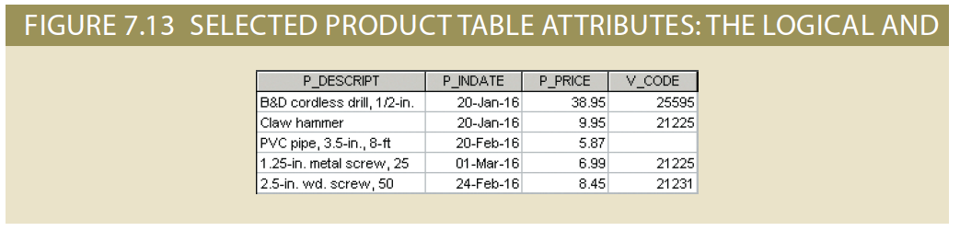
Figure 7.13 - Selected PRODUCT Table Attributes: The Logical AND

Slide 25
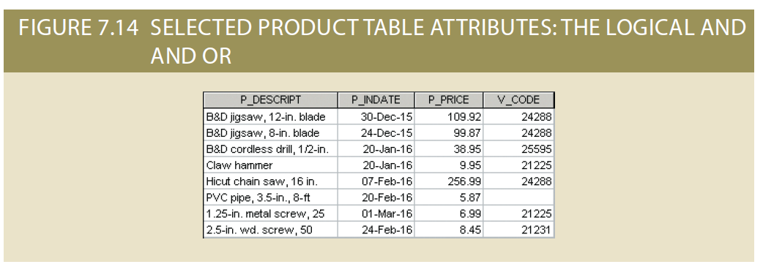
Figure 7.14 - Selected PRODUCT Table Attributes: The Logical AND and OR

Slide 26
Special Operators
BETWEEN
IS NULL
LIKE
IN
EXISTS
Checks whether attribute value is within a range
Checks whether attribute value is null
Checks whether attribute value matches given string pattern
Checks whether attribute value matches any value within a value list
Checks if subquery returns any rows

Slide 27
Additional Data Definition Commands
ALTER TABLE command: To make changes in the table structure
Keywords use with the command
ADD - Adds a column
MODIFY - Changes column characteristics
DROP - Deletes a column
Used to:
Add table constraints
Remove table constraints

Slide 28
Changing a Column’s Data Type and Data Characteristics
ALTER used to change data type and characteristics
Some RDBMSs do not permit changes to data types unless column is empty
Changes in characteristics are permitted if they do not alter the existing data type
Syntax:
Data Type: ALTER TABLE tablename MODIFY (columnname(datatype));
Data Characteristic: ALTER TABLE tablename MODIFY (columnname(characteristic));

Slide 29
Adding and Dropping Columns
Adding a column
Use ALTER and ADD
Do not include the NOT NULL clause for new column
Dropping a column
Use ALTER and DROP
Some RDBMSs impose restrictions on the deletion of an attribute

Slide 30
Advanced Data Updates
UPDATE command updates only data in existing rows
If a relationship is established between entries and existing columns, the relationship can assign values to appropriate slots
Arithmetic operators are useful in data updates
In Oracle, ROLLBACK command undoes changes made by last two UPDATE statements

Slide 31
Copying Parts of Tables
SQL permits copying contents of selected table columns
Data need not be reentered manually into newly created table(s)
Table structure is created
Rows are added to new table using rows from another table

Slide 32
Adding Primary and Foreign Key Designations
A created new table based on another table does not include old table’s integrity rule (no primary key)
Can re-establish integrity rules using ALTER command
Use ALTER TABLE command to ADD primary and foreign keys
Composite primary keys and multiple foreign keys can be designated in a single SQL command

Slide 33
Deleting a Table from the Database
DROP TABLE: Deletes table from database
Syntax - DROP TABLE tablename;
Can drop a table only if it is not the one side of any relationship
RDBMS generates a foreign key integrity violation error message if the table is dropped

Slide 34
Additional SELECT Query Keywords
Logical operators work well in the query environment
SQL provides useful functions that:
Count
Find minimum and maximum values
Calculate averages
SQL allows user to limit queries to entries:
Having no duplicates
Whose duplicates can be grouped

Slide 35
Ordering a Listing
ORDER BY clause is useful when listing order is important
Syntax - SELECT columnlist
FROM tablelist
[WHERE conditionlist]
[ORDER BY columnlist [ASC | DESC]];
Cascading order sequence: Multilevel ordered sequence
Created by listing several attributes after the ORDER BY clause

Slide 36
Listing Unique Values
DISTINCT clause: Produces list of values that are unique
Syntax - SELECT DISTINCT columnlist
FROM tablelist;
Placement of nulls does not affect list contents
In Oracle can place nulls at top of list

Slide 37
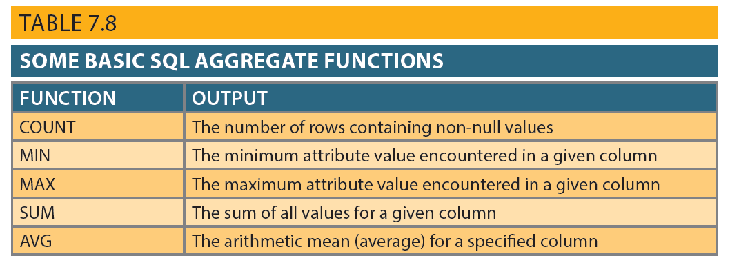
Table 7.8 - Some Basic SQL Aggregate Functions

Slide 38
Grouping Data
Frequency distributions created by GROUP BY clause within SELECT statement
Syntax - SELECT columnlist
FROM tablelist
[WHERE conditionlist]
[GROUP BY columnlist]
[HAVING conditionlist]
[ORDER BY columnlist [ASC | DESC]];

Slide 39
HAVING Clause
Extension of GROUP BY feature
Applied to output of GROUP BY operation
Used in conjunction with GROUP BY clause in second SQL command set
Similar to WHERE clause in SELECT statement

Slide 40
Joining Database Tables
Performed when data are retrieved from more than one table at a time
Equality comparison between foreign key and primary key of related tables
Tables are joined by listing tables in FROM clause of SELECT statement
DBMS creates Cartesian product of every table in the FROM clause

Slide 41
Joining Tables With an Alias and Recursive Joins
Alias identifies source table from which data are taken
Any legal table name can be used as alias
Add alias after table name in FROM clause
Recursive query: Table is joined to itself using alias
Use aliases to differentiate the table from itself

