Slide 1
Multilinear Regression
Week 3 – MSDS 660

Slide 2
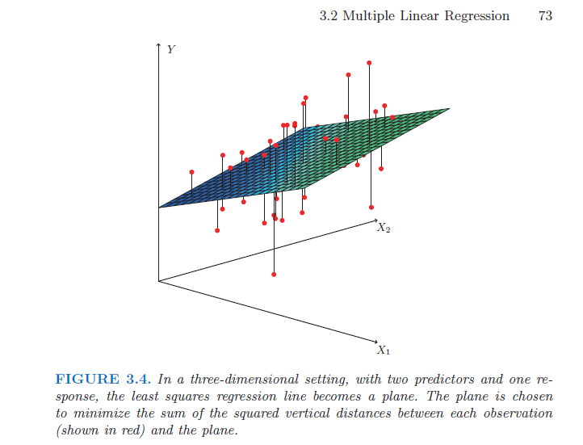
When to use Multilinear

Slide 3
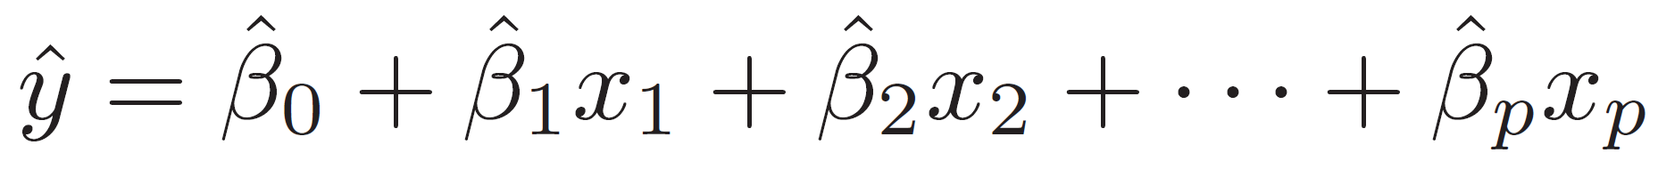
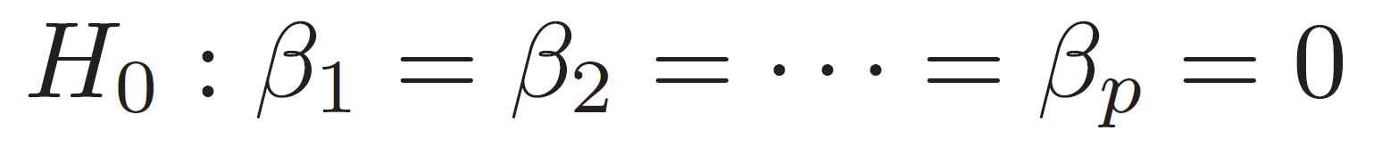
Multilinear Regression
More than one predictor variable we want to use
Ensure communicability
Null hypothesis: All coefficients are 0
Alternative Hypothesis: at least one coefficient is not 0

Slide 4
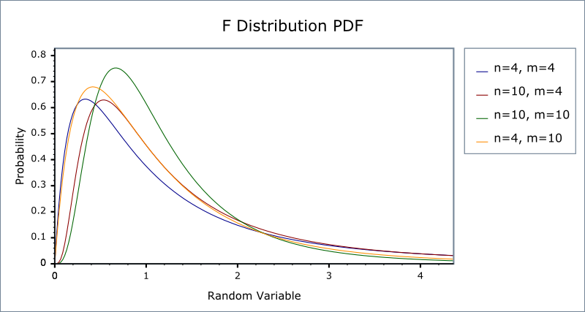
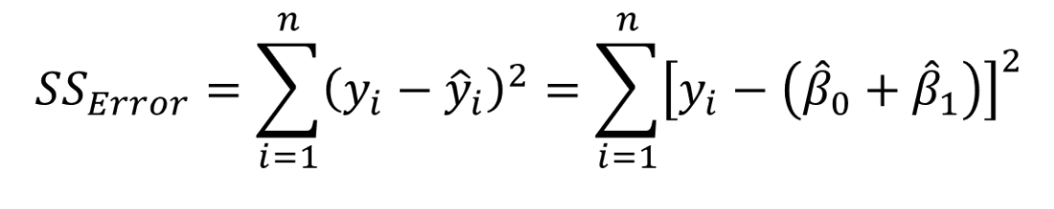
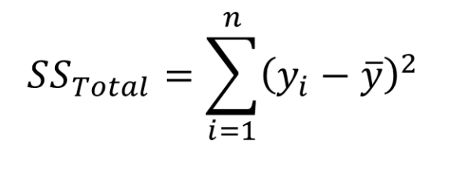

F-Statistic
Used to compare multiple groups
“The difference between the variance of the data size of the residuals divided by the size of the residuals”
$F=\frac{{\left(SST−SSE\right)}/k}{RSS/{\left(n−k−1\right)}}$
K is the number of predictors (betas)
N is the number of samples

Slide 5
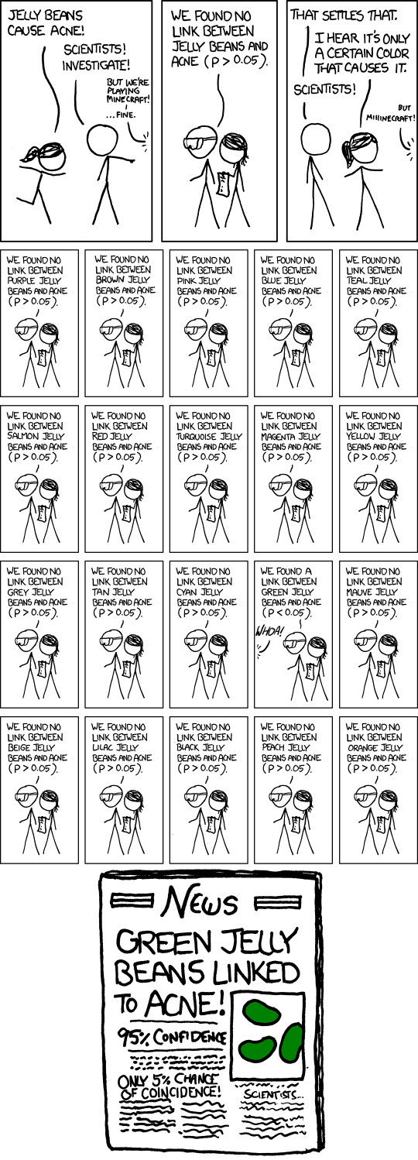
P-Hacking
John Oliver P-Hacking – YouTube
I Fooled Millions Into Thinking Chocolate Helps Weight Loss

Slide 6
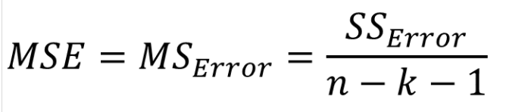

Adjusting previous calculations
Penalty for adding predictors
Mean Squares Error already accounted for predictors
Tends to be more reliable than adjusted R²
Adjusted $R^{2}=1−\frac{SSE/{\left(n−k−1\right)}}{SST/{\left(n−1\right)}}$

Slide 7
Akaike Information Criterion (AIC)
Method for evaluating how well a model fits the data it was generated from
Can also be used to compare models
The best-fitting model is the one that explains the greatest amount of variation using the fewest possible independent variables
stepAIC()
Backward search (default)
Forward search
Both
Akaike Information Criterion | When & How to Use It (scribbr.com)
Bayesian Information Criterion (BIC)
Notes:
Backward search (default)
Start with all variables, remove one by one and evaluate metrics.
Forward search
Start with one variable, add others and evaluate metrics.
Both
A combination of forward and backward selection

Slide 8
Dummy Variables
Used for qualitative predictors
Cannot use factors because they imply ordinality
Too many dummy variables increases computational strain and adds dimensionality
How to Create Dummy Variables in R (Step-by-Step) (statology.org)

Slide 9
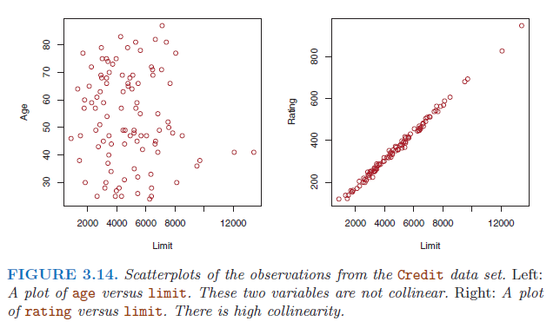
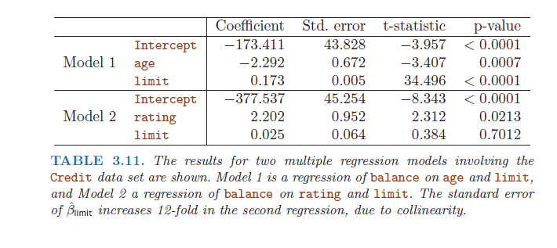
Collinearity
Two or more predictor variables are closely related
Difficult to separate the individual affects and can makes variable importance
Notes:
Gender and pregnancy

Slide 10
Addressing Collinearity
Plot correlation
Compute Variance Inflation Factor (VIF)
Ratio of variance in the model with multiple terms divided by the variance of a model with one term alone
Smallest value can be 1
5-10 indicates a problematic amount of collinearity
Remove or combine variables based on VIF
Multicollinearity Essentials and VIF in R - Articles - STHDA

Slide 11
Summary of MLR process
1. Check for multicollinearity
Plot everything rather than eyeball
Check correlations
cor()
Check VIF
2. Look at stepAIC() to remove unnecessary variables
3. Check p-values on variables
Try dropping anything greater than .05 and see how metrics change
4. Repeat until model does not improve

