Slide 1
One Way ANOVA
MSDS 660

Slide 2
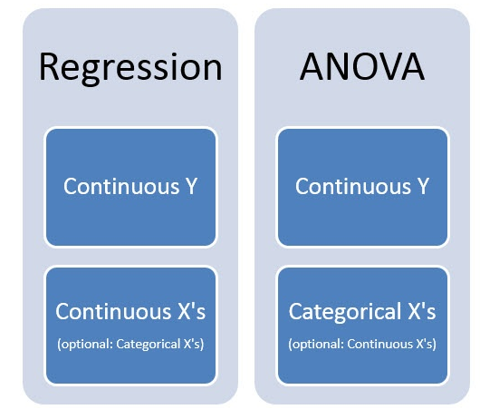
What is ANOVA?
ANOVA stands for “analysis of variances”
ANOVA is regression with categorical predictors. That’s it.

Slide 3
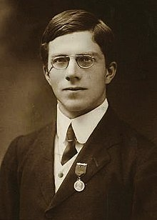
ANOVA
Typically used to analyze data from experiments
Use categorical predictors are usually groups to which experimental unis (ex. Subjects) are assigned
Focuses on comparing means of different groups to one another
There are conventions for reporting ANOVA results that are simpler and cleaner than regression
Ronald Fischer

Slide 4

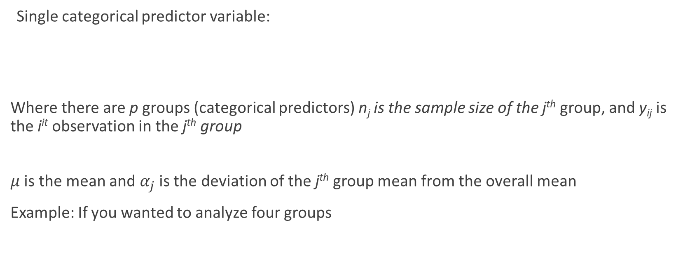
One-Way ANOVA
Single categorical predictor variable:
Where there are p groups (categorical predictors) n_{j} is the sample size of the j^{th} group, and y_{ij} is the i^{it} observation in the j^{th} group
$μ$ is the mean and $α_{j}$ is the deviation of the j^{th} group mean from the overall mean
Example: If you wanted to analyze four groups
Regression:

Slide 5
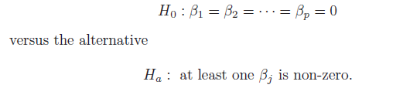
Hypothesis Testing with ANOVA
Null: all group means are the same
Alternative: at least one group mean is different
P-value represents the proportion of at least one predictor is correlated to the response
Power of ANOVA comes from post-hoc analysis

Slide 6
Post-Hoc Tests
Bonferroni (pairwise) t-test correction
Tukey HSD
Games-Howell
Fisher’s LSD
Duncan test
Other tests: Post Hoc Definition and Types of Tests - Statistics How To

Slide 7
Discussion Assignment
Research one post hoc analysis and share your findings with the class
Make sure no one picks the same one

Slide 8
Demo
Open ‘ChickWeights.R’ from In-Class Files to follow along

Slide 9
In-Class Assignment
Complete the ANOVA_Exercise
Post your explanations of the post hoc pairwise comparison from our discussion. Please provide the source(s) you used.

Slide 10
Homework Assignment
Complete an ANOVA analysis on another dataset of your choosing
Ensure it is suitable for one way ANOVA
Find Open Datasets and Machine Learning Projects | Kaggle
Datasets: Education and Training (nist.gov)
Wolfram Data Repository: Computable Access to Curated Data (wolframcloud.com)
Have a great night class

