Slide 1
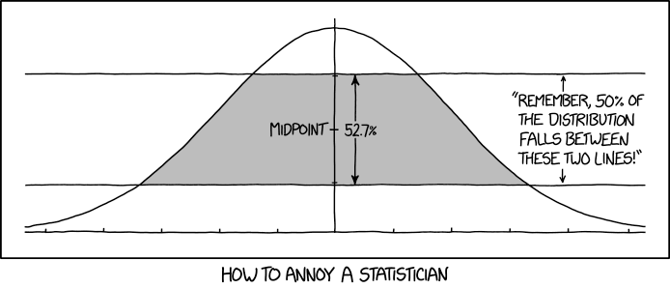
Lecture 1: Basic Concepts

Slide 2
What is Statistics?
Statistics deals with the means by which we use that data in the pursuit of knowledge. It is imperfect and our answers will be imprecise
  Statistical methods are used to summarize and simplify information contained in data
  Attempt to learn about the underlying mechanisms that creates the data in the first place
  Learn about relationships that are meaningful and significant
    Do not arise from change or occurrence
  Some statistical Statements:
  “I sleep seven hours per night, on average”
  “56% of likely voters intend to vote for the incumbent, with a margin of error of +/- 3%”
  “Students who attend class regularly tend to get higher grades than those who do not”
  “There is a 20% chance of snow tomorrow”
  What do all of these statements have in common?

Slide 3
Statistical Terminology
Population : All individuals, objects, or measurements whose properties are being studied
Sample : A subset of the population
  Generalizable to population
  Many techniques
Data : The result of sampling – a set of observations
  Qualitative
  Quantitative
Statistics : A numerical characteristic of the sample
  An estimate of a population parameter
Variable : A characteristic of interest for each person or object in a population
Parameter : A number that is used to represent a population characteristic and that generally cannot be determined easily

Slide 4
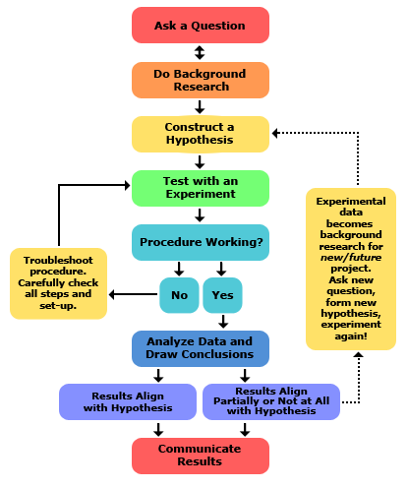
The Statistical Process
The Scientific Process
Null hypothesis H₀:
Alternative hypothesis: H_{a}:
Experimental design
Data Preparation
Exploratory Data Analysis
Choose appropriate statistical test
Interpret results
Translate results into meaningful and understandable conclusion

Slide 5
Sampling Techniques
Random Sampling
  Every member of the population has an equal chance of being selected
Stratified
  Members are divided into subgroups and each subgroup is randomly sampled
Cluster
  Dividing the population into clusters, randomly selecting clusters, randomly sampling those clusters
Systematic
  Assign a number to every population member
  Select a random number
  Select sample members at regular intervals

Slide 6
What’s wrong with our data?
Data Source
Published Studies
Outliers, errors, or missing data
Data collection methods
  Leading questions
  Self-reporting
  Sampling techniques
The replication crisis
Publication bias
Assessing bias using meta-analysis
The significance debate

Slide 7
Contemporary Issues
The replication crisis

Slide 8
The Replication Crisis
“The replication crisis” refers to a recent realization in many areas of science that previously published results do not replicate
Daryl Bem’s “Feeling the Future” published in the Journal of Personality and Social Psychology in 2011
  Utilized standard statistical tools to show strong evidence for pre cognition (ESP)
“Reproducibility Project: Psychology” published in 2015
  Center of Open Science
  Similar studies in Cancer Biology, Medicine, Economics, Marketing, and Sports Science

Slide 9
Why is Replication Important?
Why do so many studies fail to replicate?

Slide 10
Power
Also referred to as sensitivity
The likelihood of detecting an effect when there actually is one
  The probability of rejecting a null hypothesis in the case the null is false
A true effect is a real, non-zero relationship between variables in a population
A higher power in a study indicates a larger chance of a test detecting a true effect
A low power means that our test only has a small chance of detecting a true effect
  Results may be distorted by a random or systematic error
  Why does power matter in statistics?
  The goal is to collect enough data from a sample to statistically test weather you can reasonably reject the null hypothesis

Slide 11
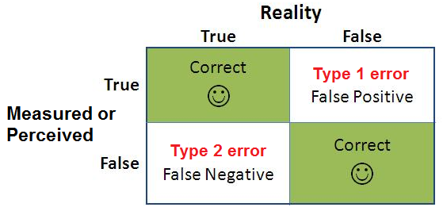
Type I and Type II Errors
“Type I” error occurs when a true H₀ is rejected
  We declare a result “statistically significant” even though no real-world effect exists
“Type II” error occurs when a false H₀ is not rejected
  We declare a result “not significant” even though a real-world effect does exist
  Low statistical power implies a high change of Type II error

Slide 12
Some History
Null hypothesis Significance testing – The drama series

Slide 13
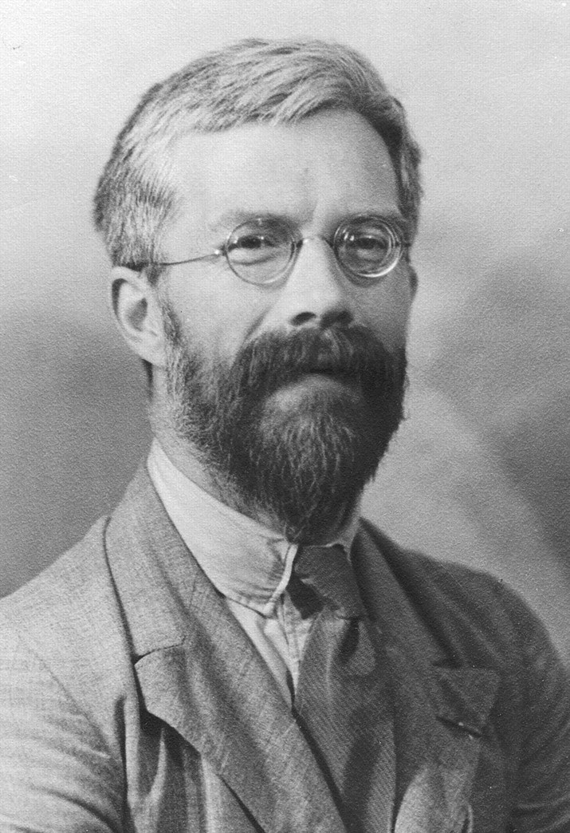
Ronald Fisher
Introduced the null hypothesis and p-value
On interpreting small p-values:
“Either an exceptionally rare chance has occurred, or the theory of random distribution is not true”
On the use of p < 0.05 as a standard of evidence:
“In order to assert that a natural phenomenon is experimentally demonstrable we need, not an isolated record, but a reliable method of procedure. In relation to the test of significance, we may say that a phenomenon is experimentally demonstrable when we know how to conduct an experiment which will rarely fail to give us a statistically significant result”

Slide 14
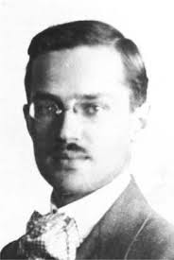
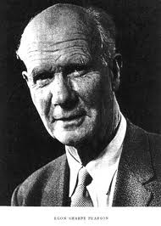
Jerzy Neyman and Egon Pearson
Introduced the alternative hypothesis, Type I and Type II errors, and power
Only reported error probabilities in testing
“We are inclined to think that as far as a particular hypothesis is concerned, no test based upon a theory of probability by itself provide any valuable evidence of the truth or falsehood of a hypothesis.”

Slide 15
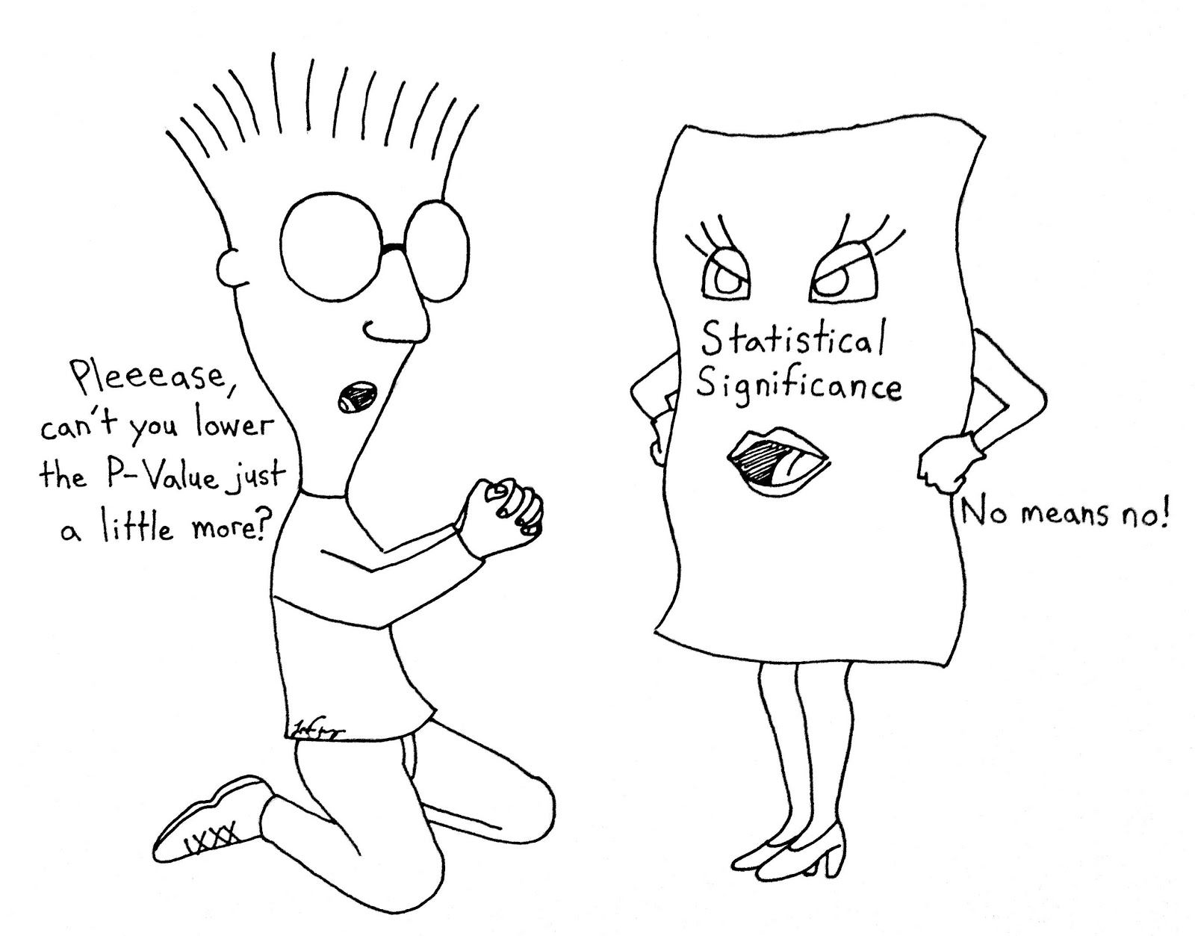
Reliance on P-value
P < 0.05 isn’t always meaningful
  .05 was arbitrarily chosen
  “significant” results are the kind that would be unlikely to occur by chance, if the null hypothesis were true

Slide 16
Confounding Factors
H₀ is true does not imply that the version of “Not H₀” is true
Observational studies may fall victim to confounders
  Maybe there is a “significant association” between variables for some reason that isn’t being considered
Experimental studies may fall victim to biases introduced by the experimental design
  Poor control, biased population, leading questions
  Example:
  Looking at the association between obesity and heart disease might be confounded by age, diet, smoking status, and other health factors that may be unevenly distributed between the groups being compared

Slide 17
A little about Null
H₀ == 0
Default null hypothesis is that there is precisely zero correlation
  Is this possible
Crud factor: the extent to which everything is correlated with everything
  Paul Meehl
The null can be used as a “Straw Man” that no one actually believes
  Overturning a straw man may not be that impressive

Slide 18
What is R?
R programming language is an open-sourced language that is largely used statistics, data analysis, and visualizations.
Developed in 1993 in New Zealand
Derived from the S programming language developed at Bell Labs
Most popular in
  Research
  Academics
  Health Care
  Government
Popular companies have implemented R solutions in their modules
  Facebook
  Google
  Uber
Very similar to Python
One of the most power machine learning platforms
Open source!
Download R-4.1.3 for Windows.

Slide 19

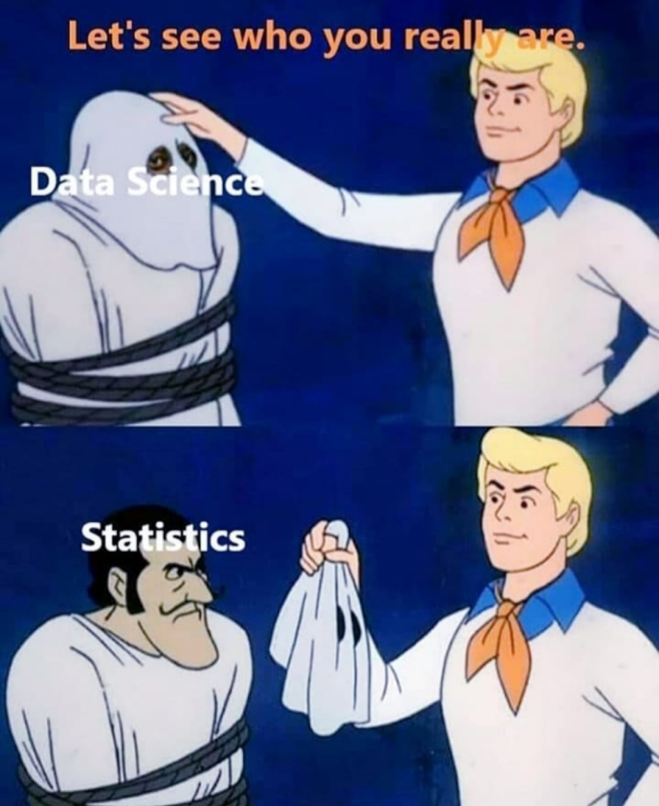
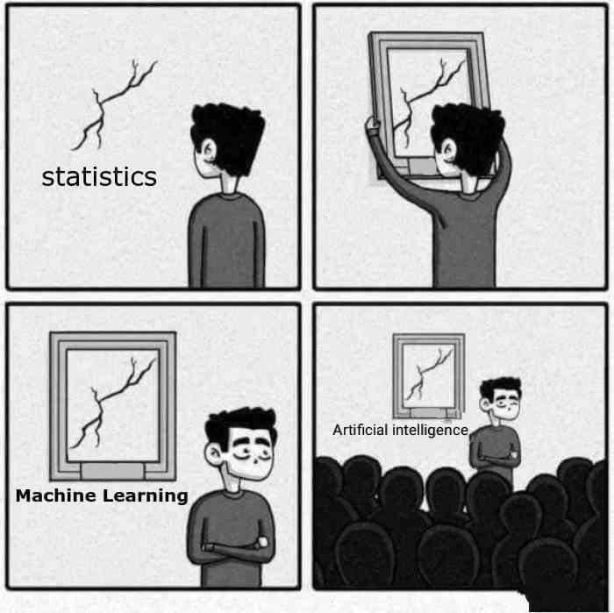
Statistics is the foundation to most machine learning, artificial intelligence, and data science algorithms

Slide 20
What is R?
R Programming Structure
Main Features
Interpreter-based language
Vector-oriented
Written (mostly) in C and C++
Not a general purpose language
  Cannot write a “full” program
  Easily integrated with other languages
Heavy graphics
Statistical functionality
Creating and manipulating data structures
Object manipulation
Numerical computation
Report creation
  RMarkDown

Slide 21
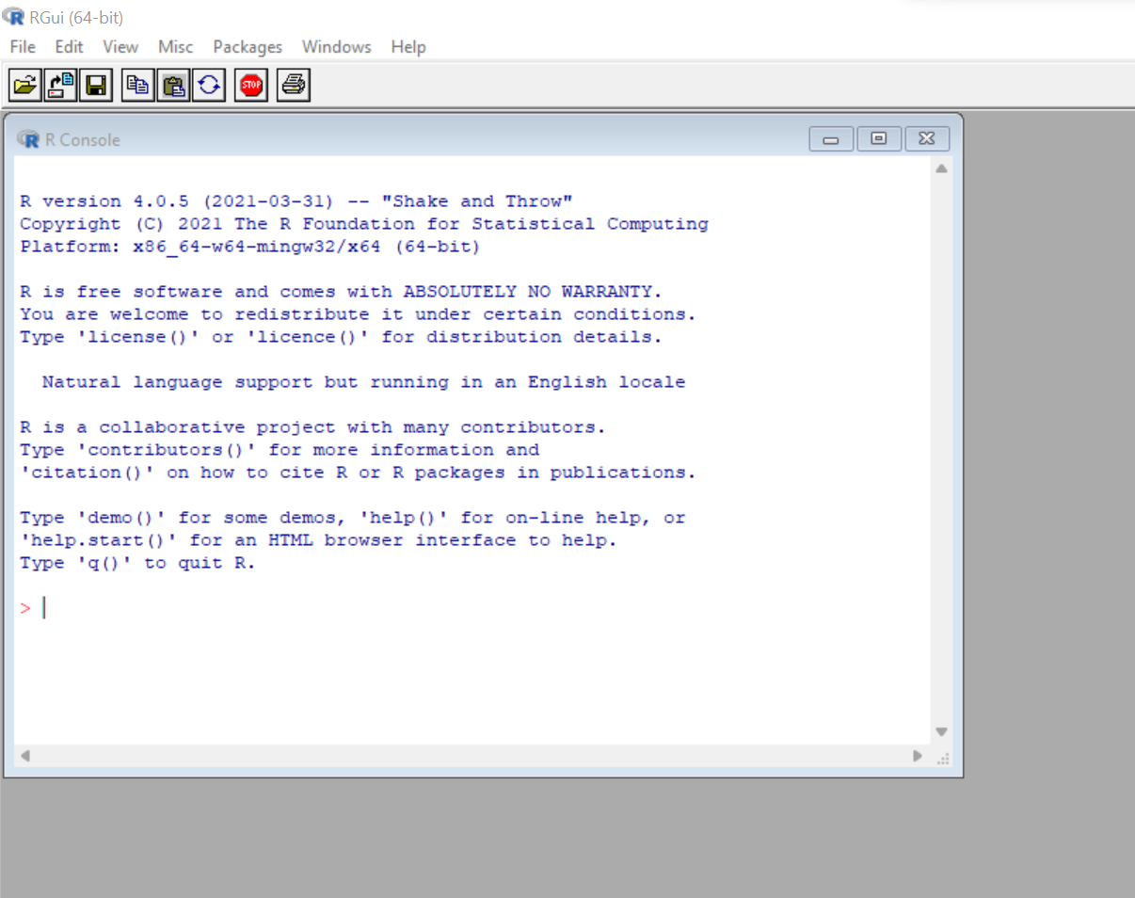
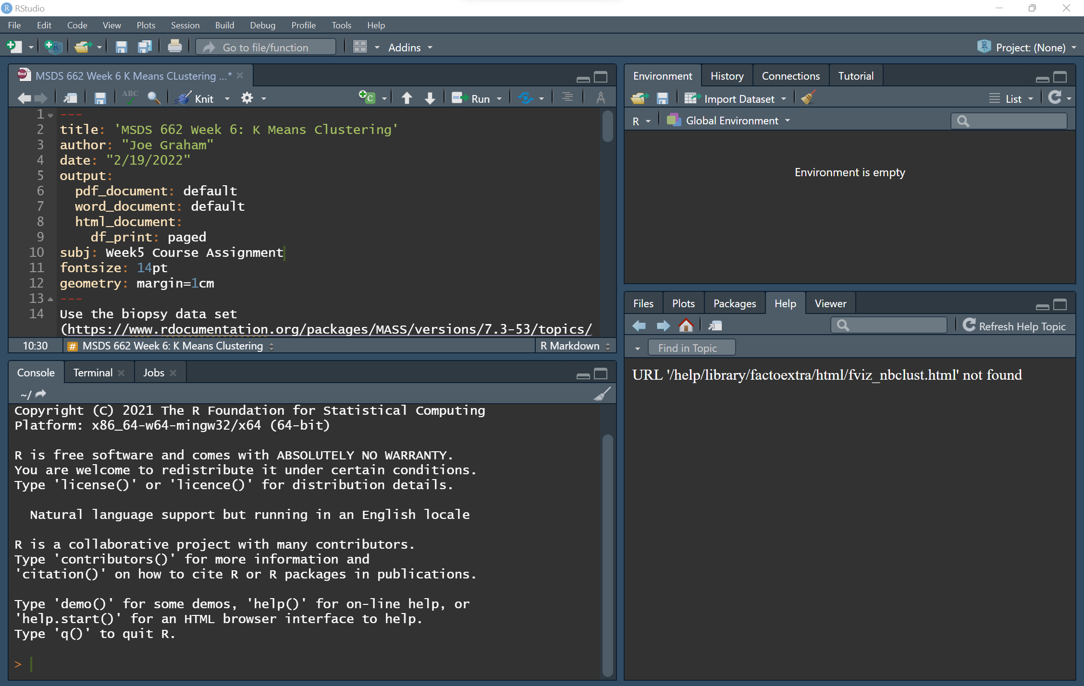
RStudio
Traditional R
R Studio
Saved variables
Scripting
Console/Terminal
Visualizations and documentation

Slide 22
Demonstration
Hypothesis: As a persons education level increases they are more likely to believe women are equitable political leader
Open: World Value Survey.R

Slide 23
In-Class Activity
Working in pairs:
  Create an hypothesis regarding the effect of tv on income and happiness
  State problems or concerns you have with the data
  Do an EDA
    Plots some graphs – include axis label the axis and title plot
  Interpret your results
  Share your results with another group
Post your r file in this week’s discussion post

Slide 24
Homework Assignment
Using the WVS, (any wave) find something that seems interesting and pick two or three variables that might be correlated.
Include:
1. Your hypothesis
2. Cleaning (if needed)
3. Exploratory Analysis
4. Plots with labeled axes and title
5. Brief explanation of your analysis process
6. Interpretation of results

