Slide 1
Course Overview
MSDS 660

Slide 2

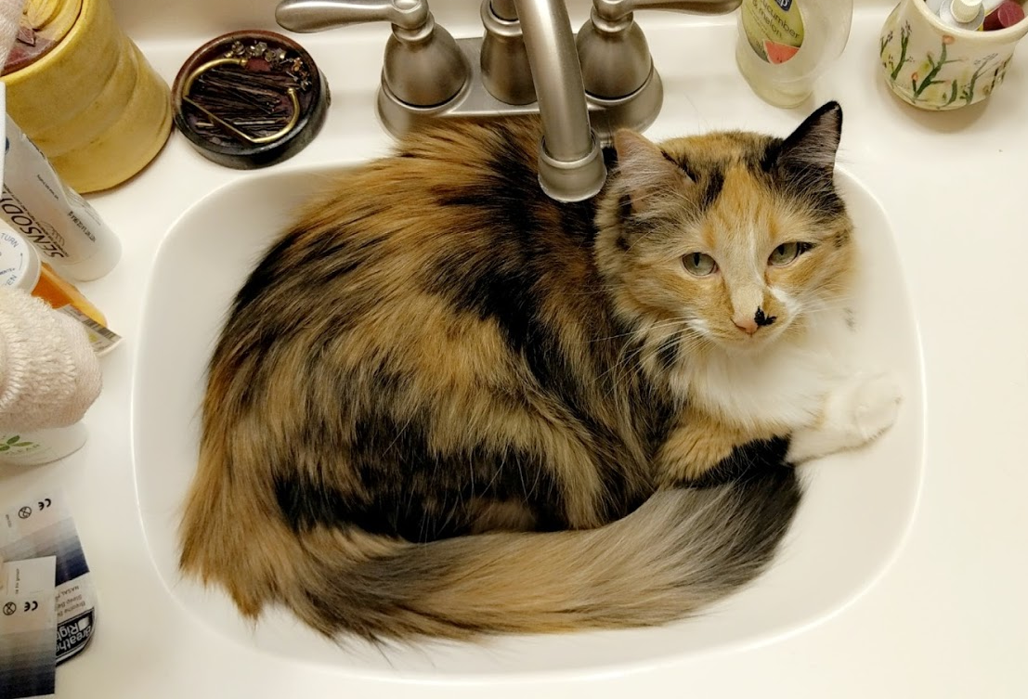
Me
Amelia O’Leary
aoleary001@regis.edu
Bachelors in Psychology – CSU
Minors in Applied Statistics and Mathematics
Masters of Data Science – Regis
Data Engineer
Lockheed Martin
Painting, climbing, dancing
Holden
Darlene

Slide 3
Course Outline

Slide 4
“The science that deals with the collection, classification, analysis, and interpretation of numerical facts or data, and that, by use of mathematical theories of probability, imposes order and regularity on aggregates of more or less disparate elements.” - Random House Dictionary
1. Basic Concepts (this week)
2. Simple Linear Regression
3. Multilinear Regression
4. One way ANOVA
5. Two way ANOVA
6. Logistic, multinomial, and polynomial regression
7. Non-Parametric Tests
8. Statistical Practice
Does function as a level 2 statistics course, background knowledge is needed

Slide 5
Homework Assignments
Two submissions:
R Markdown file (.Rmd)
Exported pdf file (.pdf)
Follow APA formatting guide:
Introduction
Methods
Results
Conclusion
Make it sensible and easy to follow
Purdue Guide
Each assignment will be due the following week after class
Wednesdays by Midnight
Allow us to discuss problems/questions within the class
If you cannot meet the deadline, please just contact me
-5% per late day
Notes:
Do not need Title Page, Abstract, or Discussion. Can combine sections if it is reasonable

Slide 6
Homework Assignments
Introduction to R and R Markdown resource files will be posted in the Student Resources Tab. Please reference these materials.
Notes:
Do not need Title Page, Abstract, or Discussion. Can combine sections if it is reasonable

Slide 7
In-Class Assignments
One submission:
Within the discussion forum
R Markdown file (.Rmd)
Comments/thoughts/questions
Loose format
More conceptual process
Ensure understanding rather than “right” answer
Each assignment will be due the following week after class
Wednesdays by Midnight
Allow us to discuss problems/questions within the class
Participation Grade

Slide 8
Demos
Weekly demonstrations will be provided to illustrate the respective week’s concepts and walk through the R code necessary to execute said concepts
Although demos will provide referenceable code, it is important to modify both the comments and code to fit the assignment (please do not copy and paste from the demo verbatim)
The demos can be used as a reference on how to walk through building your script but your submitted homework assignments should not look like a demo
In class assignment may look like the demo
*Demos are working documents and code may be deprecated and subject to change. If you find that something does not work, please notify me and I will update the code.

Slide 9
Grading
In class assignments are graded on a participation level. If you submit your piece and reply to two others in the allocated time, you will get 100%. Each discussion is work 1.5% of your grade.
There are two types of homework assignments: Exercises and Projects. Exercises are weighted a little less than projects, but are essentially the same idea. The idea is to put weight on the most important concepts in the class. You can see the weight of the homework in the “grade” tab.
Homework is graded on the following criteria:
The ability to communicate advanced statistical results and interpretation to a lay person
This includes the APA report style format
Statistical interpretation and impact
i.e. the demonstration of the understanding of said statistical results
R Code
Includes cleanliness, readability, and intent of the code being executed

Slide 10

Readings
From the Expert
Found under “Content” in World Class
Regression and Other Stories
If wanted to purchase, $45 on Amazon
Not required
Great supplemental resources if interested

