Slide 1
Linear Regression
Week 3 – MSDS 660

Slide 2
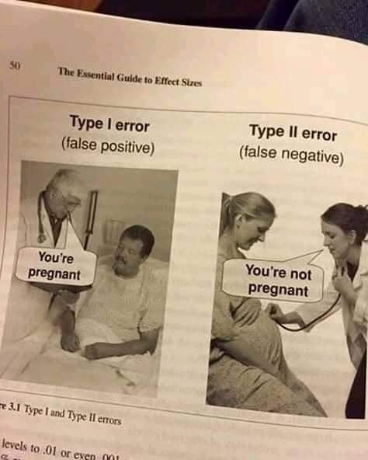
Review
1. The Statistical Method
2. The Replication Crisis
3. History of Null Significant Hypothesis Testing
Discuss the ways of dealing with Missing/Wrong data
Throw it away (on the ground)
Imputation
Mean
Median
Mode
KNN

Slide 3
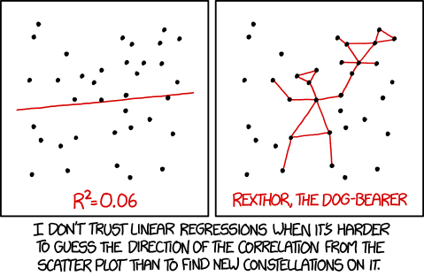
The Regression Model
In its simplest form, regression is a method for finding the “best fitting” line through a set of bivariate data

Slide 4

The Regression Model
$$y=mx+b$$
Dependent Variable = Coefficient *Independent variable + y-intercept
$y≈β0+β1xi+ εi$
Random Error
$$\hat{y}={\hat{β}}_{0}+{\hat{β}}_{1}x_{1}$$
Hat represents approximation
Notes:
It’s an unobserved random error term
Linear, missing variables, measurement error, uncertainty

Slide 5

Halloween 2016

Slide 6
How Do We Quantify Linear Regression?

Slide 7
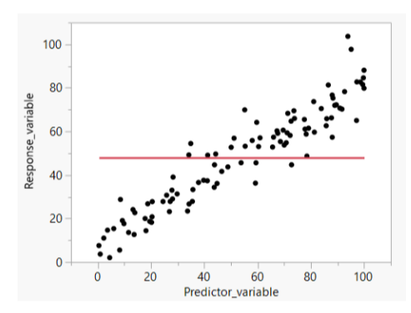
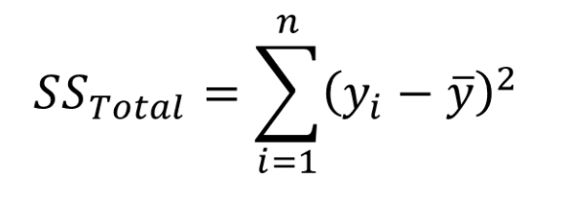
Sum of Squares
Quantifies total variability in y

Slide 8
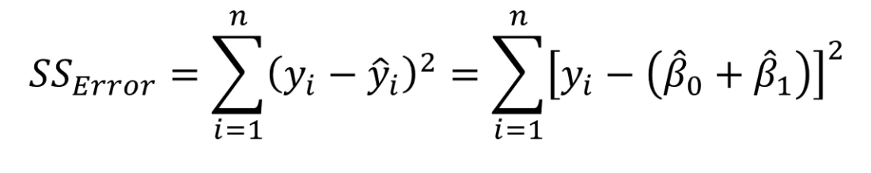
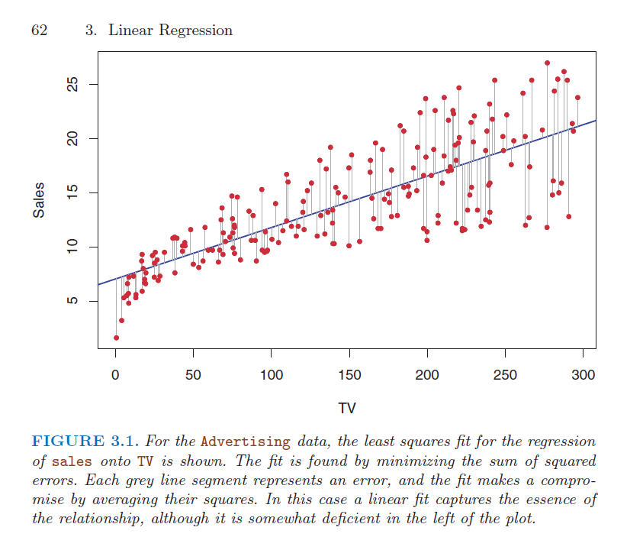
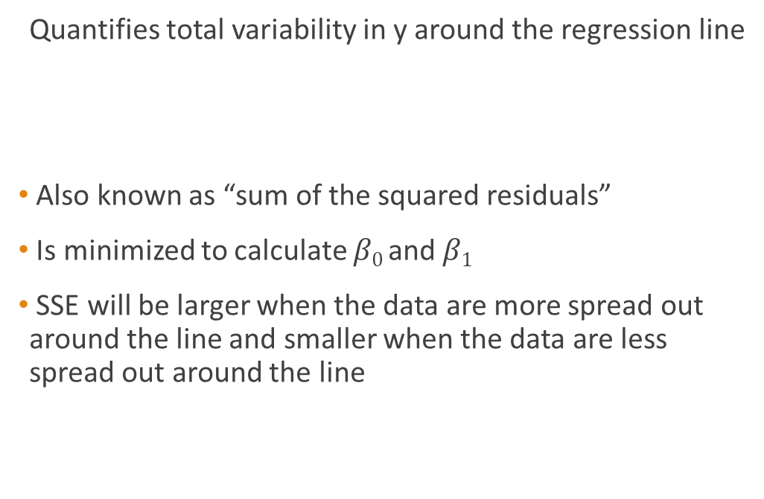
Error Sum of Squares
Quantifies total variability in y around the regression line
Also known as “sum of the squared residuals”
Is minimized to calculate $β0 \text{and} β1$
SSE will be larger when the data are more spread out around the line and smaller when the data are less spread out around the line

Slide 9
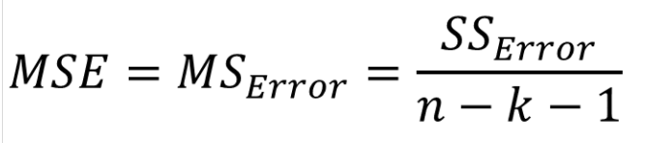

Mean Square Error
Equivalent to the variance of the residuals around the line
$k$ is the number for predictors
Simple linear regression $k=1$
$\hat{σ}=\sqrt{MSE}$
equivalent for the standard deviation around the line

Slide 10
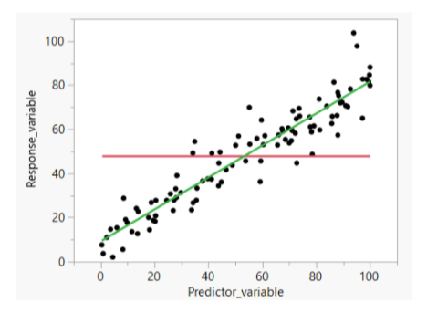
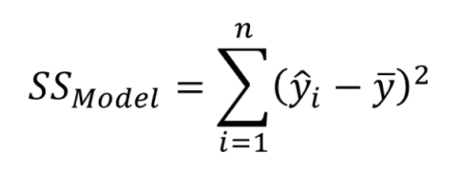

Model Sum of Squares
Quantifies how much better the model is rather than $\overline{y}$ alone at accounting for variation in the values of $y$
The sum of the squared vertical deviations between the regression line and the horizonal line, at each value of the predictor variable

Slide 11
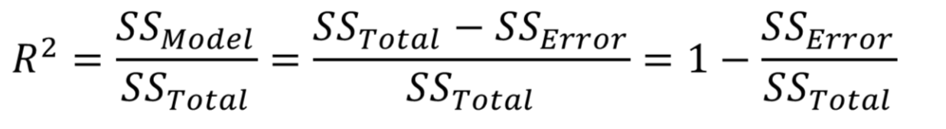

R²
The proportion of variance in $y$ that is explained by the model
The proportion of variance in $y$ that is not attributed to random error
The proportion by which prediction error decreases if we predict a value of $y$ using the line as opposed to just the mean of the response

Slide 12
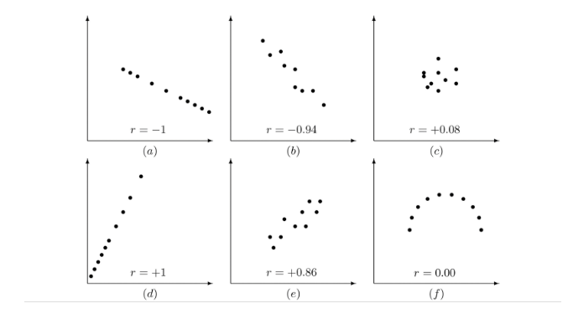
Example of R²

Slide 13
Hypothesis Testing with Regression

Slide 14
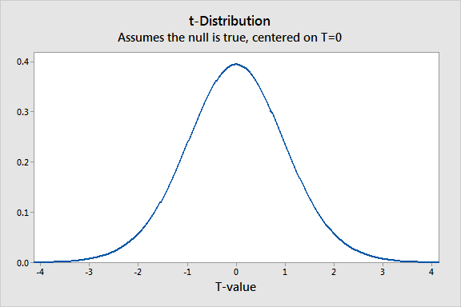
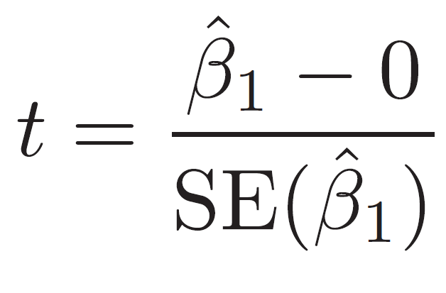
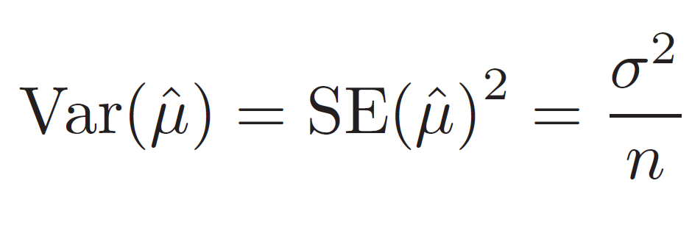
T-test
Null hypothesis: H₀ : β₁ = 0 : There is no relationship between x and y
Alternative hypothesis: H₀ : β₁ ≠ 0 : There is some relationship between x and y
T-statistic
Notes:
How do we know if β₁ is measuring a relationship between x and y by chance?
We calculate the t-value.
A high t-value corresponds to a small p-value and we reject the null hypothesis
Typically we reject the null hypothesis if the p-value is < 0.05

Slide 15
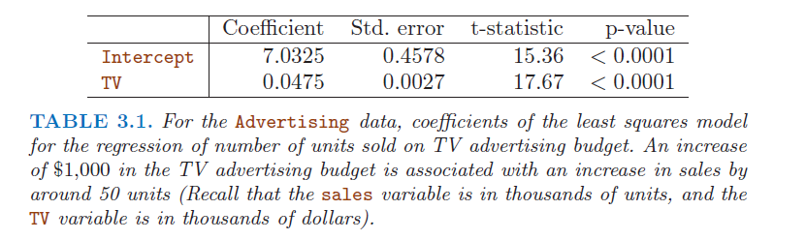
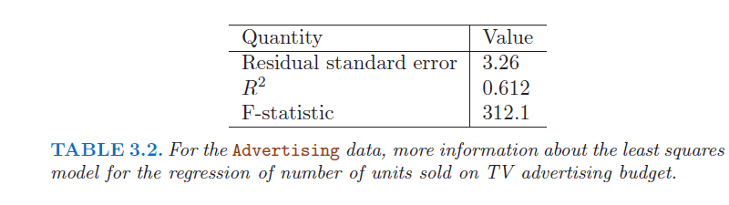
Example

Slide 16
Exploring our Data

Slide 17
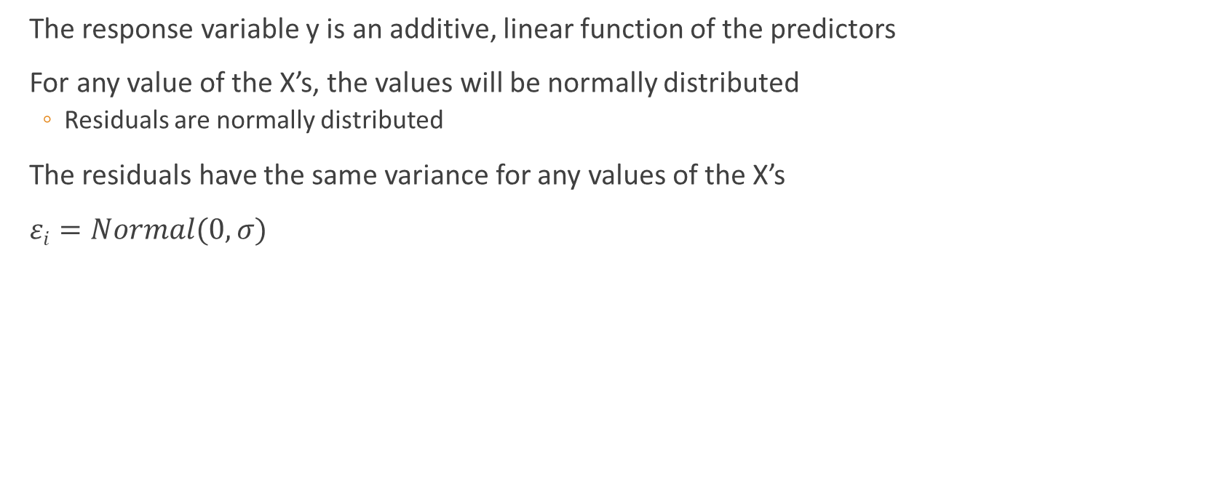
Assumptions
The response variable y is an additive, linear function of the predictors
For any value of the X’s, the values will be normally distributed
Residuals are normally distributed
The residuals have the same variance for any values of the X’s
$εi=Normal(0,σ)$

Slide 18
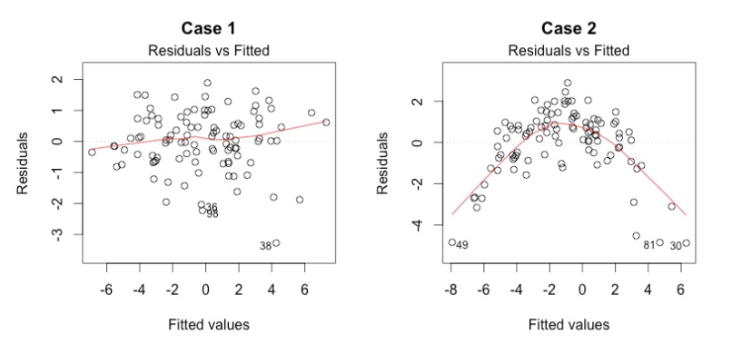
Checking Assumptions – Plots
Residual vs. Fitted
Residuals have a linear pattern
Distributed horizontally
Parabolic shape indicates non-linear relationship

Slide 19
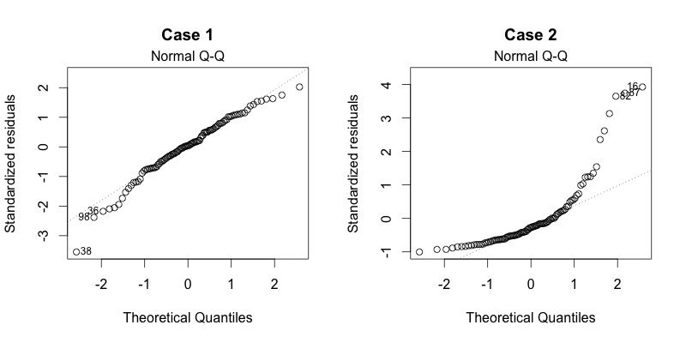
Checking Assumptions – Plots
Q-Q Plots
Shows if residuals are normally distributed
Want residuals fitting on a strait, diagonal line
Notes:
Not linear Q-Q plots indicate skewed distributions

Slide 20
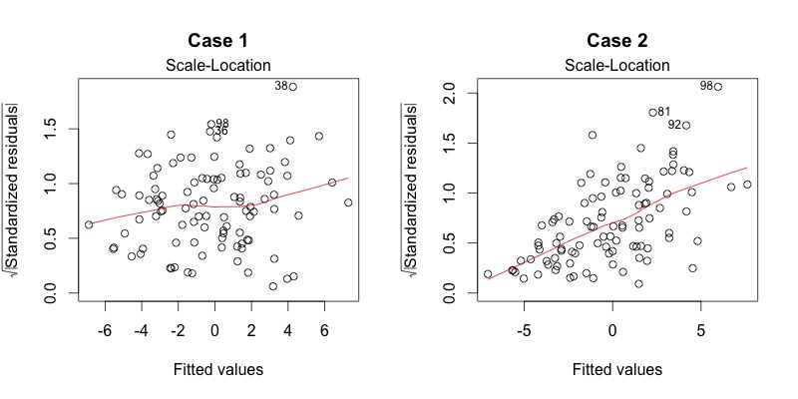
Checking Assumptions – Plots
Scale – Location
Checks for equal variance (homoscedasticity)
Want no discernable outliers or patterns
Notes:
Not linear Q-Q plots indicate skewed distributions

Slide 21
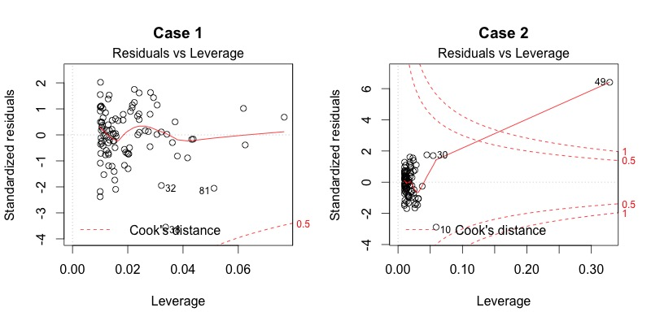
Checking Assumptions – Plots
Residuals vs Leverage
Which points have the greatest leverage or influence in the model
Look for points outside the “Cook’s Distance”
Notes:
Not linear Q-Q plots indicate skewed distributions

