Slide 1
MSDS 670
Jeremy Beard
Week 8 – Final Project
June 25 2023

Slide 2
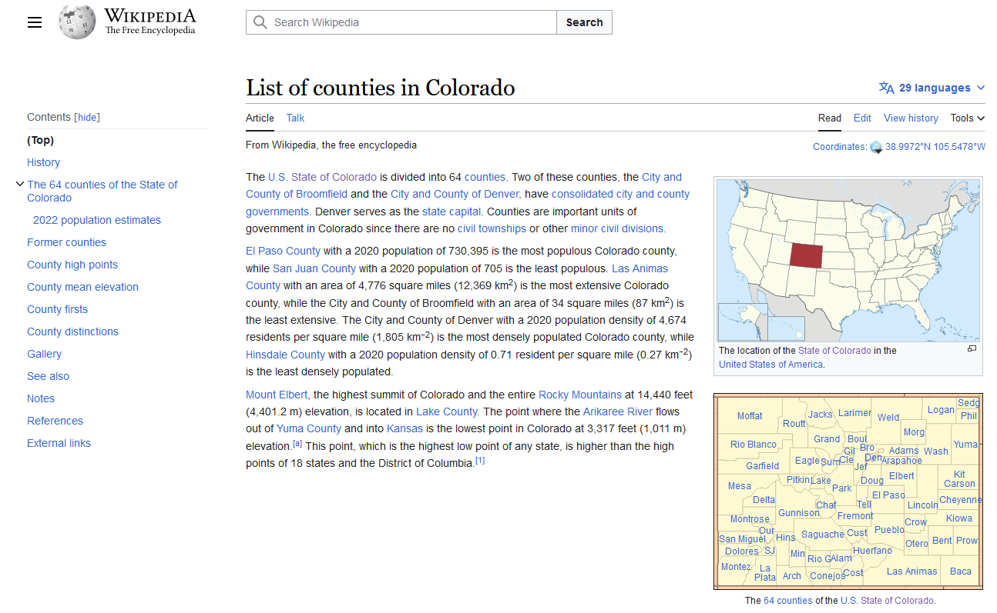
Overview
Data sourced from
web-scraped Wikipedia data
geojson/shape-file data downloaded from the web
See references
Population data specific to counties in Colorado was sourced
Multiple choropleth maps and bar charts were created
Comparisons created for the most crowded as well as the least crowded counties in Colorado
Source: https://en.wikipedia.org/wiki/List_of_counties_in_Colorado

Slide 3
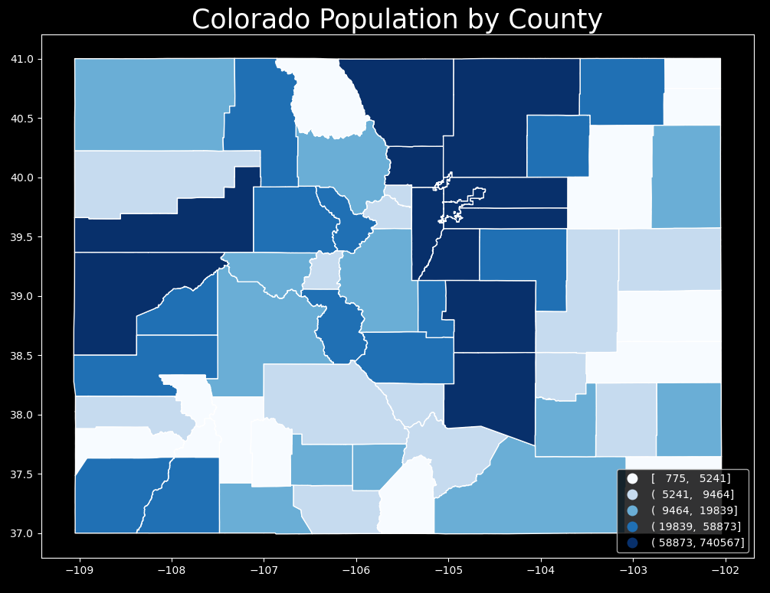
Visualization 1
Provides static look at populations within counties
Created in geopandas
White-Blue single-color mapping makes for easy comparisons
Takeaways:
The population definitely trends along I-25, from Colorado Springs up to Fort Collins
Could refine the colormap intervals a bit
Western Colorado population increased as well, why?
Getting close to Moab, close to I-70 still
Source: https://en.wikipedia.org/wiki/List_of_counties_in_Colorado

Slide 4
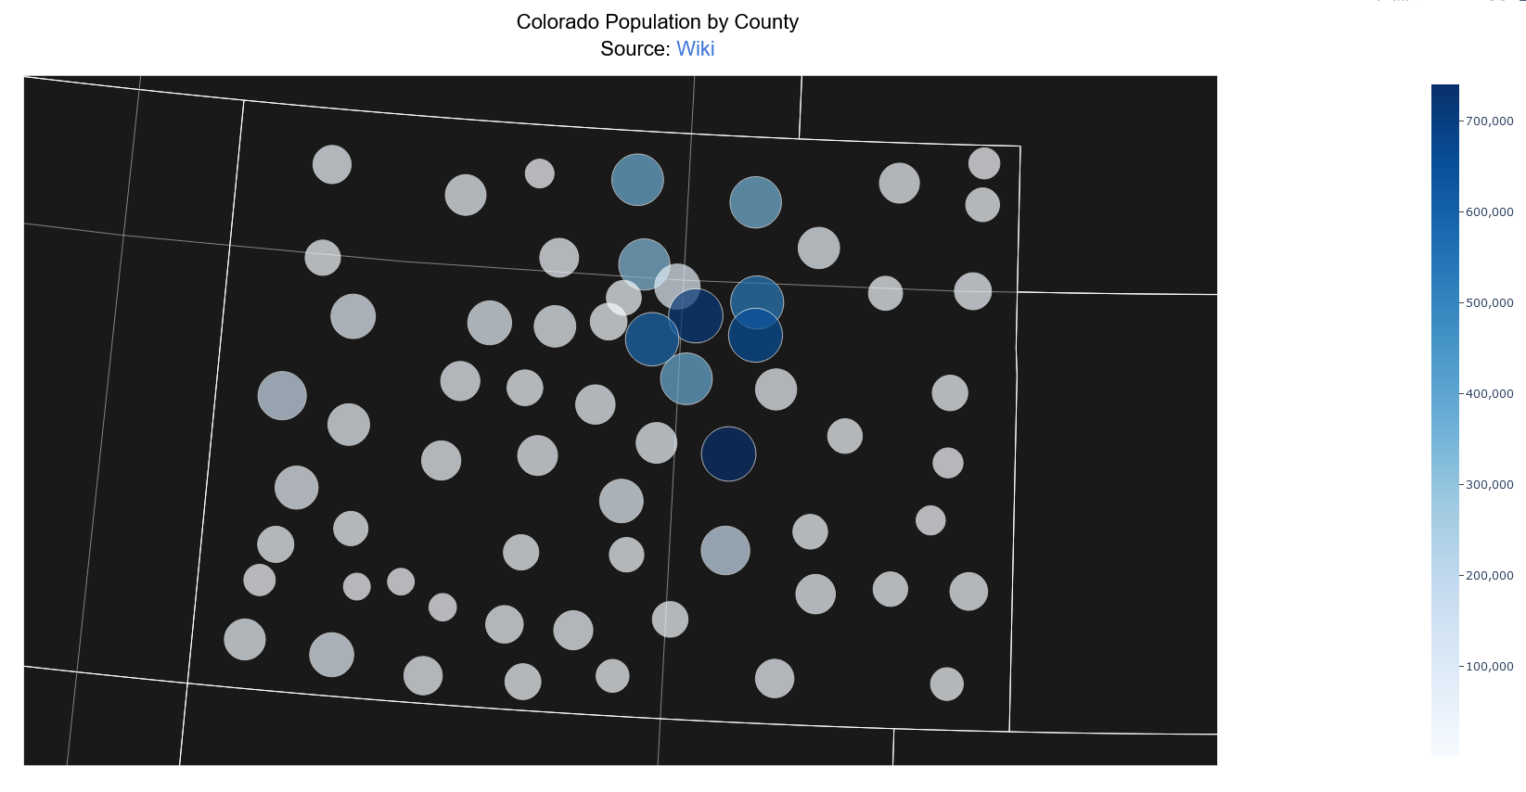
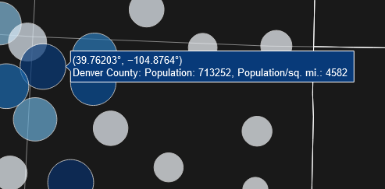
Visualization 2
Created using a plotly graph object Scattergeo visualization based on lat/lon coordinates
Interactive, tooltips show:
Lat/Lon
County name
Population
Population Density
Html, save-able. Source is linked in title
White-blue scale again
Transparency alters the colors a bit
Takeaways:
The I-25 trend is easily seen here as well with most blue circles clustered around the popular highway
Source: https://en.wikipedia.org/wiki/List_of_counties_in_Colorado

Slide 5
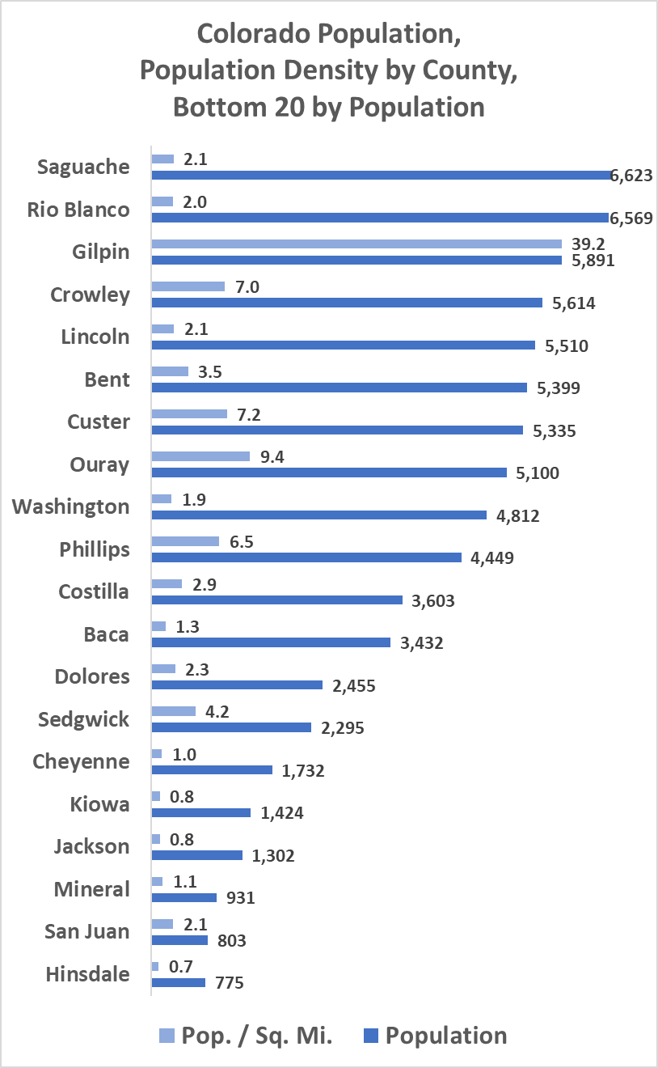
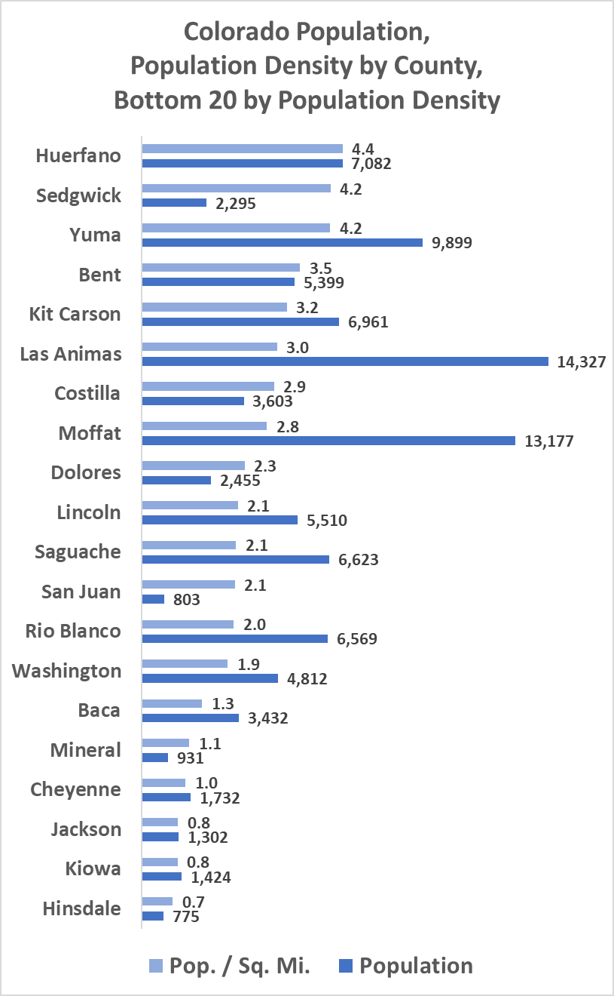
Visualization 3
A visualization of LEAST populated areas (Bottom 20)
Sorted by either population or population density
Leads to different comparisons
Takeaways:
Gilpin County is abnormally clustered/dense given its low population
Hinsdale is about as remote as you can get! By either metric
Jackson, Kiowa, Cheyenne all contenders
Source: https://en.wikipedia.org/wiki/List_of_counties_in_Colorado

Slide 6
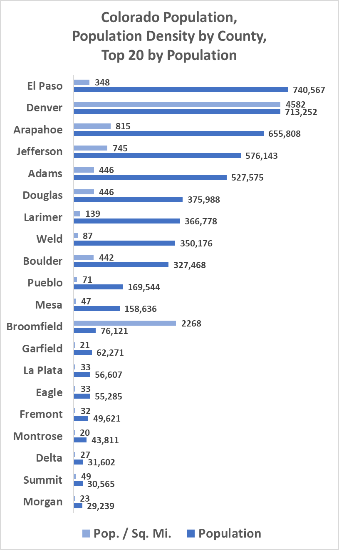
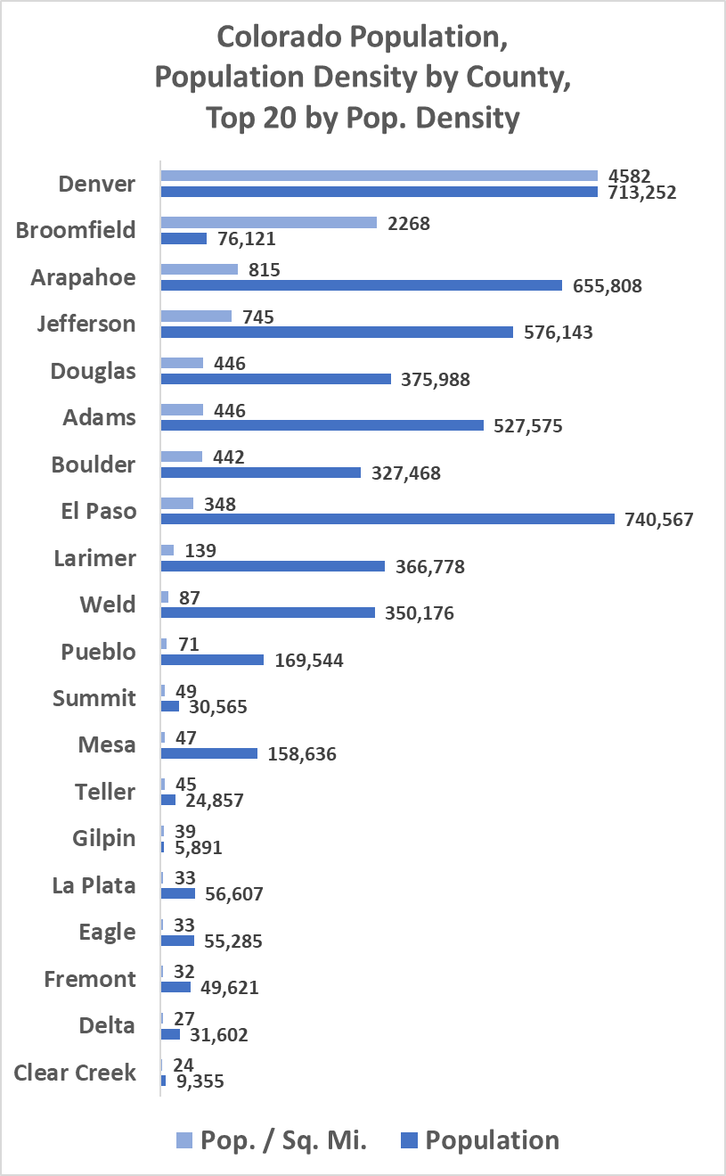
Visualization 4
A visualization of MOST populated areas (Top 20)
Sorted by either population or population density
Leads to different comparisons
Takeaways:
Denver is definitely crowded ☺
Broomfield is abnormally crowded given its lower population
El Paso has a huge population but also a huge area, still relatively not crowded
Source: https://en.wikipedia.org/wiki/List_of_counties_in_Colorado

Slide 7
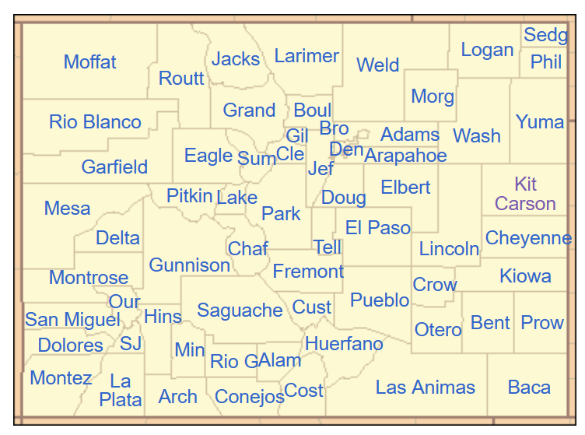
Conclusion
Source: https://en.wikipedia.org/wiki/List_of_counties_in_Colorado
The population definitely spikes along the major highways in Colorado
I-25, I-70
Interactive charts are more useful at the time of viewing
Hard to provide all the information at once though
Hinsdale is about as remote as you can get! By either metric
Jackson, Kiowa, Cheyenne all very remote
Broomfield is abnormally crowded given its lower population
Denver is definitely crowded
Future Thoughts
A 3D bar chart of population density would be really cool
Need to compare Denver county with other major cities across the US now
Need to bring in housing availability, start to calculate a home affordability value
Would like to get more granular
Would like to bring in other factors too
Plotly was being difficult with shapefiles but I’d like to re-visit
Most Crowded Areas in Colorado
Least Crowded Areas in Colorado

Slide 8
References
https://en.wikipedia.org/wiki/List_of_counties_in_Colorado
https://www.youtube.com/watch?v=7NmBCUOIYPk
https://plotly.com/python/scatter-plots-on-maps/#geographical-scatter-plot-with-pxscattergeo
https://matplotlib.org/stable/tutorials/colors/colormaps.html
https://data-cdphe.opendata.arcgis.com/datasets/colorado-county-boundaries/explore

