Slide 1
MSDS 670
Jeremy Beard
Week 1 Assignment

Slide 2
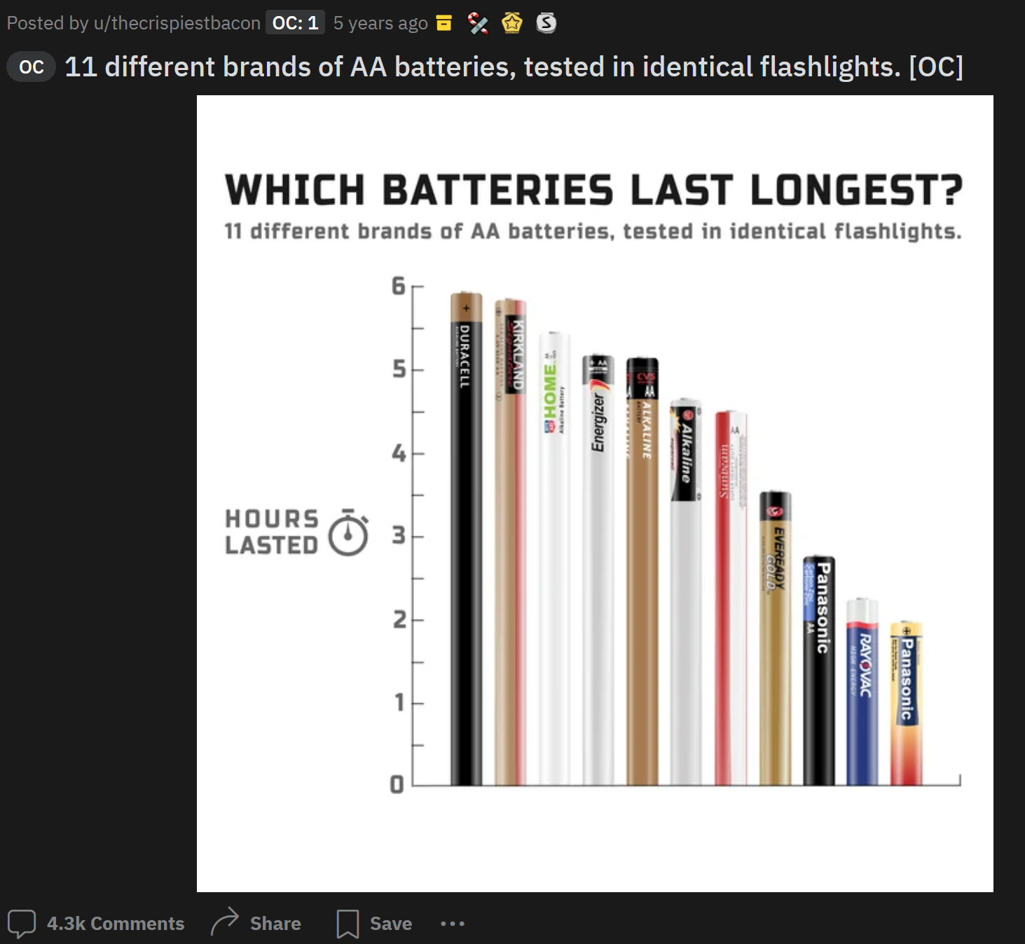
Best Overall Chart
Clear, concise
Gridlines removed for clarity
Easily understood
Creative display of bars
No x-axis needed – brands shown clearly
0-axis test = PASSED
Increases my faith in the Kirkland brand

Slide 3
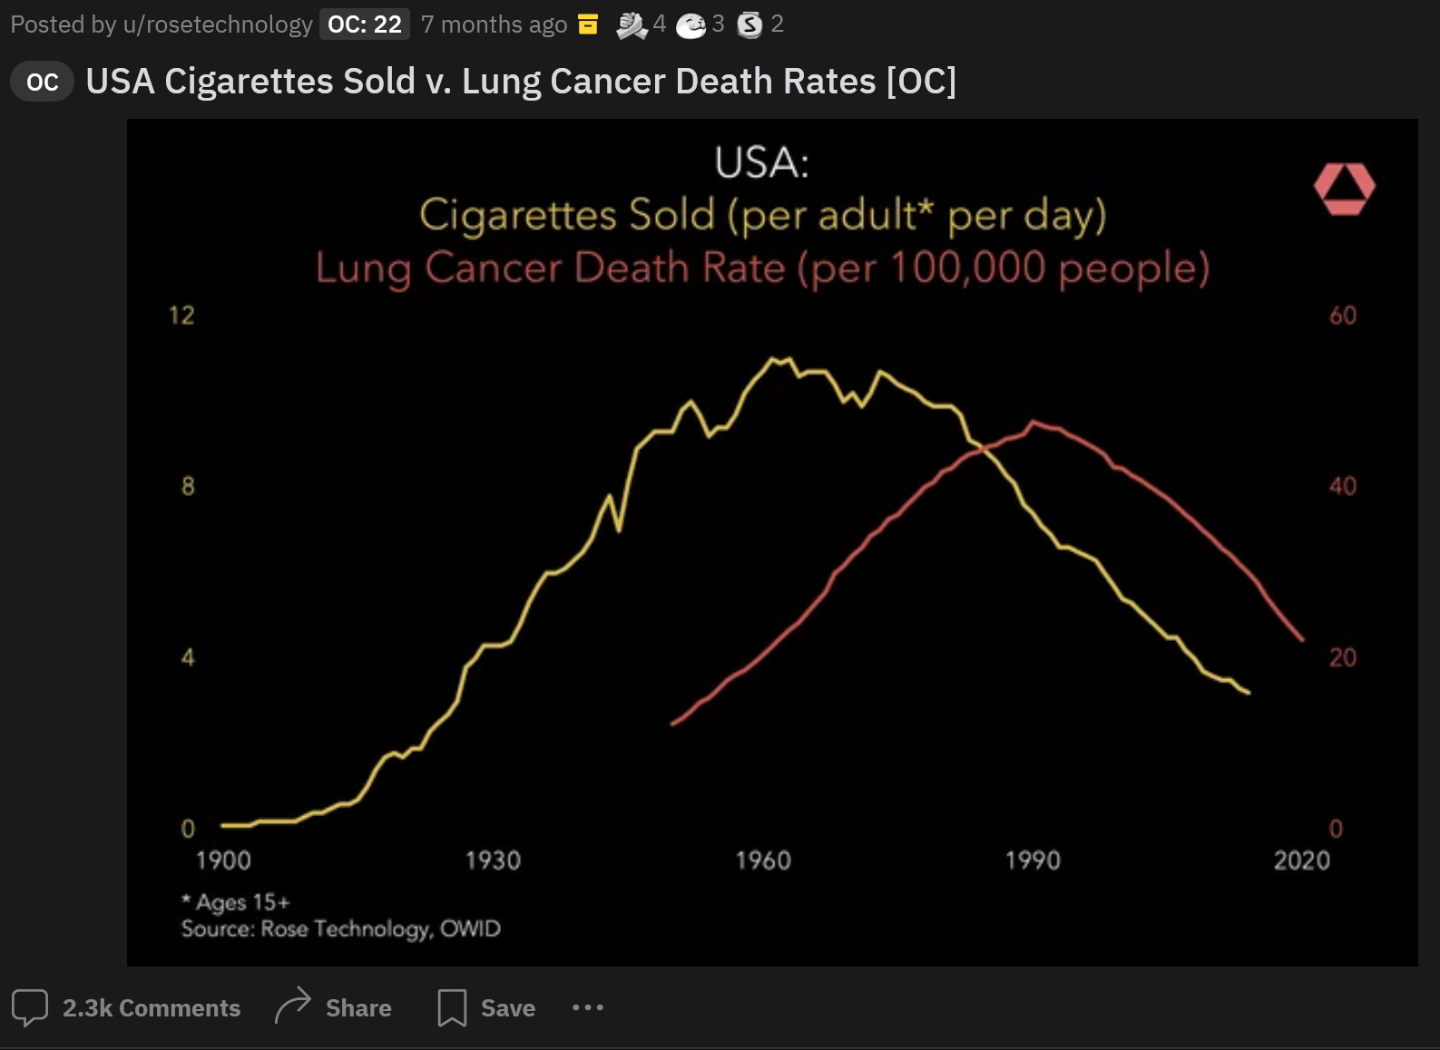
2nd Best Chart
No gridlines or borders = Clean
Easily understood (cigs are bad)
Sources cited
Simple

Slide 4
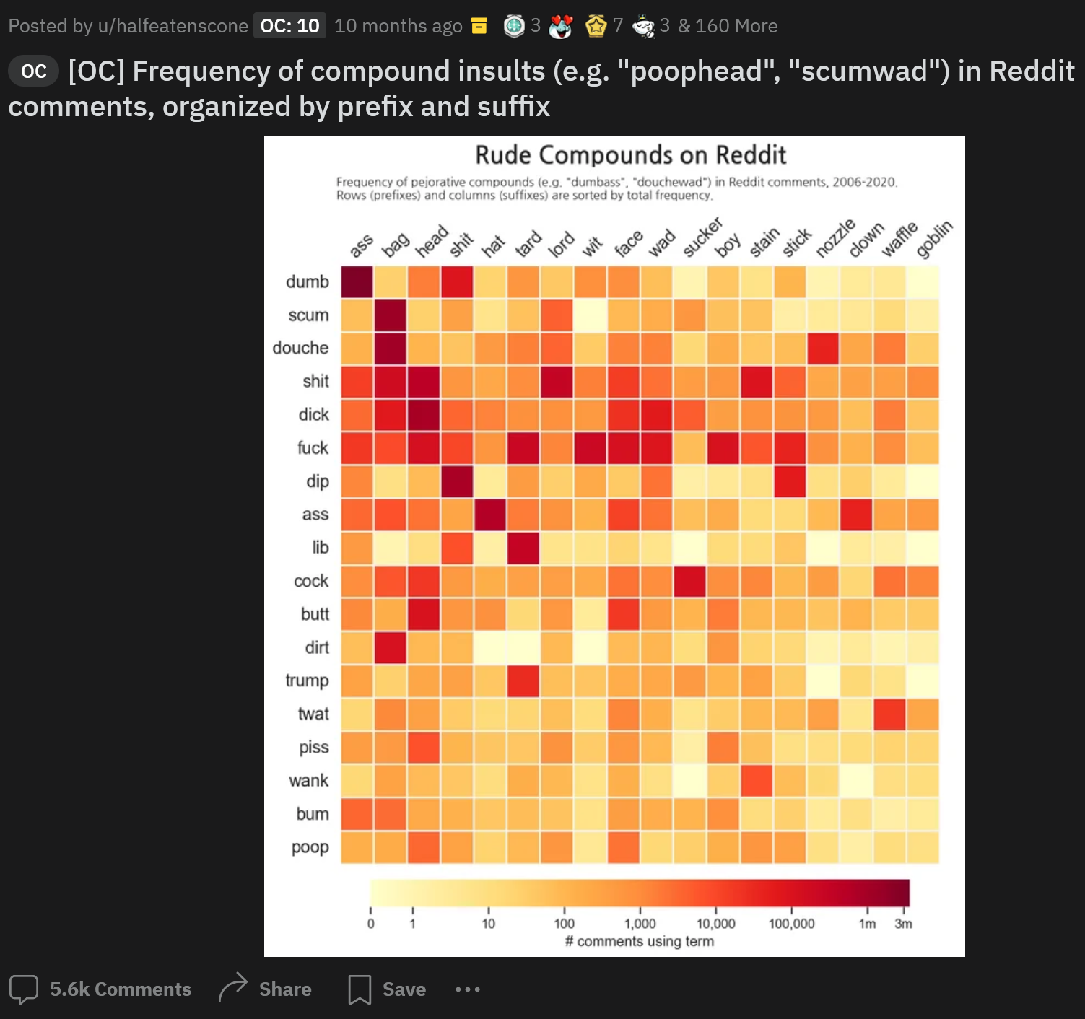
3rd Best Chart (explicit language used)
Use of color = effective and simple
Different shades of one color (red) = easily compared
Provides a lot of information without being unorganized
Creative idea

Slide 5
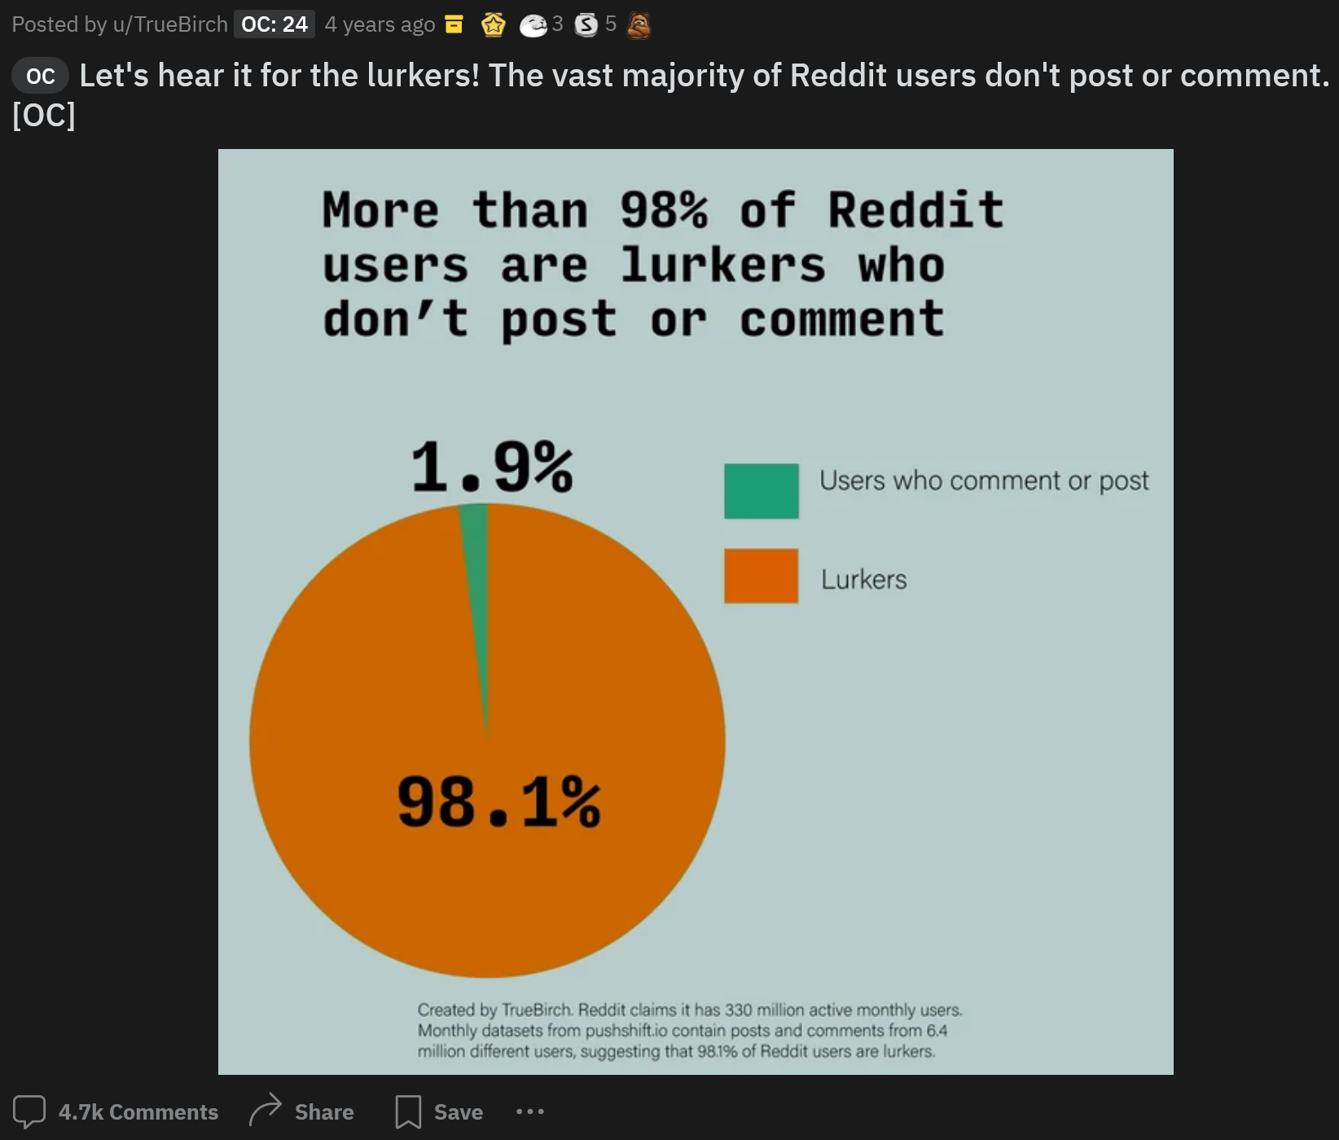
Worst Overall Chart
PIE CHART
Ms. Knaflic would not approve
Not necessary at all
Could be simplified to a statement
Doesn’t provide critical information

Slide 6
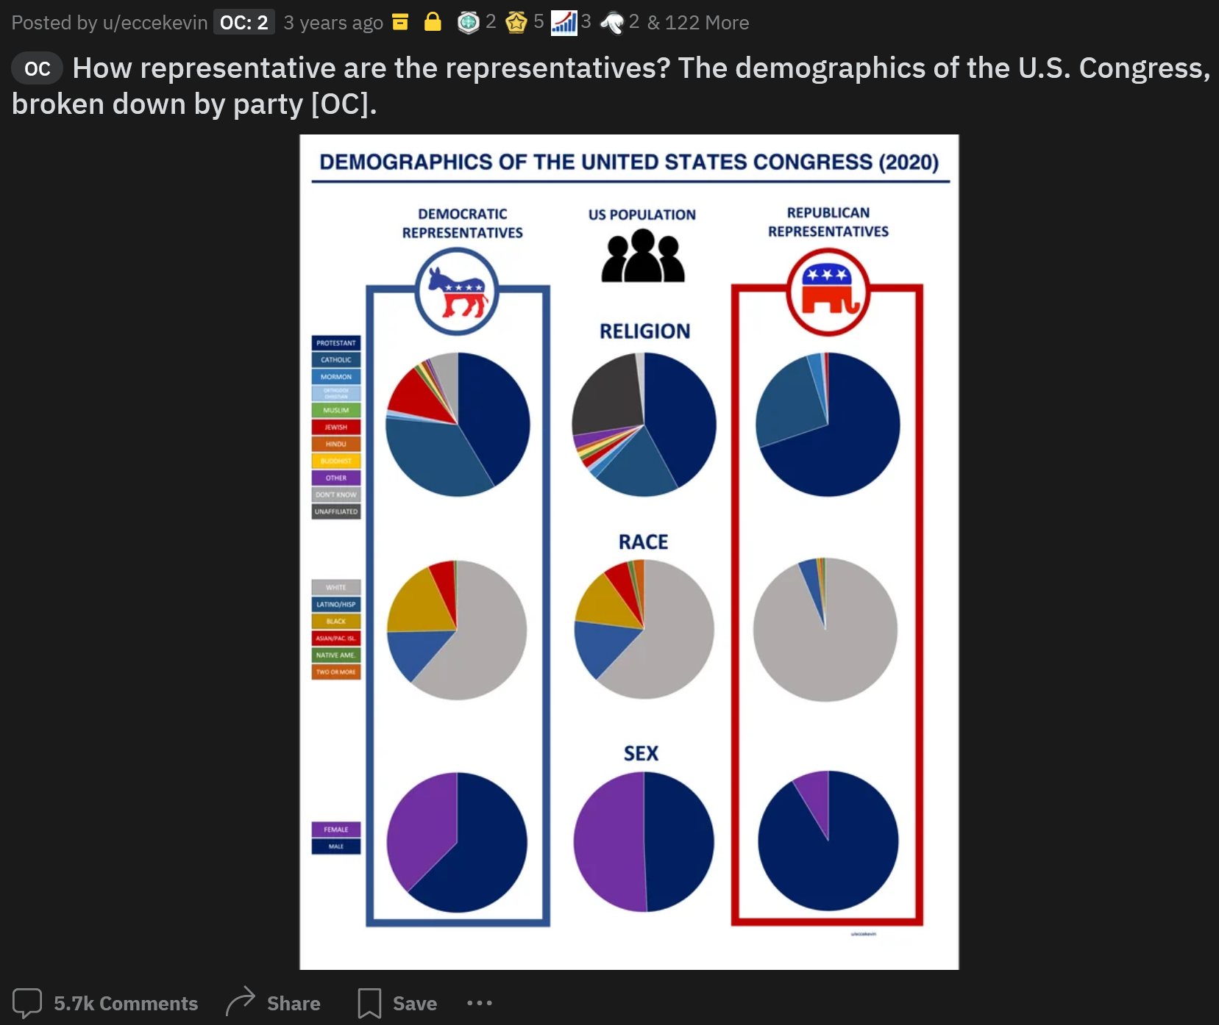
2nd Worst Chart
PIE CHART
Hard to compare
Too many small categories, could be better visualized in a different format
Very “busy”

Slide 7
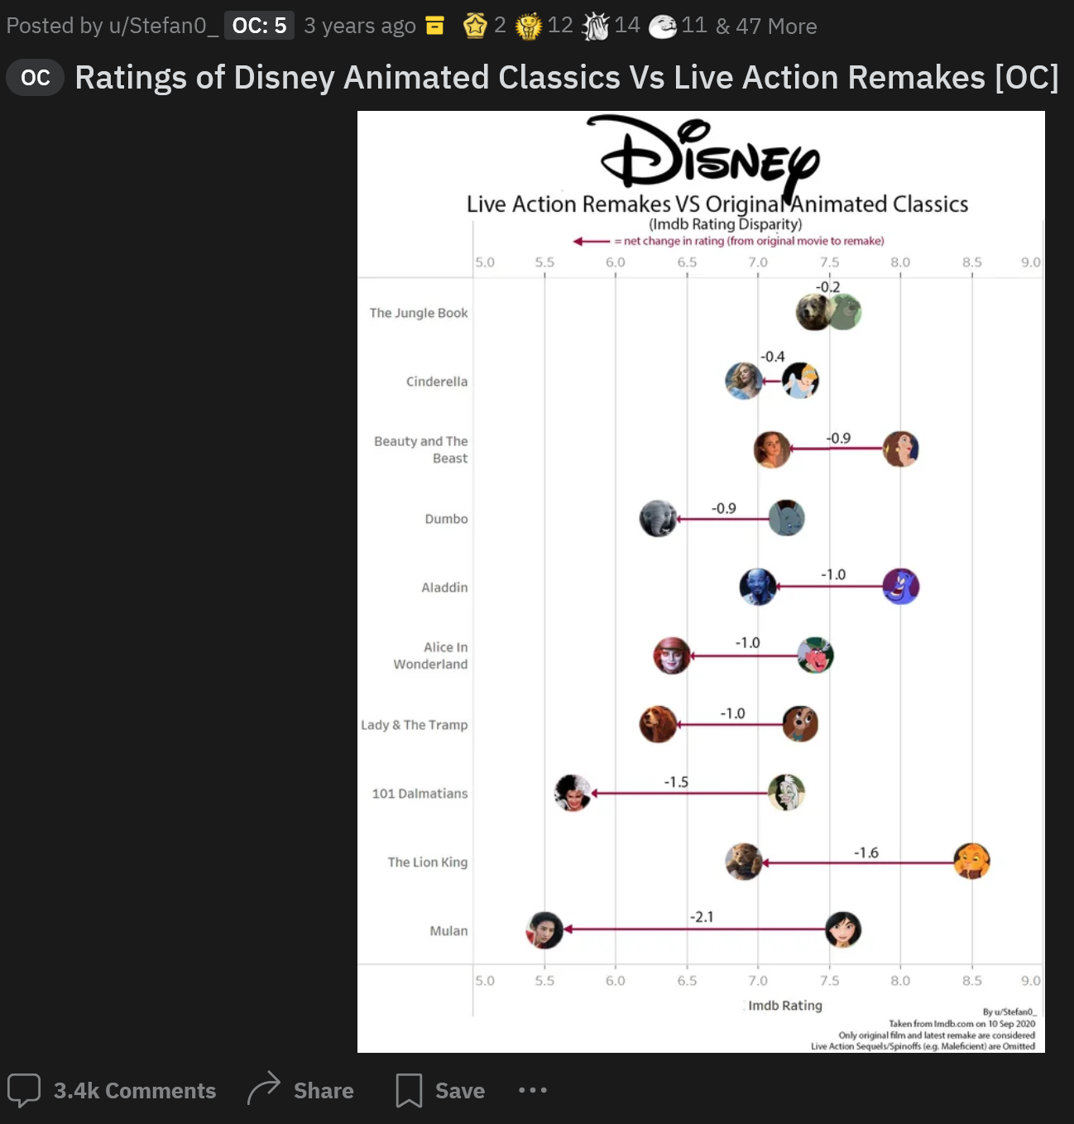
3rd Worst Chart
Big no-no for me: x-axis starts at 5.0, not 0
Vertical gridlines not needed
Text is too small, images/bubbles could be bigger too

Slide 8
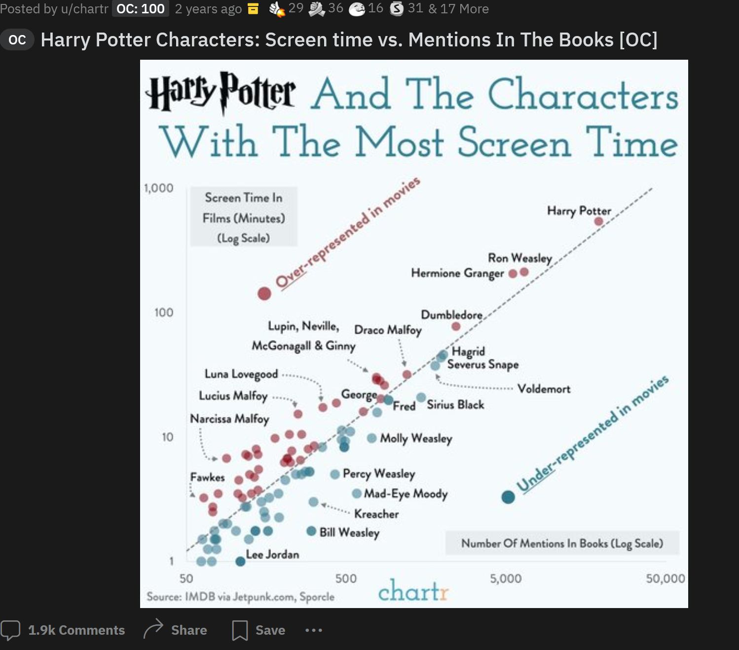
4th Worst Chart (Bonus)
Too busy
Not sure of a cleaner way to provide this information
Not all datapoints are labeled
Should do character faces instead of labeled datapoints
Not easily understandable at first glance
“and the” is capitalized in title ☺

