Slide 1
MSDS 670
Jeremy Beard
Week 2 Assignment
Data Dashboards

Slide 2
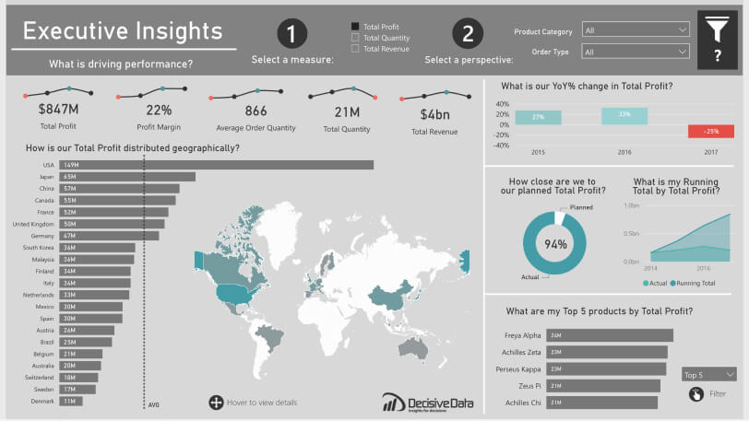
Best Dashboard - Dashboard 21
Easily understood horizontal bar chart
A lot of information conveyed, with values
Interactive – can see options on top toolbar
Blues/Reds – effective use of color when needed
Easily insightful
Possibly improve through changing donut chart
Source: https://powerbi.microsoft.com/en-us/data-dashboards/

Slide 3
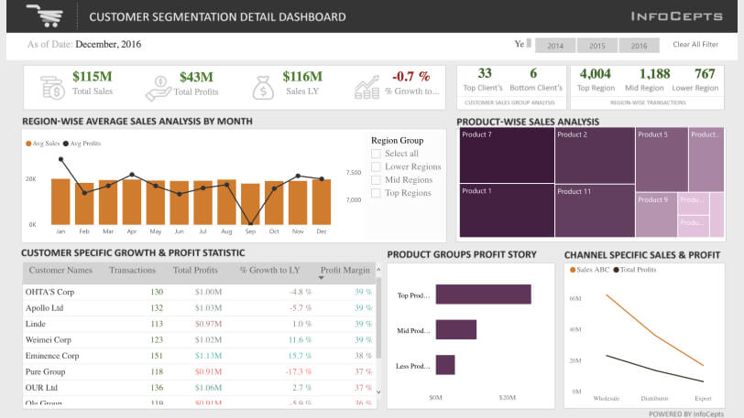
2nd Best Dashboard - Dashboard 20
A lot of information conveyed
Bar charts and line charts = yes
Figures on top toolbar – easily understood
Product-wise Sales Analysis – creative and effective
Interactive – can choose years in top-right
Could possibly improve through font change
Times New Roman is a bit stale
Source: https://powerbi.microsoft.com/en-us/data-dashboards/

Slide 4
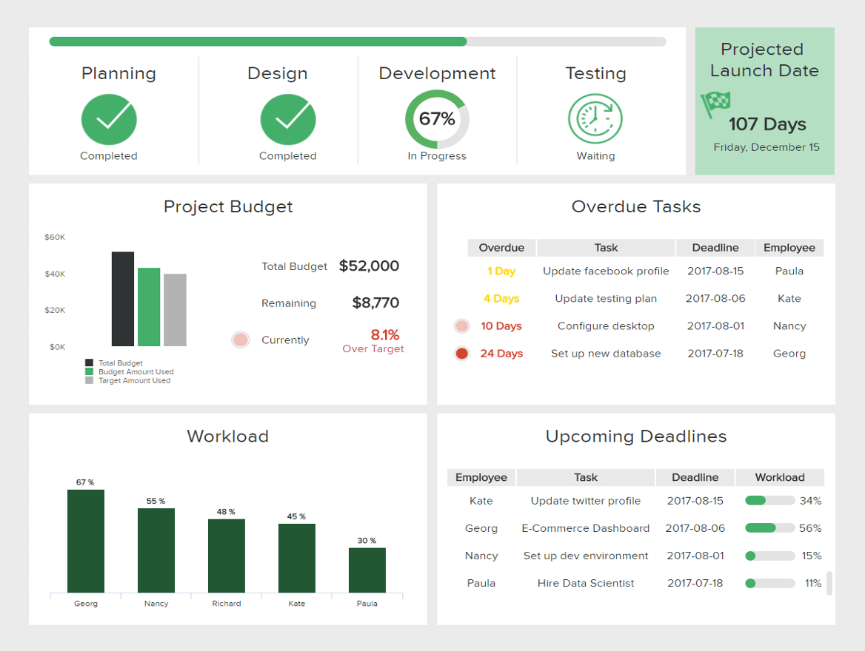
3rd Best Dashboard - Dashboard 24
A lot of information conveyed
Focus of dashboard = easily understood
Current project progress
Bar chart color differences utilized where necessary
Omitted when not necessary
Task charts utilize yellow/red/green colors effectively
Colors aren’t too strong
Source: https://www.datapine.com/blog/data-dashboards-definition-examples-templates/

Slide 5
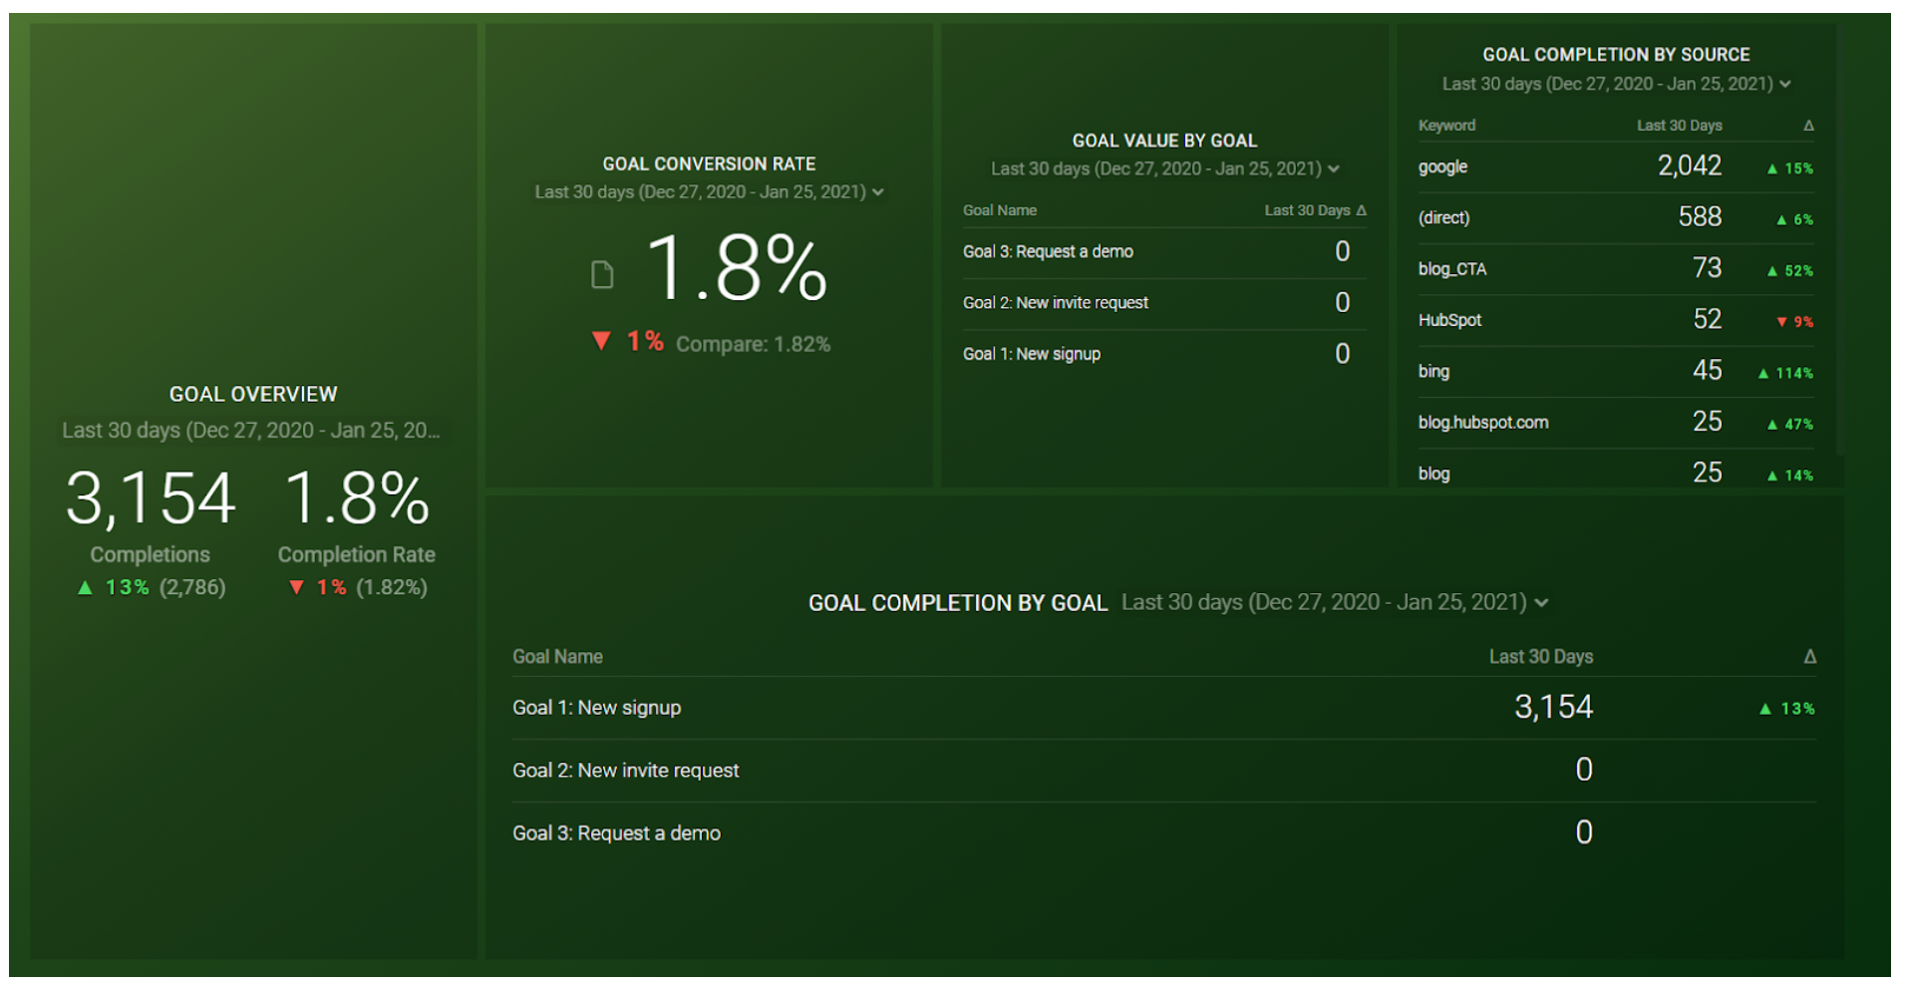
Worst Dashboard - Dashboard 03
Not a lot of information
3 figures could be displayed much more effectively
Lots of 0’s – are we showing the right data? Bad use of space
No charts – boring and ineffective
Green background a bit strong
Overall dashboard seems lazy and unimportant
Ineffective at enabling decision-making
Source: https://databox.com/data-dashboard

Slide 6
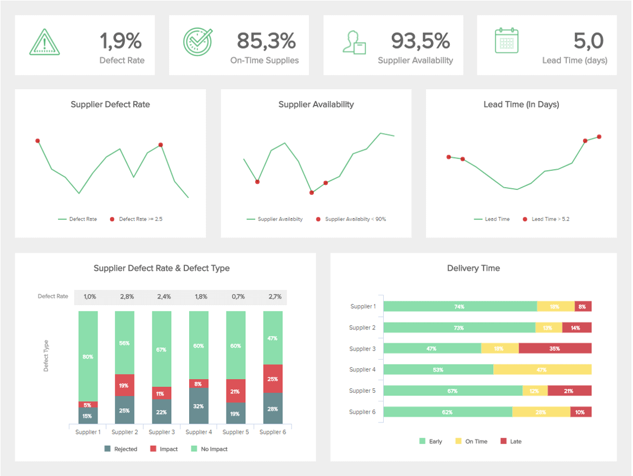
2nd Worst Dashboard - Dashboard 25
No way to understand line-chart values – unclear
Stacked bar charts – hard to understand and compare
Mixing vertical and horizontal stacked bar charts – cluttered
White text on yellow bars – difficult to read
Could show more figures on top toolbar
Source: https://www.datapine.com/blog/data-dashboards-definition-examples-templates/

Slide 7
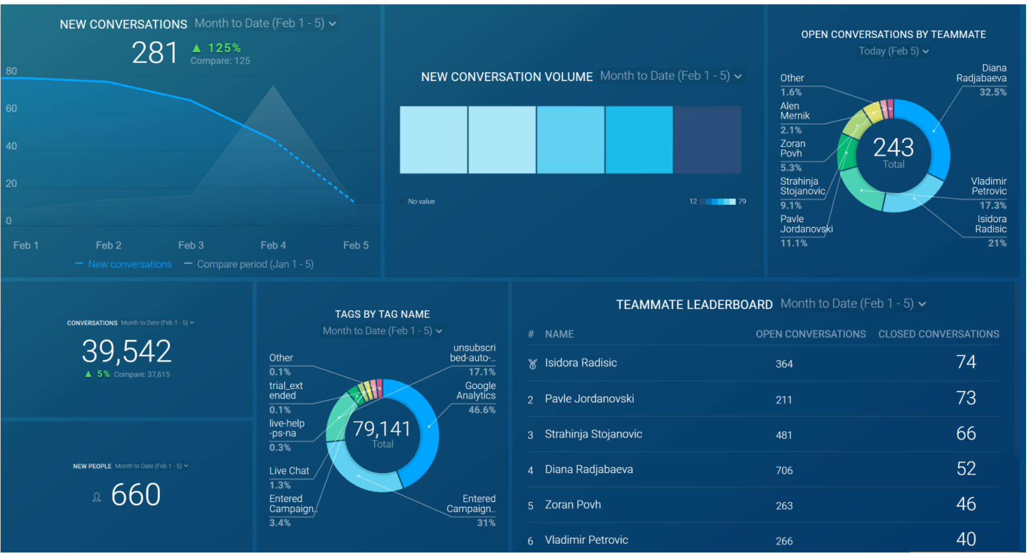
3rd Worst Dashboard - Dashboard 11
Too many donut charts – hard to understand and compare
Could use up/down arrow indications on the lower-right values
“New Conversation Volume” hard to understand
Overall dashboard is confusing and hard to draw conclusions from
What story are we telling?
Source: https://databox.com/data-dashboard

