Slide 1
MSDS 670
Jeremy Beard
Week 4 – Midterm Project
May 29 2023

Slide 2
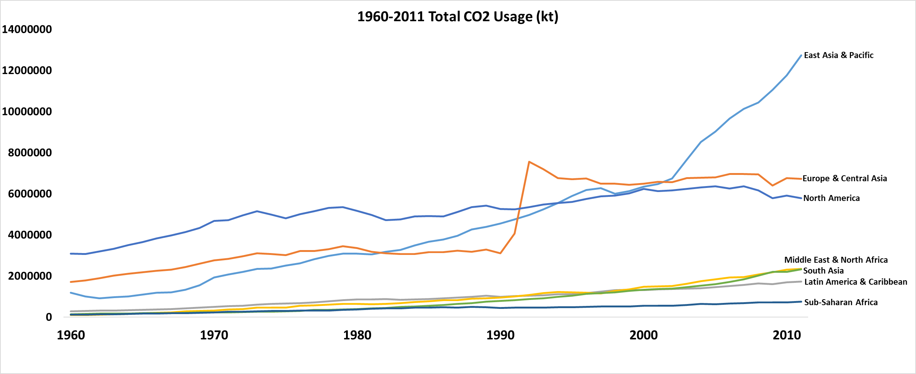
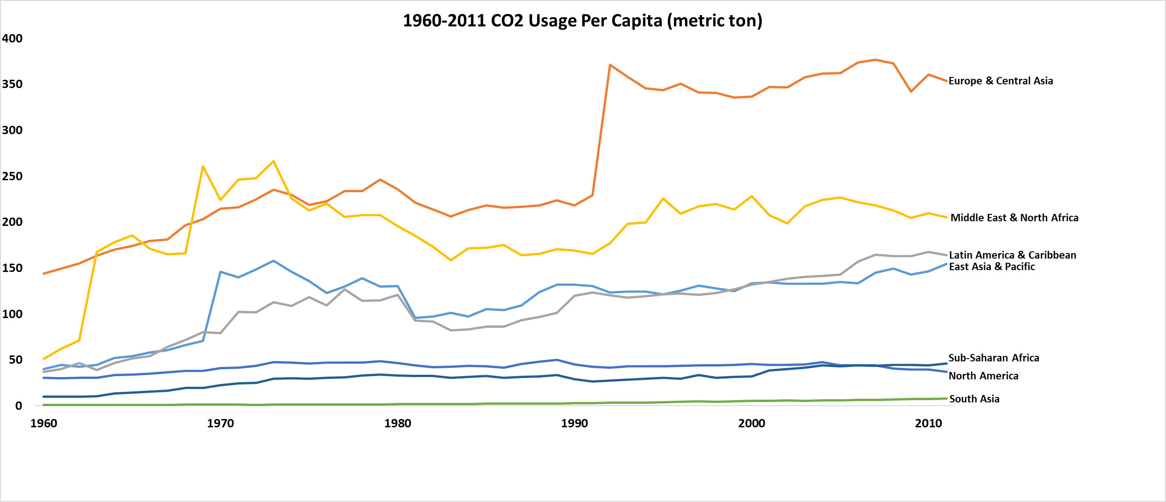
Visualization 1
Provides multiple angles of comparison
Total Usage vs. Per Capita Usage
Usage of color for contrast between groups
Clean, no gridlines, simplified axes, no legend
Takeaways:
Region choice/groupings of countries could be investigated further → Usage by Regions could be inherently misleading or biased
North America’s low usage per capita surprised me…I thought that United States and Canada would have influenced those results more
Source: World Bank CO2.xlsx

Slide 3
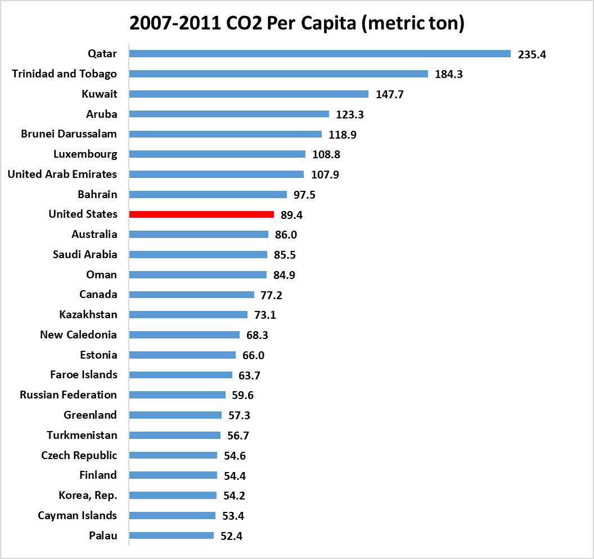
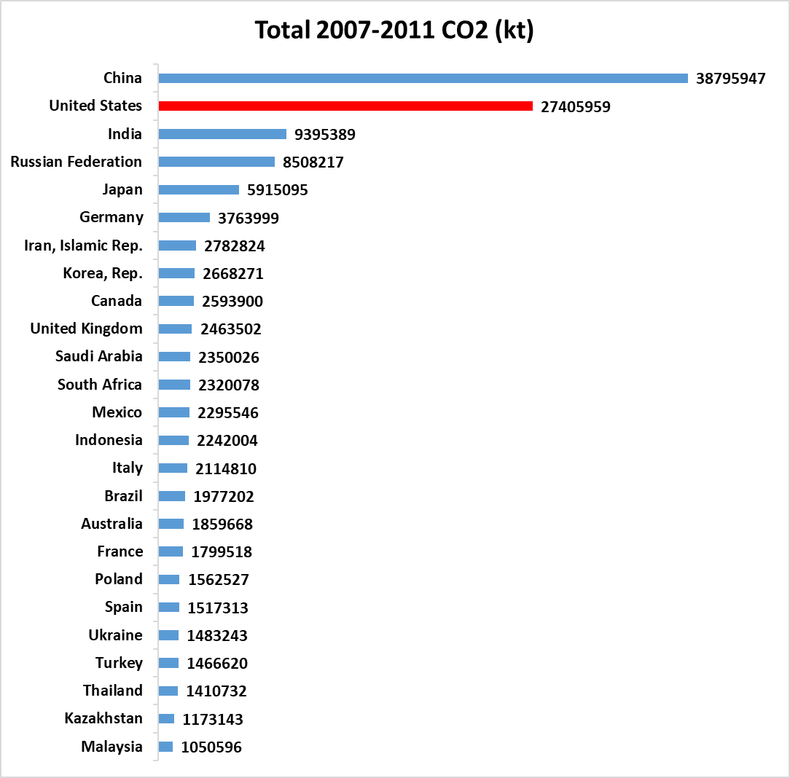
Visualization 2
Clean, no gridlines, no legend, data labels rounded
Usage of color to highlight interest group (USA)
Units of measure included
Only Top 25 included to maximize visibility
Takeaways:
Highlight high usage of CO2 by USA
Questions of overall population vs. overall usage can be explored with these charts
Source: World Bank CO2.xlsx

Slide 4
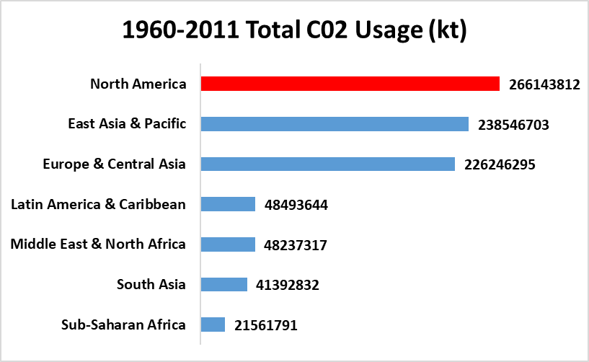
Visualization 3
Simple, clean, no gridlines, no legend, datalabels rounded
Color used to highlight interest group (North America/USA)
Takeaways:
North America: obvious high usage of C02
Needs verification of the regions/borders, could have inherent bias/inaccuracy, rendering comparison useless
Low usage of C02 in Africa
Source: World Bank CO2.xlsx

Slide 5
Conclusion
United States is a high producer of C02, both total and per capita
Higher ranking in ‘total usage’, compared to ‘per capita usage’
Africa overall a very low producer of C02
China, India, Russia, Japan, Germany also high producers of C02
Further questions remain about how different regions were chosen, why so many regions within Asia
Conclusion: How to reduce our production of C02 as a nation
Better public transportation options
Connected Vehicle Environments in order to manage traffic
More localized services

