Slide 1
MSDS 670
Jeremy Beard
Week 6 – Matplotlib
June 11 2023

Slide 2
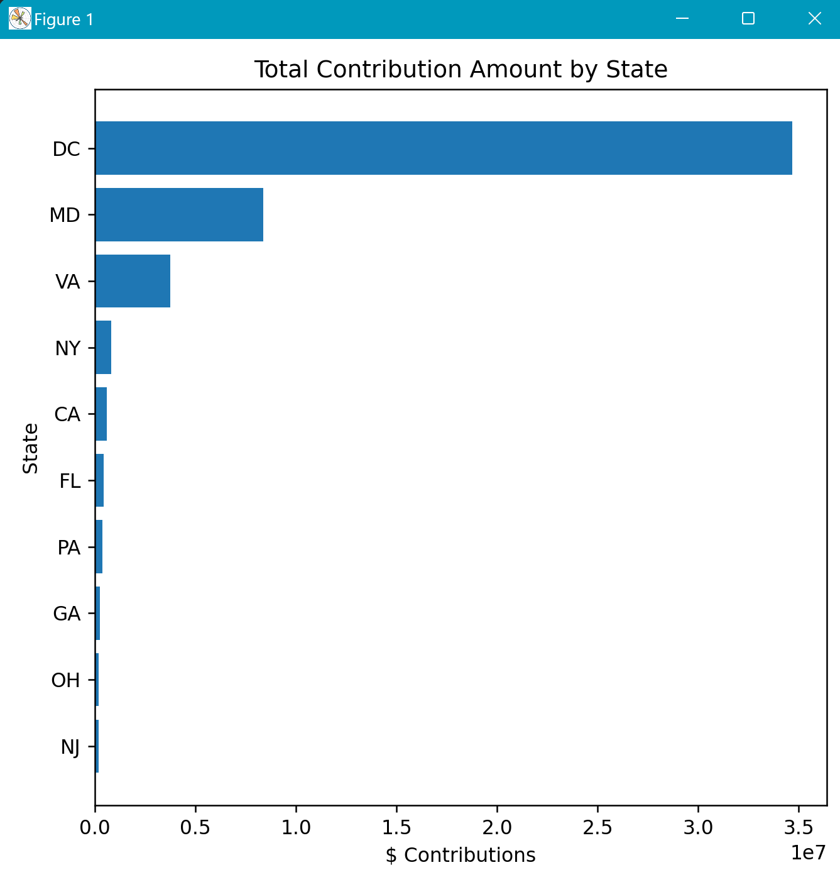
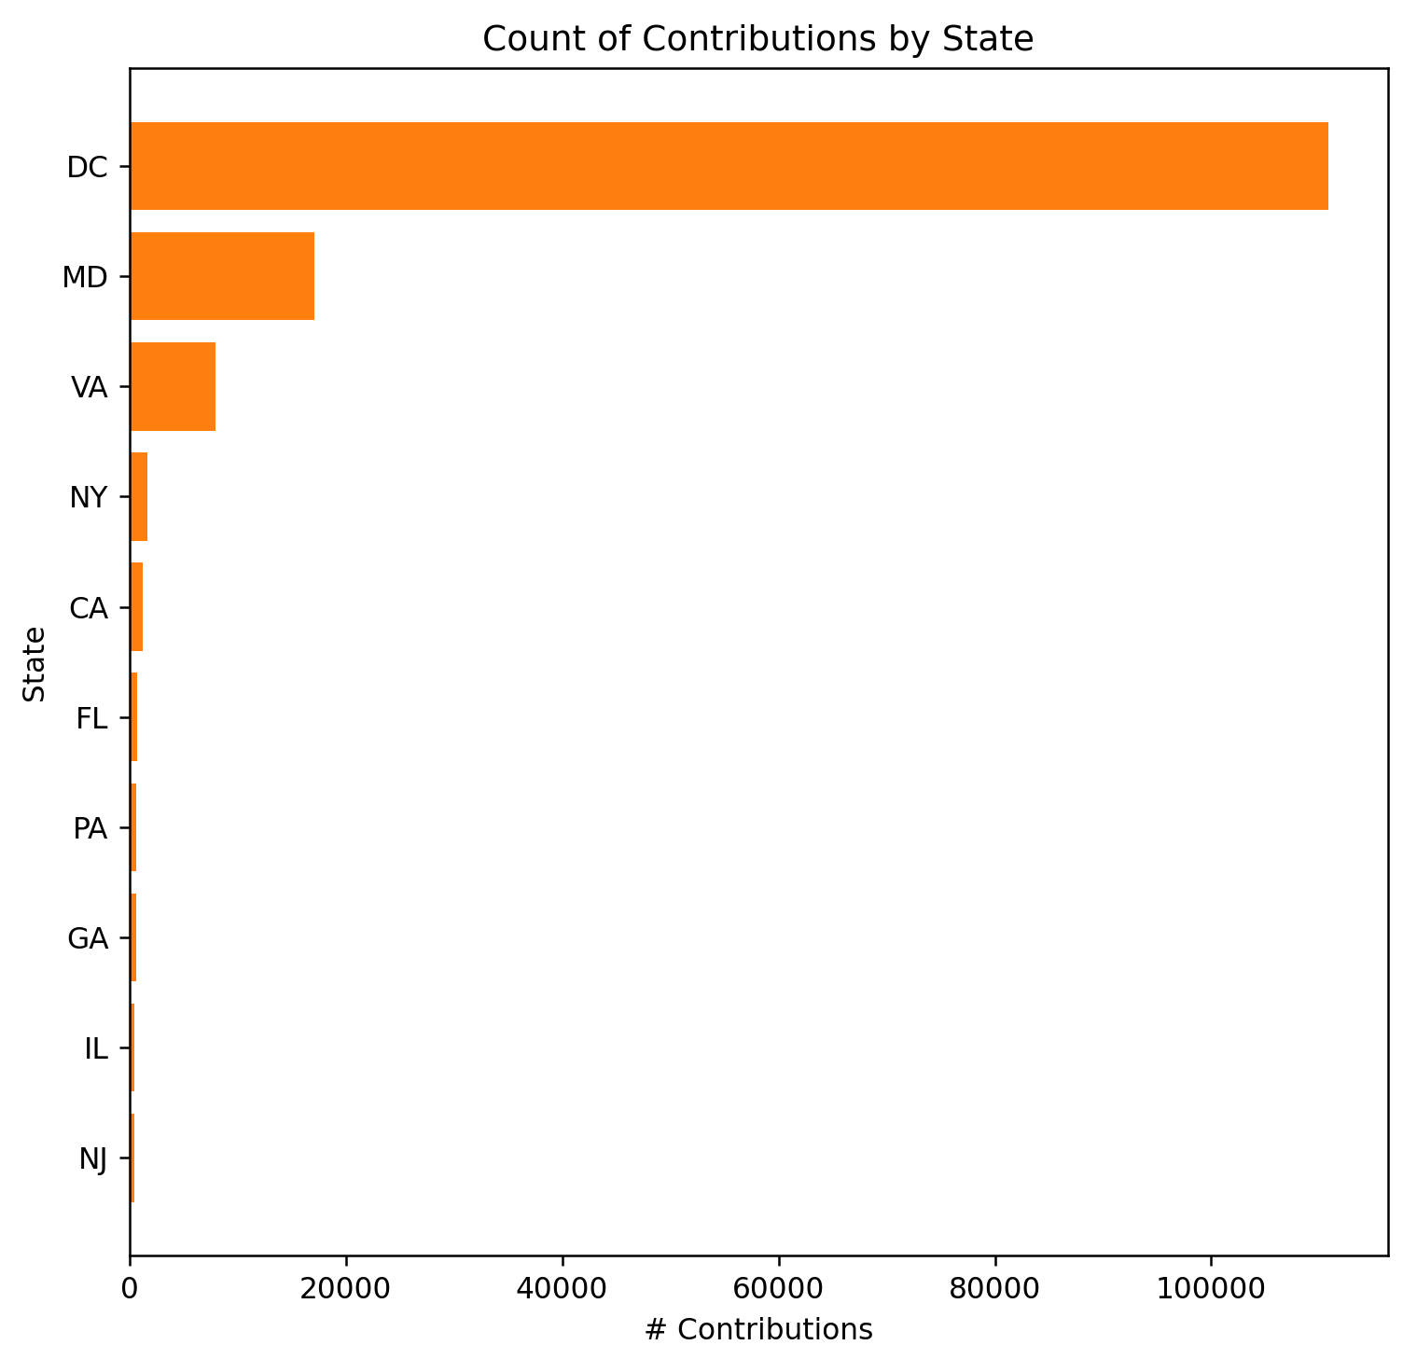
Visualization 1
State breakdown of campaign contributions
DC and MD have top contributions for both charts, makes sense
Could utilize shared y axes in the future
Wasn’t too cluttered as it is now, left it alone
Takeaway: in a DC election, DC rightfully has the most campaign contributions and the most money staked in the DC election
Maryland rightfully a close 2nd
Source: DC political contributions.csv

Slide 3
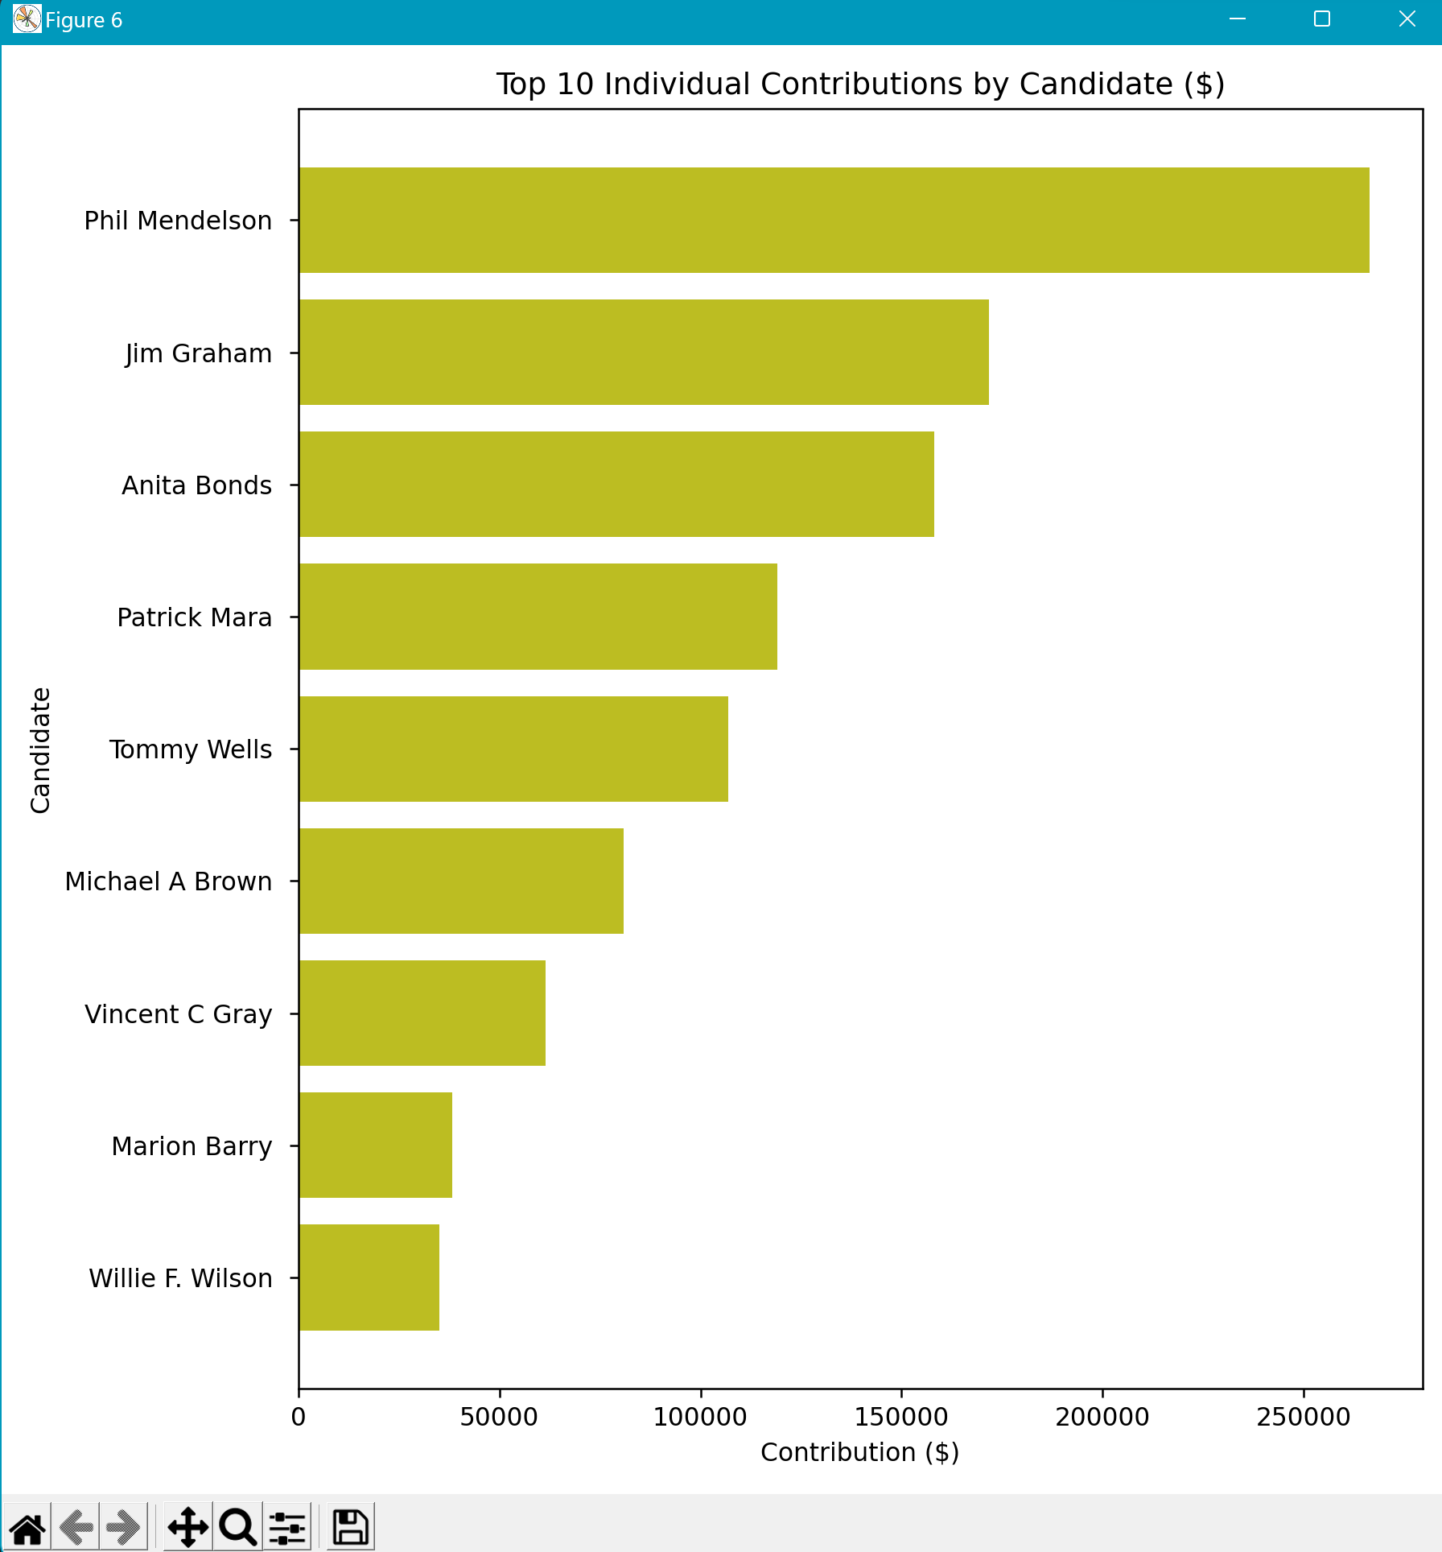
Visualization 2
Shock-value chart for Top 10 overall donations/contributions
Phil Mendelson has some rich friends
Axes could maybe be formatted better
Kept the 0’s for shock value
Could utilize bolding for axes
Takeaway: Phil Mendelson has some rich friends, what do they want? What will be Phil’s result in the election?
Source: DC political contributions.csv

Slide 4
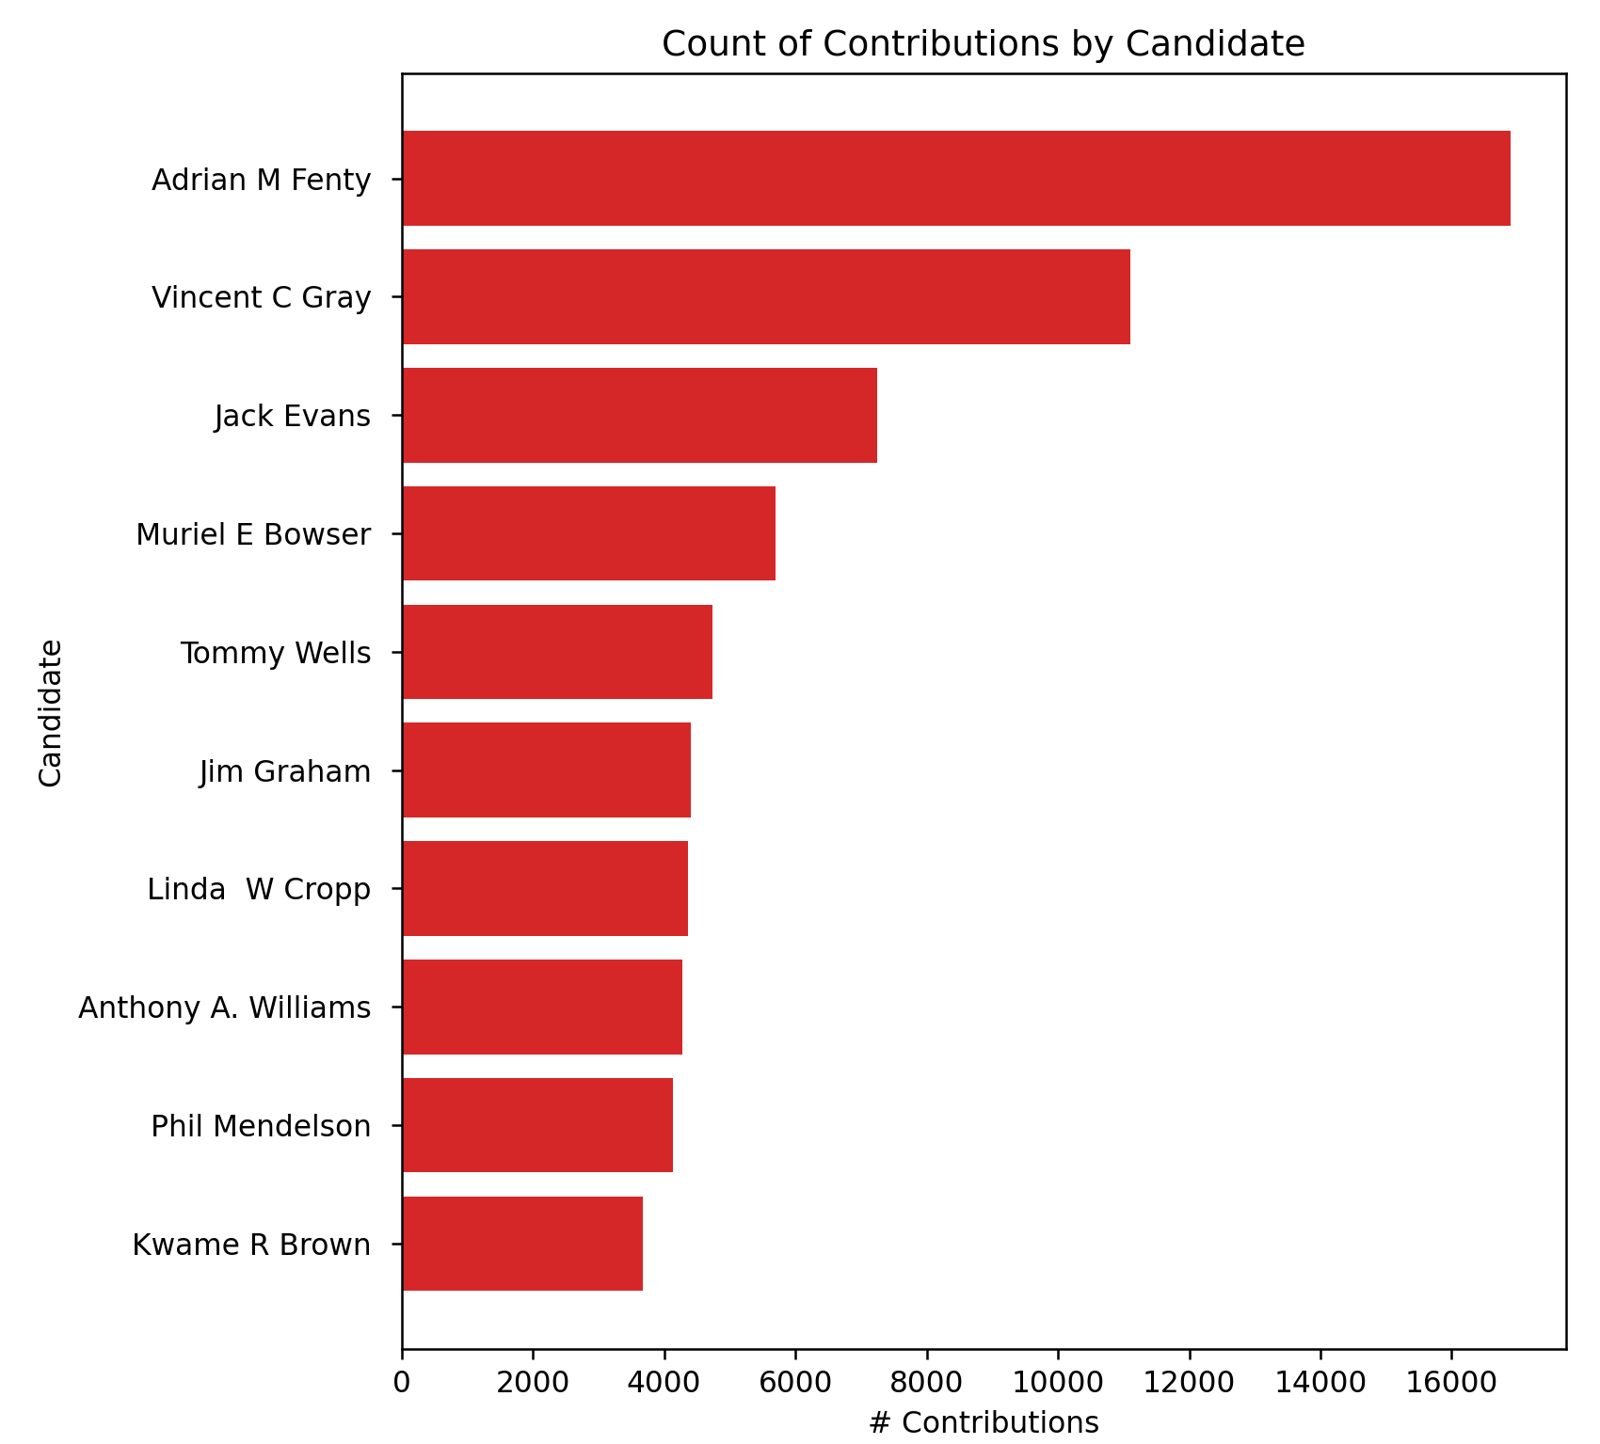
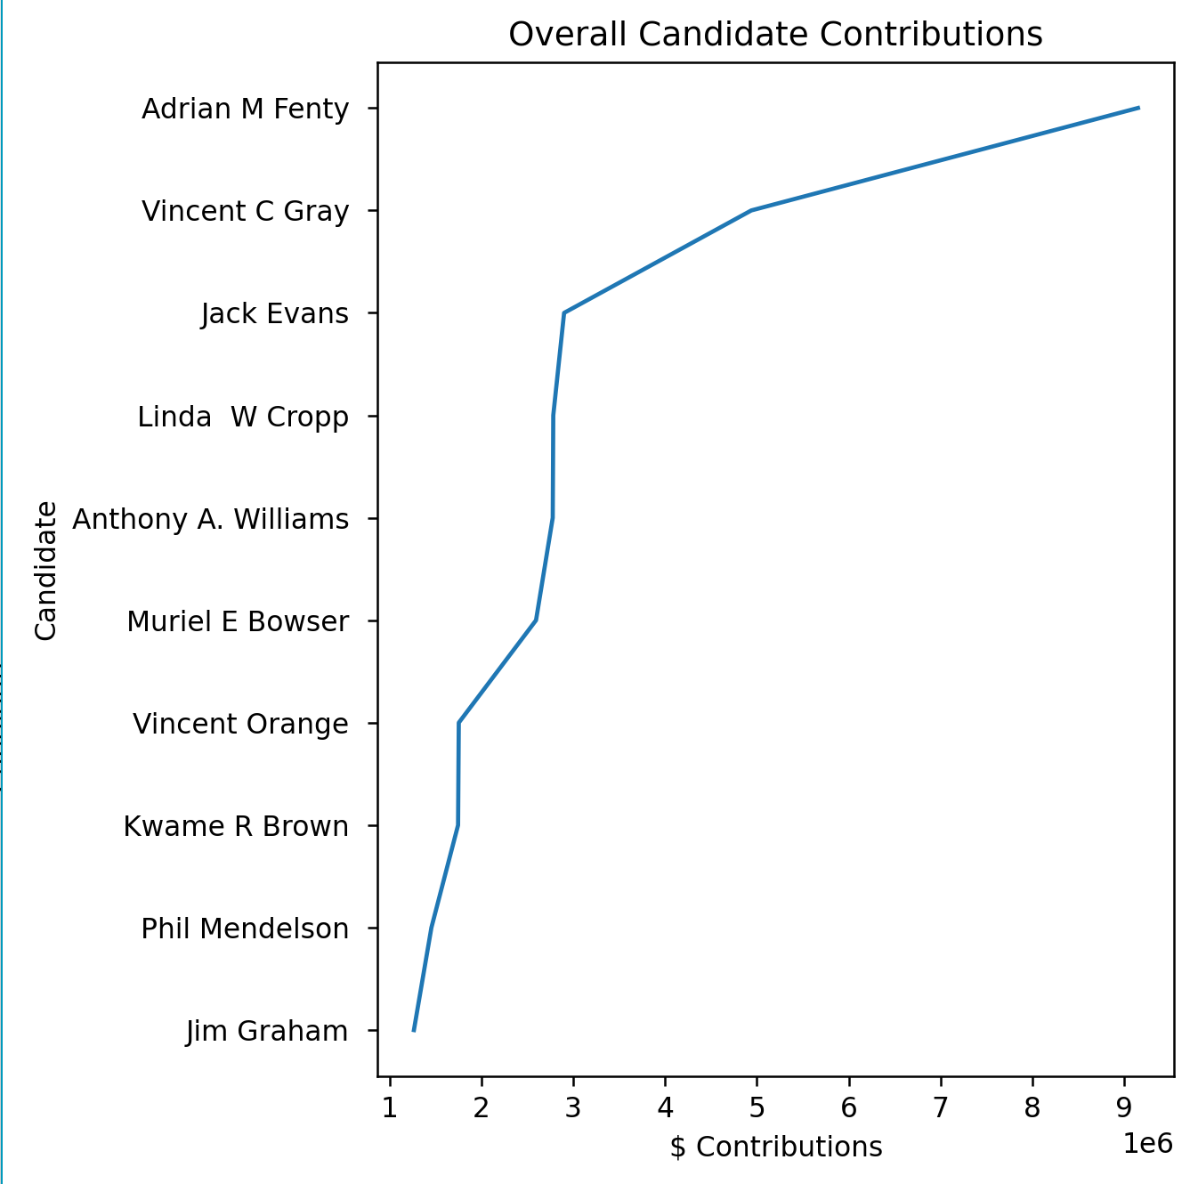
Visualization 3
No gridlines, no legend, no need for multiple colors
Contribution Count vs. Overall Contribution Dollar Amoun
Multiple angles shown
Didn’t need to set x/y limits
Was satisfied with defaults
Takeaway: Adrian M Fenty has had a high amount of campaign contributions compared to his competitors. Will this correlate to his election result?
Vincent C Gray a semi-close 2nd
Source: DC political contributions.csv

Slide 5
Conclusion
The data shows that mostly Washington D.C. and Maryland contributed to the DC election data, which makes sense. I would expect that only Washington D.C. and Maryland have much stake in a Washington D.C. election.
Phil Mendelson had the highest individual contribution
Interesting
Adrian M Fenty received the most campaign contributions overall, both in count and in dollar amount overall
Will Adrian win? Did Adrian win?
Who are Adrian’s funding sources? What are their intentions?

