Slide 1
MSDS 670
Jeremy Beard
Week 7 – Advanced Visualizations
June 18 2023

Slide 2
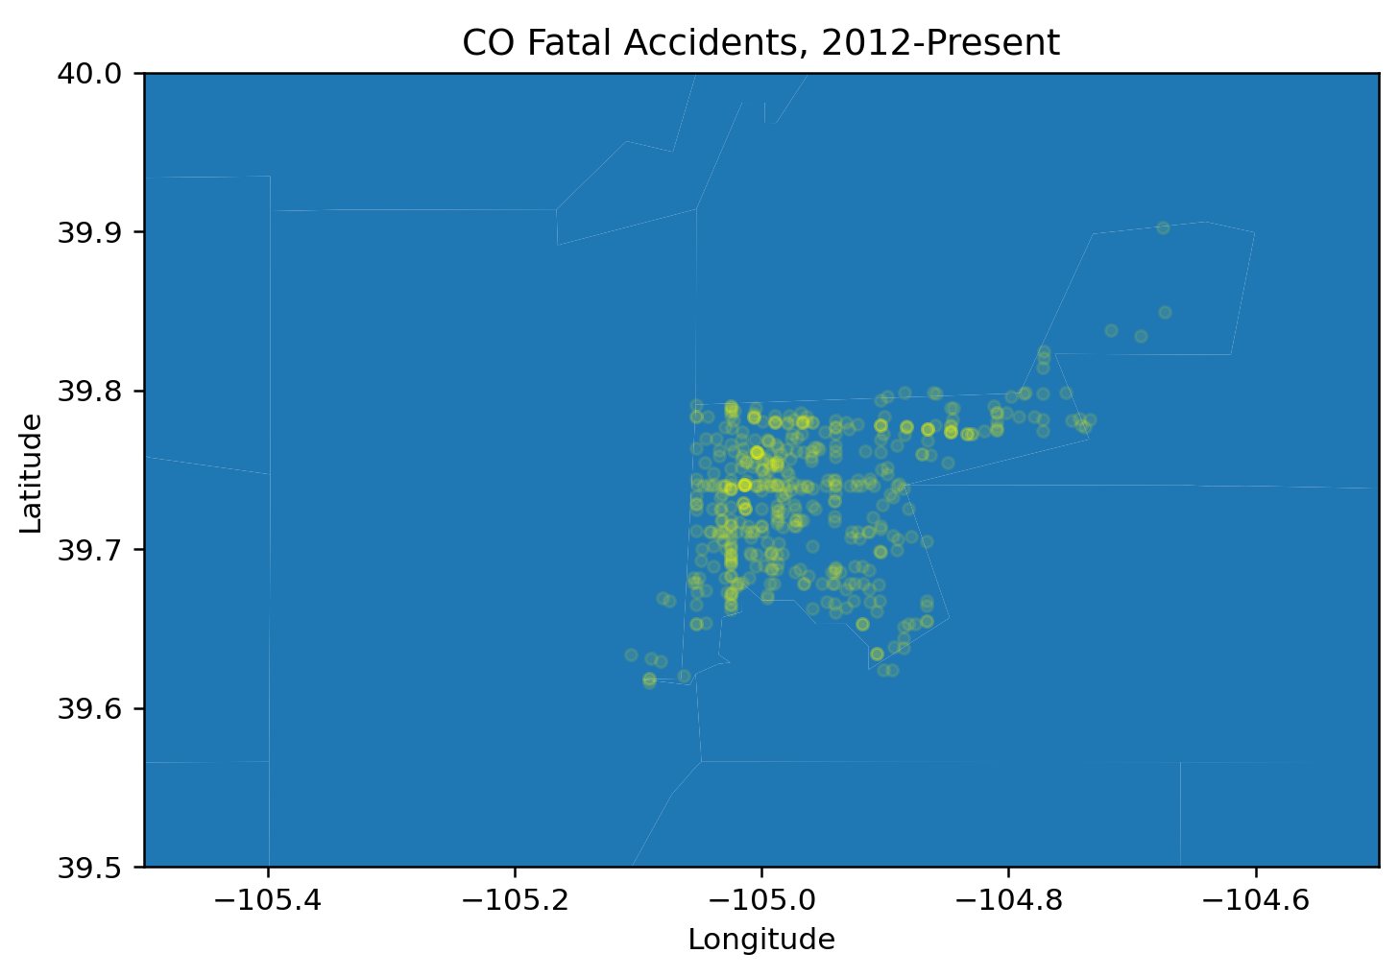
Visualization 1
Data is apparently specific to Denver county only
Data was filtered to only include fatal accidents in visualization
Very little traffic accidents at Denver International Airport
Most fatal accidents happening in heart of Denver, near I-25
Also high frequency of fatal accidents on I-70 horizontal line
Takeaway: stay away from highways!
Source: Denver Traffic Accidents https://www.kaggle.com/datasets/hrokrin/denver-traffic-accidents

Slide 3
Conclusion
Most fatal traffic accidents in Denver county happen near the center of the city and near Interstate 25.
How can we reduce fatal accidents? How can we increase the safety of our drivers?
Draw traffic away from I-25 / major city highways
Increase public transportation options
Future visualizations I would like to create from this visualization project are:
Data for all counties in Denver, judging # accidents (or fata accidents) per capita in each county
Create a time-based visualization which shows the amount of accidents in Denver county over time
Thank you!

