Slide 1
Machine Learning in the Clouds
Jeremy Beard
MSDS 696
Capstone
December 2023

Slide 2
TRAVEL IS NOT REWARD FOR WORKING, IT’S EDUCATION FOR LIVING
“
”
Anthony Bourdain

Slide 3
AGENDA
Problem Statement
Methods and Operations
​ Notable EDA Plots
ML Overview
ML Results
Future Work
Conclusions
References

Slide 4
Problem Statement
“How can we reliably predict trends and prices for air travel based on common real-life inputs to leverage the same ML tactics corporations are utilizing, but on consumer-side?”
The challenge is to implement a web-scraping solution that extracts relevant data, including departure details, flight duration, layovers, class types, and current/historical pricing information, from a relevant online source (or sources).
Solution will enable the creation of a precise predictive model and empower stakeholders with valuable insights for informed decision-making in the airline industry.

Slide 5
Methods, Operations & Processes
Web-scraping (via API)
EDA
Tableau Dashboarding
​ Model Creation
Model Comparison
Final Model Selection
​ Summary​

Slide 6
Notable EDA

Slide 7
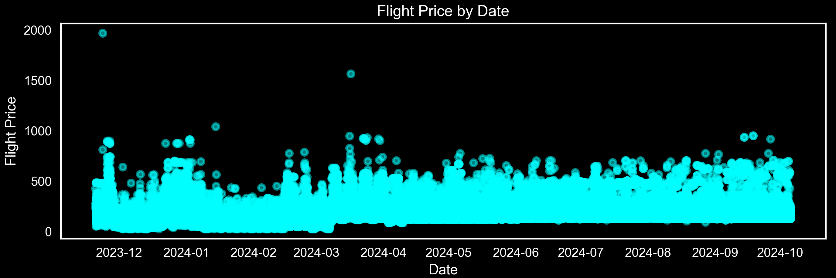
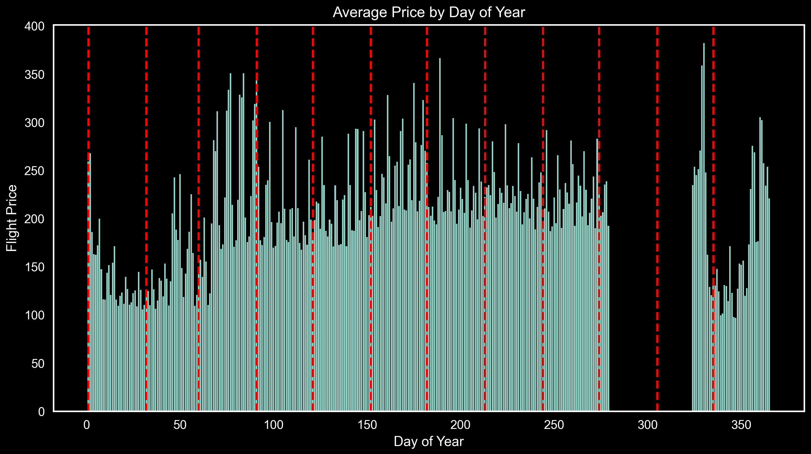

Slide 8
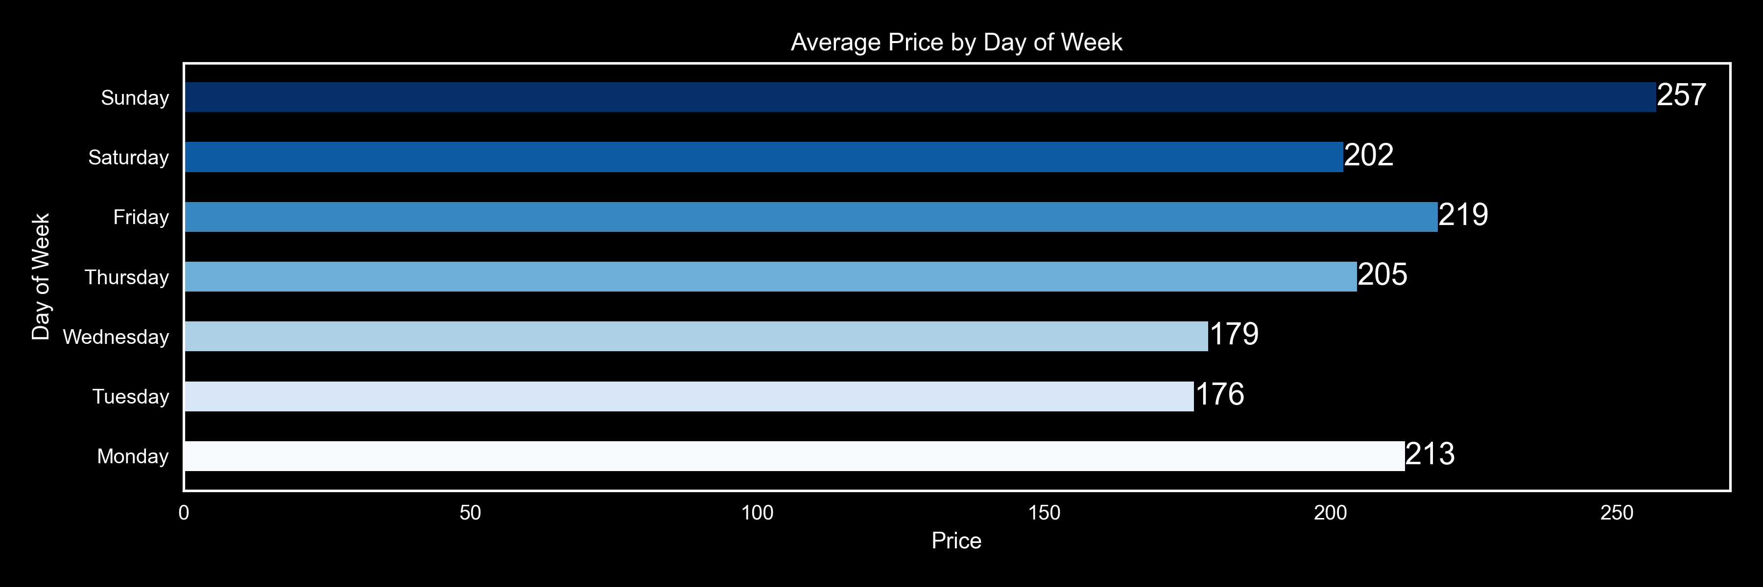
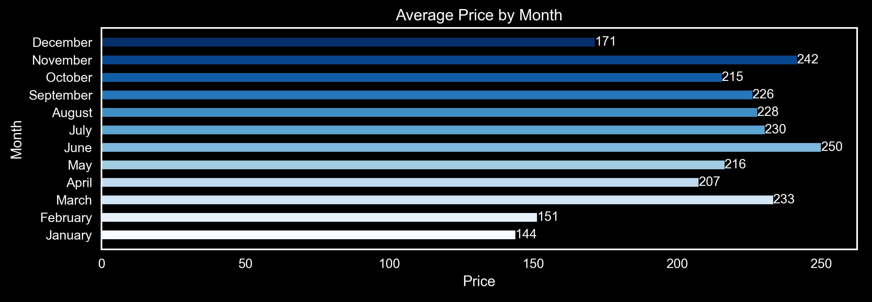

Slide 9
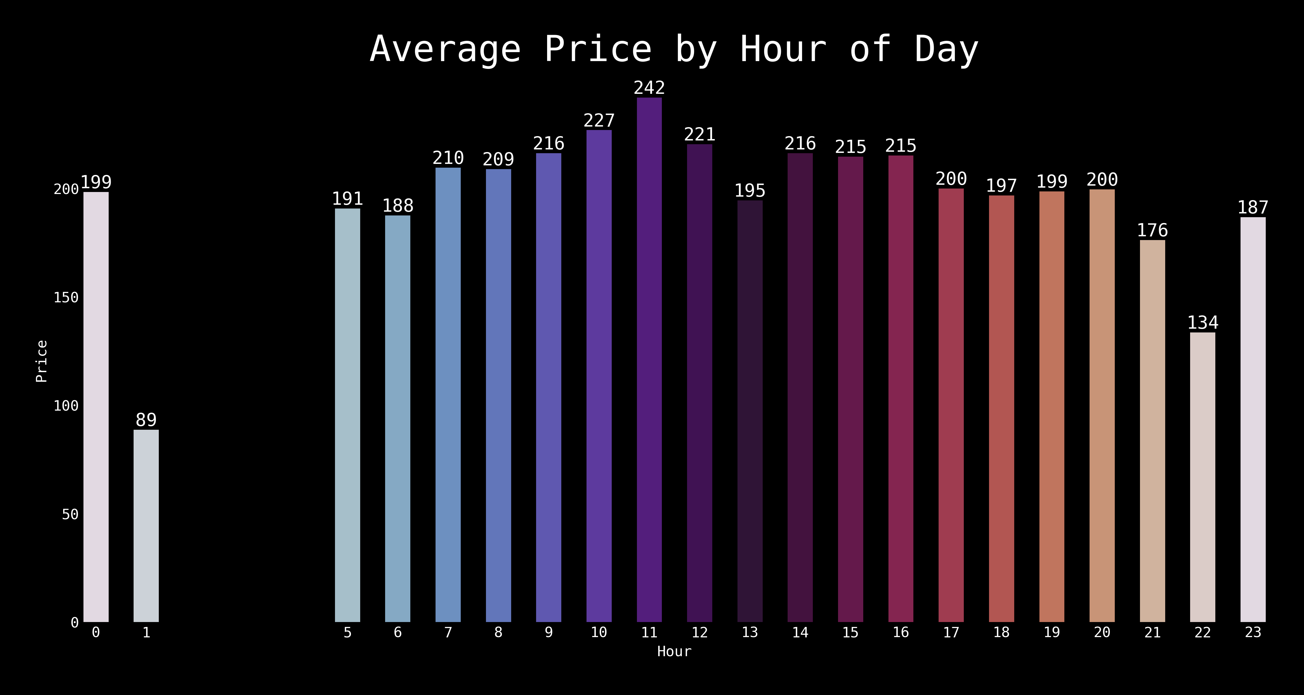

Slide 10
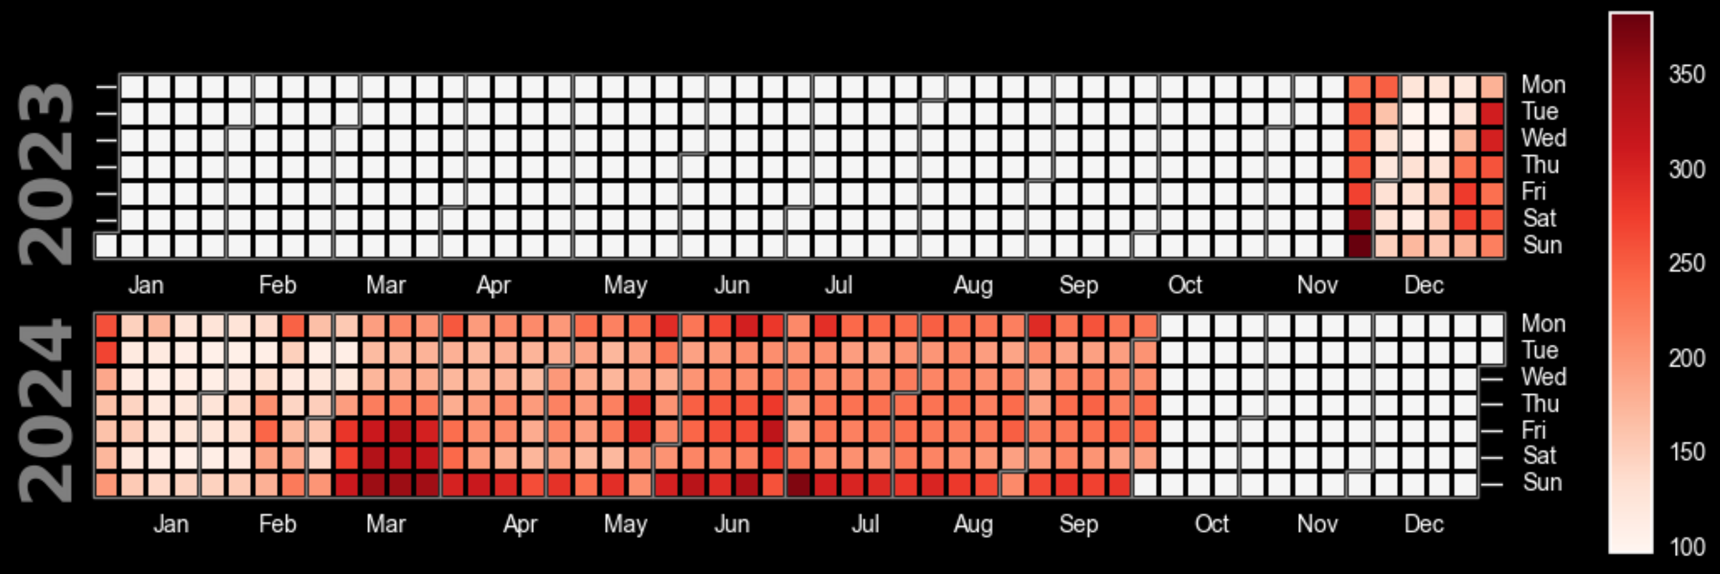

Slide 11
Tableau

Slide 12
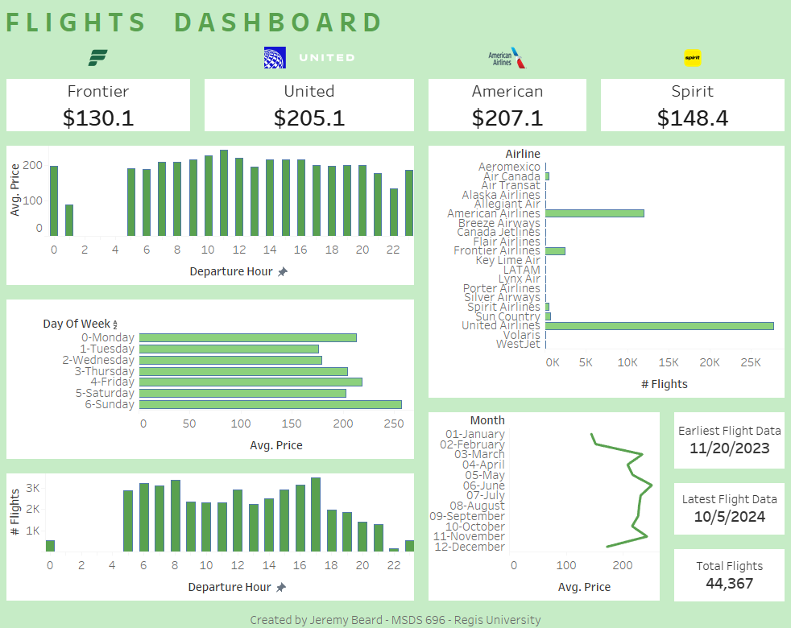

Slide 13
Machine Learning Overview

Slide 14
ML Overview
Utilized pycaret Python package for rapidly iterating on multiple ML models
Compared multiple dimensions of model parameters
Focus: timeseries handling
Compared 3-5 different methods of handling datetimes
Created 1 ML model baseline and 8 pycaret iterations through 8-10 ML models each

Slide 15
ML Model Results

Slide 16
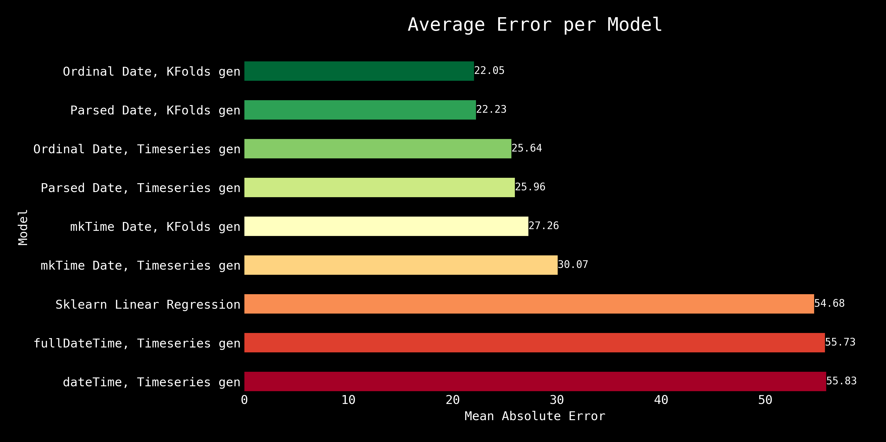
ML Model Results
Mean Absolute Error: Average of the absolute differences between the predicted and actual values

Slide 17
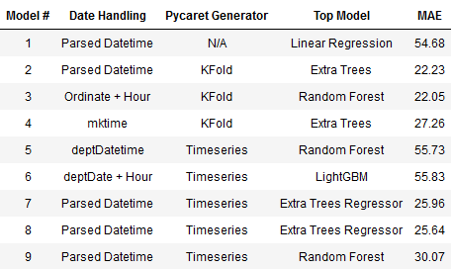
ML Model Results
Overall good performance
MAE: $22.05
R²: 0.83
Pycaret timeseries generator did not perform as well as expected
Random Forest and Extra Trees

Slide 18
Future Work
More data!
More airports, more airlines, continually update the sqlite3 database
5-sec latency API queries made 45,000 datapoints take all weekend
Research other API’s
Implement selenium?
Implement more feature engineering
Experiment with more Tableau dashboarding

Slide 19
Conclusions
Using the Booking.com API, we were able to create a model with $22 Mean Absolute Error prediction
Data is biased according to when it was scraped
Best Models: Random Forest, Extra Trees
Using Ordinal datetime
Timeseries still a question in my mind, it should perform better

Slide 20
References
https://github.com/jeremyabeard5/MSDS696
https://booking-com13.p.rapidapi.com/flights/one-way
https://stackoverflow.com/questions/40217369/python-linear-regression-predict-by-date
https://matplotlib.org/stable/gallery/style_sheets/style_sheets_reference.html
https://pandas.pydata.org/docs/reference/api/pandas.DatetimeIndex.dayofweek.html
https://pandas.pydata.org/docs/reference/api/pandas.Series.dt.month.html
https://stackoverflow.com/questions/71419004/how-to-plot-vertical-lines-at-specific-dates-in-matplotlib
https://medium.com/analytics-vidhya/calendar-heatmaps-a-perfect-way-to-display-your-time-series-quantitative-data-ad36bf81a3ed
https://calplot.readthedocs.io/en/latest/index.html
https://matplotlib.org/stable/users/explain/colors/colormaps.html
https://medium.com/analytics-vidhya/calendar-heatmaps-a-perfect-way-to-display-your-time-series-quantitative-data-ad36bf81a3ed
https://pypi.org/project/july/
https://datascience.stackexchange.com/questions/2368/machine-learning-features-engineering-from-date-time-data
https://datascience.stackexchange.com/questions/112357/feature-engineering-for-datetime-column
https://www.reddit.com/r/learnpython/comments/chunas/correlation_with_day_of_week/
https://mikulskibartosz.name/time-in-machine-learning
https://www.pycaret.org/tutorials/html/REG101.html
https://pycaret.readthedocs.io/en/latest/api/regression.html

Slide 21
THANK YOU
Jeremy Beard
jeremyab5@gmail.com
https://www.linkedin.com/in/jeremyab5

