Slide 1
ASR9K Mobile Backhaul
MPLS TE Design for ATT NNIs
Pat Abrams
patabram@cisco.com
April 2015

Slide 2


Agenda
Why & When MPLS TE
Service Definition
Explicit Path
Tunnels
PW Classes
PW IDs
Xconnect P2P Configuration
Summary

Slide 3
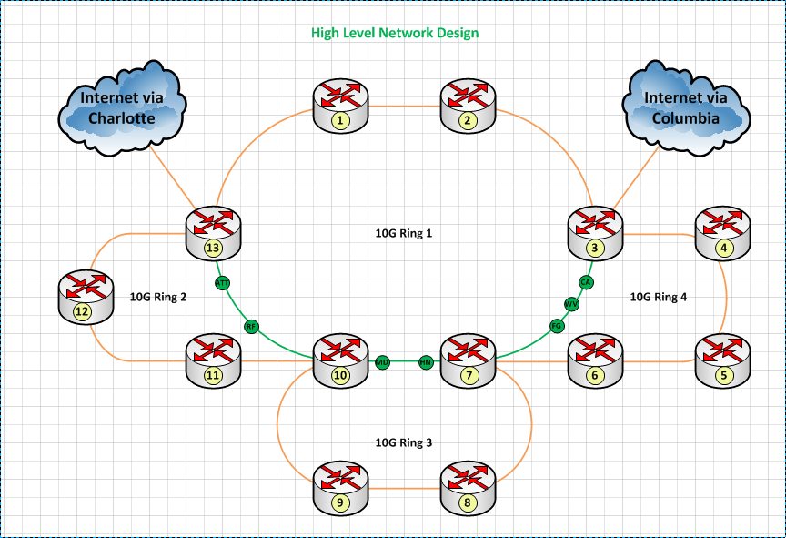
Why & When MPLS TE
ATT NNIs at R1 & R9.
Each node must establish diverse l2vpn paths.
Routing protocol (OSPF) alone will not meet the requirements. For example:
R2 to R1
R2 to R9

Slide 4
Service Definition
L2VPN services defined by 2 digit number, to be used multiple places in the overall configuration.
1x – Mobile Backhaul
11 – ATT
12 – Verizon
2x – Schools
3x – Govt
4x - ???

Slide 5
Explicit Paths
Needed to steer traffic.
Suggested to define both.
Use strict routes, not loose.
Name them by the path.
explicit-path name R9-R8-R7-R4-R3-R2
index 1 next-address strict ipv4 unicast 10.160.8.1
index 2 next-address strict ipv4 unicast 10.160.7.1
index 3 next-address strict ipv4 unicast 10.160.23.1
index 4 next-address strict ipv4 unicast 10.160.3.1
index 5 next-address strict ipv4 unicast 10.160.2.1

Slide 6
Tunnels
Named by service number and tunnel destination
Always unnumbered using loopback.
Leverage the explicit path.
interface tunnel-te1102
ipv4 unnumbered Loopback16
destination 10.160.0.2
path-option 1 explicit name R9-R8-R7-R4-R3-R2

Slide 7
PW Class
l2vpn
pw-class SVC11-ATT-MOBILE-SEC-TO-R2
encapsulation mpls
preferred-path interface tunnel-te 1102
Naming by service and destination.
Tunnel tied to this class.

Slide 8
Xconnect & PW IDs
8 Digits
11 – Service #
01 – Instance (Tower)
02 – Source
09 – Destination
Src/Dst Always Low/High Node
xconnect group SVC11-ATT-MOBILE
p2p TOWER01-SEC-TO-R2
interface TenGigE0/0/0/0.999
neighbor ipv4 10.160.0.2 pw-id 11010209
pw-class SVC11-ATT-MOBILE-SEC-TO-R2

Slide 9
R1
interface Loopback16
description MPLS: VRF-LOOPBACK
ipv4 address 10.160.0.1 255.255.255.255
ipv6 address 2604:eb00:160::1/128
router ospf 1
area 0
mpls traffic-eng
interface Loopback16
mpls traffic-eng router-id Loopback16
rsvp
interface TenGigE0/0/0/0.1622
interface TenGigE0/0/0/1.1601
interface TenGigE0/1/0/0.1621
interface TenGigE0/1/0/1.1613
mpls traffic-eng
interface TenGigE0/0/0/0.1622
interface TenGigE0/0/0/1.1601
interface TenGigE0/1/0/0.1621
interface TenGigE0/1/0/1.1613
mpls ldp
interface TenGigE0/0/0/0.1622
interface TenGigE0/0/0/1.1601
interface TenGigE0/1/0/0.1621
interface TenGigE0/1/0/1.1613
explicit-path name R1-R2
index 1 next-address strict ipv4 unicast 10.160.1.2
interface tunnel-te1102
ipv4 unnumbered Loopback16
destination 10.160.0.2
path-option 1 explicit name R1-R2
l2vpn
pw-class SVC11-ATT-MOBILE-PRI-TO-R2
encapsulation mpls
preferred-path interface tunnel-te 1102
xconnect group SVC11-ATT-MOBILE
p2p TOWER01-PRI-TO-R2
interface TenGigE0/1/0/1.999
neighbor ipv4 10.160.0.2 pw-id 11010102
pw-class SVC11-ATT-MOBILE-PRI-TO-R2
description TOWER-ADDRESS-HERE

Slide 10
R9
interface Loopback16
description MPLS: VRF-LOOPBACK
ipv4 address 10.160.0.9 255.255.255.255
ipv6 address 2604:eb00:160::9/128
router ospf 1
area 0
mpls traffic-eng
interface Loopback16
mpls traffic-eng router-id Loopback16
rsvp
interface TenGigE0/0/0/0.1609
interface TenGigE0/1/0/0.1608
mpls traffic-eng
interface TenGigE0/0/0/0.1609
interface TenGigE0/1/0/0.1608
mpls ldp
interface TenGigE0/0/0/0.1609
interface TenGigE0/1/0/0.1608
explicit-path name R9-R8-R7-R4-R3-R2
index 1 next-address strict ipv4 unicast 10.160.8.1
index 2 next-address strict ipv4 unicast 10.160.7.1
index 3 next-address strict ipv4 unicast 10.160.23.1
index 4 next-address strict ipv4 unicast 10.160.3.1
index 5 next-address strict ipv4 unicast 10.160.2.1
interface tunnel-te1102
ipv4 unnumbered Loopback16
destination 10.160.0.2
path-option 1 explicit name R9-R8-R7-R4-R3-R2
l2vpn
pw-class SVC11-ATT-MOBILE-SEC-TO-R2
encapsulation mpls
preferred-path interface tunnel-te 1102
xconnect group SVC11-ATT-MOBILE
p2p TOWER01-SEC-TO-R2
interface TenGigE0/0/0/0.999
neighbor ipv4 10.160.0.2 pw-id 11010209
pw-class SVC11-ATT-MOBILE-SEC-TO-R2
description TOWER-ADDRESS-HERE

Slide 11
R2
explicit-path name R2-R1
index 1 next-address strict ipv4 unicast 10.160.1.1
explicit-path name R2-R3-R4-R7-R8-R9
index 1 next-address strict ipv4 unicast 10.160.2.2
index 2 next-address strict ipv4 unicast 10.160.3.2
index 3 next-address strict ipv4 unicast 10.160.23.2
index 4 next-address strict ipv4 unicast 10.160.7.2
index 5 next-address strict ipv4 unicast 10.160.8.2
interface tunnel-te1101
ipv4 unnumbered Loopback16
destination 10.160.0.1
path-option 1 explicit name R2-R1
interface tunnel-te1109
ipv4 unnumbered Loopback16
destination 10.160.0.9
path-option 1 explicit name R2-R3-R4-R7-R8-R9
l2vpn
pw-class SVC11-ATT-MOBILE-PRI-TO-R1
encapsulation mpls
preferred-path interface tunnel-te 1101
pw-class SVC11-ATT-MOBILE-SEC-TO-R9
encapsulation mpls
preferred-path interface tunnel-te 1109
xconnect group SVC11-ATT-MOBILE
p2p TOWER01-PRI-TO-R1
interface TenGigE0/0/0/1.999
neighbor ipv4 10.160.0.1 pw-id 11010102
description TOWER-ADDRESS-HERE
p2p TOWER01-SEC-TO-R9
interface TenGigE0/0/0/1.888
neighbor ipv4 10.160.0.9 pw-id 11010209
pw-class SVC11-ATT-MOBILE-SEC-TO-R9
description TOWER-ADDRESS-HERE
interface Loopback16
description MPLS: VRF-LOOPBACK
ipv4 address 10.160.0.2 255.255.255.255
ipv6 address 2604:eb00:160::2/128
router ospf 1
area 0
mpls traffic-eng
mpls traffic-eng router-id Loopback16
rsvp
interface TenGigE0/0/0/1.1602
interface TenGigE0/1/0/1.1601
mpls traffic-eng
interface TenGigE0/0/0/1.1602
interface TenGigE0/1/0/1.1601
mpls ldp
interface TenGigE0/0/0/1.1602
interface TenGigE0/1/0/1.1601

Slide 12
Show Output
Name: tunnel-te1109 Destination: 10.160.0.9
Signalled-Name: R2_t1109
Status:
Admin: up Oper: up Path: valid Signalling: connected
path option 1, type explicit R2-R3-R4-R7-R8-R9 (Basis for Setup, path weight 500)
G-PID: 0x0800 (derived from egress interface properties)
Bandwidth Requested: 0 kbps CT0
Creation Time: Thu Apr 30 12:16:43 2015 (4d01h ago)
Config Parameters:
Bandwidth: 0 kbps (CT0) Priority: 7 7 Affinity: 0x0/0xffff
Metric Type: TE (default)
Hop-limit: disabled
Cost-limit: disabled
AutoRoute: disabled LockDown: disabled Policy class: not set
Forward class: 0 (default)
Forwarding-Adjacency: disabled
Loadshare: 0 equal loadshares
Auto-bw: disabled
Fast Reroute: Disabled, Protection Desired: None
Path Protection: Not Enabled
BFD Fast Detection: Disabled
Reoptimization after affinity failure: Enabled
Soft Preemption: Disabled
History:
Tunnel has been up for: 3d22h (since Thu Apr 30 14:55:38 EDT 2015)
Current LSP:
Uptime: 3d22h (since Thu Apr 30 14:55:38 EDT 2015)
Reopt. LSP:
Last Failure:
LSP not signalled, identical to the [CURRENT] LSP
Date/Time: Thu Apr 30 15:38:12 EDT 2015 [3d21h ago]
Path info (OSPF 1 area 0):
Node hop count: 5
Hop0: 10.160.2.2
Hop1: 10.160.3.2
Hop2: 10.160.23.2
Hop3: 10.160.7.2
Hop4: 10.160.8.2
Hop5: 10.160.0.9
Show mpls traff tunn

