Slide 1
RouteGen
Project Intro

Slide 2
Simplified Scope
The purpose of the RouteGen Project is to generate partial configuration files for Cisco routers running the IOS XR operating system.
The partial configuration generated will be for the creation of traffic engineered paths.
The format of the configuration file is a simple text file.

Slide 3
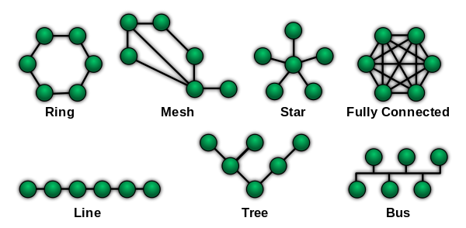
Network Topologies
Notes:
https://en.wikipedia.org/wiki/Network_topology

Slide 4
What is a Router?
Connects locations over “distance”.
Distance is arbitrary and could be:
Wiring Closets in a Building
Buildings on a Campus
Cities
States
Routers also provide network segmentation for administrative, security, and scalability.

Slide 5
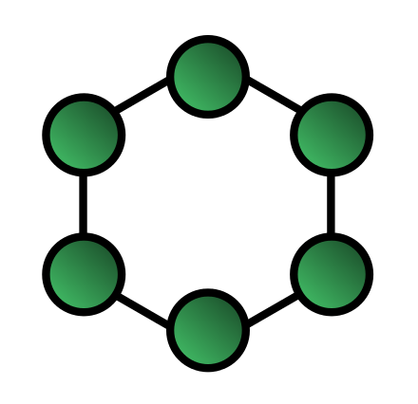
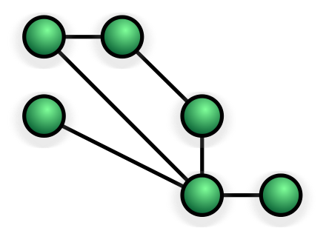
RouteGen Topology
The RouteGen project will primarily be based upon a ring topology, but there needs to be consideration for adding a mesh between some sites in the ring.
As far as distance is concerned, we will be creating configurations for routers located in different cities

Slide 6
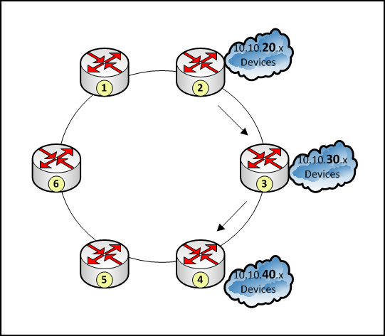
“Normal” Traffic Flow
Routers use routing protocols to tell each other about the networks or links that they own. A routing protocol is an Interior Gateway or Exterior Gateway Protocol.
IGP = RIP, OSPF, IS-IS, EIGRP
EGP = BGP
How does traffic from 10.10.20.x get to 10.10.40.x ?
Shortest Path, which is 2 -> 3 -> 4

Slide 7

“Engineered” Traffic Flow
What if we want traffic from 10.10.20.x to 10.10.40.x to take the path:
1 -> 6 -> 5 -> 4
Taking a path other than the one that the routing protocol selects for you is traffic engineering. You force the traffic where you want it to go.
Why would you do that?

Slide 8
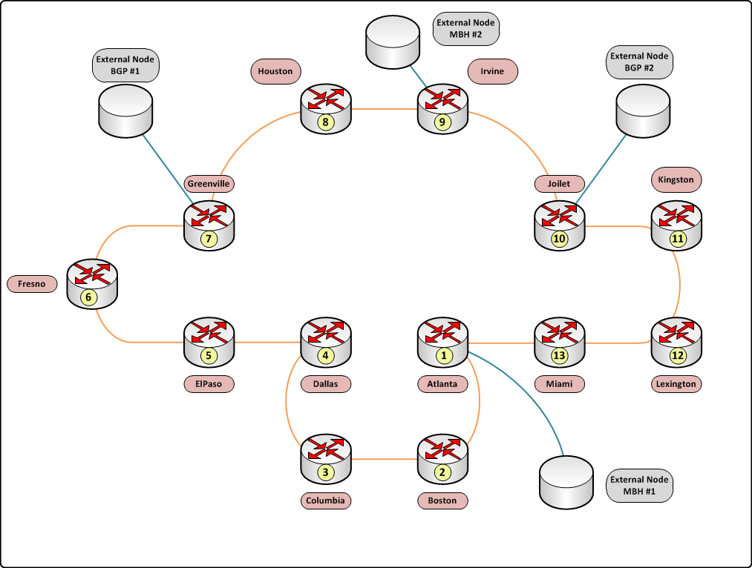
RouteGen Project Topology

Slide 9
RouteGen Project Notes
How can you capture this diagram, and then have the ability to recreate the diagram?
The diagram is made up of 13 “Internal Nodes” and 4 “External Nodes”. Do you capture the nodes, the links, or both?
Internal Nodes are the devices we generate configuration for. External nodes are not owned by us, but we need to include them.
BGP – An internet peering router
MBH – A mobile backhaul router
TWR – Not on diagram, but every internal node has cell towers.

Slide 10
RouteGen Project Database???
ProjectName
InternalNodes
Name
Description
LoopbackIPAddress
Interfaces
Ethernet1
Name
Description
IPAddress
VRFName
RemoteNode
Ethernet2
ExternalNodes
BGP
MBH
TWR
ProjectName

Slide 11
RouteGen Project Breakup
Gathering the Data
Developing the code that allows for entering the information on the diagram. Time consuming and will need to work closely with database definition
Database Definition
The DB will be fairly small, but needs a structure that allows for expansion.
Documentation
Need to clearly document how the program works, what assumptions are made and any caveats.

Slide 12
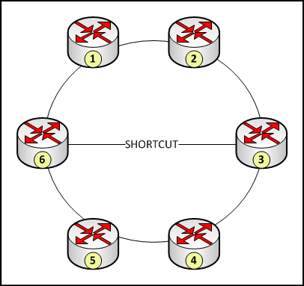
RouteGen Project Breakup
Traffic Engineering
Need to develop an algorithm for generating the clockwise and counterclockwise paths. Then need to look at what happens when a “shortcut” path is added between two non adjacent nodes.
Example diagram, from 1 to 2:
ClockWiseRing – 1 -> 2
CounterClockwiseRing – 1 -> 6 -> 5 -> 4-> 3-> 2
CCWAlternate – 1 -> 6-> Loose to 3 -> 2
Loose to 3 means use any path to get to 3

Slide 13
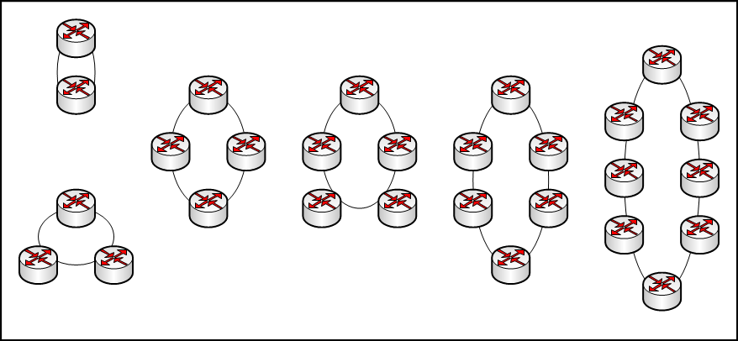
RouteGen Project Breakup
Regenerate the diagram. Once all data is entered, no matter how many nodes, you should be able to generate a simplistic diagram.

