Slide 1



A General Neural Architecture for Carbohydrate and Bolus Recommendations in Type 1 Diabetes Management Jeremy Beauchamp, Razvan Bunescu, and Cindy Marling School of Electrical Engineering and Computer Science Ohio University, Athens, Ohio, USA The 5th International Workshop on Knowledge Discovery in Healthcare Data August 30, 2020

Slide 2
Introduction and Motivation
Type 1 Diabetes is a disease in which the body does not produce insulin.
Hyperglycemia
Occurs when Blood Glucose Levels (BGLs) are too high (> 140 mg/dl).
A meal without enough insulin in the body will raise BGLs.
Hypoglycemia
Occurs when Blood Glucose Levels (BGLs) are too low (< 70 mg/dl).
Insulin in the body without eating carbohydrates will lower BGLs.
140
How much should I eat or bolus to correct/maintain my blood glucose level?
100
Time
70
BGL

Slide 3
Introduction and Motivation
Current blood glucose level = 120
Target blood glucose level in 30 minutes = 160
Lunch is in 5 minutes
How much should I eat?
BGL=160
Carbs=?
BGL=120
t
t + 5
t + 30
Time

Slide 4

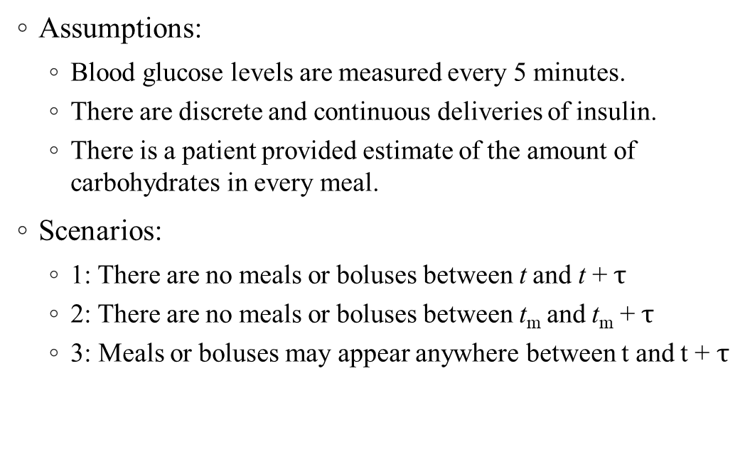

Carbohydrate Recommendation Scenarios
Assumptions:
Blood glucose levels are measured every 5 minutes.
There are discrete and continuous deliveries of insulin.
There is a patient provided estimate of the amount of carbohydrates in every meal.
Scenarios:
1: There are no meals or boluses between t and t + $τ$
2: There are no meals or boluses between t_{m} and t_{m} + $τ$
3: Meals or boluses may appear anywhere between t and t + $τ$
$$C_{t_{m}}$$
BG_{t + 𝜏}
$$∆=t_{m}−t$$
t
t_{m}
t + 𝜏
Time

Slide 5
Baseline Models
Global Average Baseline: The average number of carbs over a patient’s training data is calculated and predicted for every example.
Time-Dependent Baseline: An average number of carbs are calculated over a patient’s training data for each of the below time frames and the average corresponding to the time of the meal in the example is predicted.
12am-6am
Early Breakfast
10am-2pm
Lunch
6pm-12am
Late Dinner
6am-10am
Breakfast
2pm-6pm
Dinner

Slide 6



LSTM₁
LSTM₂
…
…
BG_{t + 𝜏}
Δ
𝜇_{m}
bolus
meal
$$C_{t_{m}}$$
FCN
BG_{t + 𝜏}
$${\hat{C}}_{t_{m}}$$
Blood glucose level
$$∆=t_{m}−t$$
basal
t
t_{m}
t + 𝜏
Time
past
prediction window

Slide 7
Dataset
OhioT1DM Dataset:
Data from 6 patients
~50 days of data per patient
Contains BGL, insulin, carbs, exercise, sleep, etc.
Variety of different behaviors
Data was split in the following way:
Testing Data: Last 10 days
Validation Data: Previous 10 days
Training Data: All remaining days
Meal Statistics
Subject | Meals | Average | Standard Deviation
559 | 179 | 36.0 | 16.0
563 | 153 | 29.9 | 16.3
570 | 169 | 105.3 | 42.0
575 | 284 | 40.6 | 22.9
588 | 257 | 30.8 | 16.6
591 | 249 | 31.6 | 14.2
Total | 1291 | 43.5 | 33.1

Slide 8
Dataset
Examples Counts by Scenario, for 30 and 60 minutes
Dataset | Scenario 1 |  | Scenario 2 |  | Scenario 3
 | 30 Min | 60 Min | 30 Min | 60 Min | 30 Min | 60 Min
Training | 2396 | 1923 | 3889 | 3491 | 5096 | 5931
Testing | 629 | 510 | 1061 | 981 | 1388 | 1626
Validation | 469 | 339 | 950 | 851 | 1236 | 1435
Total | 3494 | 2772 | 5900 | 5323 | 7720 | 8992

Slide 9
Experimental Evaluation
Pretraining Results
Optimization Algorithm: Adam
Maximum Epochs: 100
Regularization Methods:
Early Stopping – 5 epoch patience
Dropout – 10% dropout applied to LSTM networks
Tuned Hyper-Parameters: Learning rate and batch size
Pretraining
Fine-Tuned on Training + Validation
5 models trained per patient
Setting | RMSE | MAE
Without Pretraining | 22.2 | 15.5
With Pretraining | 20.7 | 14.5
Average Model: The RMSE and MAE of each patients 5 models are averaged together.
Best Model: The RMSE and MAE of the model that had the lowest MAE on validation data for each patient.
These are then averaged across all 6 of the patients

Slide 10
Results
Scenario | Baselines & Models | RMSE |  | MAE
 |  | 30 Minutes | 60 Minutes | 30 Minutes | 60 Minutes
S1 | Baseline | 18.9 | 17.6 | 14.8 | 14.4
 | Avg Model | 19.3 | 19.5 | 14.1 | 13.9
 | Best Model | 19.0 | 19.8 | 13.9 | 13.9
S2 | Baseline | 17.4 | 15.9 | 13.1 | 12.2
 | Avg Model | 16.2 | 15.3 | 11.9 | 11.4
 | Best Model | 15.8 | 15.4 | 11.6 | 10.9
S3 | Baseline | 17.5 | 17.6 | 13.2 | 13.3
 | Avg Model | 15.7 | 15.6 | 11.5 | 11.3
 | Best Model | 15.6 | 14.8 | 11.4 | 10.6

Slide 11
Results
Training Scenario | Baseline & Models | RMSE on S1 |  | MAE on S1
 |  | 30 Minutes | 60 Minutes | 30 Minutes | 60 Minutes
 | Baseline | 18.9 | 17.6 | 14.8 | 14.4
S1 | Avg Model | 19.3 | 19.5 | 14.1 | 13.9
 | Best Model | 19.0 | 19.8 | 13.9 | 13.9
S3 | Avg Model | 18.2 | 17.6 | 13.6 | 13.3
 | Best Model | 18.3 | 16.7 | 13.8 | 13.0

Slide 12
Conclusion and Future Work
Introduced a neural architecture for the purpose of recommending carbohydrate amounts or insulin doses with respect to several factors in order to impact blood glucose levels
Demonstrated feasibility of architecture by training and evaluating models on real-patient data for making carbohydrate predictions
Future work includes training and evaluating similar models for bolus recommendations and training models to make predictions with larger prediction horizons

Slide 13
Acknowledgements
This work was supported by grant 1R21EB022356 from the National Institutes of Health (NIH).
Conversations with Josep Vehi helped shape the research directions presented herein.
The contributions of physician collaborators Frank Schwartz, MD, and Amber Healy, DO, are gratefully acknowledged.
We would also like to thank the anonymous people with type 1 diabetes who provided their blood glucose, insulin, and meal data.

