Slide 1
LSTMs and Deep Residual Networks for Carbohydrate and Bolus Recommendations in Type 1 Diabetes Management
Jeremy Beauchamp

Slide 2
Overview
Introduction
Dataset
Recommendation scenarios
Examples
Recommendation models
Training and evaluation procedures
Key results
Conclusion

Slide 3
Introduction and Motivation
Type 1 Diabetes is a disease in which the body does not produce insulin.
Without insulin, BGLs become too high.
High BGLs (> 140 mg/dl) can lead to hyperglycemia.
Hyperglycemia can cause long-term health issues if not addressed.
140
100
Time
70
BGL

Slide 4
Introduction and Motivation
External insulin sources provide insulin for those with Type 1 Diabetes.
Too much insulin can cause BGLs to drop too low.
Low BGLs (< 70 mg/dl) can lead to hypoglycemia.
Hypoglycemia can lead to serious health complications in not addressed.
140
100
Time
70
BGL

Slide 5
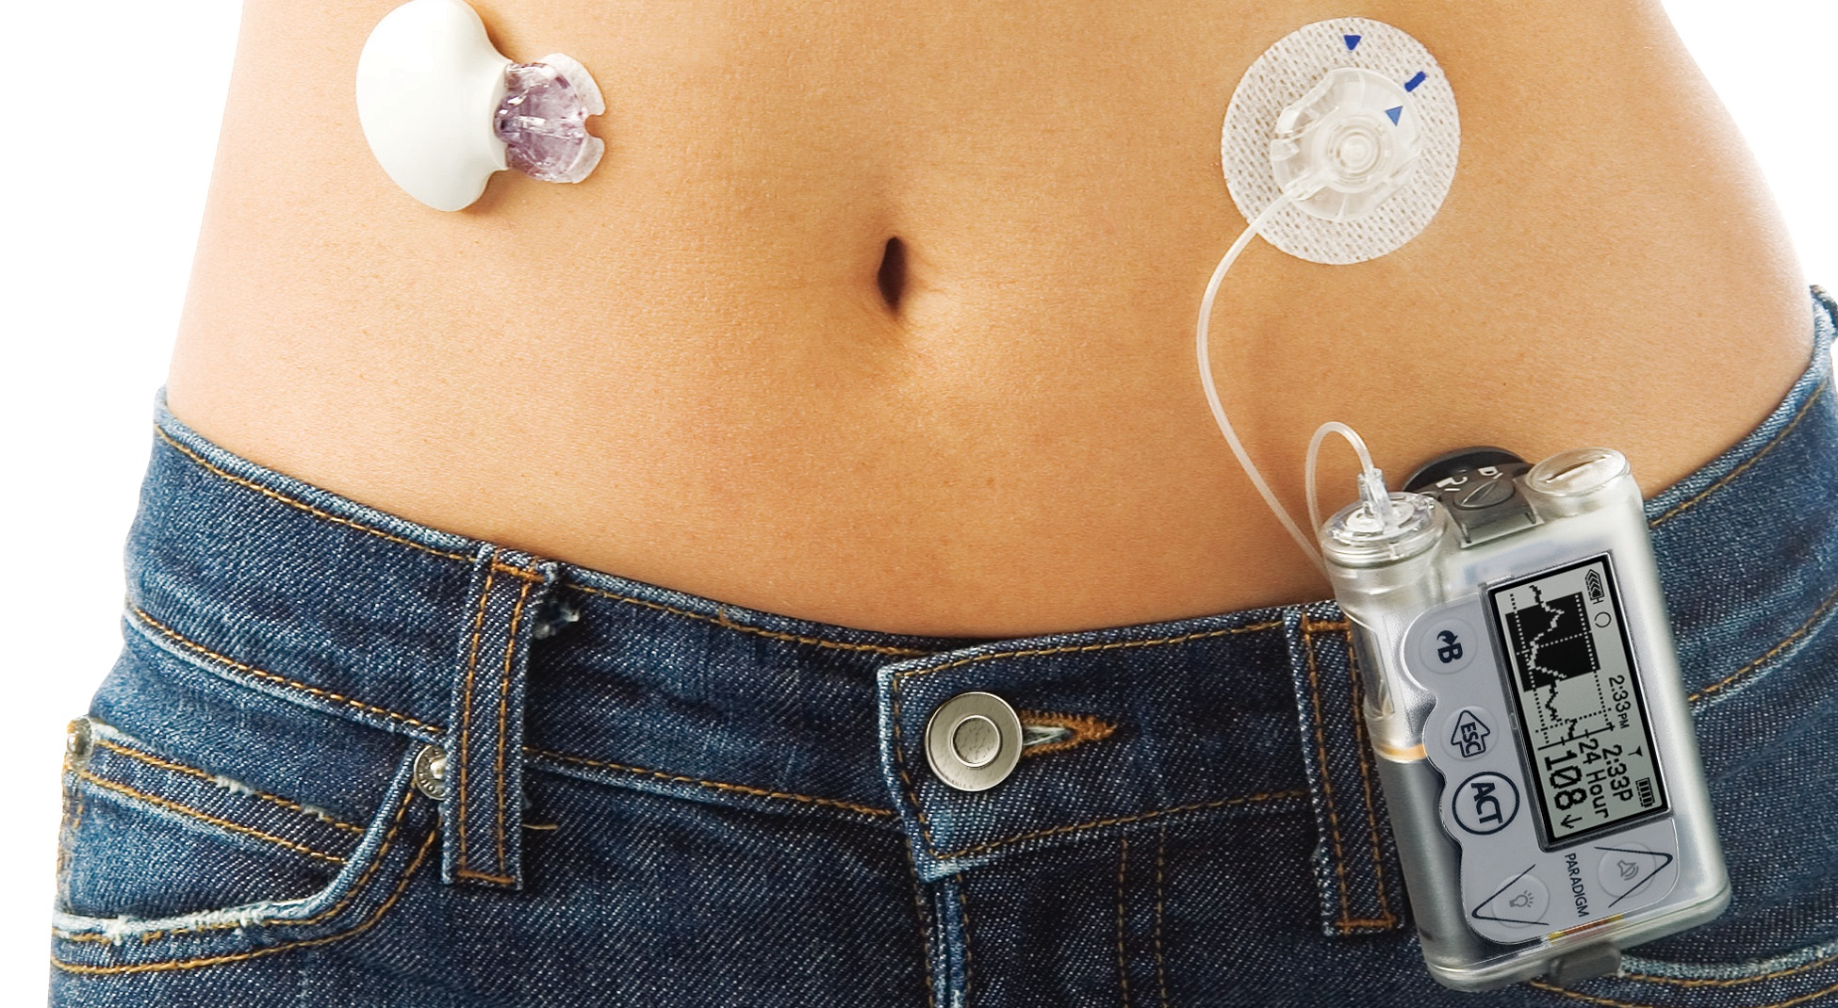
Introduction and Motivation
Type 1 Diabetes management consists of:
Vigilantly monitoring blood glucose levels.
Making careful decisions about how many carbs to eat.
Careful administration of insulin.
CGM Sensor
Insulin Pump

Slide 6
Introduction and Motivation
How much should I eat/bolus to reach my target blood glucose level?
Carb/Bolus Recommendation System
Sensor data
Recommended amount of carbs or bolus insulin
Desired BGL

Slide 7
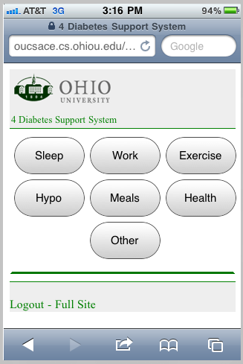
The OhioT1DM Dataset
2018 and 2020 versions.
Contains data from 12 people with T1D.
Roughly 50 days of data per patient.
Contains BGLs, insulin, carbs, exercise, sleep, and other features.
Data collected from CGM system, insulin pump, smartphone interface, and a fitness band.

Slide 8
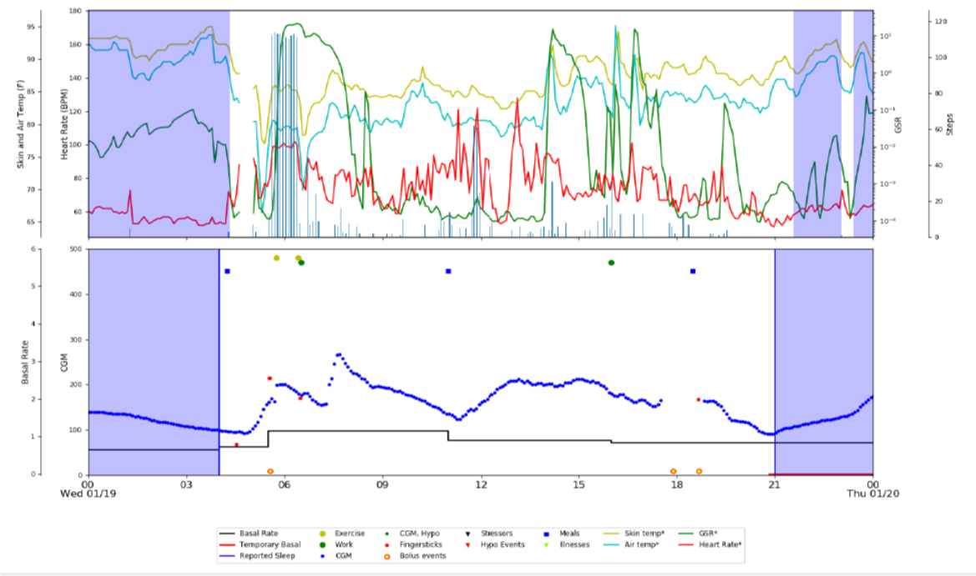
The OhioT1DM Dataset

Slide 9
The OhioT1DM Dataset
Carbohydrate Statistics
 | Carbs per Meal
Carb Events | Minimum | Maximum | Median | Average | Std. Dev.
2,894 | 1.0 | 200.0 | 39.0 | 44.9 | 31.3
Bolus Statistics
 | Insulin per Bolus
Bolus Events | Minimum | Maximum | Median | Average | Std. Dev.
4,876 | 0.1 | 25.0 | 2.9 | 4.5 | 4.3

Slide 10
The OhioT1DM Dataset
Real Patient Data vs. Simulated Data
Advantages
Disadvantages
Data generated from a human’s body instead of a mathematical model.
As close to practical use as you can get without experimenting on human subjects.
Acquiring data is time-consuming.
Data is prone to noise.

Slide 11
The OhioT1DM Dataset
There is a considerable amount of missing BGL data.
Missing data is filled in with linearly interpolated.
Limits are set on the amount of interpolated BGLs allowed in examples.
Meals are often not in their expected position relative to bolus.
Meal closest to bolus with non-zero carb input placed 10 minutes after bolus.
If no meal is found within an hour, a meal is added.
Carb counts from smartphone interface do not match insulin pump.
For carb events with an associated bolus, the carb count from the insulin pump is used in lieu of the carb count from the smartphone interface.

Slide 12
The OhioT1DM Dataset
~30 days
10 days
10 days
Training
Validation
Testing
Training Data:
Training deep learning models
Calculating values for baseline models
Validation Data:
Regularization
Hyper-parameter tuning
Ablation experiments
Testing Data:
Final evaluations

Slide 13

Recommendation Scenarios
Carb recommendation
Givens:
BGL target
Number of minutes after meal to meet target
Recommend number of carbs to eat 10 minutes in the future to raise BGL to target level.
$$C_{t+10}$$
G_{t+10+𝜏}
t
t+10
t+10+𝜏

Slide 14

Recommendation Scenarios
Bolus recommendation
Givens:
BGL target
Number of minutes after bolus to meet target
Recommend amount of insulin to bolus 10 minutes in the future to lower BGL to target level.
$$B_{t+10}$$
G_{t+10+𝜏}
t
t+10
t+10+𝜏

Slide 15

Recommendation Scenarios
Bolus recommendation given carbs
Givens:
BGL target
Number of minutes after bolus to meet target
Number of carbs in planned meal 20 minutes into the future
Recommend amount of insulin to bolus 10 minutes in the future to reach BGL target level given number of carbs in meal 10 minutes later.
$$B_{t+10}$$
$$C_{t+20}$$
G_{t+10+𝜏}
t
t+10
t+20
t+10+𝜏

Slide 16

Recommendation Cases
Ideally, all examples would include no impactful events other than label.
However, this significantly limits number of available examples.
Inertial case: No events other than label in the prediction window.
Unrestricted case: Extra events allowed within prediction window.
$$C_{t+10}$$
G_{t+10+𝜏}
t
t+10
t+10+𝜏

Slide 17
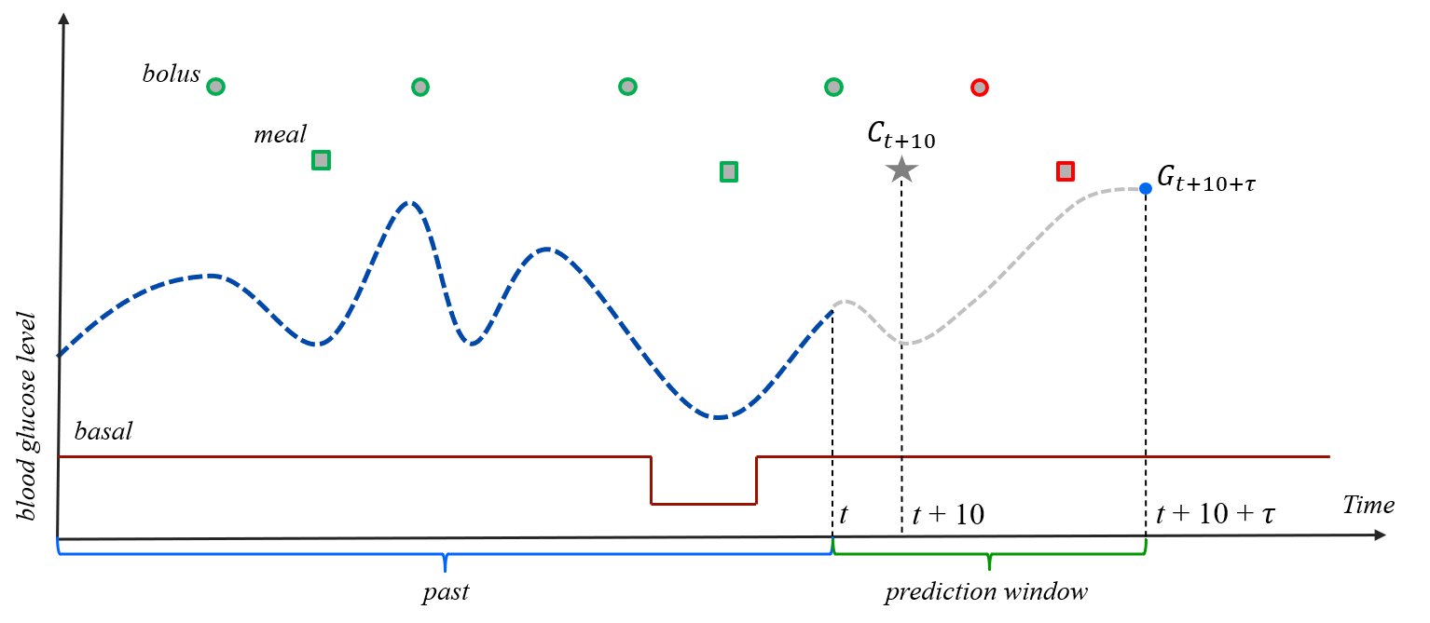
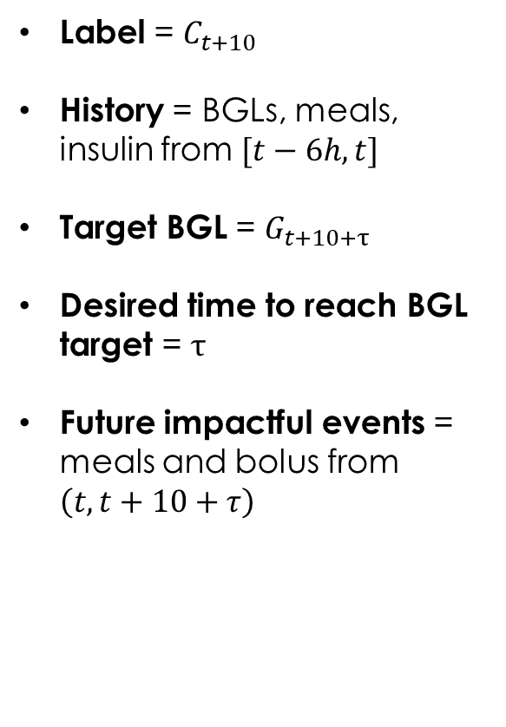
Examples
Label = $C_{t+10}$
History = BGLs, meals, insulin from $[t−6h, t]$
Target BGL = $G_{t+10+τ}$
Desired time to reach BGL target = $τ$
Future impactful events = meals and bolus from $\left(t, t+10+τ\right)$

Slide 18
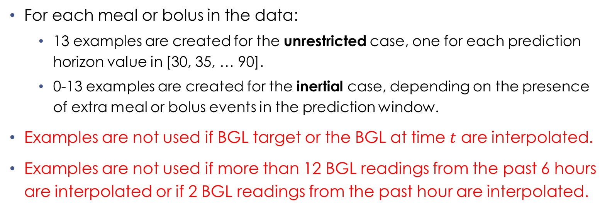
Examples
For each meal or bolus in the data:
13 examples are created for the unrestricted case, one for each prediction horizon value in [30, 35, … 90].
0-13 examples are created for the inertial case, depending on the presence of extra meal or bolus events in the prediction window.
Examples are not used if BGL target or the BGL at time $t$ are interpolated.
Examples are not used if more than 12 BGL readings from the past 6 hours are interpolated or if 2 BGL readings from the past hour are interpolated.

Slide 19
Baseline Models
Global Baseline: Predict the average amount of carbs or bolus insulin over that patient's data
Time-Dependent Baseline: Predict the average amount of carbs or bolus insulin based on the time of day
12am-6am
Early Breakfast
10am-2pm
Lunch
6pm-12am
Late Dinner
6am-10am
Breakfast
2pm-6pm
Dinner

Slide 20
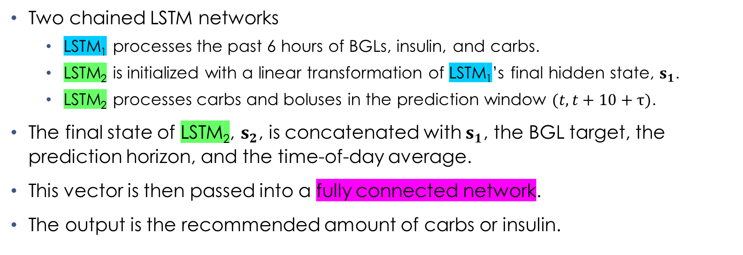
Deep Learning Models (LSTM-based)
Two chained LSTM networks
LSTM₁ processes the past 6 hours of BGLs, insulin, and carbs.
LSTM₂ is initialized with a linear transformation of LSTM₁’s final hidden state, $s_{1}$.
LSTM₂ processes carbs and boluses in the prediction window $(t,t+10+τ)$.
The final state of LSTM₂, $s_{2}$, is concatenated with $s_{1}$, the BGL target, the prediction horizon, and the time-of-day average.
This vector is then passed into a fully connected network.
The output is the recommended amount of carbs or insulin.

Slide 21
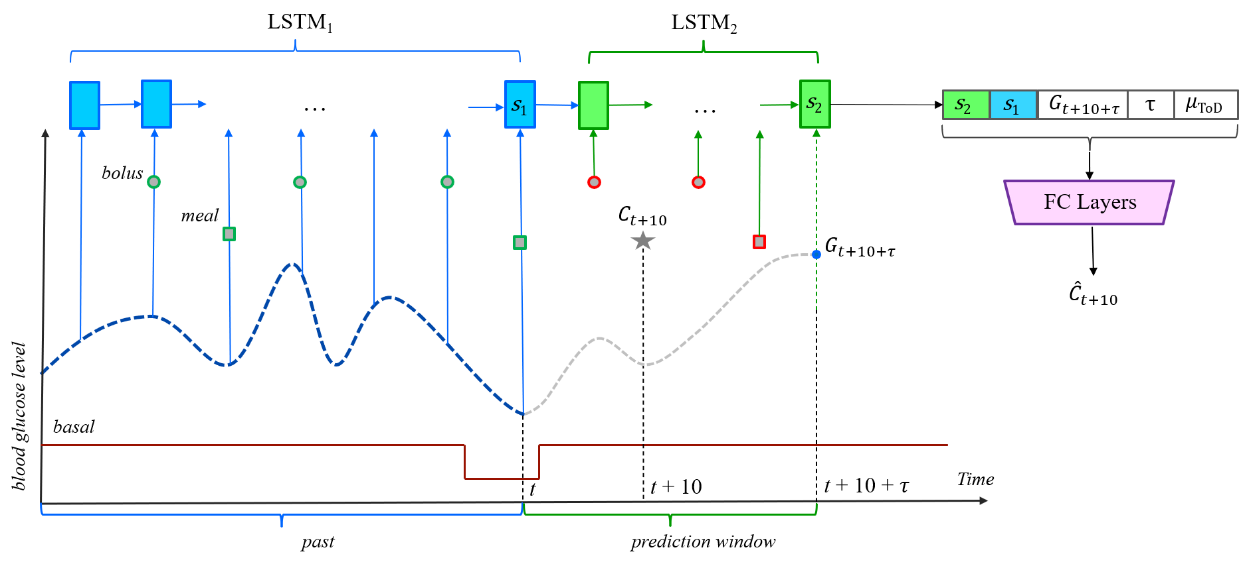
Deep Learning Models (LSTM-based)

Slide 22
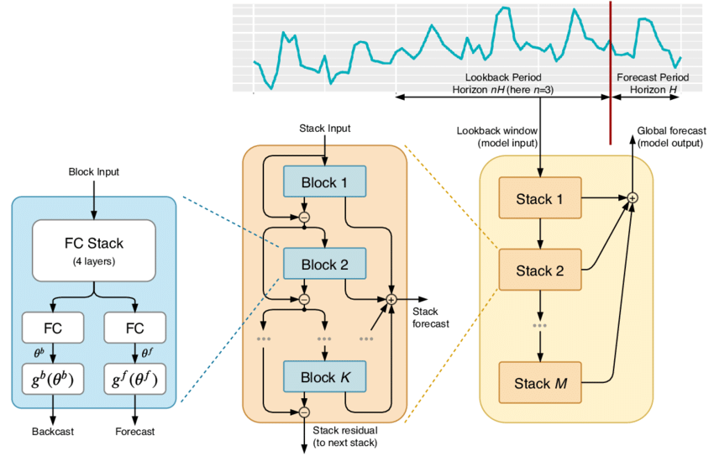
The N-BEATS Architecture
Residual network designed for time-series forecasting
State-of-the-art performance of common benchmarking datasets
M3, M4, and TOURISM
Has been shown to have success when applied to BGL Prediction
Source: “N-BEATS: Neural Basis Expansion Analysis For Interpretable Time Series Forecasting” by Oreshkin et al., 2020

Slide 23
Deep Learning Models (N-BEATS-based)
The LSTM-based model has been adapted to make backcast predictions.
This modified version of the LSTM-based model is used as block within the N-BEATS architecture.
Backcasts are done on BGLs, but carb and bolus time-series are included as context for each block.
Higher capacity model than the LSTM-based model.

Slide 24
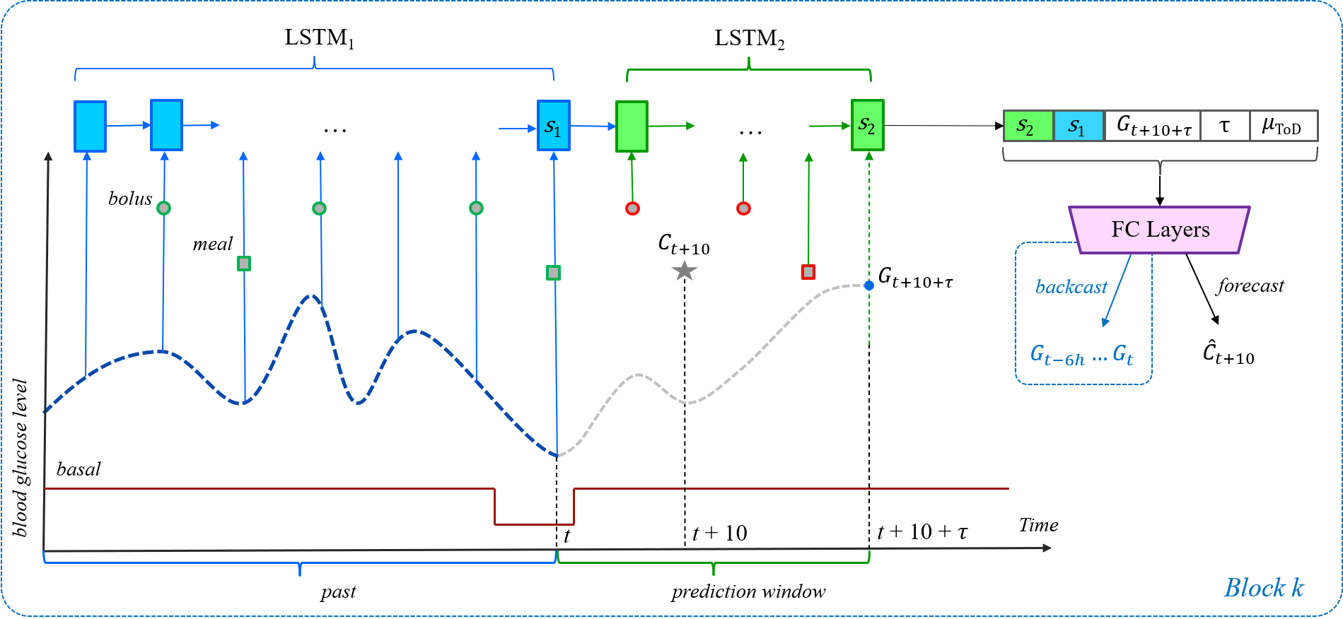
Deep Learning Models (N-BEATS-based)

Slide 25
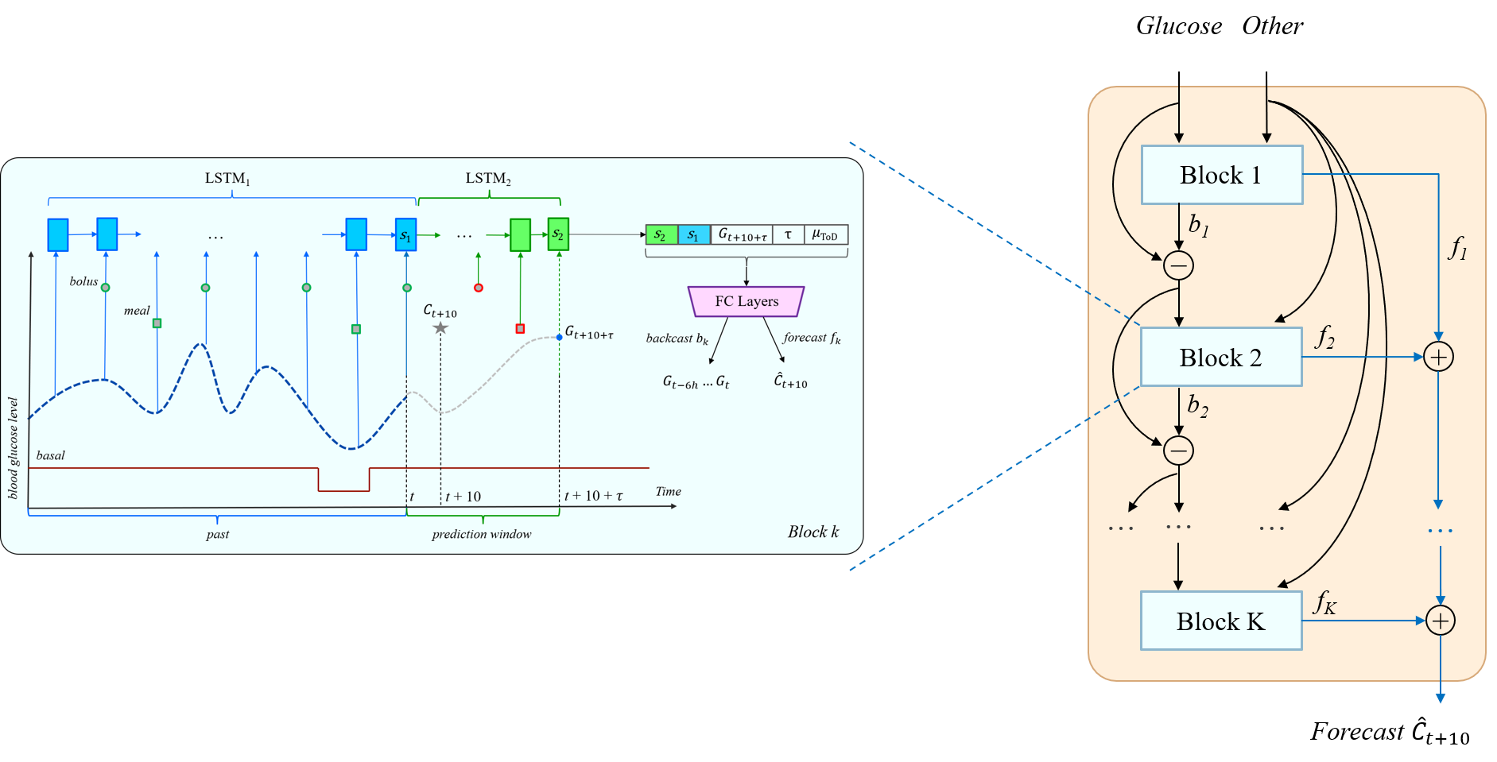
Deep Learning Models (N-BEATS-based)

Slide 26
Training Process
The LSTM-based and N-BEATS-based models were tuned and trained on both inertial and unrestricted examples for the following tasks:
Carb recommendation
Carb recommendation (no boluses)*
Bolus recommendation
Bolus recommendation given carbs
A generic model is pre-trained on the union of all patients’ training data.
For each patient, 10 models are finetuned on that patient’s training data from the generic model.

Slide 27
Example Counts
Scenario | Examples | Training | Testing | Validation | Total
Carbs | Inertial | 14,343 | 4,007 | 4,103 | 22,453
 | Unrestricted | 17,937 | 4,943 | 5,106 | 27,986
Carbs Without Bolus | Inertial | 3,100 | 486 | 620 | 4,206
 | Unrestricted | 4,140 | 624 | 853 | 5,617
Bolus | Inertial | 4,732 | 1,423 | 1,606 | 7,761
 | Unrestricted | 19,640 | 6,136 | 6,279 | 32,055
Bolus Given Carbs | Inertial | 10,514 | 3,249 | 3,269 | 17,032
 | Unrestricted | 12,052 | 3,816 | 3,784 | 19,652

Slide 28
Training Process
The Adam optimization algorithm is used for training.
Early stopping and dropout are used for regularization.
The number of layers in the FCN, dropout rate, and the number of blocks are tuned hyper-parameters.
Other hyper-parameters such as the learning rate, batch size, patience, number of units in each layer, and the number of layers in the LSTMs were chosen in early experiments.

Slide 29
Hyper-Parameters
General Hyper-Parameters
Learning Rate | Batch Size | Patience | FCN units | LSTM units | LSTM layers
0.001 | 32 | 20 Epochs | 64* | 32* | 1
Tuned Hyper-Parameter Options
Number of layers in FCN: 1-5
Number of blocks (N-BEATS only): 1-5
Dropout rate: 0.0, 0.1, … , 0.5

Slide 30
Hyper-Parameters
LSTM-based Model Tuned Hyper-Parameters
Scenario | Examples | FC Layers | Dropout
Carbs | Inertial | 3 | 0.1
 | Unrestricted | 3 | 0.1
Bolus | Inertial | 3 | 0.0
 | Unrestricted | 2 | 0.3
Bolus Given Carbs | Inertial | 2 | 0.2
 | Unrestricted | 2 | 0.5

Slide 31
Hyper-Parameters
N-BEATS-based Model Tuned Hyper-Parameters
Scenario | Examples | FC Layers | Blocks | Dropout
Carbs | Inertial | 2 | 5 | 0.3
 | Unrestricted | 3 | 3 | 0.3
Bolus | Inertial | 4 | 5 | 0.2
 | Unrestricted | 4 | 4 | 0.2
Bolus Given Carbs | Inertial | 4 | 5 | 0.5
 | Unrestricted | 5 | 3 | 0.2

Slide 32
Evaluation Procedures
For each recommendation scenario, two scores are calculated for each the LSTM-based model and the N-BEATS-based model.
Mean Score: For each patient, the average RMSE and MAE across all 10 models is calculated. These averaged RMSE and MAE values are averaged across all patients.
Best Score: For each patient, the RMSE and MAE of the model that performed best on the validation data is saved. These RMSE and MAE values are averaged across all patients.

Slide 33
Statistical Significance
One-tailed paired T-tests were performed for each set of results to determine the statistical significance of the results. Results yielding a p-value < 0.05 are considered statistically significant.
An asterisk (*) indicates the results are statistically significant. For the carb and bolus recommendation results, a single asterisk indicates the the N-BEATS-based model had statistically significant results compared to the baseline.
Two asterisks (**) indicates that the N-BEATS-based model had statistically significant results compared to both the baseline and the LSTM-based model.

Slide 34
Comparing Results With vs. Without Pre-processing
Carbohydrate Results
 | RMSE | MAE
Without | 13.42 | 10.32
With | 8.84* | 6.16*
These are the Mean Scores achieved by the N-BEATS-based models.
The models were trained and evaluated on unrestricted examples.
Pre-processing the data lead to statistically significant improvements in RMSE and MAE for both carb and bolus recommendation.
Bolus Results
 | RMSE | MAE
Without | 1.85 | 1.41
With | 1.30* | 0.92*

Slide 35
Carb Recommendation Results
Carb events with or without boluses
Model | RMSE | MAE
ToD Baseline | 20.01 | 15.78
LSTM-Based | 11.55 | 7.81
N-BEATS-Based | 9.79** | 6.45**
These results are the Mean Scores achieved by both models and the top performing baseline.
All models were trained on evaluated on inertial examples.
The N-BEATS-based models achieved better performance than the LSTM-based models and the baseline.
Only carb events without boluses
Model | RMSE | MAE
ToD Baseline | 15.55 | 13.45
LSTM-Based | 14.02 | 11.47
N-BEATS-Based | 13.76 | 11.42

Slide 36
Bolus Recommendation Results
Bolus events with or without carbs
Model | RMSE | MAE
ToD Baseline | 2.40 | 1.86
LSTM-Based | 1.75 | 1.35
N-BEATS-Based | 1.56* | 1.20**
The Mean Scores are showed for the general bolus scenario, and the Best Scores are shown for the bolus given carbs scenario.
All models were trained on evaluated on inertial examples.
The N-BEATS-based models achieved better performance than the LSTM-based models, which in turn outperformed the baseline.
Bolus events with carbs
Model | RMSE | MAE
ToD Baseline | 2.87 | 2.21
LSTM-Based | 0.94 | 0.67
N-BEATS-Based | 0.85* | 0.61*

Slide 37
Transfer Learning Results
N-BEATS-based models were trained only on examples with a specific prediction horizon. Models were trained for prediction horizons of 30, 45, 60, 75, and 90 minutes.
N-BEATS-based models that were trained on all examples were evaluated only on examples with a specific prediction horizon.
The results shown are the averages of the Mean Scores across the 5 prediction horizons mentioned above.
The results appear to show transfer learning is present between prediction horizons.
Scenario | Trained on | RMSE | MAE
Carbs | One Horizon | 10.08 | 6.88
 | All Horizons | 9.74 | 6.43
Bolus | One Horizon | 1.53 | 1.23
 | All Horizons | 1.50 | 1.17*
Bolus Given Carbs | One Horizon | 0.94 | 0.71
 | All Horizons | 0.88* | 0.65*

Slide 38
Conclusion
Introduced a neural architecture consisting of two chained LSTMs designed to provide carb and bolus recommendations to assist Type 1 Diabetes management.
Adapted a state-of-the-art time-series forecasting architecture to perform carb and bolus recommendations, using our previous architecture as a component of the new architecture.
Achieved promising results on real-patient data that suggests this approach could potentially be of practical use to those with Type 1 Diabetes

Slide 39
Publications
“A General Neural Architecture for Carbohydrate and Bolus Recommendations in Type 1 Diabetes Management”
by Jeremy Beauchamp, Razvan Bunescu, and Cindy Marling.
Proceedings of the 5th International Workshop on Knowledge Discovery in Healthcare Data. 2020
“An LSTM-based Approach for Insulin and Carbohydrate Recommendations in Type 1 Diabetes Self-Management”
by Jeremy Beauchamp, Razvan Bunescu, and Cindy Marling.
Recommender Systems for Medicine and Music. (in pres.). 2021 (invited book chapter)
“LSTMs and Deep Residual Networks for Carbohydrate and Bolus Recommendations in Type 1 Diabetes Management”
by Jeremy Beauchamp, Razvan Bunescu, Cindy Marling, Zhongen Li, and Chang Liu.
MDPI Sensors Journal. 2021 (Under review)

Slide 40
Questions?

