Slide 1

Data-Driven Basketball

Slide 2





Dataset
618,019
Records
12,874
Games
1098
Players
34
Teams
2
Stages
10
Seasons

Slide 3
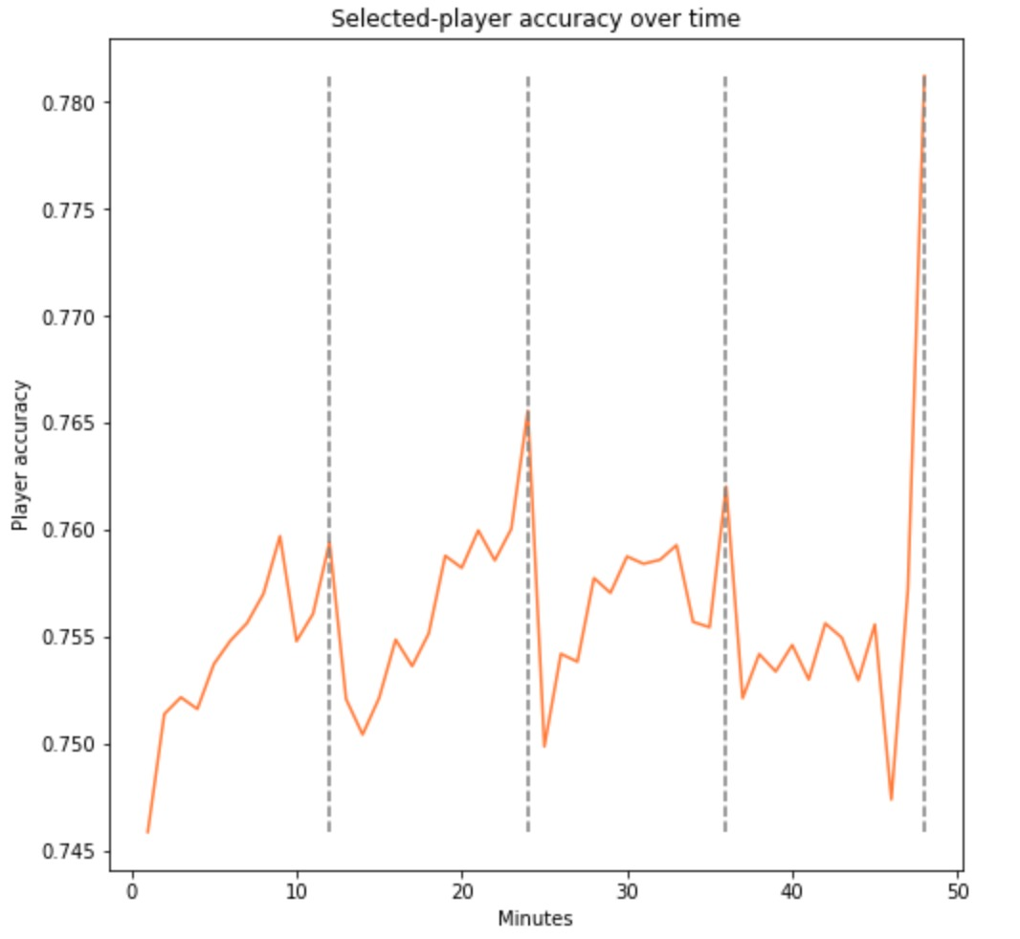
Competitor Analysis
Understanding the strategies used by competitors is vital when preparing for upcoming games.
The analysis shows that competitors tend to choose players with higher free throw accuracy to take shots towards the end of a period.

Slide 4
Talent Acquisition
Monitoring variations in free shot accuracy can be useful when scouting for talent. Players who show continuous accuracy improvement are ideal, as their market value will most likely get higher.
The table on the right shows the top 5 players which have shown constant accuracy improvement over the last 5 seasons.
Player | Avg Seasonal Improvement
Lou Amundson | 24.5%
Jon Leuer | 24.2%
Charlie Villanueva | 22.4%
Ish Smith | 17.9%
Ian Mahinmi | 15.3%

Slide 5
Squad Selection
Being mindful of upcoming games is important when selecting which players should play. This is imperative to ensure that the best players are not fatigued or injured if a difficult game is coming up.
The table on the right shows the top challenging teams for the Atlanta Hawks and the average end-result difference, over the last 3 seasons.
Team | Avg End Result Difference
LAC | 5.8
ORL | 7.7
OKC | 8.0
DAL | 8.0
NO | 8.1

Slide 6
Future Projects
Features Expansion
Add more features to the dataset, such as current player market value, injury history and real-time game data
Recommendation System
A machine-learning model to recommend which player should perform the free throw
Player Valuation Model
A model to help determine the value of a player, which can then be used during the transfer season

