Slide 1
Code is for Humans
Jeremy Clark jeremybytes.com
@jeremybytes

Slide 2








Cincy Deliver 2024 Sponsors
Diamond
Gold
Silver

Slide 3
Code is for Humans
Jeremy Clark jeremybytes.com
@jeremybytes

Slide 4
Computers Don’t Care
The computer doesn’t care what code looks like.
All that matters is that the code compiles.
But what about the humans?

Slide 5
Why Do Humans Matter?
There’s no such thing as write-once code

Slide 6
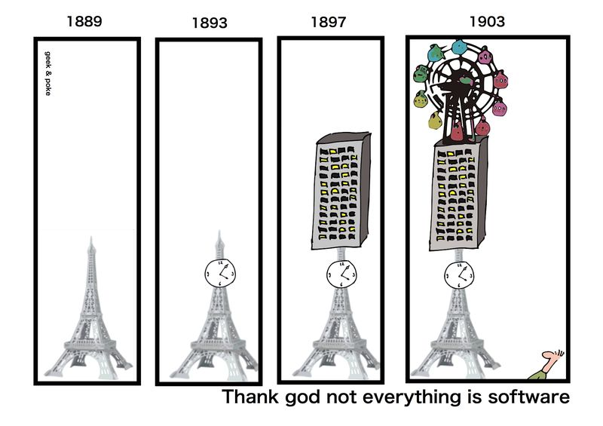
http://geekandpoke.typepad.com/geekandpoke/2012/03/thank-god-not-everything-is-software.html

Slide 7
Why Do We Care?
There’s no such thing as write-once code
Bug Fixes
Business Changes
Enhancements
New Functionality

Slide 8
Code Qualities
Readable
Maintainable
Testable
Elegant

Slide 9
Blockers
Ignorance
Stubbornness
Short-Timer Syndrome
Arrogance
Job Security
Scheduling

Slide 10
Blockers
Number one reason:
“I’ll fix it later.”
Pro Tip: “Later” never comes.

Slide 11
The Truth about Human Code
Human readable code saves time.
We can’t take a short-term view of software.
We need to look at the lifespan of the application.

Slide 12
Inspiration
Rule of Thumb:
Imagine that the developer who comes after you is a homicidal maniac who knows where you live.
-Unknown

Slide 13
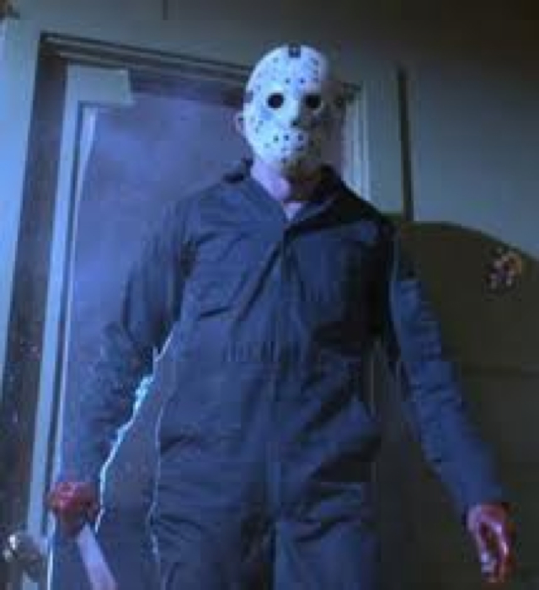
The Next Developer
Json

Slide 14
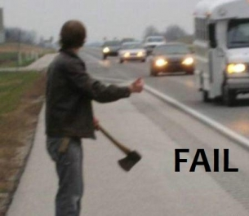
This Might Take Awhile

Slide 15
The Problem
Readable (by mere mortals)
Maintainable
Testable
Elegant
All of these qualities are subjective.

Slide 16
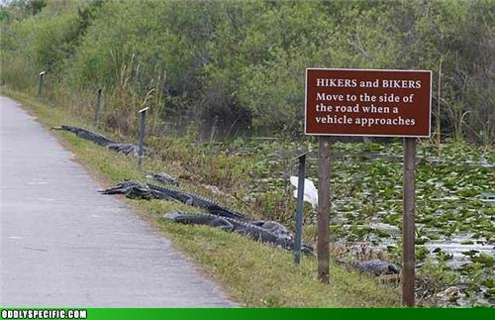
“Best Practices”

Slide 17
The Dry Principle
Don’t Repeat Yourself
copy/pasta = spaghetti code

Slide 18
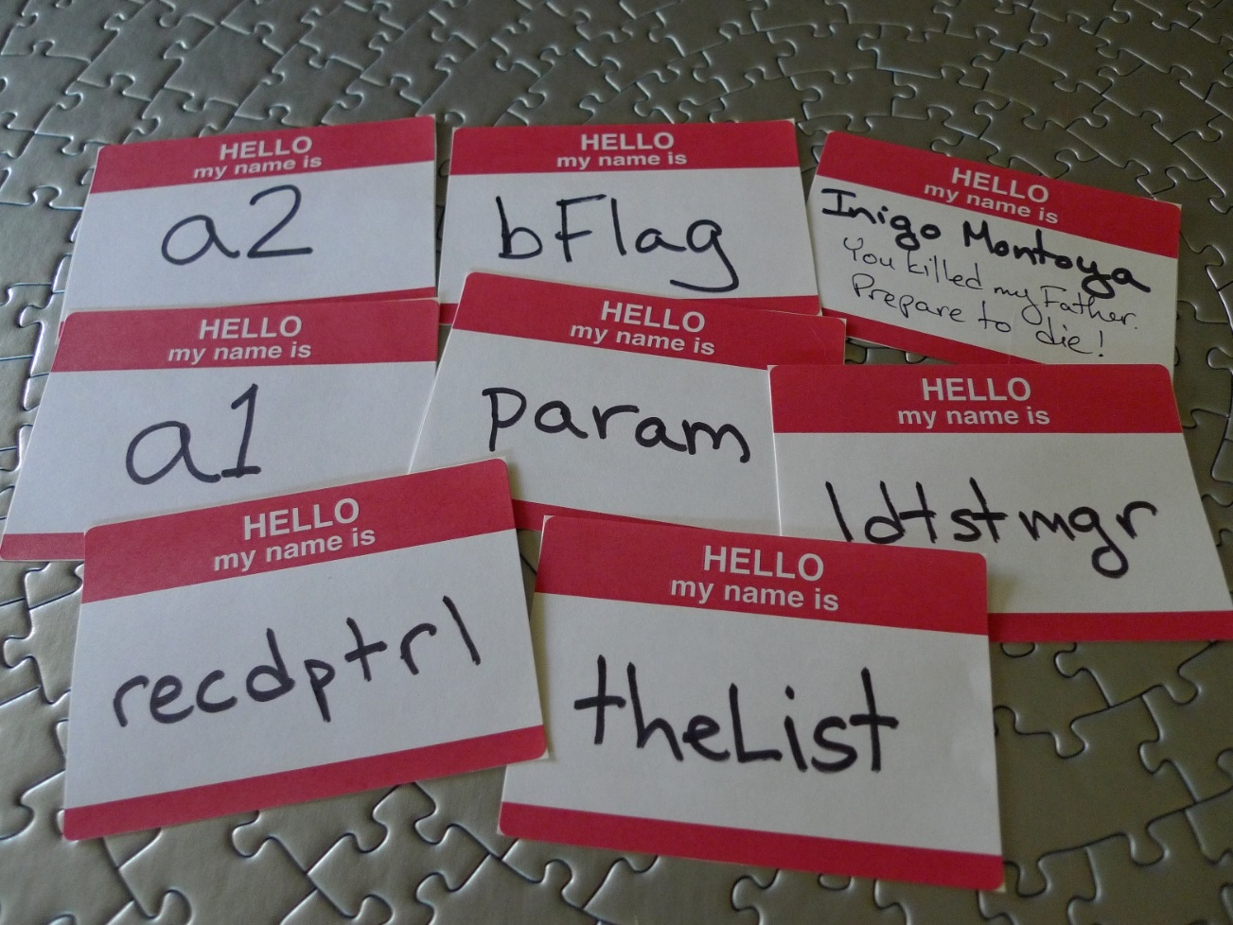
Naming

Slide 19
Intentional Naming
theList
Not very good
ProductList
A bit better
ProductCatalog
Good

Slide 20
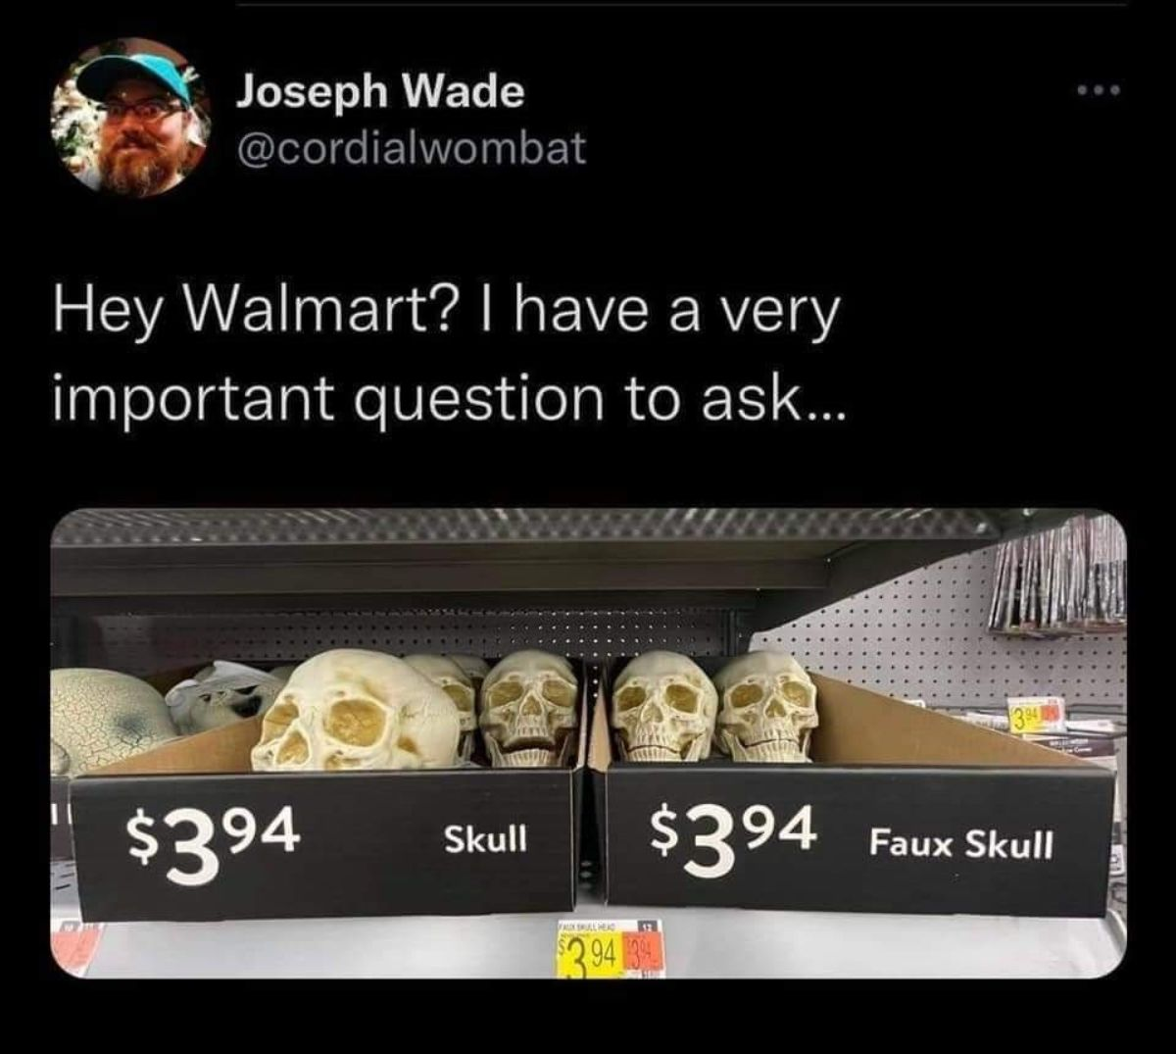

Slide 21
Naming Tips
Use Nouns for Variables, Properties, Parameters
indexer, currentUser, PriceFilter
Use Verbs for Methods and Functions
SaveOrder(), getDiscounts(), RunPayroll()
Pronounceable and Unambiguous
recdptrl = received patrol? record department role?

Slide 22
Naming Standards
camelCase?
PascalCase?
snake_case?
kebab-case?
It doesn’t matter
Have a Standard
Be Consistent

Slide 23
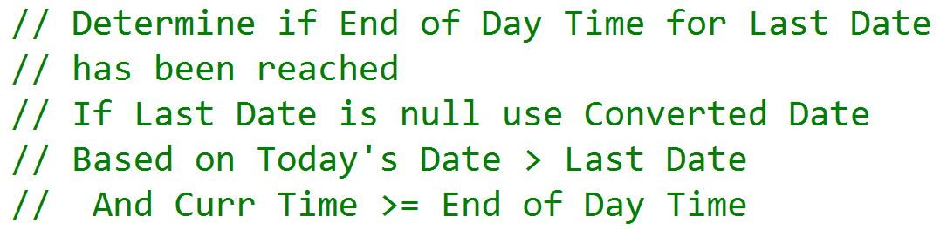
Comments

Slide 24
Comments
Rule #1: Comments lie
Code is updated or moved, but not the comments

Slide 25
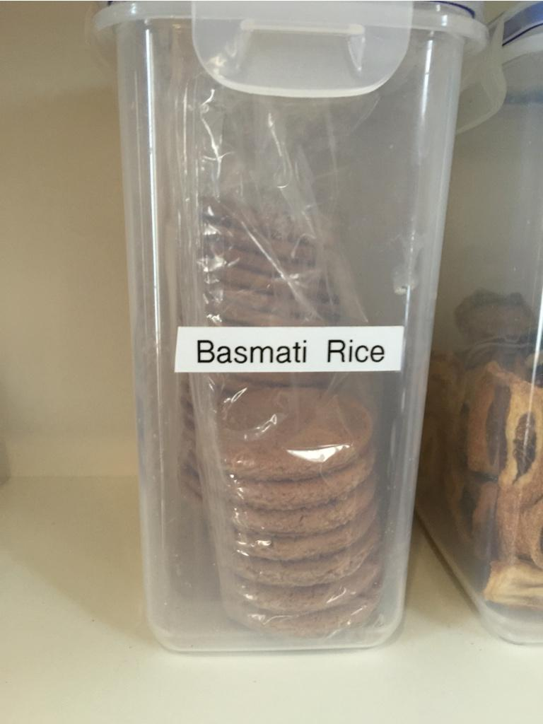
Comments Lie

Slide 26
Comments
Rule #1: Comments lie
Code is updated or moved, but not the comments
Rule #2: Comments do not make up for bad code
If the code is that unclear, rewrite the code

Slide 27
Good Comments
Can be used to describe intent or clarification
Ex: // Sample input: Oct 5, 2015 - 13:54:15 PDT
Can be used to give warnings or consequences
Ex: // We do a deep copy of this collection to make // sure that updates to one copy do not affect // the other

Slide 28
Good Comments
Can be used for TODOs
Especially useful when the IDE supports it
These should be temporary

Slide 29
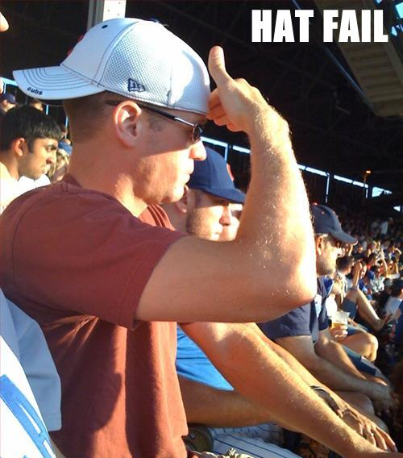
Know Your Tools

Slide 30
Bad Comments
Do not comment out code
Code no longer in use should be deleted
If needed, you can always retrieve it from source control

Slide 31
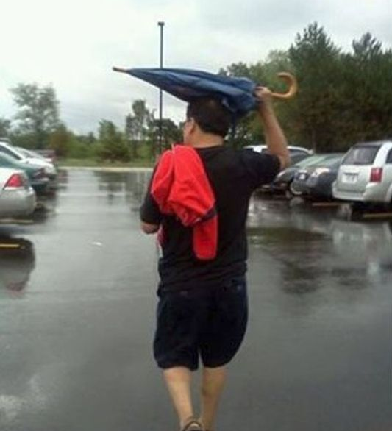
Know Your Tools

Slide 32
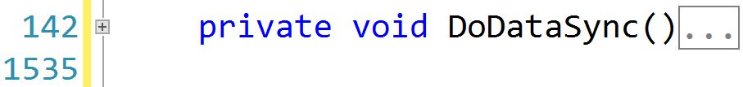
Functions and Methods

Slide 33
Functions and Methods
Keep methods short
Should fit on a single screen
Prefer methods no longer than 10 lines
Do one thing!

Slide 34
Multiple Levels of Methods
High level
Overview of functionality
Mid-level
More details, but not too deep
Detail
The “weeds” of the functionality

Slide 35
Work in Small Chunks
If you aren’t writing incremental code,
you are writing excremental code.

Slide 36
What is Refactoring?
Making code better
without changing the functionality

Slide 37
Refactoring and Unit Testing
If you don’t have unit tests, you don’t know what your code does.
Refactoring Step 1:
Bring your code under test.
Refactoring Step 2:
Safely and confidently update the code.

Slide 38

Working Effectively with Legacy Code
- Michael C. Feathers

Slide 39
The Watcher
Json

Slide 40
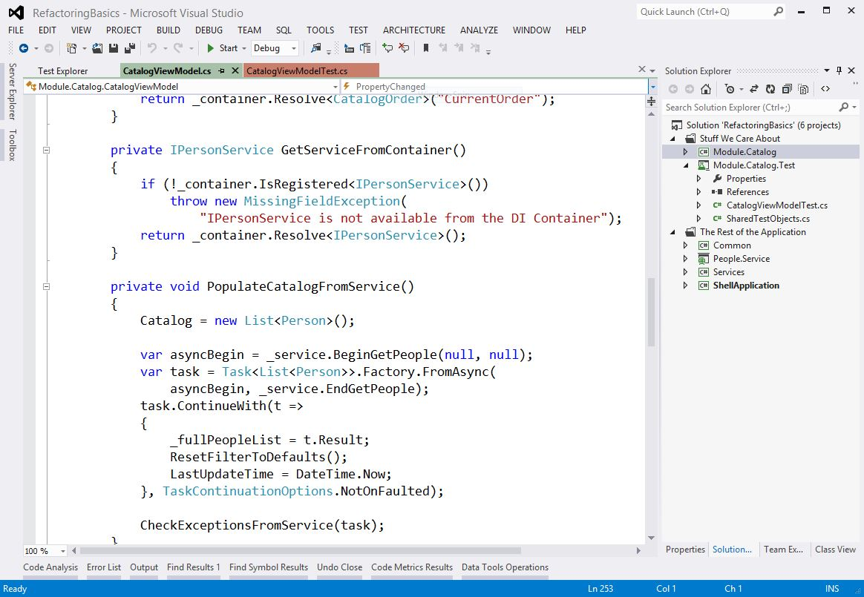
Coding for Humans

Slide 41
Wrap Up
There’s no such thing as write once code
Be nice to the humans who have to change your code (it may be you)

Slide 42
Thank You!
Jeremy Clark
jeremybytes.com
jeremy@jeremybytes.com
@jeremybytes

