Slide 1

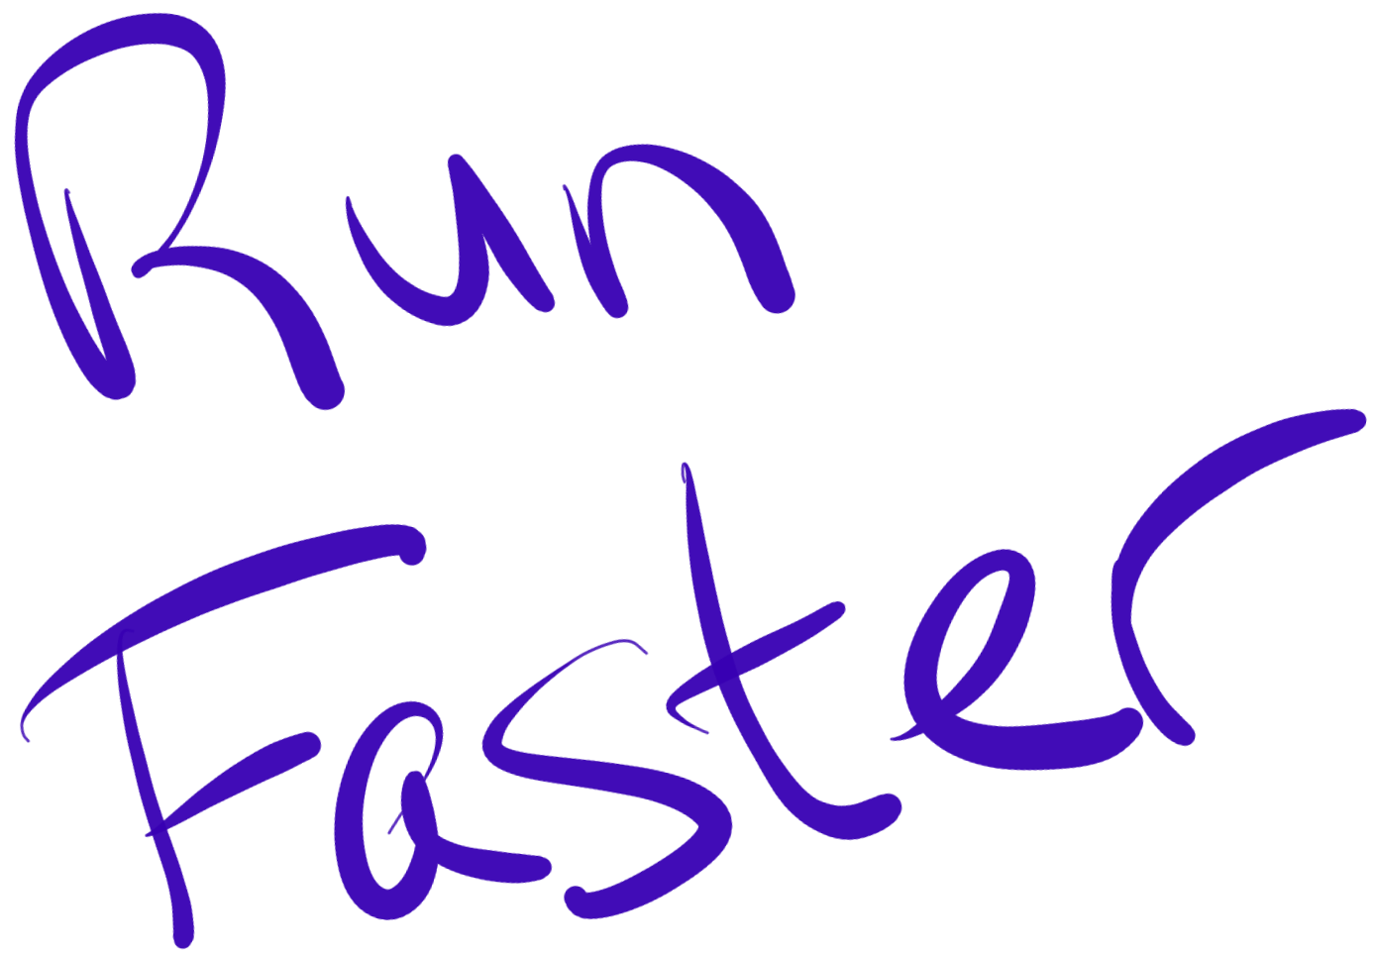

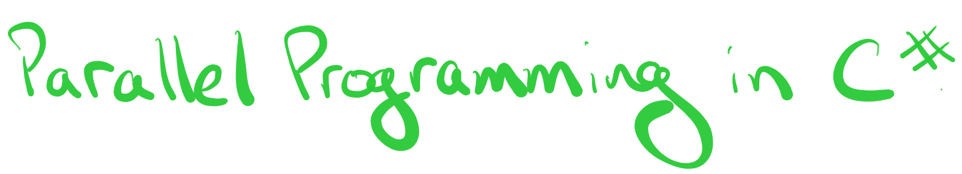
@jeremybytes
Notes:
Run Faster: Parallel Programming in C#
Presented by Jeremy Clark
Twitter @jeremybytes

Slide 2

@jeremybytes
Notes:
What are we talking about today?

Slide 3
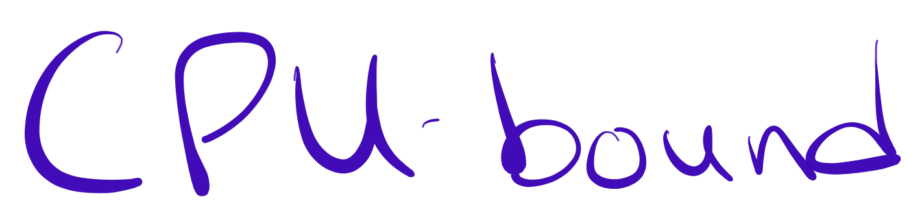

@jeremybytes
Notes:
CPU-bound operations

Slide 4
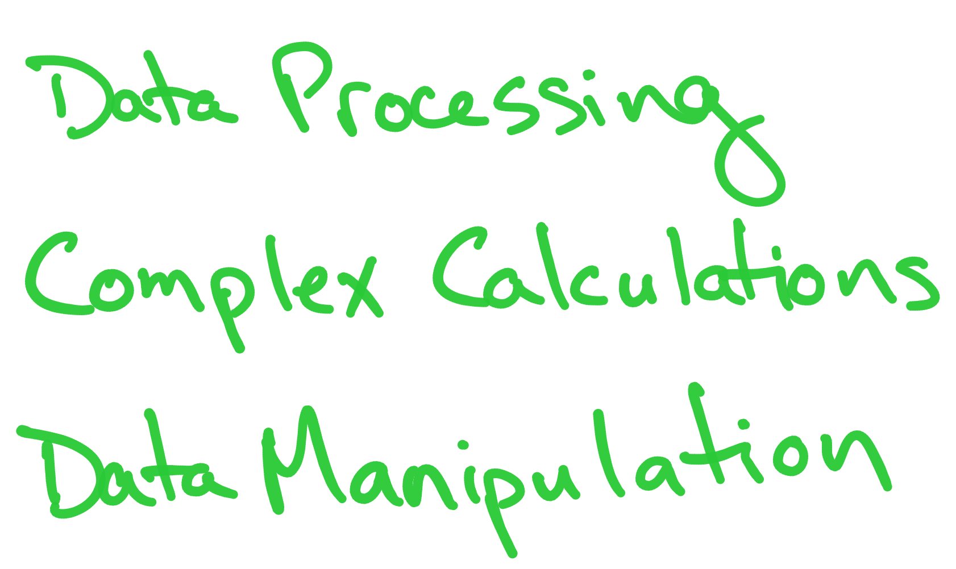
@jeremybytes
Notes:
CPU-bound operations are things like
Data processing
Complex calculations
And Data manipulation

Slide 5

@jeremybytes
Notes:
Why do we need to worry about parallel programming?

Slide 6
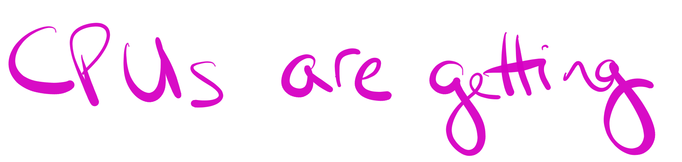


@jeremybytes
Notes:
CPUs are getting bigger, not faster

Slide 7

@jeremybytes
Notes:
Single-core CPU

Slide 8

@jeremybytes
Notes:
Single-core CPU at full load

Slide 9
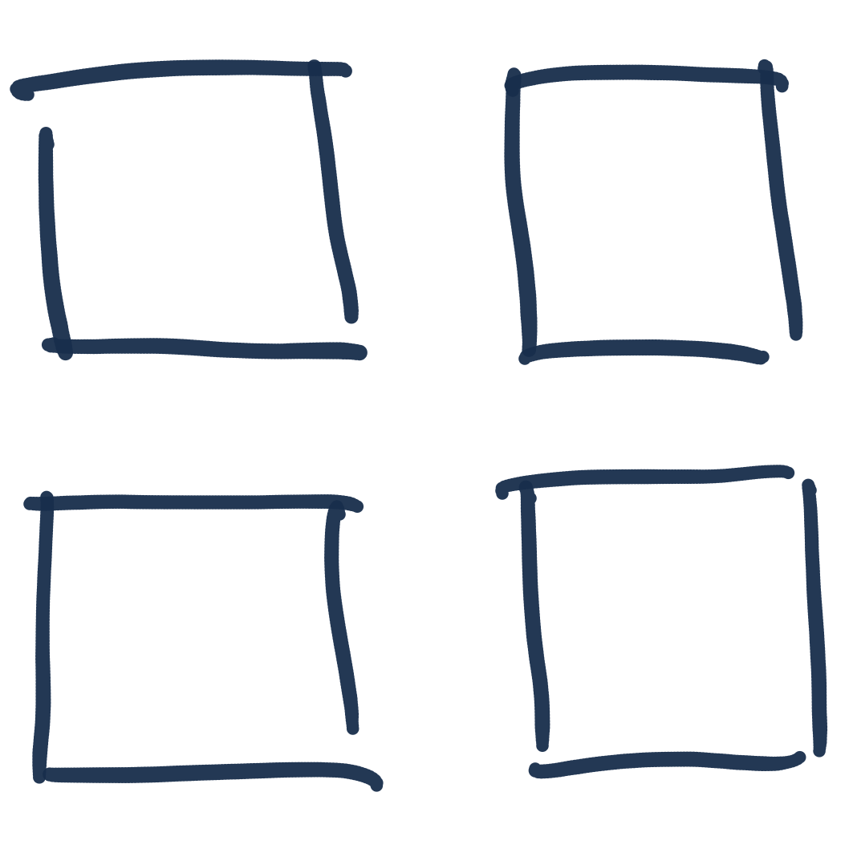
@jeremybytes
Notes:
4-core CPU

Slide 10
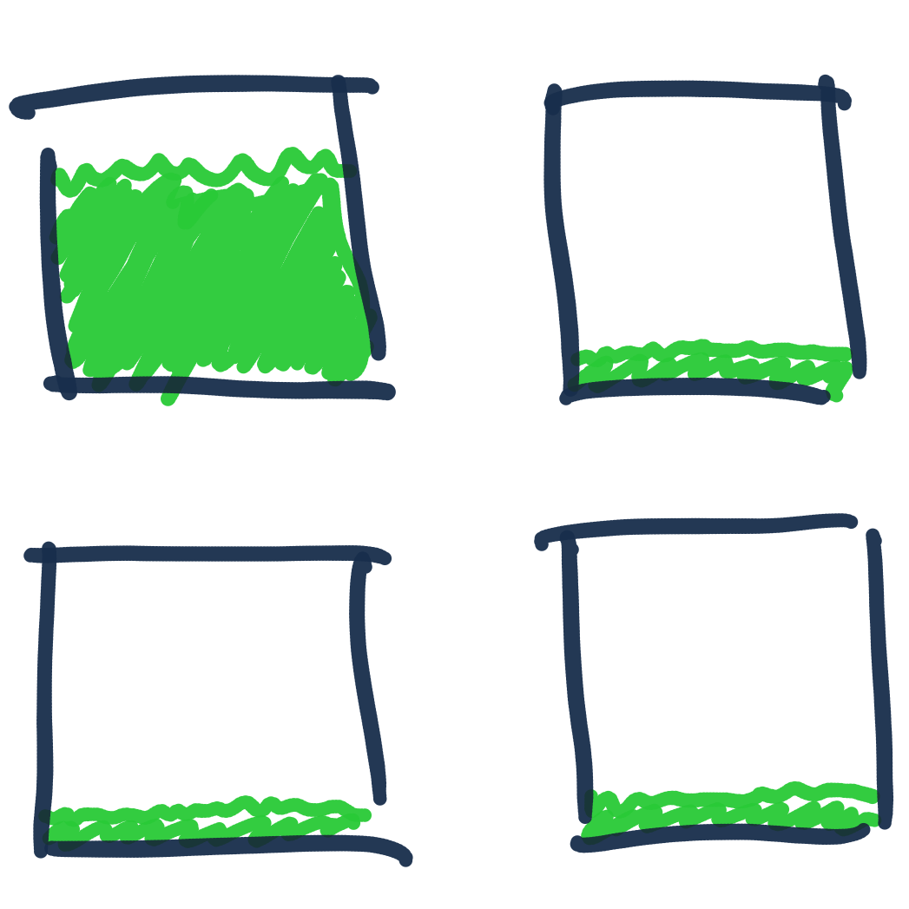
@jeremybytes
Notes:
4-core CPU with one core at full load and 3 cores at minimal load

Slide 11
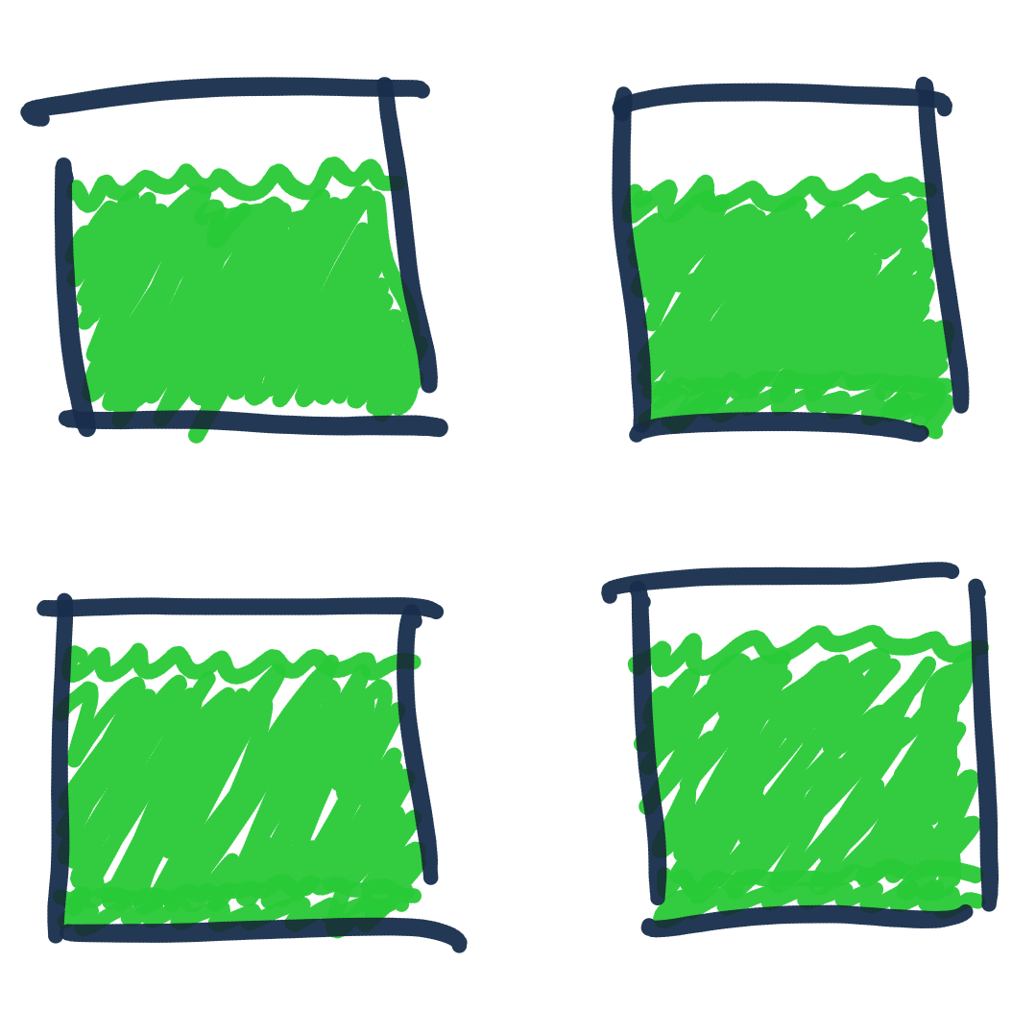
@jeremybytes
Notes:
4-core CPU with 4 cores at full load

Slide 12
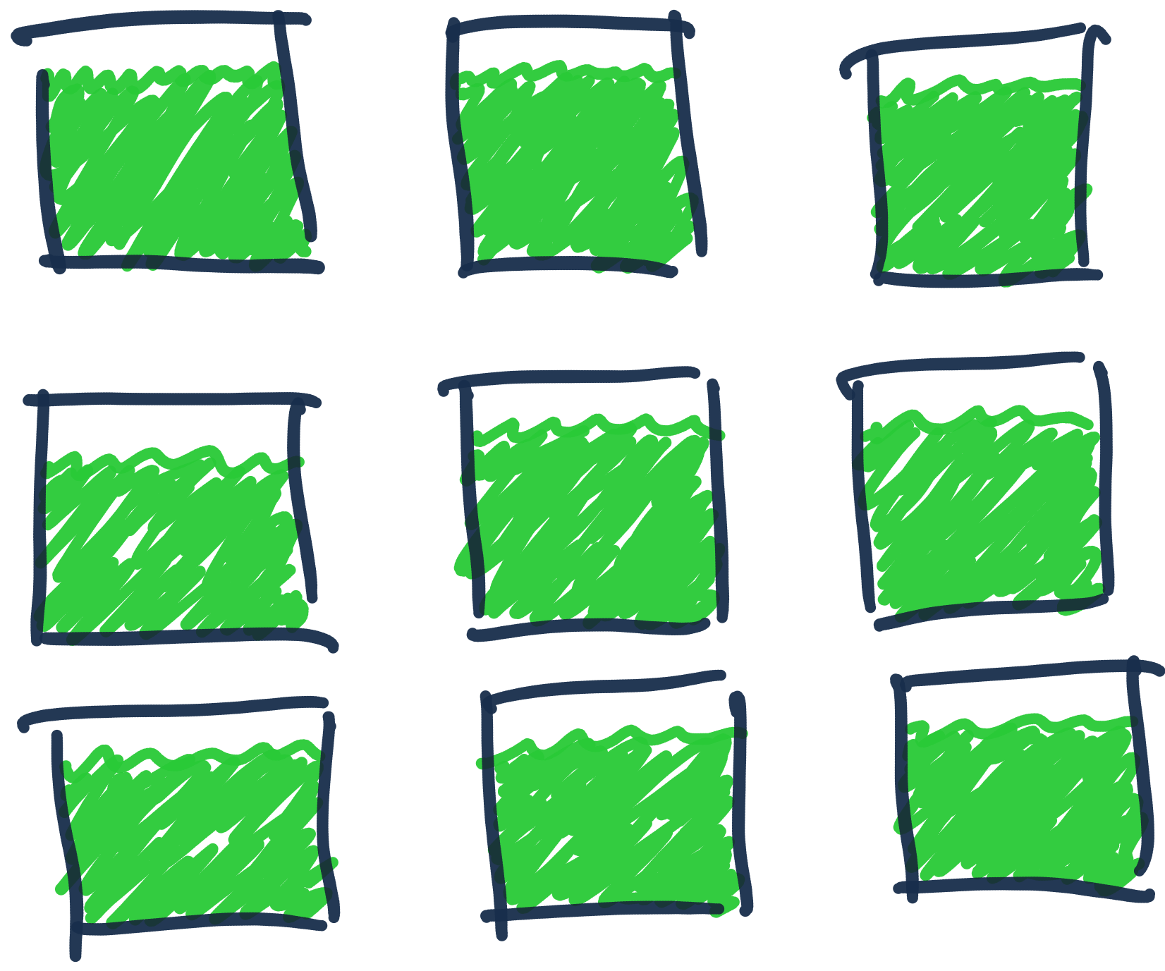
@jeremybytes
Notes:
18-core CPU at full load

Slide 13


@jeremybytes
Notes:
Can I run my code in parallel?

Slide 14


@jeremybytes
Notes:
Maybe
Maybe not

Slide 15
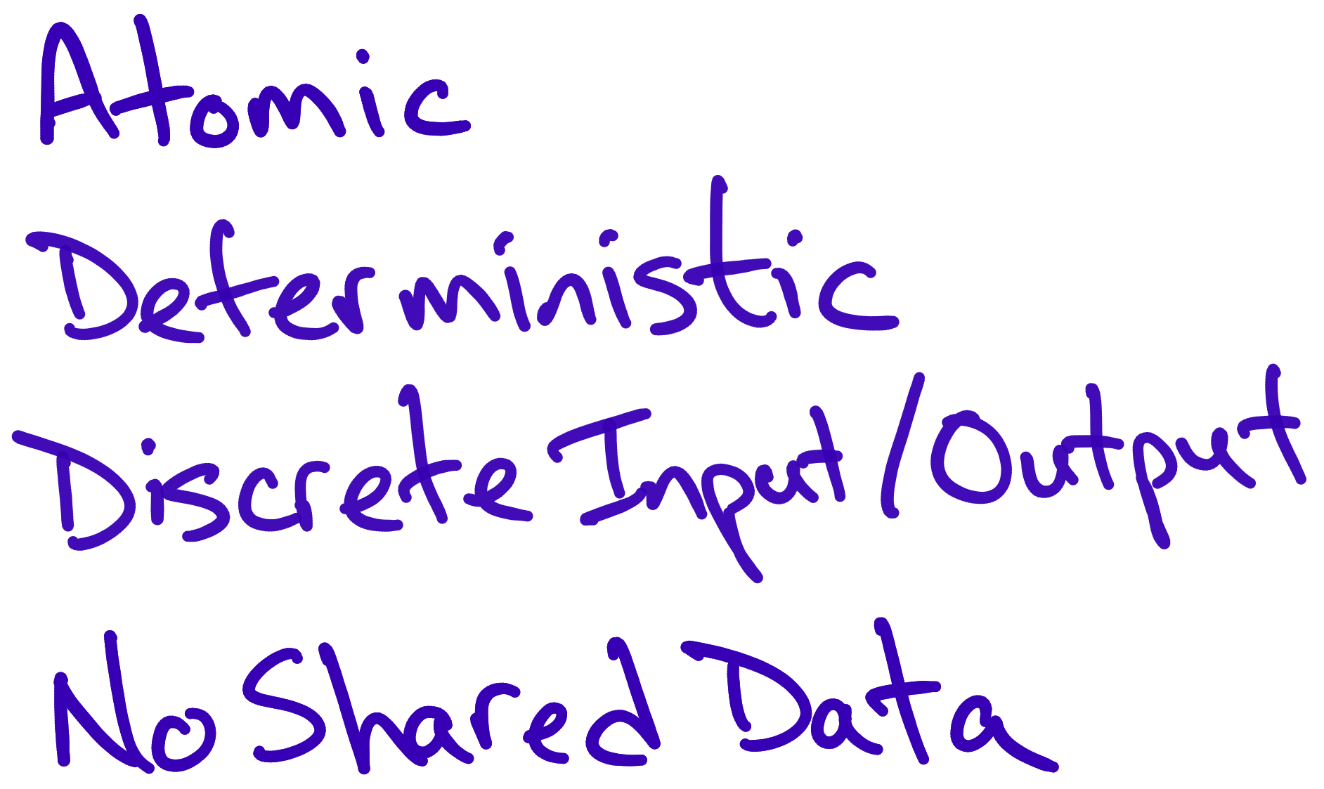
@jeremybytes
Notes:
Maybe parallel code characteristics, i.e. code that is easier to run in parallel.
Atomic
Deterministic
Discrete input and output
No shared data

Slide 16
@jeremybytes
Notes:
Maybe not

Slide 17
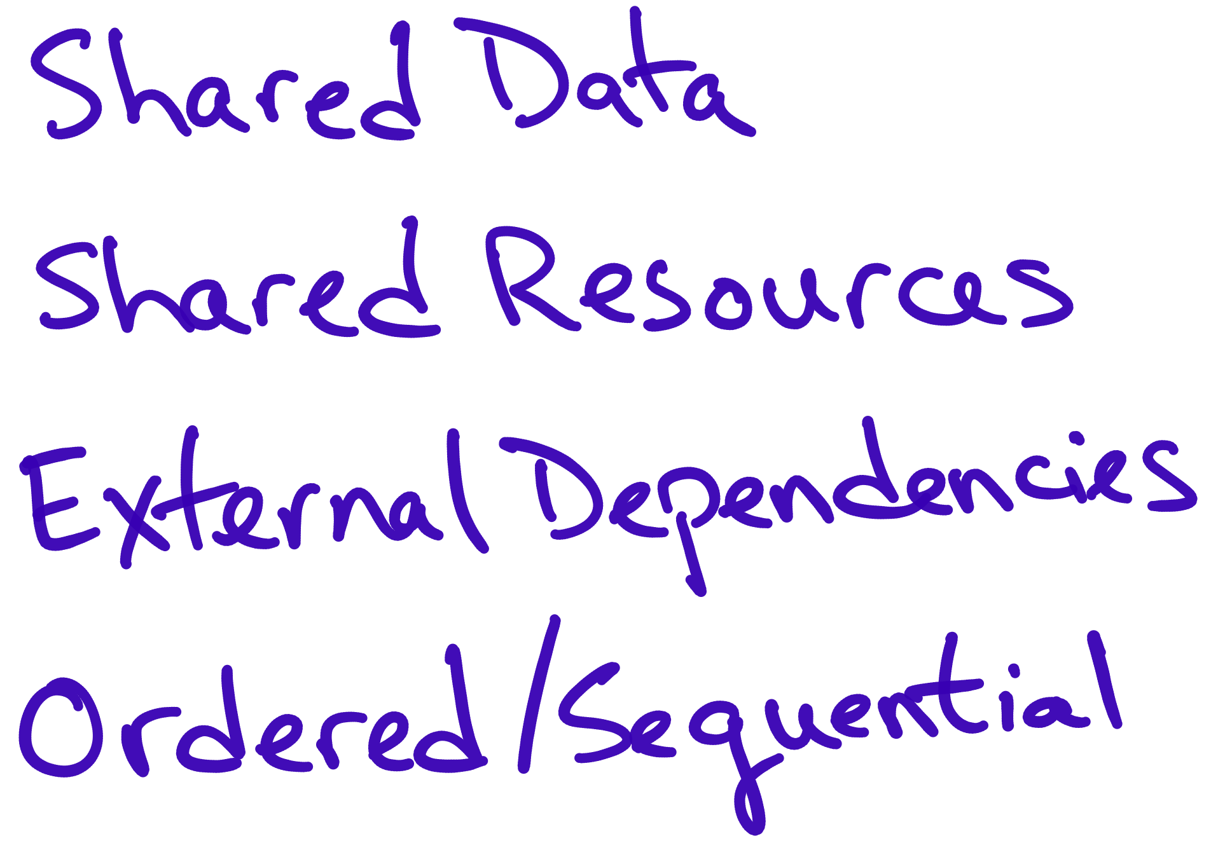
@jeremybytes
Notes:
Maybe not parallel characteristics, i.e. code that is difficult to run parallel.
Shared data
Shared resources
External dependencies
Ordered or sequential operations

Slide 18
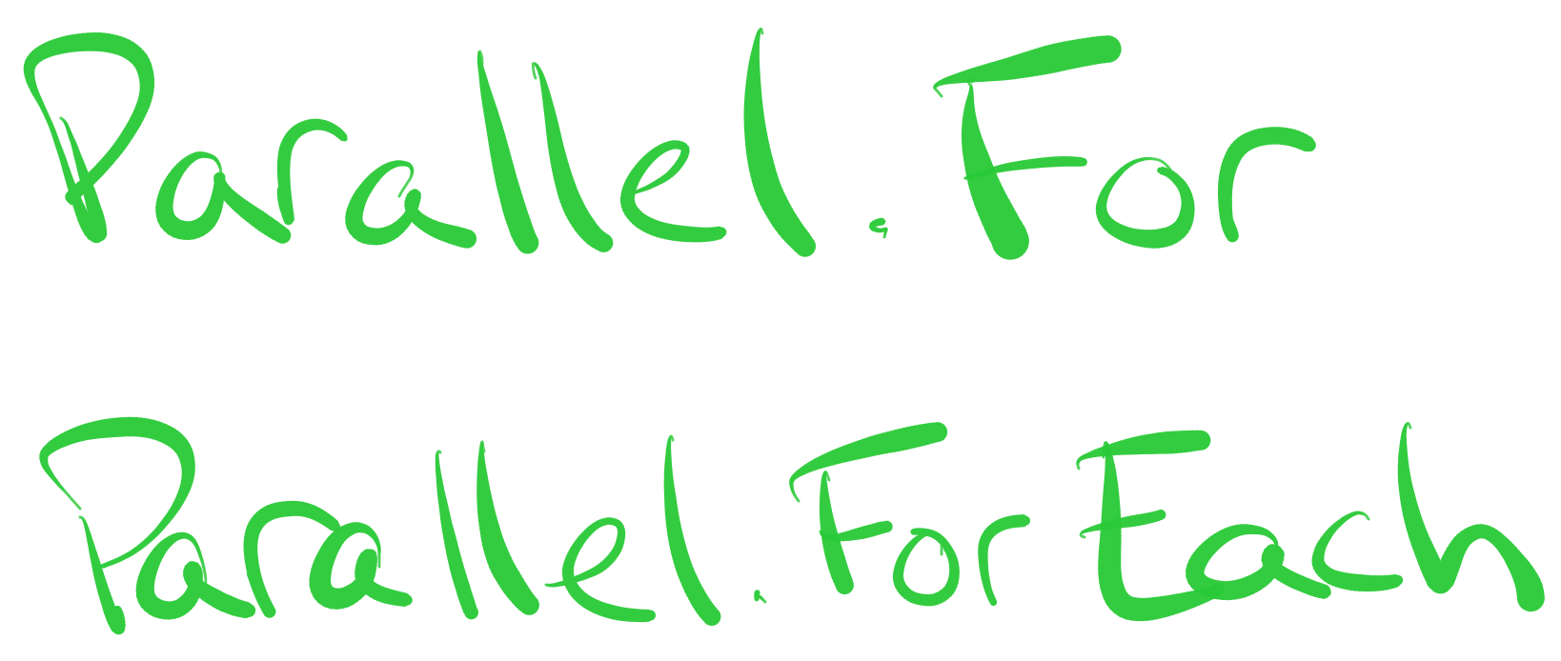
@jeremybytes
Notes:
Parallel.For and Parallel.ForEach

Slide 19

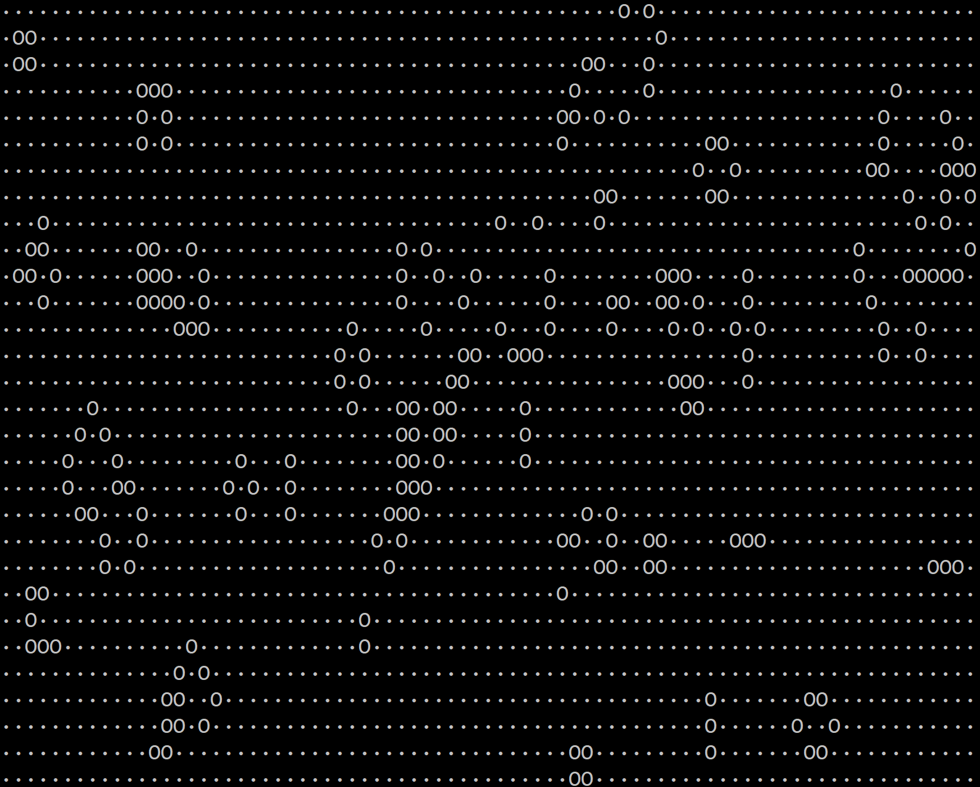


@jeremybytes
Notes:
Example application using Parallel.ForEach
Conway's Game of Life

Slide 20


@jeremybytes
Notes:
Hard to Run Parallel

Slide 21

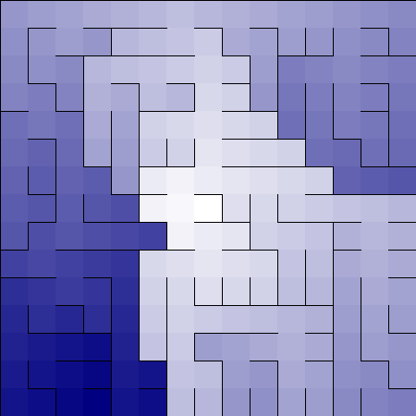
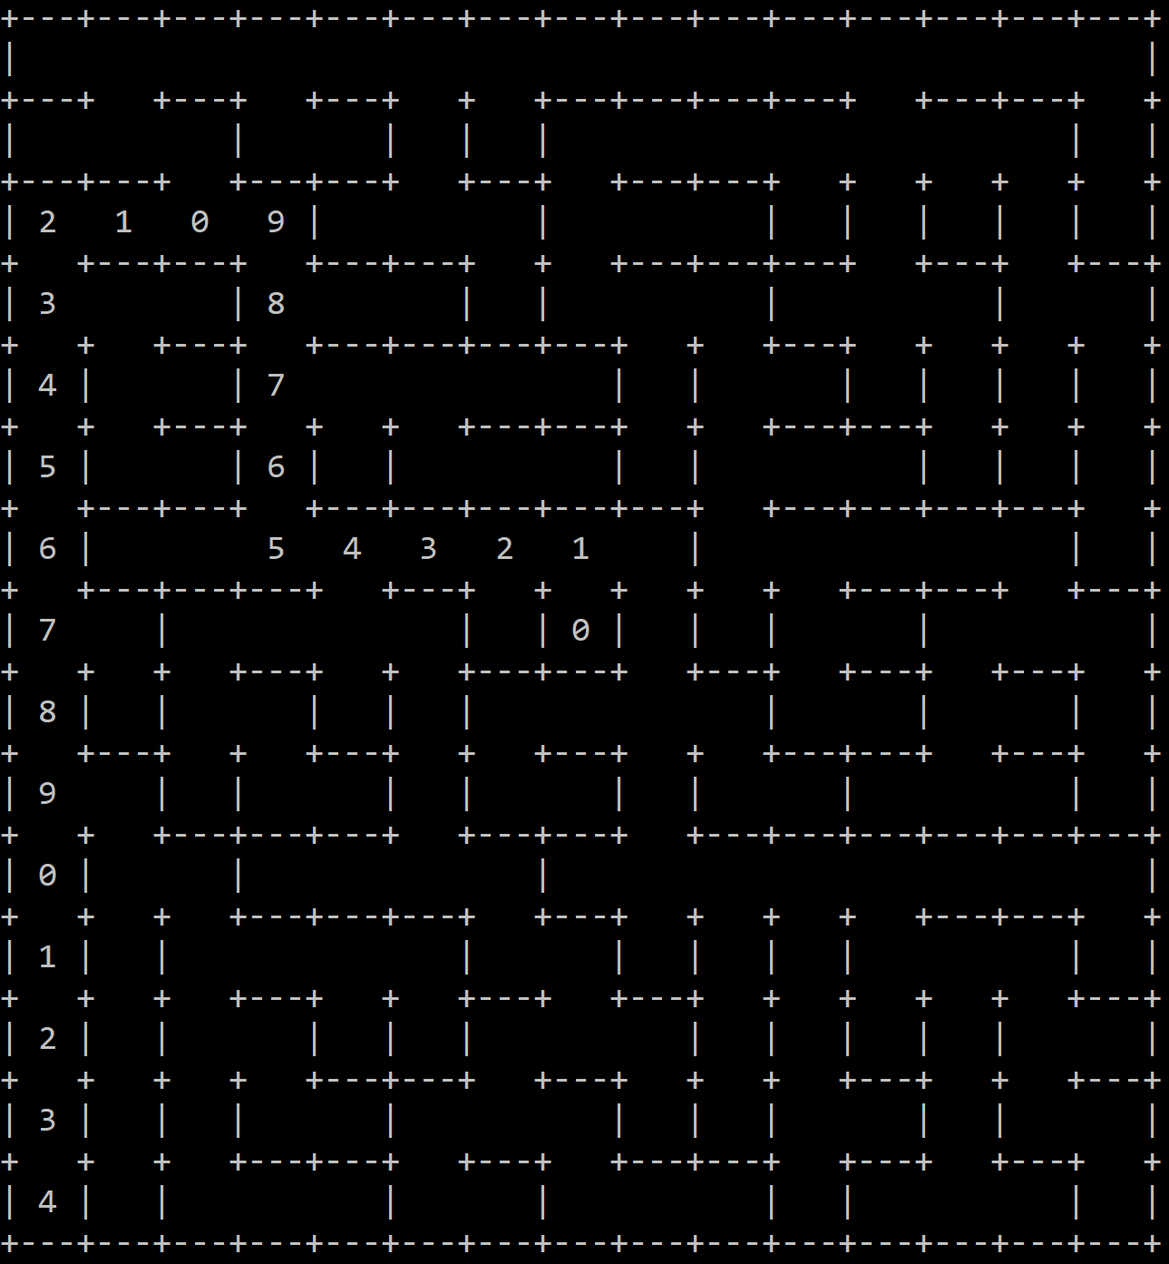
@jeremybytes
Notes:
Example application with code that would be hard to run parallel
Maze generation

Slide 22

@jeremybytes
Notes:
Parallel Tasks

Slide 23

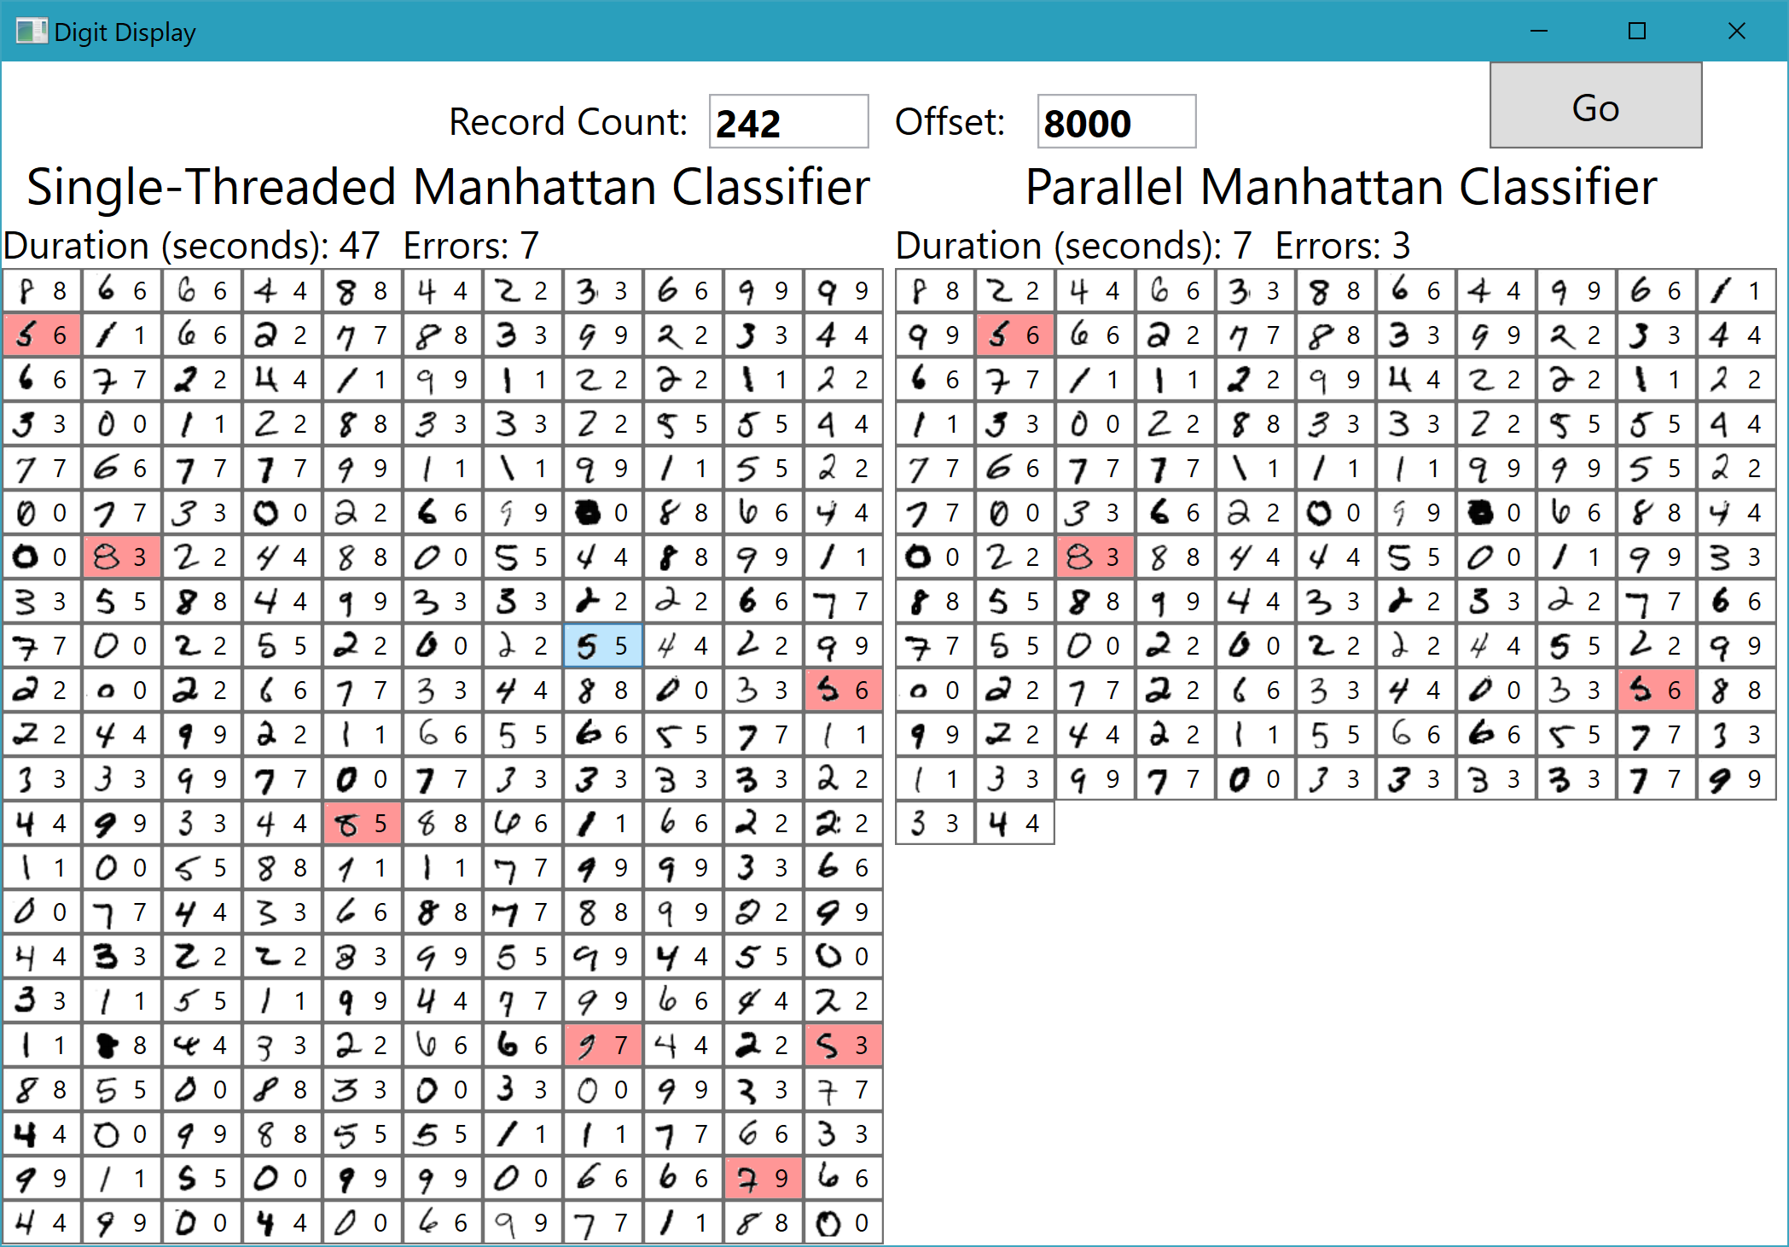
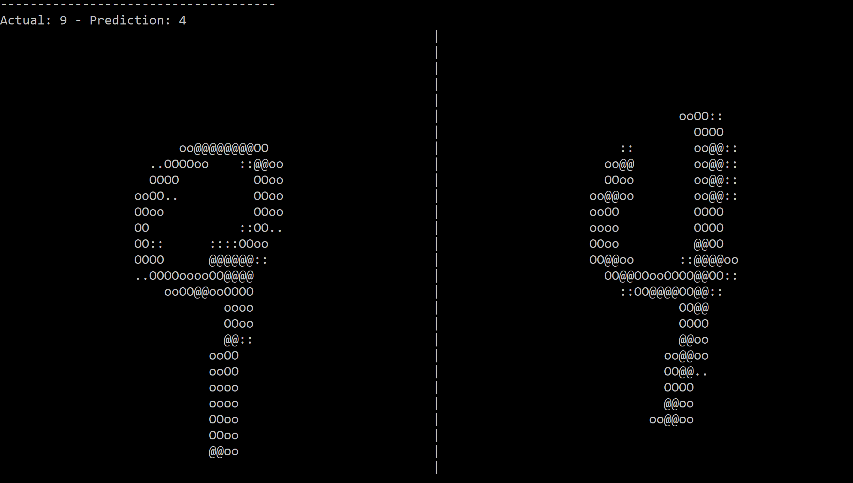
@jeremybytes
Notes:
Example application using Parallel Tasks
Digit recognition

Slide 24
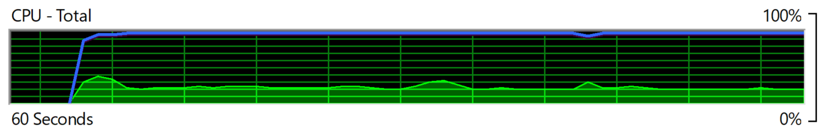
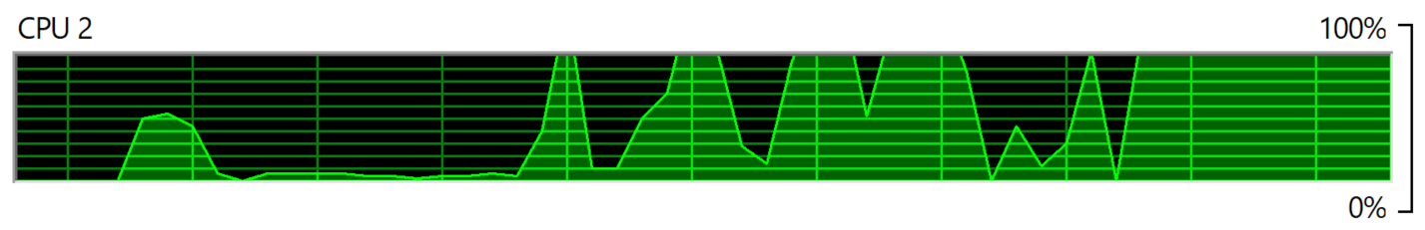
@jeremybytes
Notes:
Single-threaded code run
Overall CPU runs at 20% utilization
CPU #2 (1 core) run at 100% utilization

Slide 25
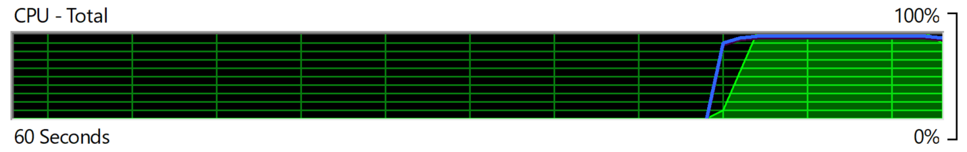
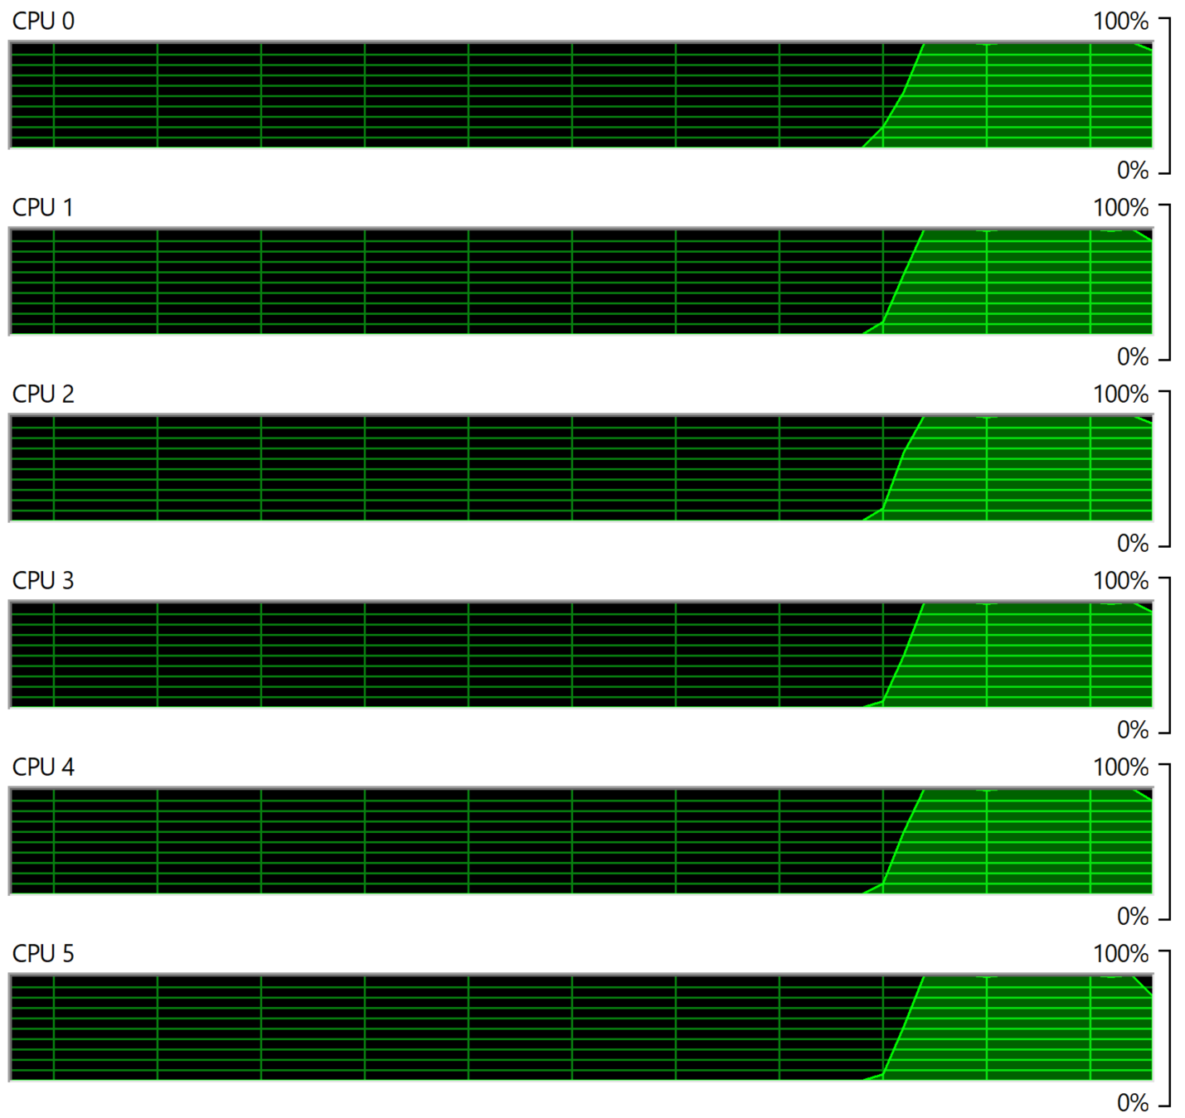
@jeremybytes
Notes:
Parallel code run
Overal CPU at 100% utilization
6 cores running at 100% utilization (other cores not shown)

Slide 26
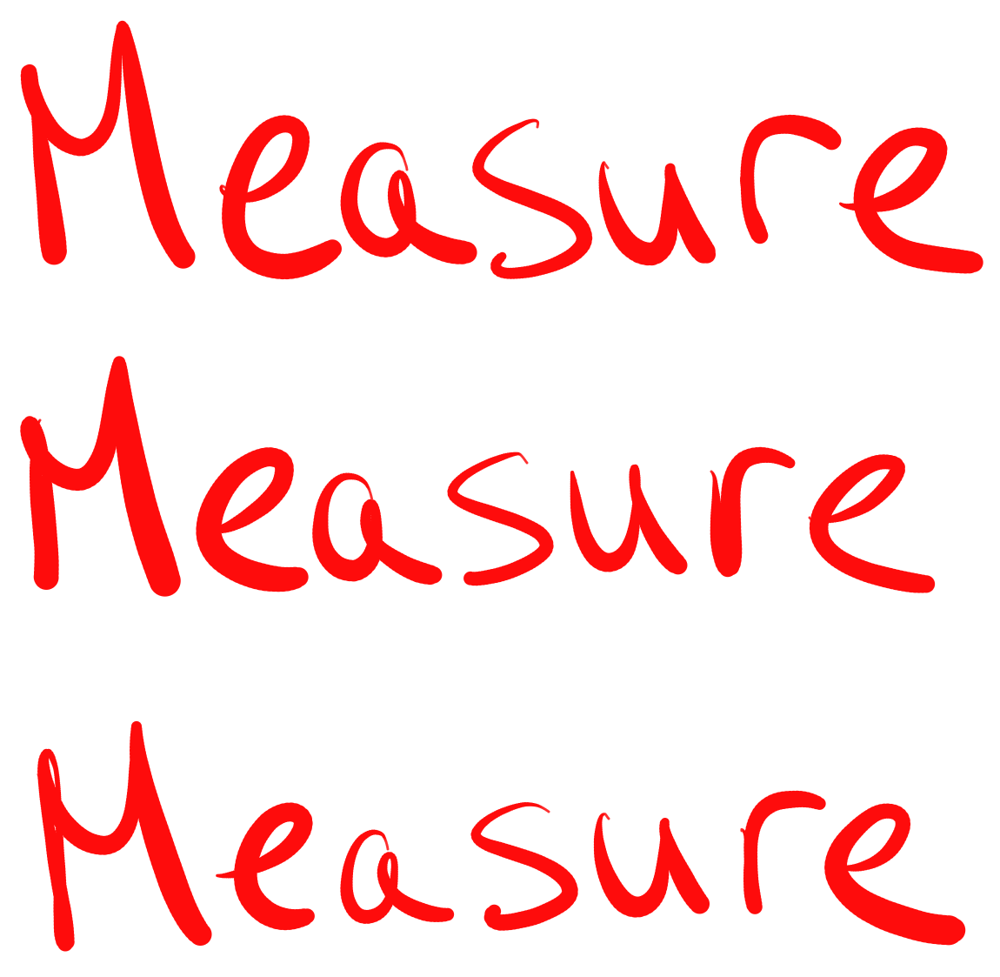
@jeremybytes
Notes:
Measure Measure Measure

Slide 27

@jeremybytes
Notes:
Resources

Slide 28


@jeremybytes
Notes:
Parallel Programming with Microsoft .NET

Slide 29
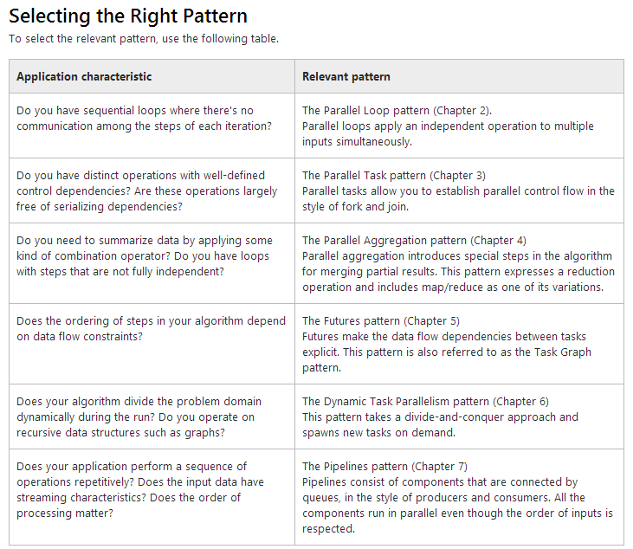
@jeremybytes
Notes:
Parallel Programming with Microsoft .NET
Chart: Selecting the Right Pattern
This is from the "Introduction" available here: https://docs.microsoft.com/en-us/previous-versions/msp-n-p/ff963542(v=pandp.10)#design-approaches

Slide 30
Parallel Programming w/ Microsoft .NET https://docs.microsoft.com/en-us/previous-versions/msp-n-p/ff963553(v=pandp.10)
Task & Await http://www.jeremybytes.com/Demos.aspx#TaskAndAwait
Presentation Links http://www.jeremybytes.com/Demos.aspx#RunFaster
GitHub https://github.com/jeremybytes/parallel-programming
@jeremybytes

Slide 31


@jeremybytes
Notes:
Thank You
Website: jeremybytes.com
Twitter: @jeremybytes

