Slide 1
Catching up with C# Interfaces What you know is probably wrong
Jeremy Clark
www.jeremybytes.com
@jeremybytes

Slide 2
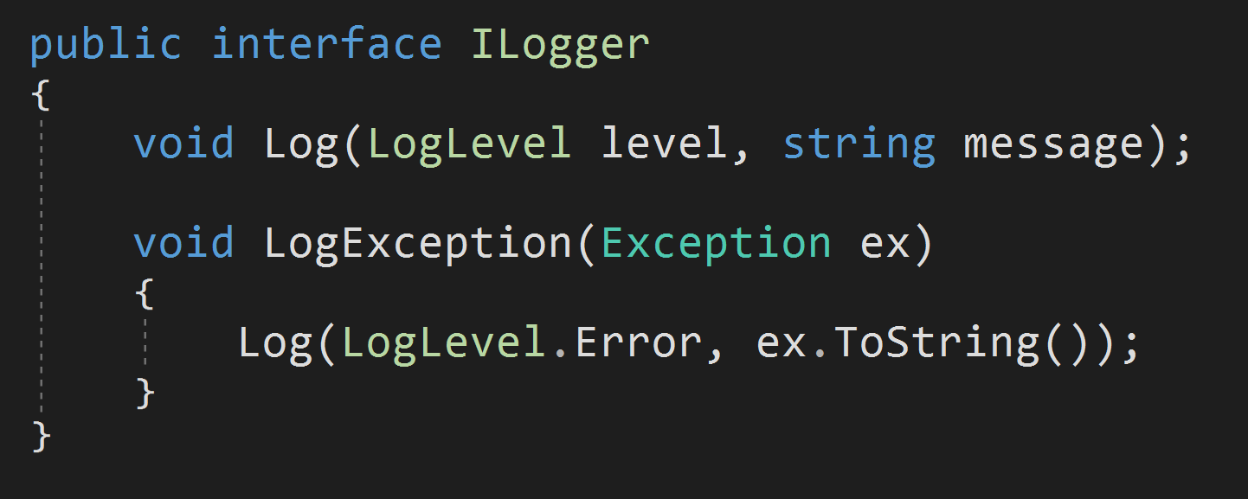
Default Implementation

Slide 3
Default Implementation
MORE THAN JUST THIS

Slide 4
New Features
Default Implementation
Methods, Properties, Events, and Indexers
Access Modifiers
public, private, protected, internal, etc.
Static Members
Methods, Fields, Constructors
Abstract Members
Partial Interfaces
Static Main

Slide 5
Reasons for the Update
Compatibility with Java (Android) and Swift (iOS)
Extend existing APIs
Mix-ins

Slide 6
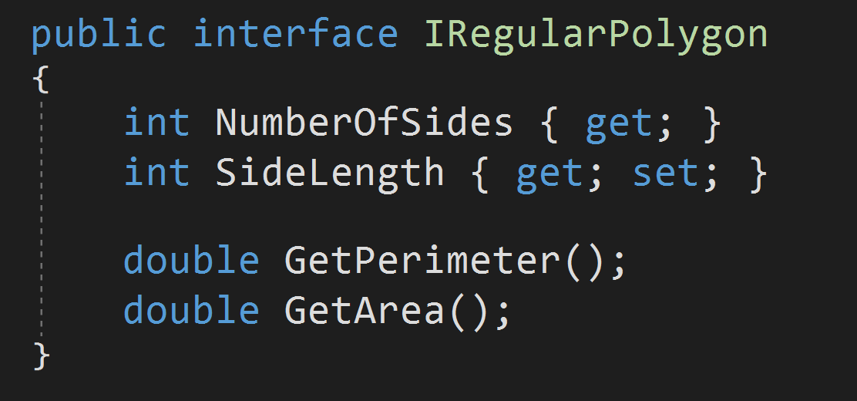
Before C# 8
No implementation
Everything "public"
No statics
No fields

Slide 7
Before C# 8
Interface
Abstract Class
May not contain implementation code
A class may implement any number of interfaces
Members are always public
May contain properties, methods, events, and indexers (not fields, constructors or destructors)
No static members
May contain implementation code
A class may only descend from a single base class
Members contain access modifiers
May contain fields, properties, constructors, destructors, methods, events and indexers
May contain static members

Slide 8
After C# 8
Interface
Abstract Class
May not contain implementation code
A class may implement any number of interfaces
Members are always public
May contain properties, methods, events, and indexers (not fields, constructors or destructors)
No static members
May contain implementation code
A class may only descend from a single base class
Members contain access modifiers
May contain fields, properties, constructors, destructors, methods, events and indexers
May contain static members

Slide 9
Using Default Implementation (and other features)
.NET Core 3.1
.NET Standard 2.1
.NET 5 (out of support)
.NET 6
.NET Framework 4.8
.NET Standard 2.0

Slide 10
New Features
Default Implementation
Methods, Properties, Events, and Indexers
Access Modifiers
public, private, protected, internal, etc.
Static Members
Methods, Fields, Constructors
Abstract Members
Partial Interfaces
Static Main

Slide 11
Default Method Implementation
https://github.com/jeremybytes/csharp-8-interfaces/blob/main/CodeSamples/DefaultImplementation/ILogger.cs

Slide 12
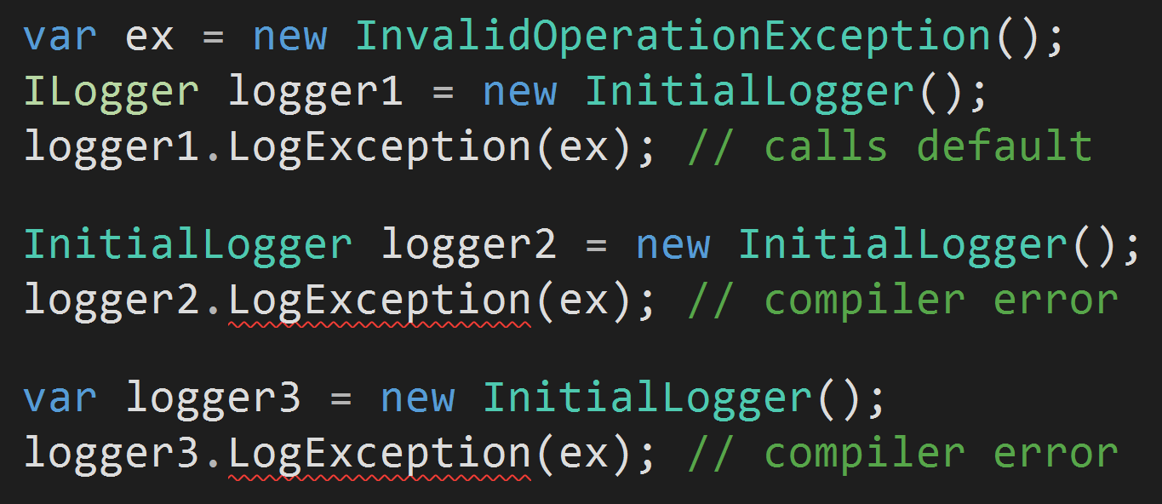
Calling a Default Method Implementation
Must be called using the interface type
The class type will not work
"var" will not work

Slide 13
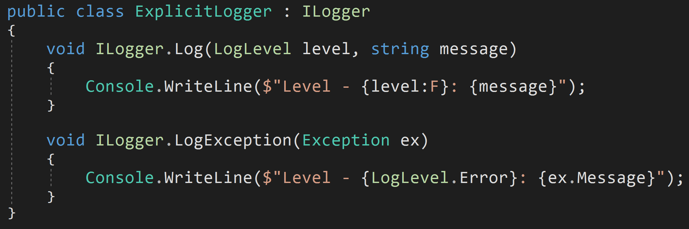
Explicit Implementation
https://github.com/jeremybytes/csharp-8-interfaces/blob/main/CodeSamples/DefaultImplementation/ExplicitLogger.cs

Slide 14

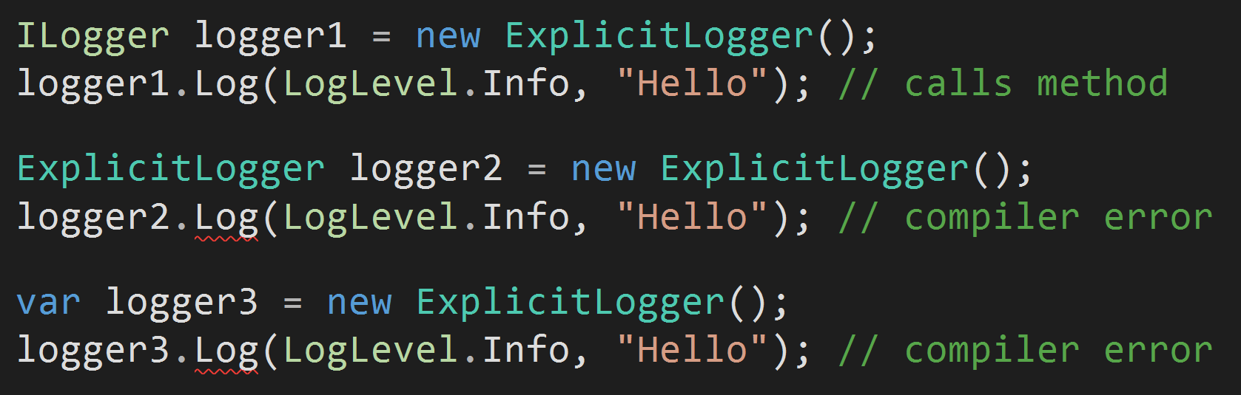
Explicit Implementation

Slide 15
What is an Interface?
An interface describes a set of capabilities of an object.
The capabilities might not be directly exposed (example: explicitly implemented interface members).
An object may only have the capabilities if it is referenced the right way (i.e., by the interface type rather than the class type).
A default implementation is called the same way as an explicit implementation.

Slide 16
Default implementation is called the same way as explicit implementation

Slide 17
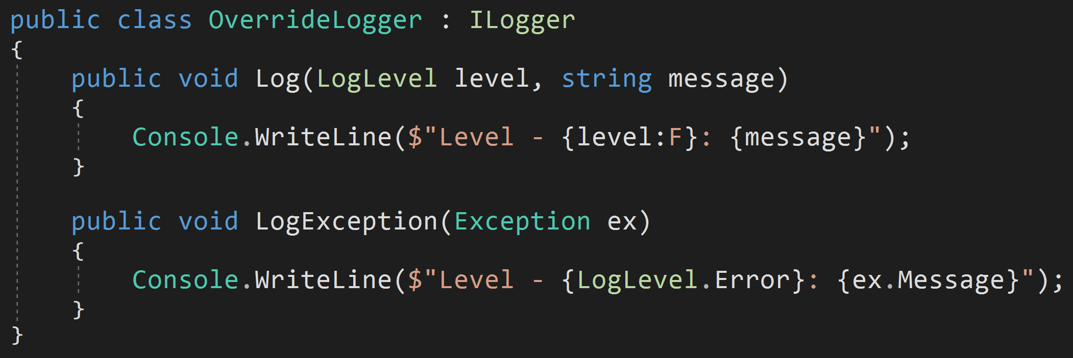
Overriding a Default
Implementing class can provide an implementation
https://github.com/jeremybytes/csharp-8-interfaces/blob/main/CodeSamples/DefaultImplementation/OverrideLogger.cs

Slide 18
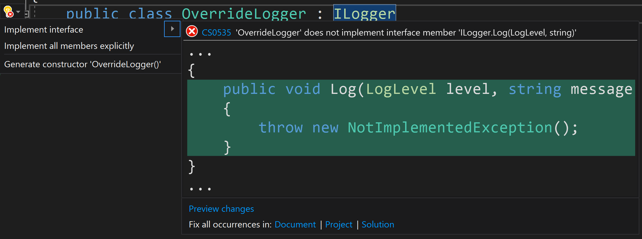
Visual Studio Tooling Quirk
Visual Studio 2022 does not include interface members with default implementation in the "Implement interface" shortcut.

Slide 19
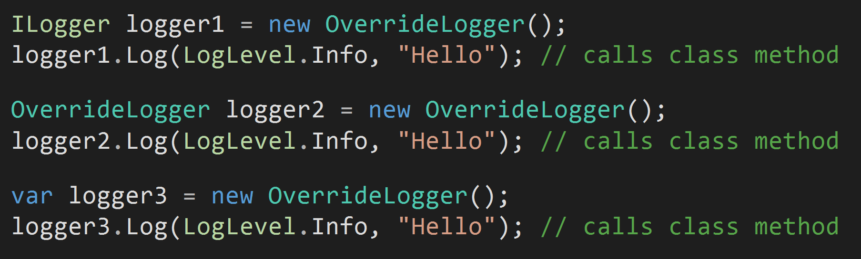
Calling an Implemented Interface Member
The most specific method is always called (meaning, the default implementation is ignored if a class has a public implementation).

Slide 20
Confused Yet?
If a class does *NOT* provide an implementation…
Using the interface type, the default is called.
Using the class type, the code does not compile.
Using "var", the code does not compile.
If the class *DOES* provide an implementation…
Using the interface type, the class method is called.
Using the class type, the class method is called.
Using "var", the class method is called.

Slide 21
Recommendation
When calling interface members, use the interface type.

Slide 22
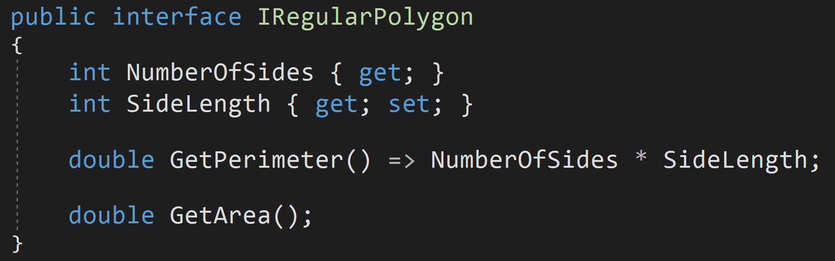
"dynamic" and Default Implementation
"dynamic" relies on runtime type information.
The result is that "dynamic" cannot see default implementations.
https://github.com/jeremybytes/csharp-8-interfaces/blob/main/CodeSamples/DynamicAndDefaultImplementation/Polygon/IRegularPolygon.cs

Slide 23
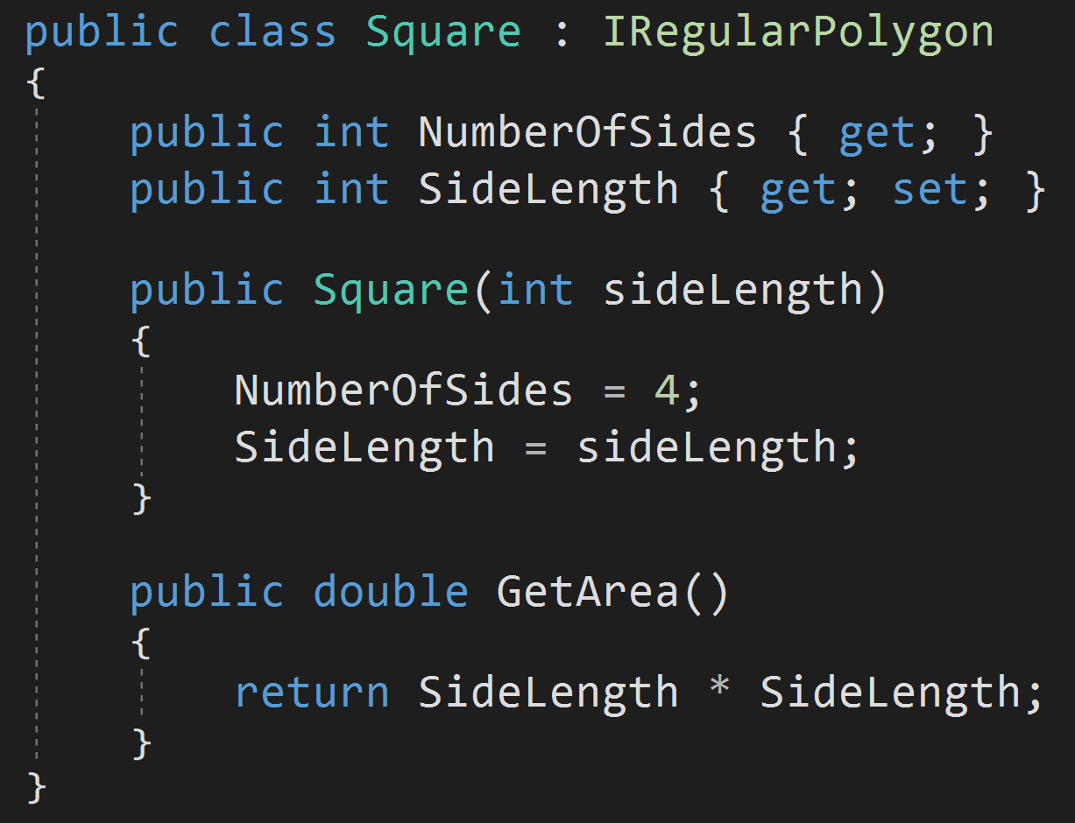
A Tale of Two Objects
Square relies on the default implementation for "GetPerimeter()".
https://github.com/jeremybytes/csharp-8-interfaces/blob/main/CodeSamples/DynamicAndDefaultImplementation/Polygon/Square.cs

Slide 24
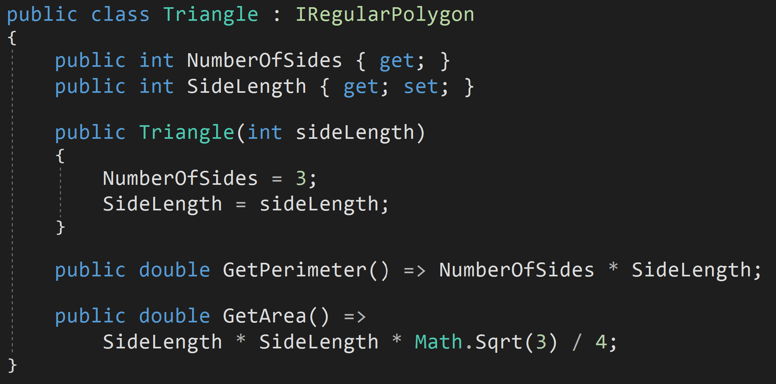
A Tale of Two Objects
Triangle provides its own implementation for "GetPerimeter()".
https://github.com/jeremybytes/csharp-8-interfaces/blob/main/CodeSamples/DynamicAndDefaultImplementation/Polygon/Triangle.cs

Slide 25
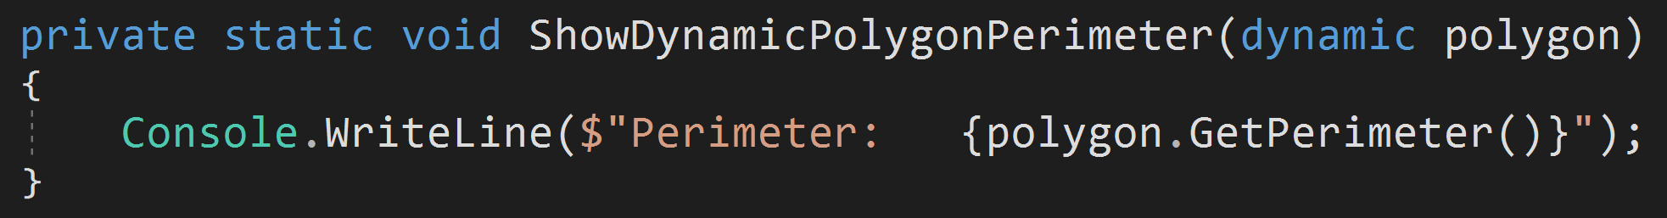
Methods on a "dynamic" object
With a Triangle object, this method runs fine. Triangle has a "GetPerimeter" method.
With a Square object, this method throws a runtime exception. Square does not directly have a "GetPerimeter" method. "dynamic" does not see the interface.
https://github.com/jeremybytes/csharp-8-interfaces/blob/main/CodeSamples/DynamicAndDefaultImplementation/Program.cs

Slide 26
Unit Testing & Mocks
Mocking frameworks do not call default implementations by default.
There are open issues on Moq and FakeItEasy regarding default implementation.
Moq: Interface Default methods are ignored (#972) https://github.com/moq/moq4/issues/972
FakeItEasy: support calling default interface methods (#1633) https://github.com/FakeItEasy/FakeItEasy/issues/1633

Slide 27
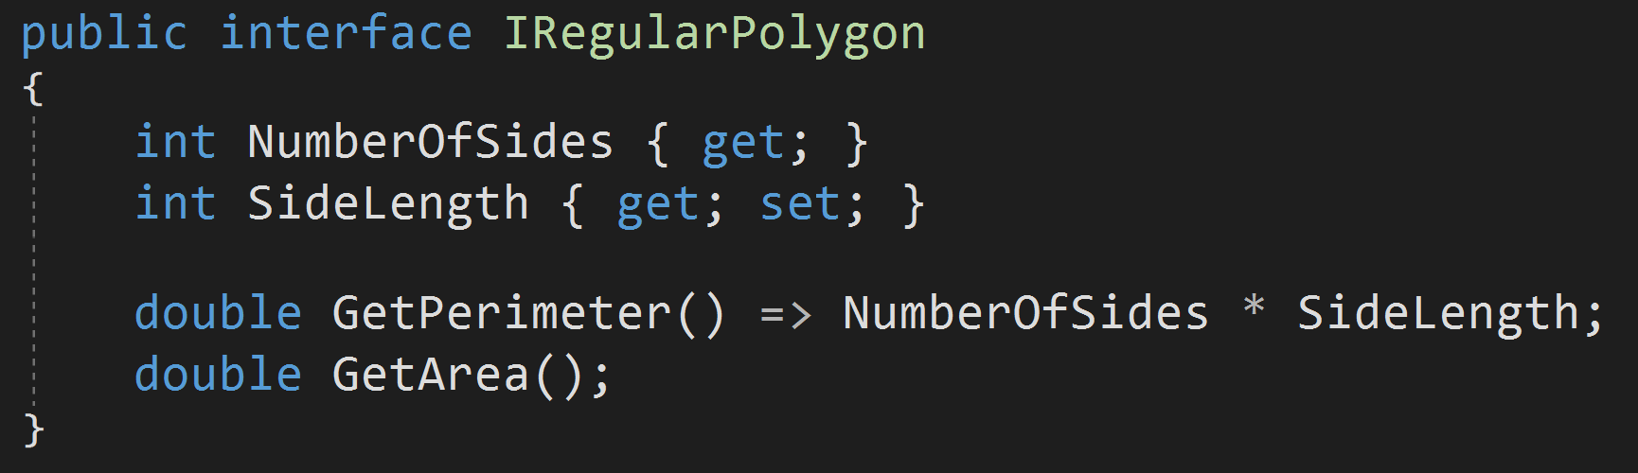
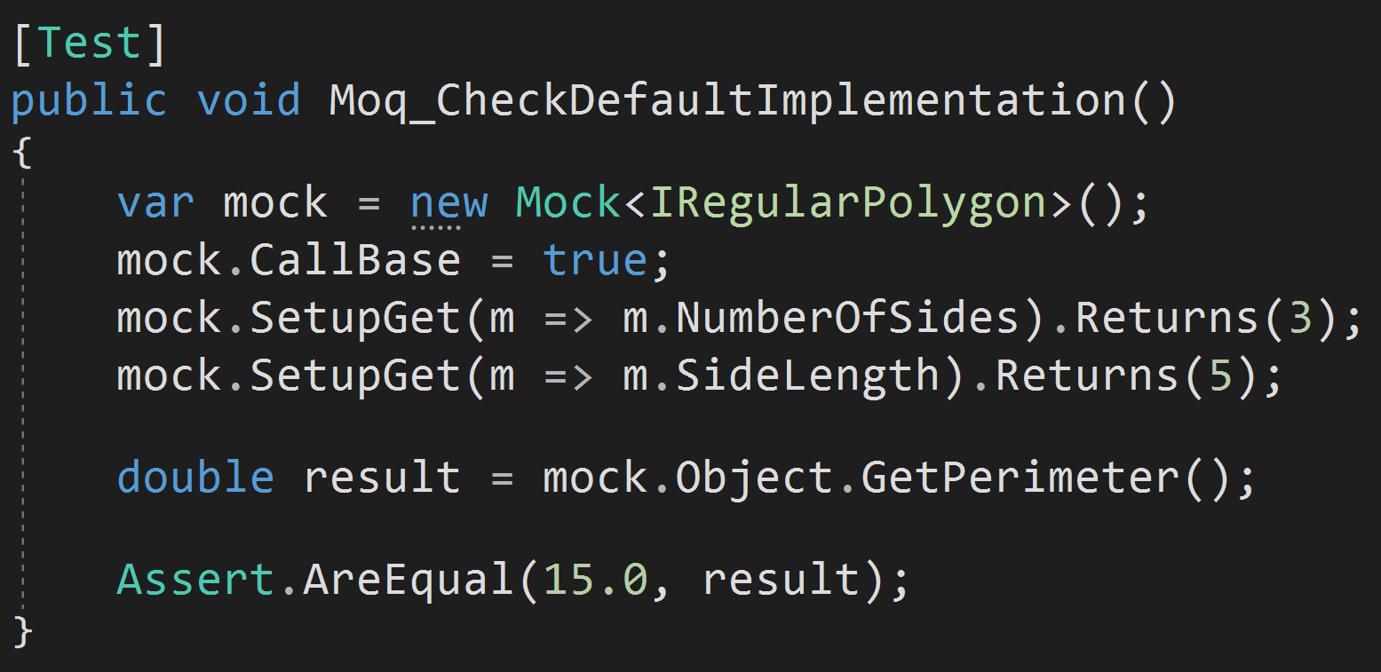
Example: Moq
Test Fails: Since "GetPerimeter" is not set up on the mock object, Moq uses its own default behavior (which is to return "0" for a method returning an integer).
https://github.com/jeremybytes/csharp-8-interfaces/blob/main/CodeSamples/UnitTests.Tests/IRegularPolygonTests.cs

Slide 28
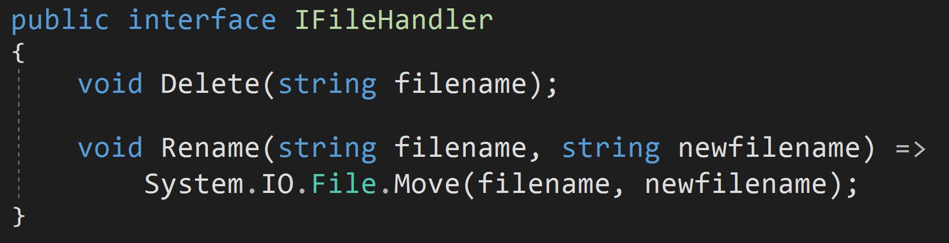
Be Careful of Assumptions
What's wrong with the following interface?
Answer: It makes assumptions about the IFileHandler implementers (specifically that they use System.IO.File objects).
https://github.com/jeremybytes/csharp-8-interfaces/blob/main/CodeSamples/DangerousAssumptions/BadInterface/IFileHandler.cs

Slide 29
Recommendation
Default implementations should only reference other interface members.

Slide 30
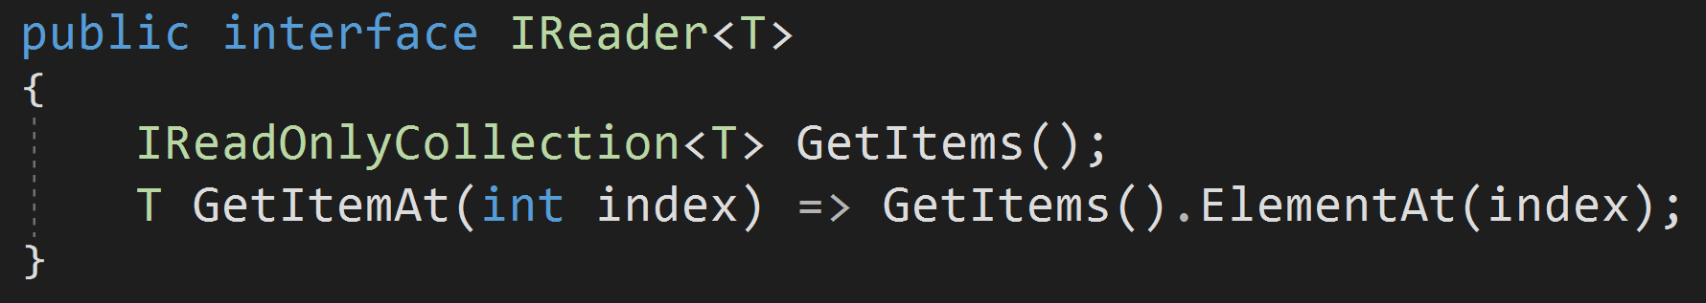
Be Careful of Assumptions
What's wrong with the following interface?
Answer: It assumes that using an iterator is okay. If "GetItems" returns a large collection, this could cause memory pressure. If the "Get" operation is slow (for example a large calculation), then getting the entire list to pull out a single item is inefficient.
https://github.com/jeremybytes/csharp-8-interfaces/blob/main/CodeSamples/DangerousAssumptions/SlowPerformance/IReader.cs

Slide 31
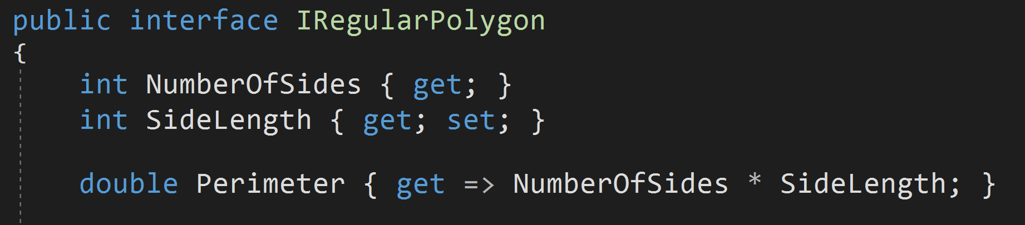
Default Property Implementation
Good for calculated properties (getters)
https://github.com/jeremybytes/csharp-8-interfaces/blob/main/CodeSamples/InterfaceProperties/Interface/IRegularPolygon.cs

Slide 32
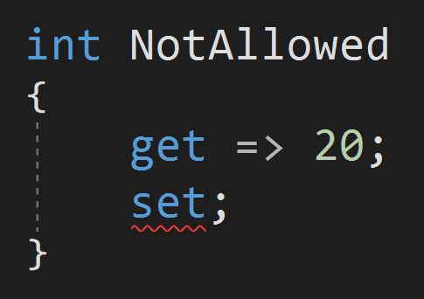
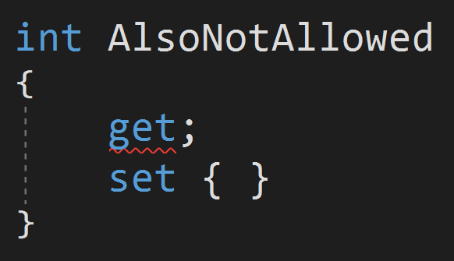
Default Property Implementation
Read/Write Properties must have default implementation for both "get" and "set"… *
*See caveat on next slide
https://github.com/jeremybytes/csharp-8-interfaces/blob/main/CodeSamples/InterfaceProperties/BadInterface/IBadInterface.cs

Slide 33
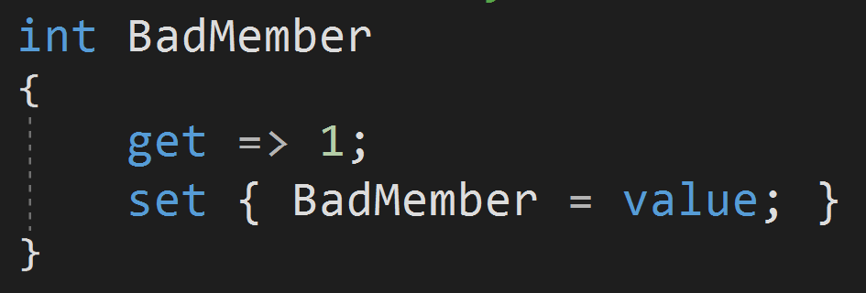
Default Property Implementation
Default implementation doesn't really make sense for "set" (there's no way to have a backing field).
Things like this cause a StackOverflow:
https://github.com/jeremybytes/csharp-8-interfaces/blob/main/CodeSamples/InterfaceProperties/BadInterface/IBadInterface.cs

Slide 34
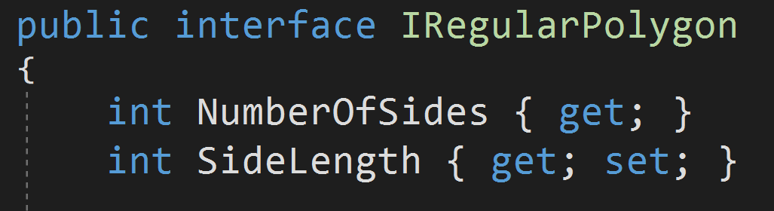
Default Property Implementation
Default implementation cannot be used to specify an automatic property.
The following interface properties are normal (abstract) interface members:
https://github.com/jeremybytes/csharp-8-interfaces/blob/main/CodeSamples/InterfaceProperties/Interface/IRegularPolygon.cs

Slide 35
Access Modifiers
All access modifiers are allowed
public
private
protected
internal
etc.
Default access modifier is "public"
"privates" must be implemented

Slide 36
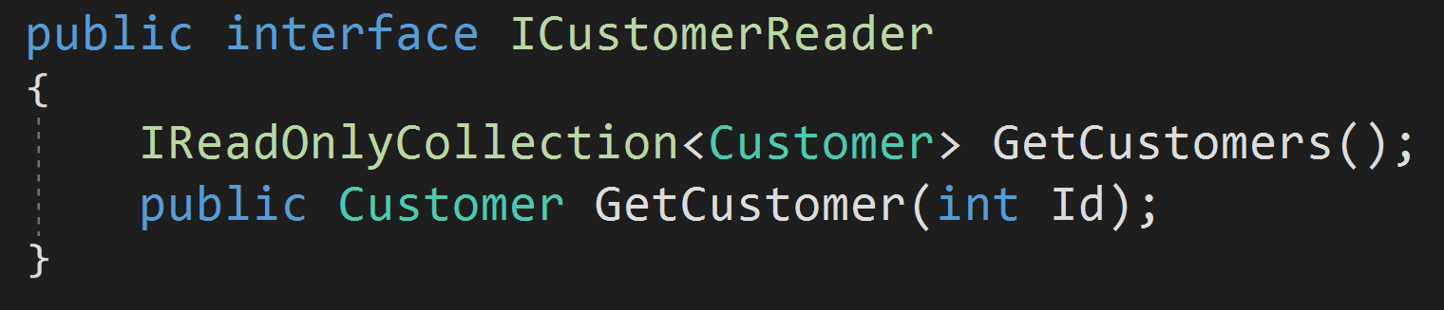
Access Modifiers - Public
Default access modifier is "public" for interfaces.
The following interface members are both "public":
https://github.com/jeremybytes/csharp-8-interfaces/blob/main/CodeSamples/AccessModifiers/Public/ICustomerReader.cs

Slide 37
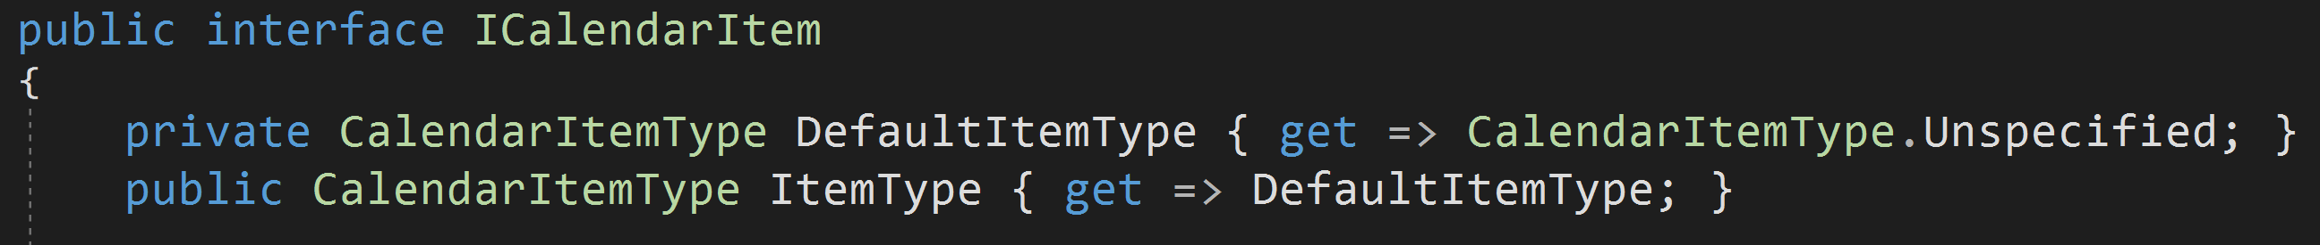
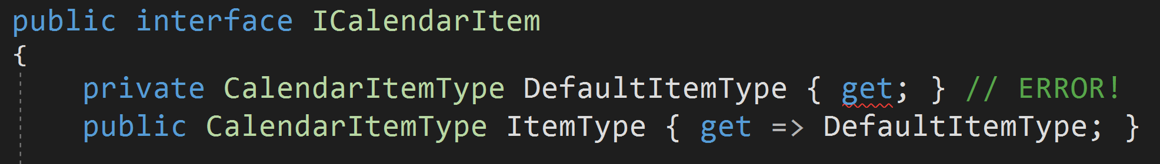
Access Modifiers - Private
"private" members can only be accessed within the interface.
"private" members must have a default implementation.
*Note: This sample is a bit contrived to show that "private" members must have implementation
https://github.com/jeremybytes/csharp-8-interfaces/blob/main/CodeSamples/AccessModifiers/Private/ICalendarItem.cs

Slide 38
Access Modifiers - Private
"private" members can be used to break up larger default implementation methods.
For example, if a "public" method has a complex default implementation, it can be split up into smaller "private" methods inside the interface.
My Opinion: If code inside an interface is complex enough that it requires this type of factoring, maybe it is not appropriate for it to be part of an interface.

Slide 39
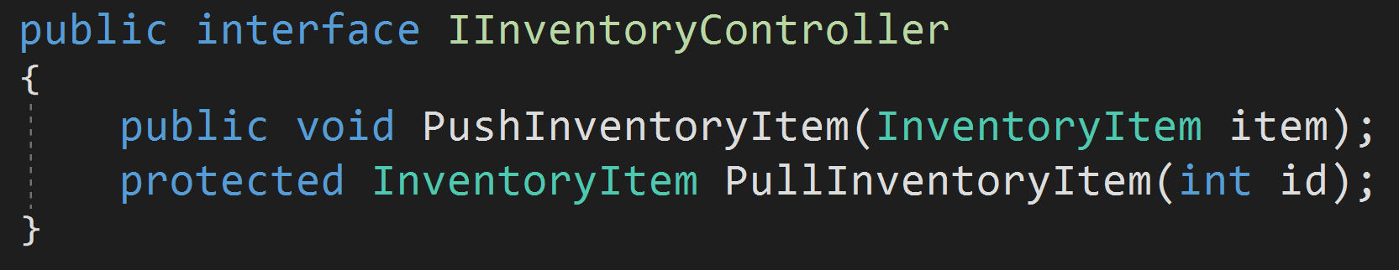
Access Modifiers - Protected
"protected" members are possible, but are a bit strange.
"protected" members do *not* require a default implementation.
https://github.com/jeremybytes/csharp-8-interfaces/blob/main/CodeSamples/AccessModifiers/Protected/IInventoryController.cs

Slide 40
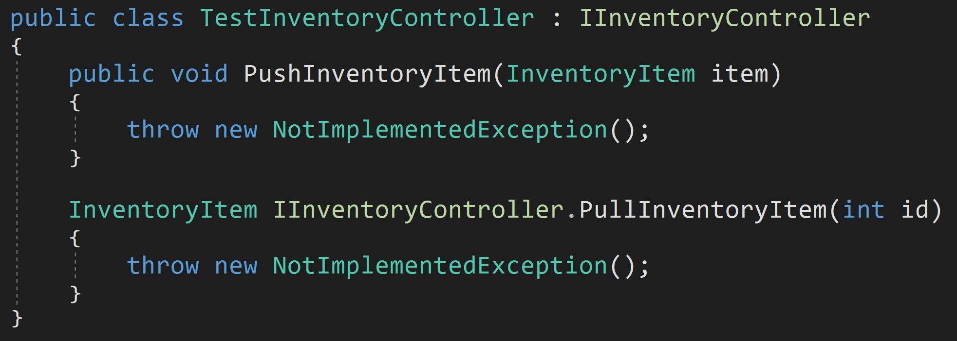
Access Modifiers - Protected
"protected" members must be implemented explicitly by the implementing class.
https://github.com/jeremybytes/csharp-8-interfaces/blob/main/CodeSamples/AccessModifiers/Protected/TestInventoryController.cs

Slide 41
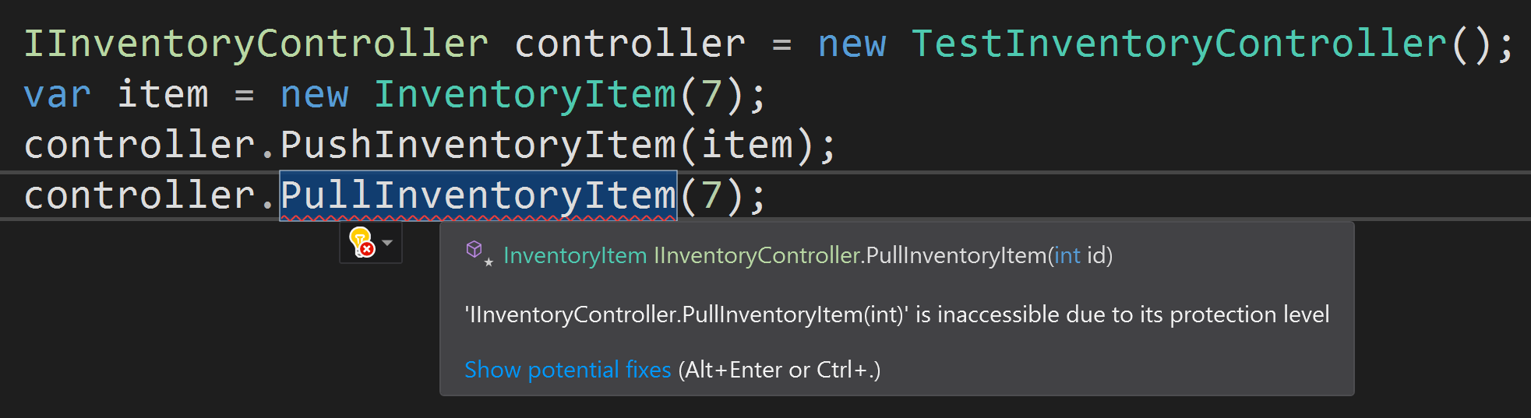
Access Modifiers - Protected
HOWEVER, there is no way to call the "protected" member.
https://github.com/jeremybytes/csharp-8-interfaces/blob/main/CodeSamples/AccessModifiers/Program.cs

Slide 42
Access Modifiers - Protected
"protected" members may be useful in an interface hierarchy (an interface that derives from this one can reference the protected member). However, I have not seen a good use case for this.
My opinion: Stick with "public" and "private" members.
https://github.com/jeremybytes/csharp-8-interfaces/blob/main/CodeSamples/AccessModifiers/Protected/IInventoryController.cs

Slide 43
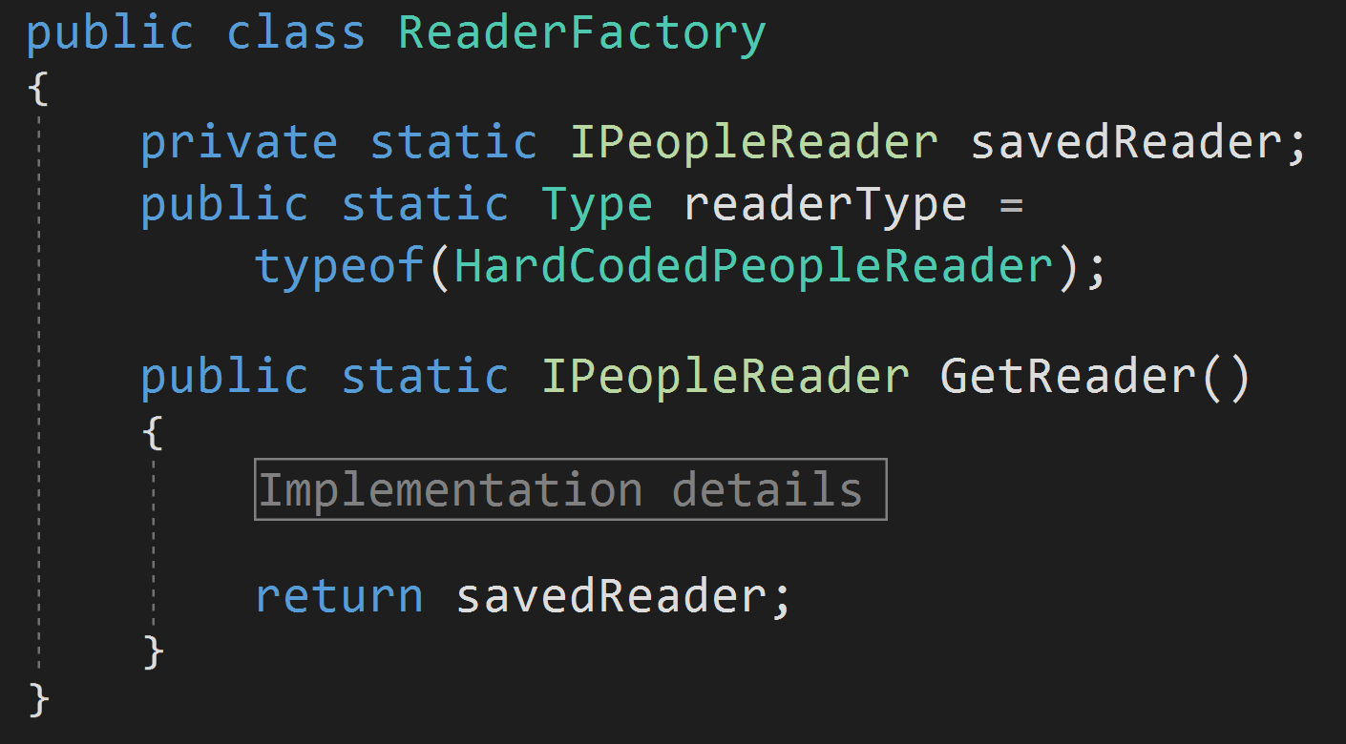
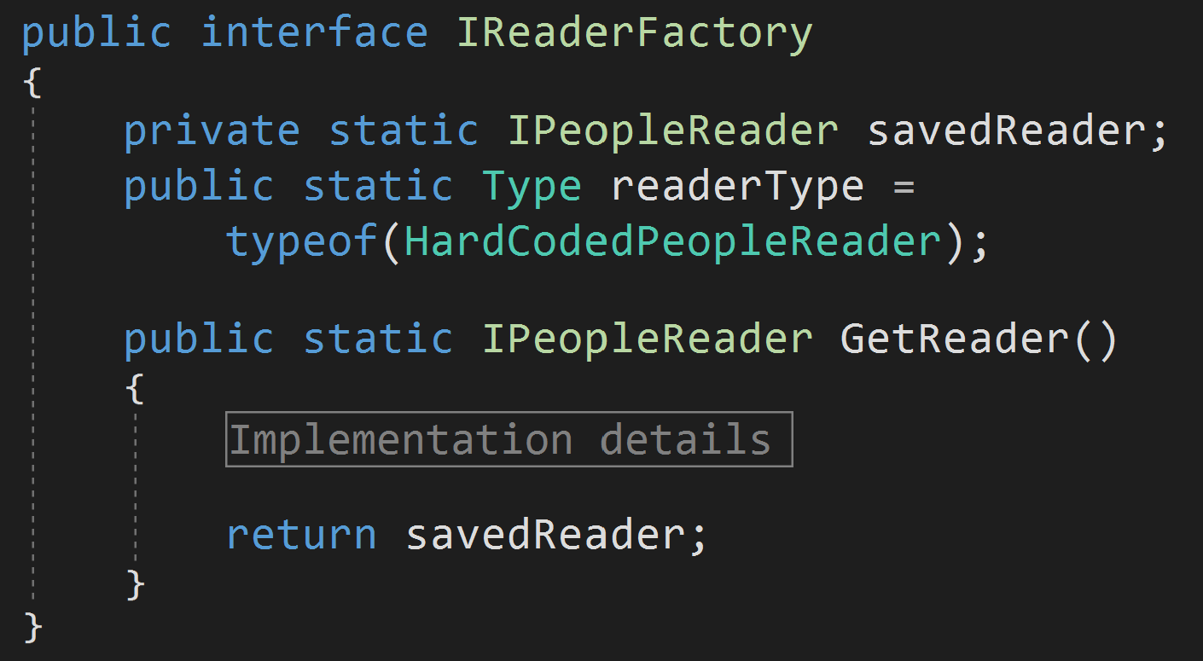
Static Methods
Interface "static" methods are just like "static" methods on a class.
The following are equivalent:
https://github.com/jeremybytes/csharp-8-interfaces/tree/main/CodeSamples/StaticMembers/Factories

Slide 44
Static Fields
"static" fields on an interface are just like "static" fields on a class.
A static field is a shared value; it is associated with the interface rather than any particular instance.

Slide 45
Static Fields as Parameters
"static" fields can be used to parameterize a default implementation.
See Microsoft Docs example: https://docs.microsoft.com/en-us/dotnet/csharp/tutorials/default-interface-methods-versions#provide-parameterization

Slide 46
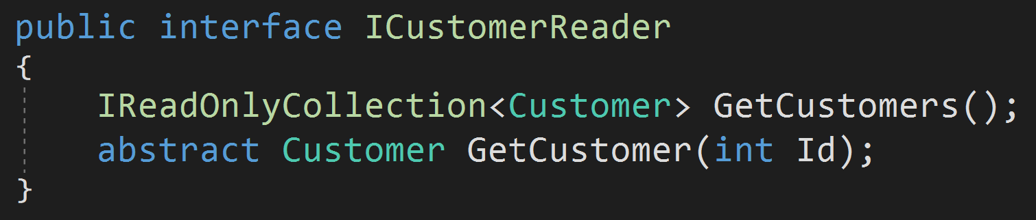
Abstract Members
A member can be marked "abstract" (which is the default).
The following properties are both abstract:
In complex hierarchies a member with default implementation can be re-abstracted. (Note: If you're doing this, your code may be too complex.)

Slide 47
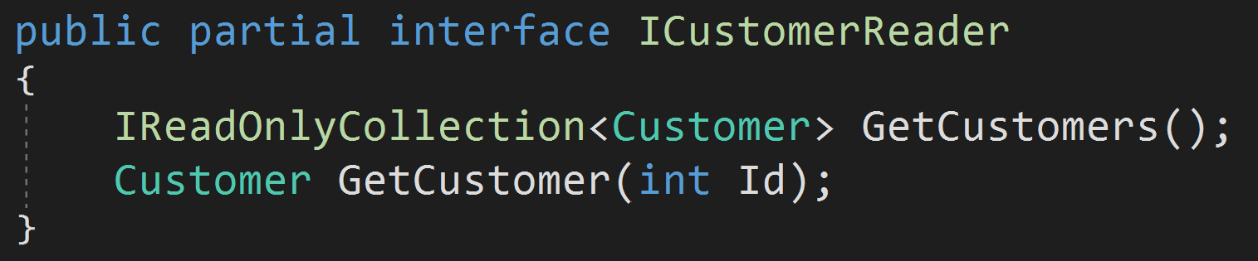
Partial Interfaces
Interfaces can now be marked "partial" (just like classes).
This allows them to be extended in a separate file (and at a later time).

Slide 48
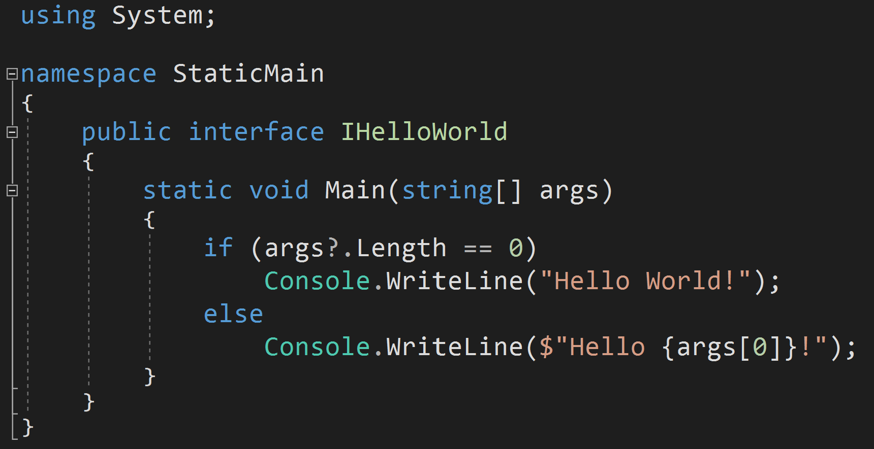
Static Main
"static Main()" is the entry point to an application.
This is a valid console application (just this file):
https://github.com/jeremybytes/csharp-8-interfaces/blob/main/CodeSamples/StaticMain/IHelloWorld.cs

Slide 49
Static Main
A few notes about "static Main()":
"static Main()" is the entry point to an application.
"static Main()" can be in any class (it doesn't have to be in "Program").
There can only be one "static Main()" method per application.*
"static Main()" can now be in an interface.
* If you have more than one "static Main()", you *must* use the "-main" compiler directive or the "<StartupObject>" element in the project file to specify the startup object. More info: https://docs.microsoft.com/en-us/dotnet/csharp/language-reference/compiler-options/main-compiler-option

Slide 50
Reasons for the Update
Compatibility with Java (Android) and Swift (iOS)
Extend existing APIs
Mix-ins

Slide 51
Compatibility with Android and iOS
Both Java (Android) and Swift (iOS) offer default implementation.
For mobile & cross-platform developers, this provides C# with compatibility.
My Opinion: Compatibility with libraries is a good reason to support default implementation (however, I would like to see the use limited as much as possible).

Slide 52
Extending APIs
Default implementation allows API maintainers to extend an API after it is released.
My Opinion:
Because default implementations should call existing members, it is difficult to come up with scenarios that are not trivial.
Interface inheritance supports a more controlled way of extending an interface.
Strays from the Interface Segregation Principle (ISP).

Slide 53
Changing an API
When we have control over both the interface and the implementers, default implementation can give us a way to change the API without breaking the build.
Sample Scenario:
Add new member (with default implementation) to an existing API.
Application continues to build and run.
API implementers can add the new member and functionality at their leisure (hopefully quickly).
As soon as the implementers are updated, the default implementation can be removed from the interface.

Slide 54
Mix-Ins
Mix-ins are a cool idea.
Create interfaces with *only* default implementations.
Results in a fairly safe way to do multiple inheritance.
IoT example:
https://docs.microsoft.com/en-us/dotnet/csharp/tutorials/mixins-with-default-interface-methods
My Opinion: I like the idea of mix-ins, but I wish that it was implemented with a different construct.

Slide 55
New Features
Default Implementation
Methods, Properties, Events, and Indexers
Access Modifiers
public, private, protected, internal, etc.
Static Members
Methods, Fields, Constructors
Abstract Members
Partial Interfaces
Static Main

Slide 56
Thank You!
Jeremy Clark
http://www.jeremybytes.com
jeremy@jeremybytes.com
@jeremybytes

