Slide 1
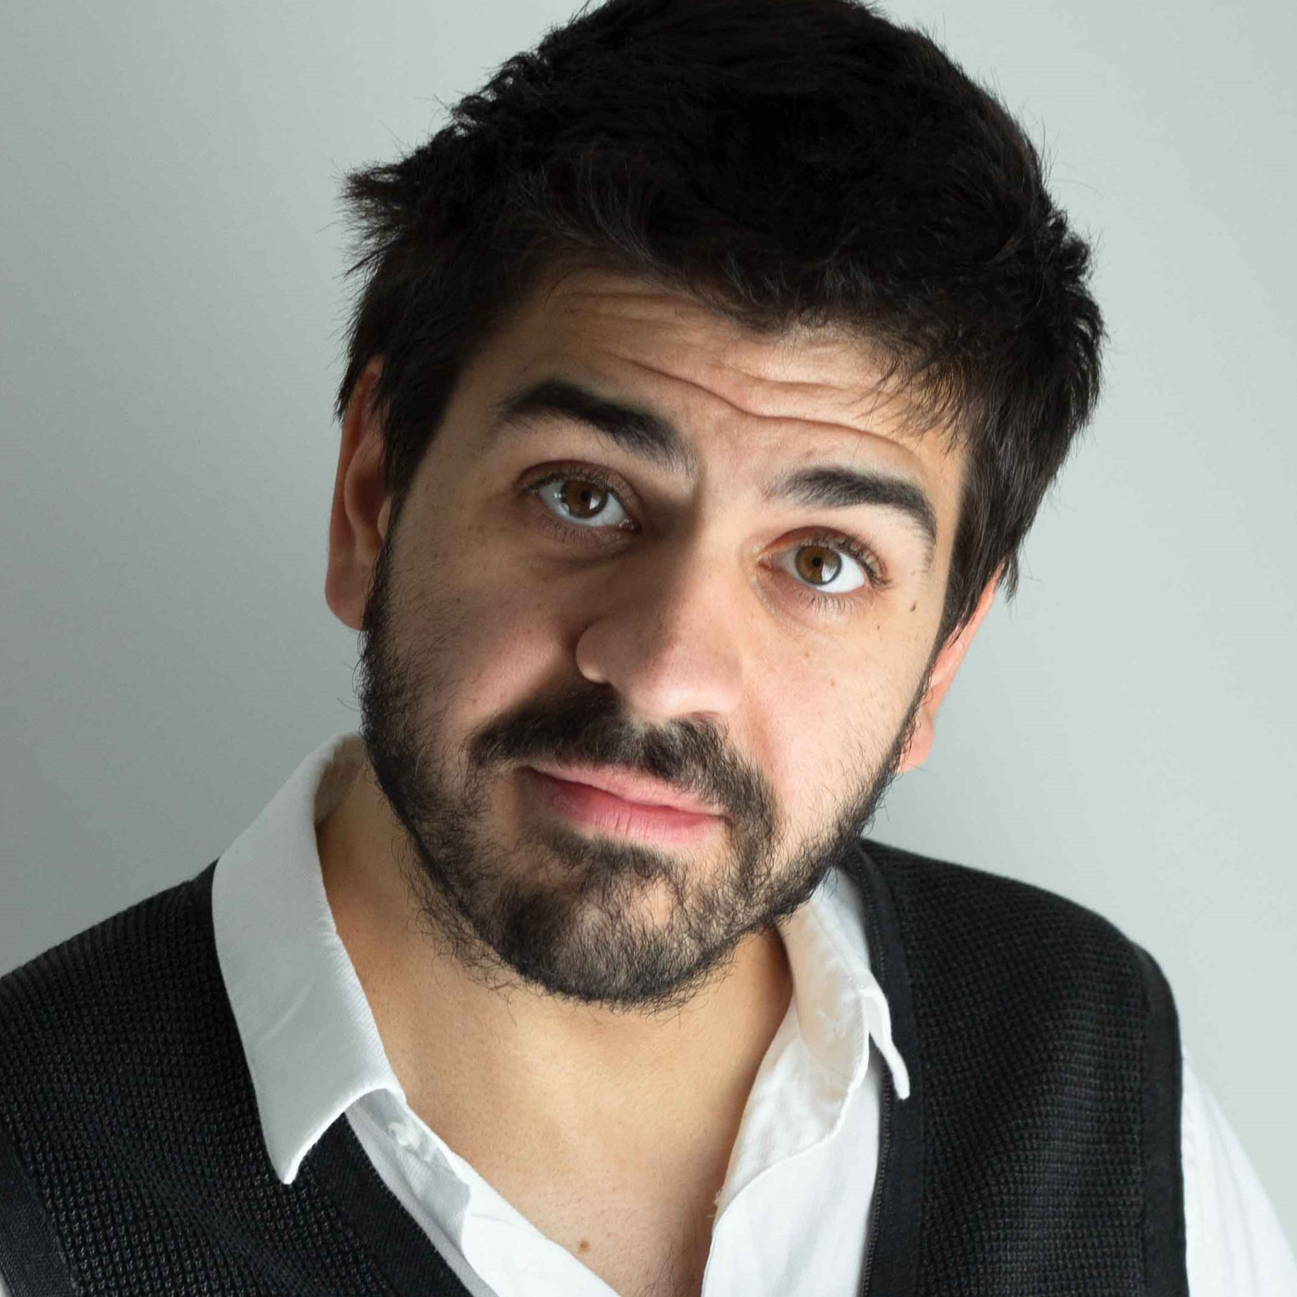






_{WORK HISTORY}
^{2019 - NOW}
^{FULL-STACK WEB-DEVELOPER}
^{MOONSHINER - VIENNA, AUSTRIA}
²⁰¹⁴ ⁻ ²⁰¹⁹
^{FULL-STACK WEB-DEVELOPER}
EASY-DÉVELOPPEMENT - LILLE, FRANCE
²⁰¹⁷
^{INTERNSHIP SUPERVISOR}
EASY-DÉVELOPPEMENT - LILLE, FRANCE
_{JEREMY CHARBONNEL}
²⁰¹⁶
^{PHP / MYSQL TEACHER}
^{full-stack web-developer}
^{M2I - PARIS, FRANCE}
^{w/ 7 years experience}
²⁰¹⁴
^{FULL-STACK WEB-DEVELOPER}
^{INERIS - NANCY, FRANCE}
28-year-old French, moved to Austria more than 2 years ago, seeks new experiences.
²⁰¹³
FULL-STACK WEB-DEVELOPMENT INTERN
^{INERIS - NANCY, FRANCE}
²⁰¹²
FULL-STACK WEB-DEVELOPMENT INTERN
^{based in Vienna}
^{CINÉMA CAMEO - NANCY, FRANCE}
²⁰¹¹
^{jeremy@charbonnel.me}
FULL-STACK WEB-DEVELOPMENT INTERN
⁰⁽⁺⁴³⁾ ⁶⁷⁸ ¹²⁷⁵¹⁷⁶
LYCÉE JEANNE D'ARC - REMIREMONT, FRANCE
_{EDUCATION}
^{2013 - BSC DEGREE}
Previous owner of 13 music instruments, set foot in 14 different countries and obtained countless Steam achievements ...
IUT CHARLEMAGNE, NANCY - FRANCE
2012 - BTEC HIGHER NATIONAL DIPLOMA
^{LYCÉE CHOPIN, NANCY - FRANCE}
2011 - COMPUTER AND TECHNOLOGY CERTIFICATE
^{LYCÉE CHOPIN, NANCY - FRANCE}
^{2010 - A LEVEL IN SCIENCES}
LYCÉE JEANNE D'ARC, REMIREMONT - FRANCE
_{MAIN TECH-STACK}
PHP
MySQL
Javascript
Laravel
Livewire
Tailwind
Alpine
Vue
React
GIT
^{https://jeremy.charbonnel.me}

