Slide 1

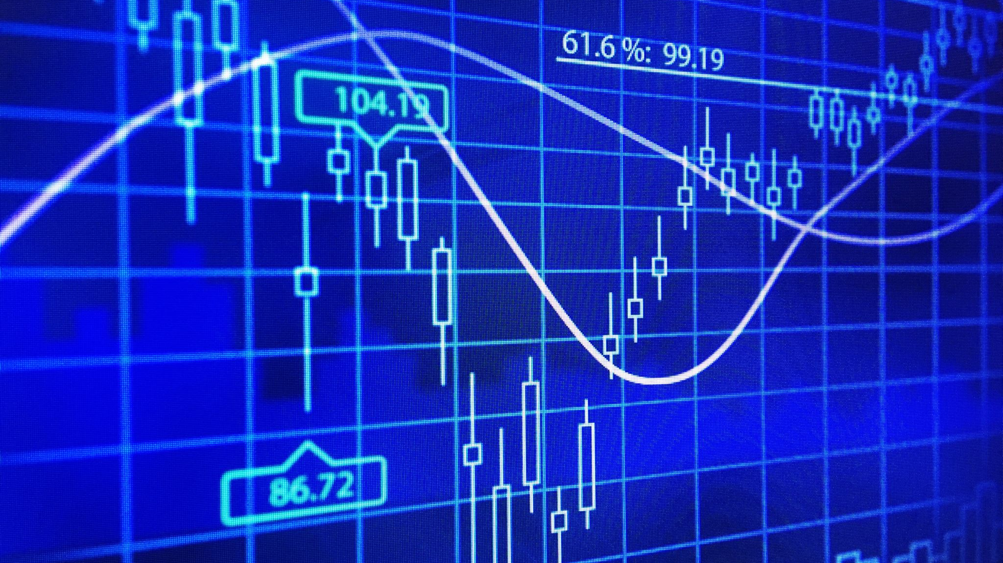
STOCK MARKET ANALYSIS PREDICTIVE MODELLING

Slide 2

Objective
Build a Stock Price Prediction Model using Tesla, Microsoft and GameStop
Develop multiple Dashboards and layer stock market datasets for comparison
Provide insight to future opening and closing prices
Comparing Predicted vs Actual of Market Volume, Highs and Lows, Opening and Closing prices via interactive dashboards

Slide 3


Development process
All of Stock Market Data was web scraped via Yahoo Finance package in Python
Tools used: Python, MatlotLib, Plotly, Tableau, HTML, CSS, Facebook Prophet
Tableau – Visualisation
Prophet – Robust at handling missing data, shifts in trends, handles outliers well, intuitive forecasting tool
Exploring ARIMA, LSTM and Javascript

Slide 4
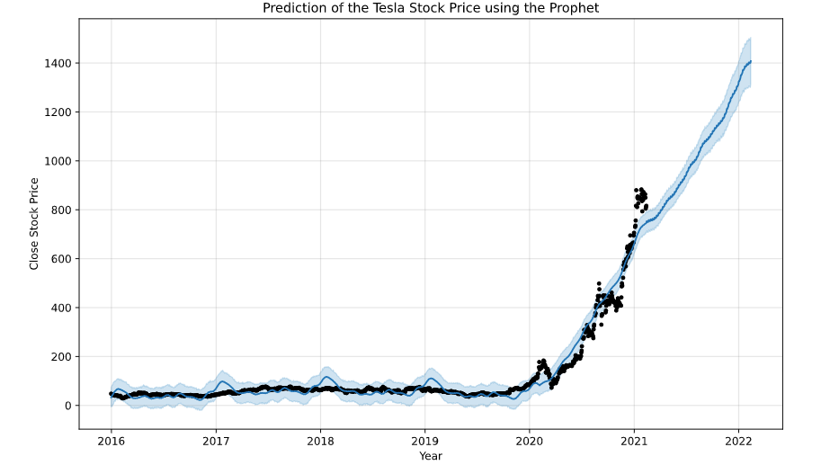
Predictive Modelling & FBProphet
Prophet uses three main components:
Trend, Seasonality and Holidays
Model used all training data (black dots) and predicted Tesla Stock price up to year 2022. Blue Shadow is the confidence interval
Notes:
About Facebook's Prophet
An open-source package (for both Python and R) for forecasting time series data based on an additive model where non-linear trends are fit with yearly, weekly, and daily seasonality, plus holiday effects
Why Prophet?
It works best with time series that have strong seasonal effects and several seasons of historical data.
Robust to missing data and shifts in the trend, and typically handles outliers well.

