Slide 1

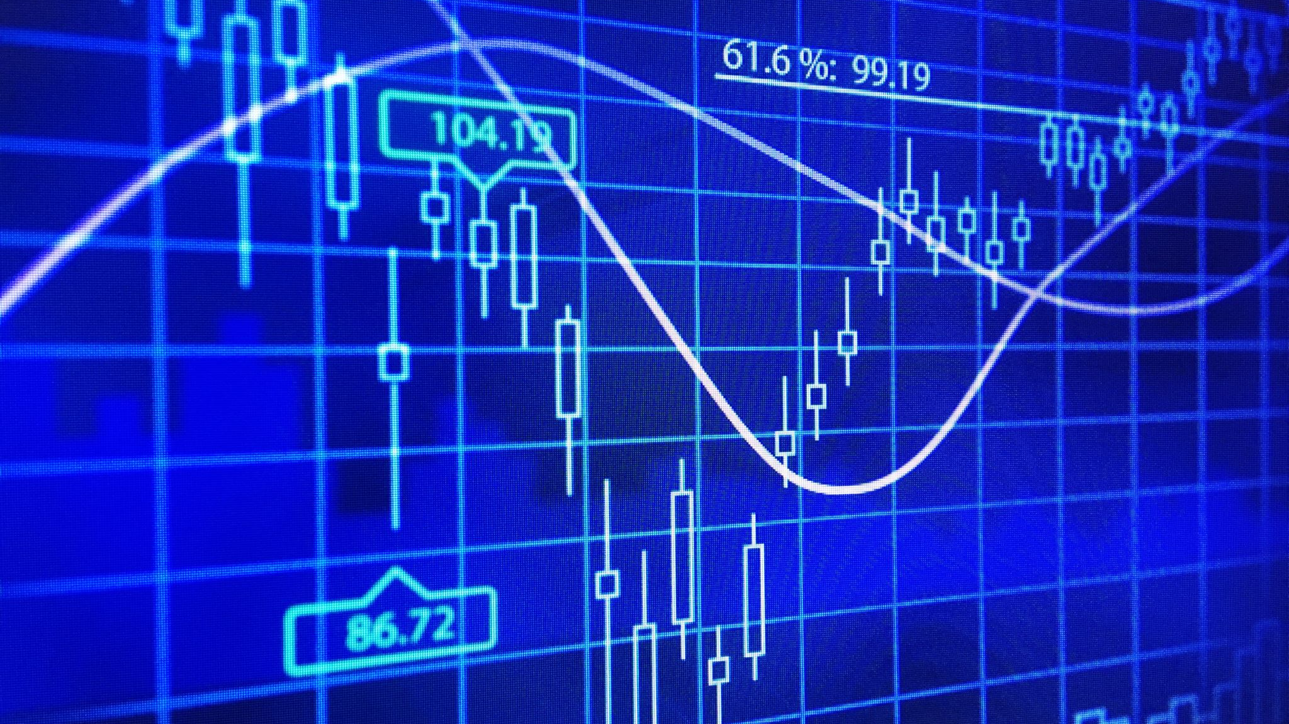
STOCK MARKET ANALYSIS PREDICTIVE MODELLING

Slide 2

Objective
Build a Stock Price Prediction Model using Tesla, Microsoft and GameStop
Develop multiple Dashboards and layer stock market datasets for comparison
Provide insight to future opening and closing prices
Comparing Predicted vs Actual of Market Volume, Highs and Lows, Opening and Closing prices via interactive dashboards

Slide 3
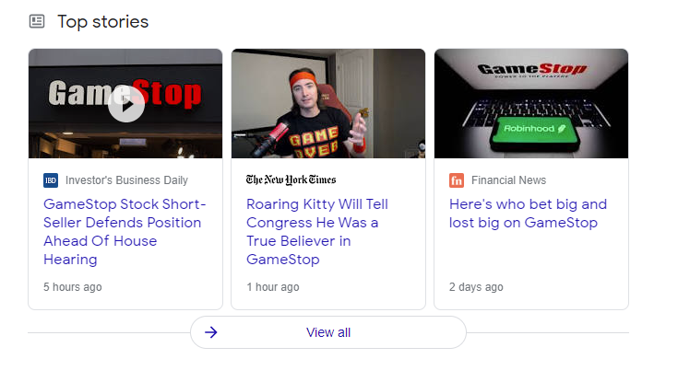
OUT OF THE LOOP Why GameStop
GameStop has been quite controversial since mid-2020
This fascination with GME started with r/wallstreetbets on Reddit
Wall Street Bets subreddit is basically an echo chamber for buying high risk stocks and building momentum
TLDR: Investors were shorting GameStop stocks. They borrowed it, sold it and waited for it crash to buy it at a lower price. However, WSB did the opposite which placed a significant amount of pressure on the investors (aka short-squeeze)

Slide 4

DATA Retrieval & Data Cleaning
All of Stock Market Data was web scraped via Yahoo Finance package in Python
The data retrieved was perfectly structured, so cleaning and data manipulation was not required.
Created a new column of the differences in Highs and Lows and Opening and Closing prices for Candle chart

Slide 5
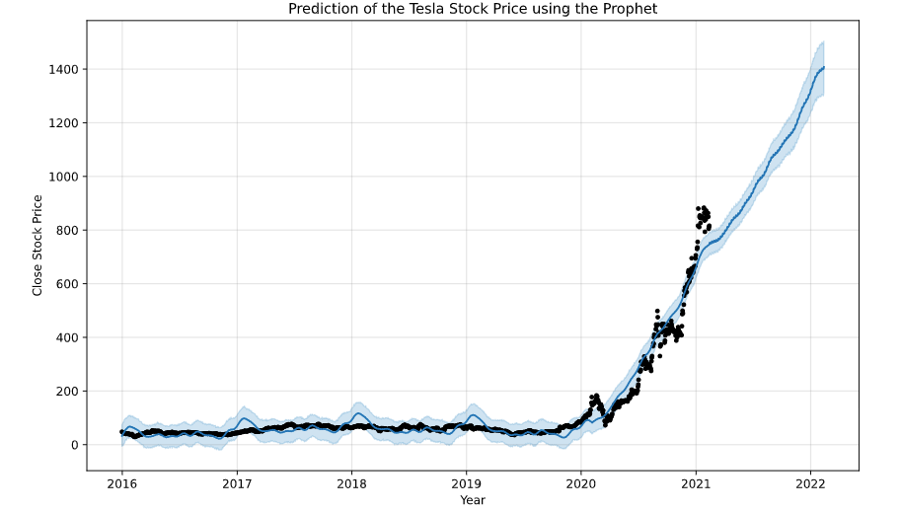
Predictive Modelling & FBProphet
Prophet uses a decomposable time series model with three main components:
Trend, Seasonality and Holidays
First fitted the model using all stock market data
Created data frame of 1 year into the future
Predict function to forecast
Model used all training data (black dots) and predicted Tesla Stock price up to year 2022. Blue Shadow is the confidence interval
Notes:
About Facebook's Prophet
An open-source package (for both Python and R) for forecasting time series data based on an additive model where non-linear trends are fit with yearly, weekly, and daily seasonality, plus holiday effects
Why Prophet?
It works best with time series that have strong seasonal effects and several seasons of historical data.
Robust to missing data and shifts in the trend, and typically handles outliers well.

Slide 6
Visualisation demonstration deployed on github pages

Slide 7
Future considerations
Initially used ARIMA package to forecast data
Revisit ARIMA: Run a loop with different lag values to find the best R-squared
Explore percentage differences in testing Mean Squared Error as Stock Market Prices are relative
Explore LSTM package
Compare the accuracy and results three different packages
Utilize Javascript to create more dynamic visualisations and introduce more interactivity

