Slide 1

Note: The data and information in this document is reflective of a hypothetical situation and client. This document is to be used for KPMG Virtual Internship purposes only.
Sprocket Central Pty Ltd
Data analytics approach
[Division Name] - [Engagement Manager], [Senior Consultant], [Junior Consultant]

Slide 2
Note: The data and information in this document is reflective of a hypothetical situation and client. This document is to be used for KPMG Virtual Internship purposes only.
Agenda
Introduction
Data Exploration
Model Development
Interpretation

Slide 3
Note: The data and information in this document is reflective of a hypothetical situation and client. This document is to be used for KPMG Virtual Internship purposes only.
Introduction
Identify and recommend the top 1000 customers to target
Outline of Problem
Sprocket Central specialises in selling high quality bicycles and cycling accessories
The company is looking to better target their customers based on past datasets
Contents Outline
Potential and existing customer age distributions
Bike related purchases over the last 3 years by gender
Job industry distributions
Wealth segmentation by age
Number of cars owned and not owned by states
RFM analysis and customer classification

Slide 4
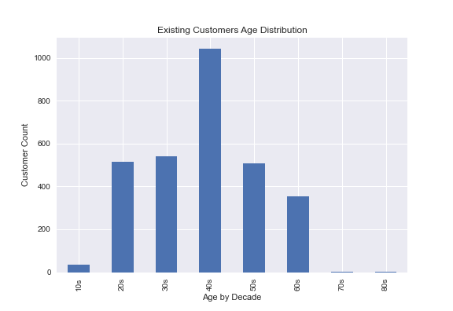
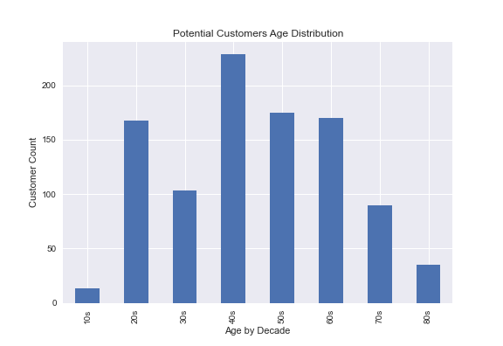
Note: The data and information in this document is reflective of a hypothetical situation and client. This document is to be used for KPMG Virtual Internship purposes only.
Data Exploration
Potential and Existing customers age distribution
Customers ages are clustered in the 40s age range for both existing and potential customers
The lowest age groups are below 20 and above 80 for both existing and potential customers
Potential customers indicate 20s, 50s and 60s as good targets
There is a steep drop in customers in the 30s age group for potential customers

Slide 5
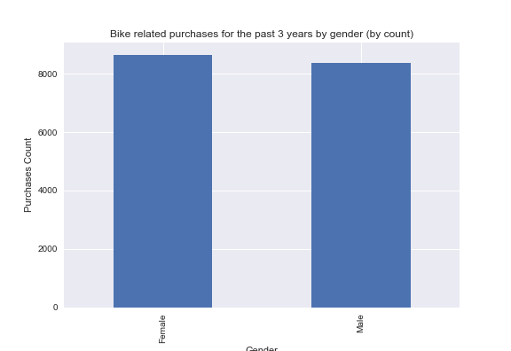
Note: The data and information in this document is reflective of a hypothetical situation and client. This document is to be used for KPMG Virtual Internship purposes only.
Data Exploration
Bike related purchases over the last 3 years by gender
Gender demographics are quite similar for both genders with female customers being slightly higher
Indicates that both genders are equally involved in bike related purchases with Sprocket Central

Slide 6
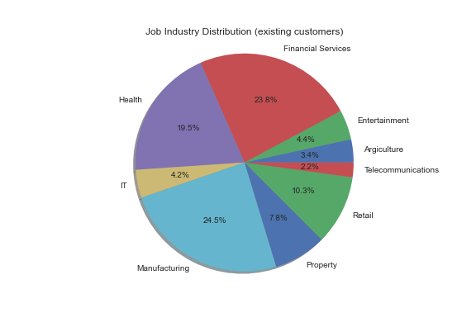
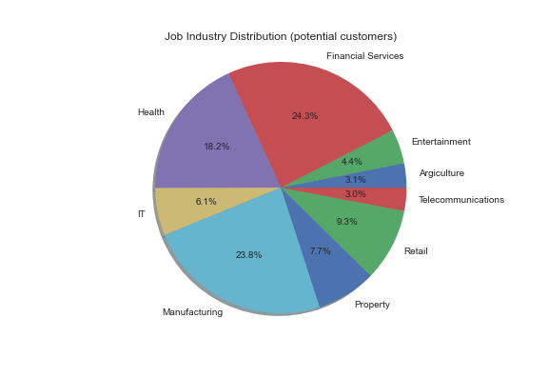
Note: The data and information in this document is reflective of a hypothetical situation and client. This document is to be used for KPMG Virtual Internship purposes only.
Data Exploration
Job Industry Distribution
A large portion of customers are in the manufacturing and financial services industry for both existing and potential customers
Customers in the telecommunications industry make up for the smallest portion for both existing and potential customers

Slide 7
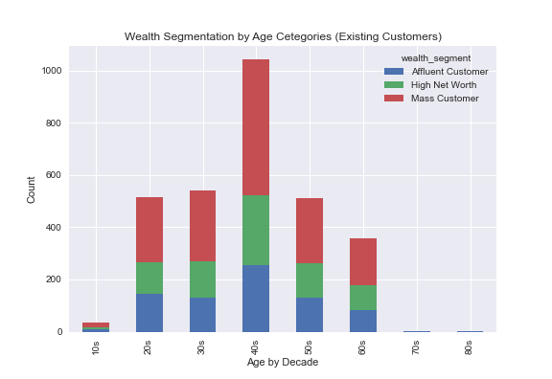
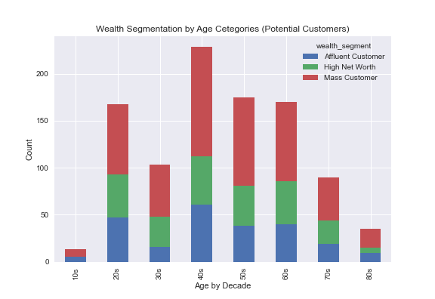
Note: The data and information in this document is reflective of a hypothetical situation and client. This document is to be used for KPMG Virtual Internship purposes only.
Data Exploration
Wealth Segmentation by Age Category
The largest customer base is made up of mass customers for all age groups in both existing and potential customers
High net worth and mass customers are highest in the 40s age group for both existing and potential customers

Slide 8
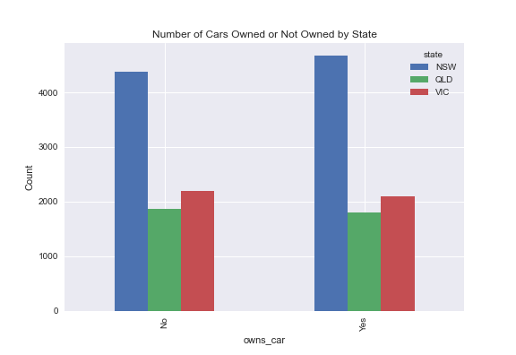
Note: The data and information in this document is reflective of a hypothetical situation and client. This document is to be used for KPMG Virtual Internship purposes only.
Data Exploration
Number of cars owned and not owned by state
NSW has the highest number of people who do not own a car. However, there were more data collected from NSW compared to other states
Both VIC and QLD are almost equal in terms of proportion of people who own cars and do not

Slide 9
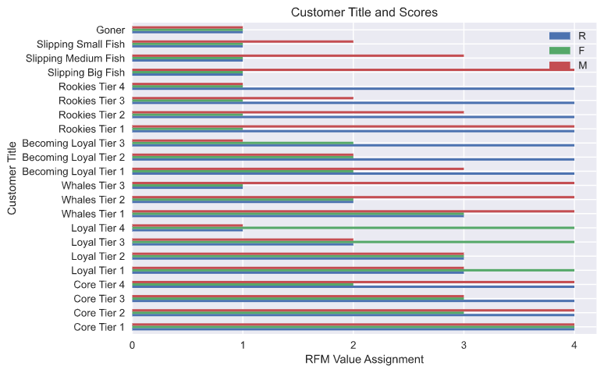
Note: The data and information in this document is reflective of a hypothetical situation and client. This document is to be used for KPMG Virtual Internship purposes only.
Model Development
RFM (Recency, Frequency, Monetary)
Analysis and Customer Classification
RFM Analysis is used to determine which customers a business should target to maximise revenue and value
The RFM model shows customers that have demonstrated high levels of engagement with the business in the three categories mentioned

Slide 10
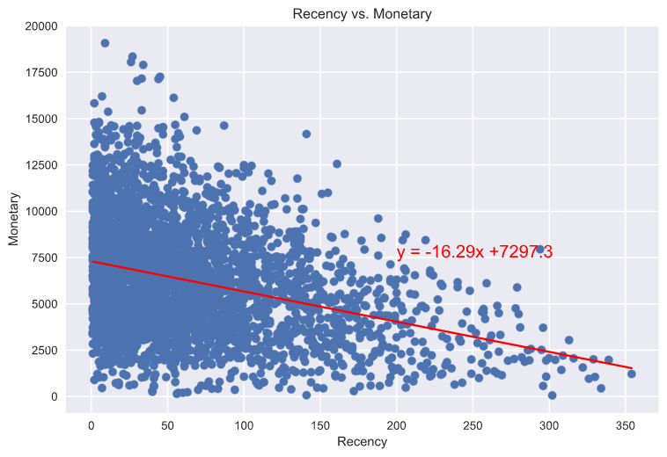
Note: The data and information in this document is reflective of a hypothetical situation and client. This document is to be used for KPMG Virtual Internship purposes only.
Model Development
RFM Analysis (Recency vs Monetary)
The correlation between both factors is -0.32
Moderate correlation between recency and monetary
Customers who purchased more recently are more likely to provide more revenue for the business

Slide 11
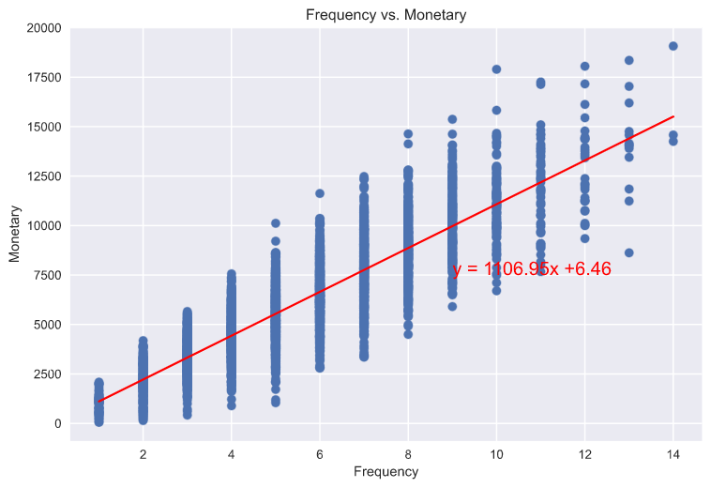
Note: The data and information in this document is reflective of a hypothetical situation and client. This document is to be used for KPMG Virtual Internship purposes only.
Model Development
RFM Analysis (Frequency vs Monetary)
The correlation between both factors is 0.87
Strong correlation between frequency and monetary gain for the business

Slide 12
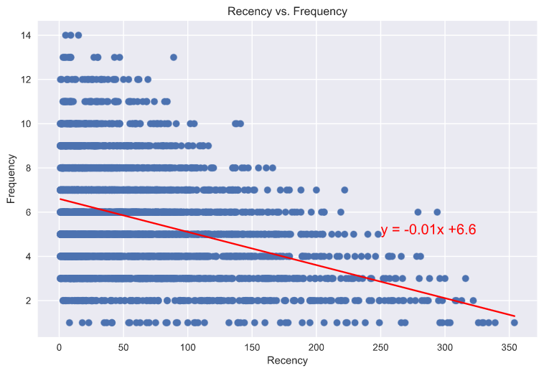
Note: The data and information in this document is reflective of a hypothetical situation and client. This document is to be used for KPMG Virtual Internship purposes only.
Model Development
RFM Analysis (Recency vs Frequency)
The correlation between both factors is -0.38
Moderate correlation between recency and frequency
Customers who visited more recently are more likely to visit more frequently, and vice versa

Slide 13
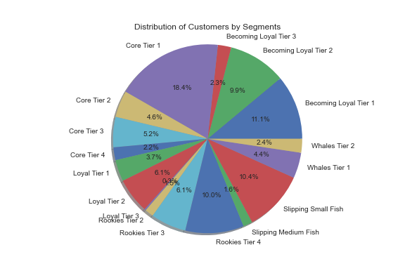
Note: The data and information in this document is reflective of a hypothetical situation and client. This document is to be used for KPMG Virtual Internship purposes only.
Model Development
Distribution of Existing Customers
1. Core - Your Best Customers
Who They Are: Highly engaged customers who have bought the most recent, the most often, and generated the most revenue.
2. Loyal - Your Most Loyal Customers
Who They Are: Customers who buy the most often from your store.
3. Whales - Your Highest Paying Customers
Who They Are: Customers who have generated the most revenue for your store.
4. Becoming Loyal - Customers With Good Impression On The Company
Who They Are: Customers who are becoming loyal by recently purchases and with promising frequency.
5. Rookies - Your Newest Customers
Who They Are: First time buyers on your site.
6. Slipping - Once Loyal, Now Gone
Who They Are: Great past customers who haven't bought in awhile.

Slide 14
Note: The data and information in this document is reflective of a hypothetical situation and client. This document is to be used for KPMG Virtual Internship purposes only.
Interpretation
Top 1000 to Target from Existing Customer List
Segment Name | Count | Cumulative Count
Core Tier 1 | 210 | 210
Core Tier 2 | 52 | 262
Core Tier 3 | 59 | 321
Core Tier 4 | 25 | 346
Loyal Tier 1 | 42 | 388
Loyal Tier 2 | 69 | 457
Loyal Tier 3 | 3 | 460
Whales Tier 1 | 50 | 510
Whales Tier 2 | 27 | 537
Becoming Loyal Tier 1 | 126 | 663
Becoming Loyal Tier 2 | 113 | 776
Becoming Loyal Tier 3 | 26 | 802
Rookies Tier 1 | 17 | 819
Rookies Tier 2 | 69 | 888
Rookies Tier 3 | 114 | 1002

Slide 15
Note: The data and information in this document is reflective of a hypothetical situation and client. This document is to be used for KPMG Virtual Internship purposes only.
Interpretation
Top 1000 Customers to Target from New Customer List
Same analysis can be done on the new customer list once more transaction data is received over time
Using the same approach on the company’s transaction data of existing customers, new customers can be segmented the same way to accurately determine who to best target to maximise revenue

Slide 16
Note: The data and information in this document is reflective of a hypothetical situation and client. This document is to be used for KPMG Virtual Internship purposes only.
Appendix

Slide 17
Note: The data and information in this document is reflective of a hypothetical situation and client. This document is to be used for KPMG Virtual Internship purposes only.
Appendix
This is an optional slide where you may place any supporting items.

