Slide 1
ARCHITECTURE EVALUATION · CROSS-CLOUD ICEBERG · DRAFT
Zero-Copy Federation: Reading GCS Data from Snowflake
Can we skip the copy to S3? A tested feasibility study, with a recommendation.
Data Engineering · July 2026

Slide 2
Bottom Line Up Front
The recommendation first — the rest of the deck is the evidence behind it
Can it be done?
YES
Built and proven end to end — GCS-resident Iceberg read live from Snowflake on AWS, no data copied into Snowflake.
Should it be done?
CONDITIONALLY
Only when GCS must remain the authoritative lake AND Snowflake reads are infrequent. It is not a free win.
Default recommendation
STAY THE COURSE
If the data is already destined for AWS, land it in S3 and do zero-copy within AWS — which is what the EDW team already does, and it is cheaper.
Internal Use

Slide 3
The Question We Set Out to Answer
Today the pipeline copies data into AWS. Could Snowflake instead read it live from GCS?
Today: copy into AWS
Proposed: read from GCS
Pub/Sub topics stream straight to S3
The Iceberg lake lives in S3, in AWS
Snowflake reads it zero-copy WITHIN AWS — same region, no cloud boundary crossed
The one copy is paid once, at ingest; every read after is free
Land the same stream in GCS instead (Dataflow: Pub/Sub source, GCS sink)
The Iceberg lake stays in GCS, in GCP
Snowflake reads it zero-copy ACROSS clouds — GCS to Snowflake-on-AWS
No second copy in S3 — but every read now crosses the cloud boundary
Status: in production. Works, and cheap.
Status: this evaluation. Feasible — with real strings attached.
Internal Use

Slide 4
Current State — Copy to S3, Zero-Copy Within AWS
The stream lands in AWS once; Snowflake exposes it without a second copy
GCP
AWS
cross-cloud hop paid ONCE, here
Pub/Sub
event topics
S3 Landing
raw objects
Iceberg Lake
curated, in S3
Snowflake
reads in place
(exposed, not copied)
Modeled Tables
BI / consumers
Because the lake already lives in S3, Snowflake's read never leaves AWS: same-region, no per-query egress, and it works for every AWS engine — Athena and Redshift included.
Internal Use

Slide 5
Proposed Alternative — Keep the Lake in GCS
No S3 copy; Snowflake reaches across the cloud boundary on every read
GCP
AWS
Pub/Sub
event topics
Dataflow
Pub/Sub source,
GCS sink
(streaming)
GCS Iceberg Lake
BigLake REST
catalog
Snowflake
catalog-linked DB
reads GCS live
cross-cloud read — egress $ on EVERY query
The lake stays authoritative in GCS and there is no second copy to maintain — but the cloud boundary is now crossed at read time, so egress is metered per query and only some AWS engines can participate.
Internal Use

Slide 6
How the Cross-Cloud Read Works
Three pieces, no standing credentials anywhere
1
2
3
Open table format
Managed REST catalog
Keyless trust
The data is Apache Iceberg (Parquet + metadata) in GCS. The metadata lets a remote engine discover and plan reads on its own.
BigLake exposes the table over an Iceberg REST endpoint reachable from AWS, and vends short-lived, per-request storage credentials.
Workload Identity Federation: Snowflake exchanges its own OIDC token for a short-lived GCP token at query time. No service-account key is ever shipped.
The result: a Snowflake catalog-linked database over the GCS table. A plain SELECT reads the same Parquet files the producer wrote — no ingest, no ETL, no copy landing in Snowflake's storage.
Internal Use

Slide 7
Limitation 1 — Only Some AWS Engines Can Do It
Zero-copy across clouds needs a pluggable storage layer. AWS-native SQL doesn't have one.
CAN read GCS directly
CANNOT — no workaround
Snowflake — via a catalog-linked database (tested, working)
Spark, Trino, Flink — via a GCS connector on a pluggable I/O layer
Athena — read path is hardcoded to S3
Redshift Spectrum — same S3-bound read path
The trap: Glue happily accepts a table pointing at a gs:// path — no error. It fails only at query time.
If Athena or Redshift are on the consumer list, cross-cloud zero-copy is off the table for them — physical copy to S3 is the only option.
Internal Use

Slide 8
Limitation 2 — You Pay Egress on Every Scan
There is no pipeline to bill once; the meter runs per query
$90 – 155 / TB scanned
Cross-cloud egress, metered by Snowflake under DATA_LAKE plus GCP's own egress. At POC scale it was cents — the point was proving the meter works before production.
Fine when...
Not fine when...
Long-tail tables queried occasionally
Monthly scanned bytes stay well under table size
You value avoiding a second copy more than a few cents per scan
A dashboard hammers the same hot table all day
Nightly jobs scan terabytes on a schedule
Note: Snowflake's warehouse cache softens repeat reads — but the cache dies on auto-suspend, so bursty use re-pays
Internal Use

Slide 9
What We Measured
Numbers from the running POC, not vendor estimates
~90 sec
1 – 10 min
~1.5 – 3x
publish -> committed Iceberg snapshot
commit -> visible in Snowflake
cold-scan read latency vs intra-region
streaming write on the GCP side
observed, against a nominal 30-sec catalog refresh - measure before you promise an SLA
network round-trips across the cloud boundary; warm cache narrows the gap
Read this as: freshness is analytics-grade, not real-time; the read is slower than a native Snowflake table but rarely disqualifying; and the cost is a per-query meter, not a fixed line item. All three are acceptable for the right workload and quietly expensive for the wrong one.
Internal Use

Slide 10
Trade-Offs — Cross-Cloud Zero-Copy vs Physical Copy to S3
The same table, two ways to reach it from Snowflake
Cross-cloud zero-copy (GCS)
Physical copy to S3 (today)
Data movement
None at rest; bytes cross per query
One copy at ingest, then none
Storage footprint
Single copy, in GCS
Two copies (GCS + S3)
Cost shape
Per-query egress, $90-155/TB
Ingest transfer once, then free reads
Consumer reach
Snowflake / Spark / Trino only
Any AWS engine (Athena, Redshift too)
Freshness
Live, ~1-10 min lag
As fresh as the last sync / ingest
Authoritative lake
Stays in GCS
Moves to (or duplicated in) S3
Internal Use

Slide 11
The Deciding Insight
Where the data's home already is changes the whole calculation
If the data is already destined for AWS, the copy is just the ingest — and it happens once.
The EDW team already lands the stream in S3. From there, Snowflake reads it zero-copy within AWS: same region, so no Snowflake egress and no cloud-provider egress, and it works for every AWS engine. The cross-cloud GCS approach would trade that away to avoid a second copy — paying egress on every read instead of once at ingest.
Cross-cloud GCS wins only when...
Fact check: intra-AWS reads are free
GCS must stay the source of truth (GCP-native consumers need it too)
Snowflake reads are infrequent enough that per-query egress beats a second S3 copy
Snowflake meters no egress for same-region transfers, and the cloud provider charges none intra-region either. Cross-cloud reads trigger both. Confirmed against Snowflake's data-transfer documentation.
Internal Use

Slide 12
Recommendation
Do it when
Stay the course when
GCS is the authoritative lake and GCP-native consumers also read it
The consumer is Snowflake, Spark, or Trino — not Athena or Redshift
Reads are long-tail / infrequent, so per-query egress stays small
Avoiding a duplicated copy and a sync pipeline is worth more than the egress
The data is already destined for AWS — land it in S3 and read zero-copy within AWS (what we do today)
Athena or Redshift are on the consumer list
Tables are hot / frequently scanned
You need the fastest reads or lowest, most predictable cost
Net: feasible and proven, but a niche tool. Reach for it to keep GCS authoritative for occasional Snowflake reads — not as a replacement for the S3 path already serving the EDW.

Slide 13
APPENDIX — RUNBOOK: CODE & PROOF

Slide 14
Appendix · Step 1 of 5 — Catalog + Storage
Enable the API, make the bucket, register a REST catalog with credential vending
# enable API, make the bucket,
# register the REST catalog
gcloud services enable \
biglake.googleapis.com
gsutil mb -l $REGION gs://$BUCKET
gcloud biglake iceberg catalogs \
create $BUCKET \
--catalog-type gcs-bucket \
--credential-mode vended-credentials
# then grant the catalog runtime SA
# storage.objectUser on the bucket
The GCS bucket now backing the catalog.
Internal Use

Slide 15
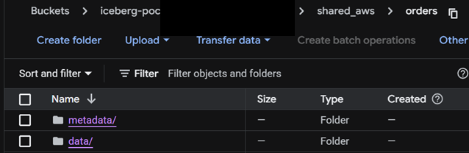
Appendix · Step 2 of 5 — Write the Table
BigQuery cannot DDL here — Spark (Dataproc Serverless) creates and loads the table
# Spark writes the Iceberg table
# via the same REST catalog.
spark.sql("CREATE NAMESPACE IF NOT "
"EXISTS shared_aws")
spark.sql("""
CREATE TABLE shared_aws.orders (
order_id BIGINT,
customer STRING,
amount DECIMAL(10,2),
order_ts TIMESTAMP )
USING iceberg""")
# INSERT rows, submit as a batch
After the write: metadata/ and data/ — a plain, open Iceberg table.
Internal Use

Slide 16
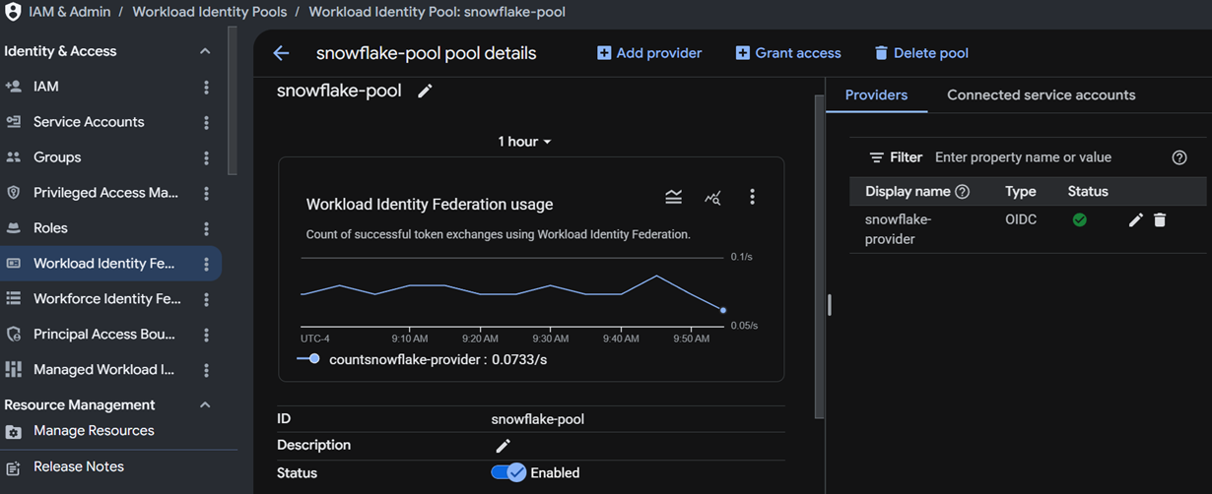
Appendix · Step 3 of 5 — Keyless Trust (WIF)
Snowflake's issuer becomes a GCP workload-identity pool; no key is ever shipped
# issuer URL from Snowflake:
# SELECT SYSTEM$GET_WORKLOAD_
# IDENTITY_ISSUER_URL();
gcloud iam workload-identity-pools \
create $POOL_ID --location global
gcloud iam workload-identity-pools \
providers create-oidc $PROVIDER_ID \
--workload-identity-pool $POOL_ID \
--location global \
--issuer-uri "<ISSUER_URL>" \
--attribute-mapping \
"google.subject=assertion.sub"
The pool, active — a token exchange fires on every query.
Internal Use

Slide 17
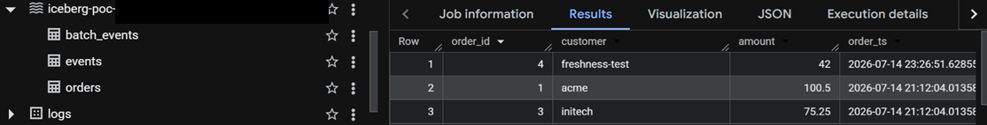
Appendix · Step 4 of 5 — Catalog Integration
On the Snowflake side: a token-exchange integration against the same catalog
CREATE OR REPLACE CATALOG INTEGRATION
biglake_int
CATALOG_SOURCE = ICEBERG_REST
TABLE_FORMAT = ICEBERG
REST_CONFIG = (
CATALOG_URI = 'https://biglake...',
CATALOG_NAME = 'gs://<BUCKET>',
ACCESS_DELEGATION_MODE =
VENDED_CREDENTIALS )
REST_AUTHENTICATION = (
TYPE = OAUTH,
OAUTH_GRANT_TYPE = TOKEN_EXCHANGE...)
ENABLED = TRUE;
The registered table, discoverable through the catalog (here, queried from BigQuery).
Internal Use

Slide 18
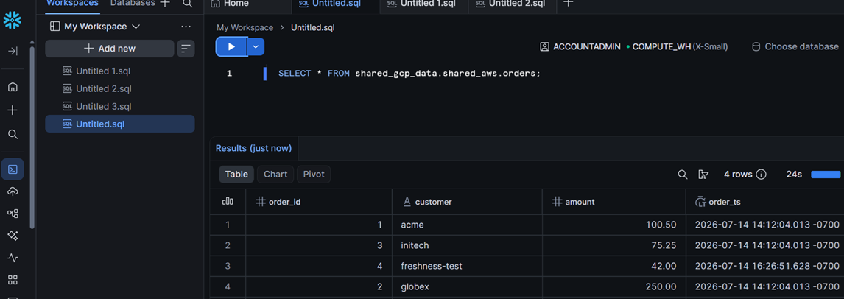
Appendix · Step 5 of 5 — Linked DB + Read
A catalog-linked database, then a plain SELECT — the zero-copy payoff
CREATE OR REPLACE DATABASE
shared_gcp_data
LINKED_CATALOG = (
CATALOG = 'biglake_int' );
-- discovery is async; wait ~1 min
SELECT *
FROM shared_gcp_data
.shared_aws.orders;
-- rows back = zero-copy read works
A plain SELECT in Snowflake — GCS-resident data, read live, no copy.
Internal Use

Slide 19
Appendix · Sharp Edges
The non-obvious failures we hit, so you don't
1
Runtime SA storage grant is NOT automatic The catalog's auto-provisioned service account needs an explicit storage.objectUser grant on the bucket, or vending fails.
2
The Snowflake principal needs more than read It also needs rights to use the project's billed APIs (serviceusage.serviceUsageConsumer) for the x-goog-user-project header.
3
CREATE OR REPLACE mints a NEW trust subject Any replace of the catalog integration invalidates prior IAM grants — re-grant the new subject and remove the old.
4
Vended credentials must be explicitly enabled Without ACCESS_DELEGATION_MODE = VENDED_CREDENTIALS the catalog-linked database refuses to create.
5
Discovery is asynchronous The schema does not appear the instant the linked database is created — give it about a minute.
Internal Use

