Slide 1
Moving to Microservices
Jeremy D. Miller

Slide 2
NOTHING IN THIS TALK IS ENGRAVED IN STONE

Slide 3
Some of our problems today
Large, legacy codebases
Slow build and testing cycle times
Loss of tribal knowledge about key systems
Teams stomping on each other
Old technologies that are unsupported and little known

Slide 4
Moving to Microservices
Buzzword compliance on all our resumes
Smaller codebases
Teams can effectively own a system
Reduced build and testing cycle times
Better ability to upgrade technologies

Slide 5
Not going guard rail to guard rail

Slide 6
Challenges
Distributed development is hard
Extracting functionality
Drawing the “bounded context” boundaries
API versioning and service discovery
Deployment and provisioning
Automated testing across microservices
Single sign on authentication
Consistent UI/UX

Slide 7
When do we break out a new service?
All new functionality
Major changes to an existing feature
Common functionality between systems

Slide 8
When do we NOT build a new service?
Cohesion & Coupling
“Shotgun Surgery”
Be cautious about bi-directional dependencies

Slide 9
Organizing a Microservice Codebase
Assembly is a unit of deployment
Jeremy strongly recommends organizing by features rather than layers

Slide 10
Strive for Simplicity
Favor more explicit code over conventional approaches?
Reduce layering
Rely on integration testing to eliminate code complexity?
Do not introduce infrastructure until it’s necessary

Slide 11
An aside on test automation
Test with the finest grained mechanism that tells you something important
Less – but > 0 – mock objects
Design purposely to utilize state based testing where appropriate
More API testing at the HTTP level
Way less Selenium
New automated testing guide forthcoming…

Slide 12
Technology Selection
React/Redux/Webpack on the client
Target the CoreCLR if possible
ASP.Net Core for HTTP services
Jasper for messaging needs
Consul for service discovery (future)

Slide 13
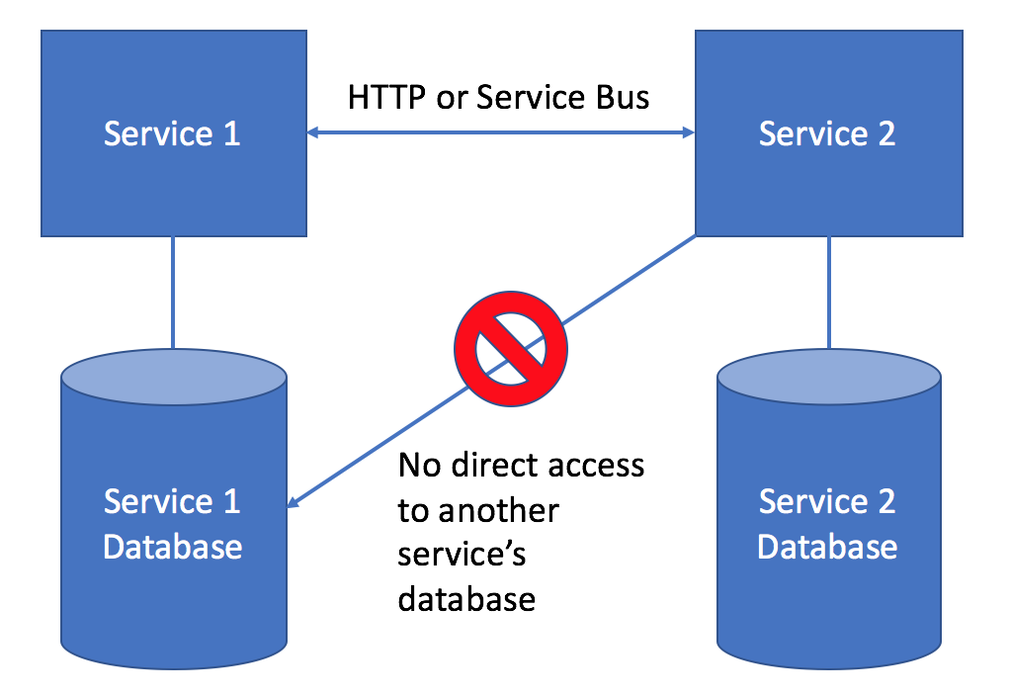
Application Databases

Slide 14
Application Databases (cont.)
Database source code and migration scripts live with the application code
Fully automated deployments

Slide 15
Choosing Persistence Tooling
Dapper/Sql Server if the domain model is simple
Marten/Postgresql if the domain model is complicated, hierarchical, or rapidly
Please avoid heavy ORM’s like EF or NHibernate in most cases
Stored procedures should be used sparingly

Slide 16
What about the Extend database?
Breaking up the database
Try to avoid directly accessing the Extend database
But if you do, use isolated copies in development & testing
Service gateways to the Extend database?
Duplicating data in services?

Slide 17
How Should Microservices Communicate?
Request/Reply
External facing services → HTTP
Publish/Subscribe
Guaranteed Delivery
Fire and Forget
Avoid integration through file drops, FTP, shared databases

Slide 18
API Versioning
DTO libraries to start
De facto V1
Additive changes
Longer term
Json Schema’s
Protobuf w/ .proto files
Embed the API version into the Url
Content Negotiation w/ content-type headers

Slide 19
“Microsites”
Monolithic user interfaces → conglomerate of smaller UI’s that appear to the user to be a single application
JWT’s for single sign on authentication
Open question about how we handle common navigation elements
Components distributed through Nuget/Artifactory?
Consul lookup for the url’s?
The OneExchange style guide

Slide 20
DevOps and you
Involve DevOps early on new services

Slide 21
Questions?

