Slide 1
Safe3D
Luigi Caprio
Chad Grubb
Jeremy Dorr

Slide 2
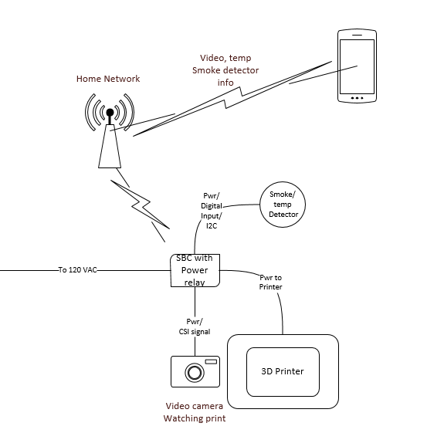
A system to prevent 3D printer fires

Slide 3
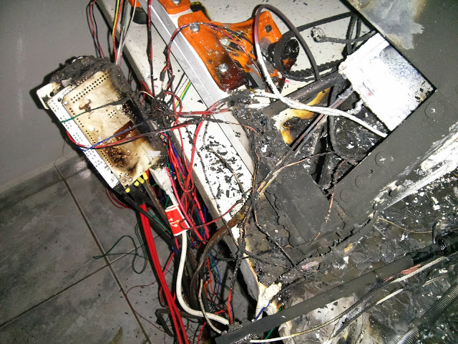
Why do 3D printers start on fire?
Designed and built by anyone
“You’re not an official reprapper until you’ve almost burnt your house down. Welcome to the club.” Anonymous User, January 14, 2014 07:11PM
Prints take many hours, it’s not practical to babysit the process.
These things run at over 200 degrees Celsius

Slide 4
How do we solve this problem?
Re-engineer the 3D printer to be safer
Not realistic
There are far too many different designs out there
Shut off the printer as soon as there is smoke or excessive heat, automagically!
Allow the maker to keep an eye on his printer and shut it down even when he is nowhere near the device.

Slide 5
Hardware
Raspberry Pi
CSI bus camera board
Solid State Relay (SSR)
TMP102 temp sensor
I2C communication with the Pi to avoid any unnecessary A/D.
Smoke detection circuit
Scavenged from a cheap Walmart smoke detector

Slide 6
Software
Python will be a good choice for the firmware on the Pi.
The smartphone app will be written for the Android OS
Easily ported to the Iphone if there is a future need
Cloud based services will be leveraged to allow video streaming and remote sensor readings.

